Slide 1
GOOGLE PHOTOS CORE EXPERIENCE · PRODUCT DISCOVERY CASE STUDY
Users Remember the Moment — Not the Exact Search Terms
Addressing core retrieval friction in personal cloud archives through AI-assisted episodic memory interpretation
THE RETRIEVAL BREAKDOWN
“I remember the moment vividly, but I don't know what words to search.”
Personal photo libraries grow into tens of thousands of items over years. When users want to find a specific past moment, human memory recalls episodic context — people present, general locations, approximate seasons, and emotional atmosphere.
However, conventional search interfaces rely heavily on exact dates or isolated keywords. When vague searches fail, users fall back to manual timeline scrubbing or abandon the retrieval task entirely.
THE COGNITIVE GAP
Human Memory vs. Conventional Search
HUMAN EPISODIC MEMORY (MULTI-CUE)
• Companion: Rohan (Friend)
• Setting: Anjuna Beach, Goa at sunset
• Fuzzy Time: ~2-3 years ago (College trip)
• Visual Cue: Ocean waves, golden sky, drinks
▼ COLLIDES WITH ▼
CORE BUSINESS GOAL
Increase the percentage of users who successfully retrieve a photo they remember but cannot precisely describe.
Domain: Google Photos Core Retrieval Experience | Product Discovery & Validation
CONVENTIONAL SEARCH FRICTION
• Rigid Exact Match: Requires date or single keyword
• Trial-and-Error: Modifying query resets context
• Workaround Fallback: 65% scroll timeline endlessly
• High Drop-off: 70.6% abandon search sessions

Slide 2
PART 2 · METRIC DECOMPOSITION & FUNNEL ANALYSIS
Successful Retrieval is a Six-Stage Journey, Not a Single Search
Deconstructing vague-memory photo retrieval reveals that success depends on iterative cue translation
STAGE 01 · P(E₁)
Memory
Formulation
User recalls fuzzy episodic fragments (person, place, vibe)
Observed Signal:
94.1% no exact date
STAGE 02 · P(E₂)
Candidate
Generation
Translates memory into initial search query
Observed Signal:
86.1% relevance failure
STAGE 03 · P(E₃)
Visual
Inspection
Scans image grid to evaluate top candidate matches
Observed Signal:
3+ searches required
STAGE 04 · P(E₄)
Secondary
Refinement
Adds or adjusts cues to narrow down results
Observed Signal:
84.7% refinement issue
STAGE 05 · P(E₅)
Workaround
Fallback
Resorts to manual scrubbing or external apps
Observed Signal:
65.3% scrub timeline
STAGE 06 · P(E₆)
Goal
Completion
Locates and confirms the intended photo
Observed Signal:
69.4% failed retrieval
EVIDENCE FROM 72 RETRIEVAL-FRICTION RECORDS
• 86.1% experienced candidate relevance failure during initial searches (Stage 2/3)
• 84.7% encountered search refinement breakdown when trying to iterate (Stage 4)
• 65.3% abandoned search to scrub timeline manually; 34.7% searched chat apps (Stage 5)
CRITICAL PRODUCT INSIGHT
Retrieval is a journey of signal translation, not a single query event.
If the system cannot help users translate fuzzy memory cues into structured retrieval filters and support additive refinement, the entire retrieval funnel collapses.

Slide 3
PART 1 · AI DISCOVERY ENGINE METHODOLOGY & PUBLIC EVIDENCE
Public Evidence Showed That Relevance and Refinement Are Where Retrieval Repeatedly Breaks
Analyzing 74 authentic public records through an AI-powered discovery pipeline revealed recurring retrieval friction points
STEP 01
Feedback
Ingestion
74 authentic user posts (Reddit, Google Help, X)
STEP 02
AI Semantic
Classification
Zero-shot intent, stage & emotion tagging
STEP 03
Behavioral
Extraction
Identified workarounds (scrubbing, chat logs)
STEP 04
HDBSCAN
Clustering
High-dimensional embeddings → 17 clusters
STEP 05
Opportunity
Matrix
Ranked frequency vs. user frustration severity
STEP 06
AI Synthesis
Findings
8 synthesized product opportunity findings
OBSERVED OUTCOMES IN PUBLIC EVIDENCE (72 FRICTION RECORDS)
• 69.4% — Failed Retrieval: User could not find intended photo
• 9.7% — Search Abandoned: Exited app before completion
• 18.1% — Successful Retrieval: Located photo after high effort
• 2.8% — Partial Match: Located related event, not exact photo
*Note: Across analyzed public records; directional evidence of friction, not statistically representative of all users.
8 SYNTHESIZED PRODUCT FINDINGS · TOP 3 PATTERNS
1. Multi-Cue Relevance Collapse (86.1%)
When users enter compound descriptions (person + approximate place), search returns irrelevant items or zero results, forcing single-term queries.
2. Destructive Query Refinement (84.7%)
Adding or editing words completely resets candidate results rather than progressively filtering down the existing pool.
3. Opaque Relevance Ranking (71.2%)
Users cannot determine why specific photos appear or why their intended photo was excluded, creating black-box frustration.

Slide 4
PART 3 · PRIMARY USER RESEARCH & BEHAVIORAL EVIDENCE (N=17)
17 Users Confirmed That People Remember Context — Not Exact Search Terms
Primary research validates that episodic human recall relies on companions, settings, and events, not dates
94.1%
Searched Without Exact Date
16 of 17 users recall approximate eras or seasons, never specific calendar dates
88.2%
Attempted ≥3 Searches
15 of 17 users engage in repeated trial-and-error reformulations per session
94.1%
Searched Outside Google Photos
16 of 17 use external workarounds (WhatsApp chats, Instagram) to find photo clues
70.6%
Abandoned Retrieval Sessions
12 of 17 users report frequently or sometimes abandoning searches due to fatigue
THE EPISODIC MEMORY FINGERPRINT (WHAT USERS RECALL)
• Person / Companion — 76.5% (13/17): Who was with them is the strongest emotional anchor
• Approximate Time — 47.1% (8/17): Relative timeframes: 'around 3 years ago', 'college days'
• Location / Setting — 47.1% (8/17): Broad geographic or contextual place: 'Goa', 'beach', 'cafe'
• Activity / Event — 41.2% (7/17): What was taking place: 'sunset', 'wedding', 'birthday dinner'
AUTHENTIC USER SEARCH BLOCKERS
“I don't know what words to search. I just remember who I was with and roughly where.”
“I don't remember the exact date, so I end up having to scroll manually through years of photos.”
“When search doesn't show it, I check my old WhatsApp messages to see when we took the photo.”

Slide 5
PART 4 · TARGET SEGMENT, ROOT CAUSE & VALUE PROPOSITION
The Episodic Personal Memory Searcher Needs Help Turning Fuzzy Cues Into a Retrieval Path
Defining the target archetype, formulating the evidence-bound root cause, and articulating dual value
TARGET USER SEGMENT ARCHETYPE
The Episodic Personal Memory Searcher
• Library Scale: Large personal photo library accumulated over years across devices.
• Memory Retrieval Style: Meaningful moments remembered episodically — emotional anchors, companions, fuzzy seasons, and visual settings.
• Knowledge Constraints: Exact dates, specific calendar months, or machine filenames often unreliable.
• Observed Search Behavior: Multiple search attempts and query reformulations may be required.
• Painful Fallback: Resorts to manual timeline scrubbing (65.3%) or external chat app searching (34.7%) when initial queries fail.
EVIDENCE-BOUND ROOT-CAUSE HYPOTHESIS
“The observed retrieval experience does not consistently help users translate multiple fuzzy memory cues into an effective search or refinement path.”
*Formulated as a user-experience hypothesis grounded in observed research, without claiming internal Google technical or ranking defects.
DUAL VALUE PROPOSITION
User Value: Emotional Reassurance & Frictionless Recovery
Restores confidence in finding cherished personal memories; replaces exhausting manual scrolling with guided, natural language cue refinement.
Business Value Hypothesis: Core Archive Utility
Strengthen the usefulness and perceived value of Google Photos as a long-term personal archive, while reducing situations where users leave Google Photos to recover a photo elsewhere.

Slide 6
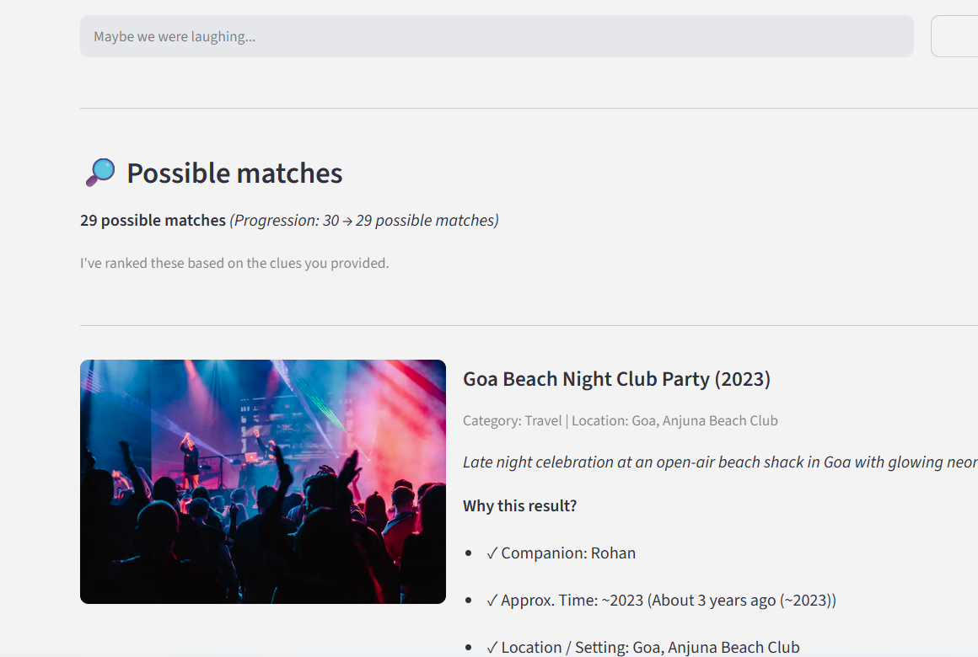
PART 5 · AI-NATIVE MVP ARCHITECTURE & WORKFLOW
The MVP Turns an Incomplete Memory Into Searchable Cues — Then Helps the User Refine
Controlled research prototype combining 8-dimensional cue extraction, explainable ranking, and additive refinement
AI MEMORY RETRIEVAL ASSISTANT WORKFLOW
1. Freeform Episodic Memory Input
User types natural language memory: 'I remember a photo with Rohan at Anjuna beach around sunset about 3 years ago.'
2. 8-Facet Cue Interpretation
NLP extracts structured signals: Person (Rohan), Location (Goa/Anjuna), Time (~2023), Activity (Sunset), Objects & Visuals.
3. Transparent Explainability
Displays 'What I Understood' cue pills and 'Why this result?' rationale bullets showing exact match drivers for each photo.
4. Iterative Additive Refinement
Users layer incremental clues ('+with evening drinks') or click '✕ Not this photo' to penalize visual distractors without resetting context.
5. Fast Candidate Convergence
Dynamically updates candidate ranks, successfully surfacing the target photo in the top spots.
CONTROLLED RESEARCH PROTOTYPE BOUNDARIES
• Tested against a 40-photo curated representative dataset with diverse categories.
• Evaluates memory-to-cue translation and refinement mechanics without live account sync.
• Provides preliminary proof-of-concept evidence for additive memory interpretation.

Slide 7
PART 6 · USABILITY TESTING & CORE PRODUCT LEARNING (N=4)
Users Found Refinement Useful — But Needed Help Knowing What Clue to Add Next
Controlled usability testing of the deployed prototype provided preliminary usability evidence and revealed the next product opportunity
4.75 / 5.0
Memory Description Ease
Users felt effortless articulating memories naturally
75%
AI Understanding Positive
3 of 4 participants confirmed AI accurately parsed their intent
4.00 / 5.0
Candidate Result Relevance
75% rated retrieved photo relevance 4 or 5 out of 5
4.25 / 5.0
Refinement Ease
Additive clue layering was intuitive and straightforward
100%
Explanations Clear
3 Yes, 1 Somewhat: all found rationale at least somewhat clear
THE CENTERPIECE QUALITATIVE LEARNING (PARTICIPANT P3)
“The idea of refining the search was quite useful, but I had to figure out what kind of clue to add next.”
Secondary Participant Feedback: Users requested smarter follow-up questions when results were ambiguous.
STRATEGIC PRODUCT LEARNING: FROM REACTIVE TO PROACTIVE REFINEMENT
While reactive refinement (user typing clues) is effective, the next breakthrough is proactive AI guidance. When candidates remain broad, the AI should identify remaining ambiguity across top results and prompt the user with targeted recognition questions ('Was it indoors or outdoors?', 'Who else was in the photo?').

Slide 8
PART 7 · SUCCESS METRIC FRAMEWORK & MEASUREMENT HIERARCHY
Success Must Measure Both Retrieval Outcome and Progress Across the Journey
A 3-tier measurement framework connecting core business impact, user journey progress, and system diagnostics
PRIMARY OUTCOME METRIC (NORTH STAR)
Vague Retrieval Success Rate (VRSR)
Percentage of vague-memory retrieval sessions where the user successfully locates their intended photo without resorting to manual timeline scrubbing or external workarounds. (Reliable benchmark to be established via large-scale evaluation).
LEADING PROGRESS INDICATORS (USER JOURNEY ADVANCEMENT)
AMUR
AI Memory Understanding Rate
% sessions where user confirms AI parsed memory accurately
CRR@3
Candidate Relevance Rate
% of top-3 retrieved photos matching user memory context
RSR
Refinement Success Rate
% of added clues that successfully increase candidate precision
QRV
Query Reformulation Velocity
Average steps/seconds needed to converge onto target photo
TSR
Time to Success
Active duration from initial prompt to photo selection
DIAGNOSTIC & GUARDRAIL METRICS (SYSTEM HEALTH)
ZHQR
Zero-Hit Query Rate
% queries returning 0 results (identifies vocabulary gaps)
RSR-Stall
Refinement Stall Rate
% sessions where added clues fail to narrow down candidate pool
EER
Evaluation Effort Rate
Excessive image clicks/enlargements indicating low confidence
TFTR
Timeline Fallback Rate
% users abandoning search bar for manual date scrubbing
SAR
Session Abandonment Rate
% search sessions ending with exit without photo selection

Slide 9
PART 8 · PRODUCT RISKS, MITIGATIONS & BOUNDARIES
The MVP Direction is Promising, But Scale, Trust, and Refinement Burden Remain Open Risks
Proactive risk management matrix addressing cognitive load, privacy, and evaluation boundaries
P0 · USER EXPERIENCE
Refinement Cognitive Burden (R3)
• Potential Impact: Users struggle to think of additional clues when candidates remain broad, causing session abandonment.
• Current Mitigation: Built additive query state and 1-click rejection (✕ Not this photo).
• Future Evolution: Introduce proactive AI suggestion chips based on candidate visual divergence.
P0 · TRUST & PRIVACY
Privacy and User Data Trust (R6)
• Potential Impact: Users may be hesitant to share intimate personal memories and photos with cloud AI models.
• Current Mitigation: Controlled synthetic evaluation dataset; clear zero-retention privacy disclosures.
• Future Evolution: Privacy-preserving approaches, data minimization, and strong user controls.
P1 · SYSTEM GENERALIZATION
Prototype Scale & Evaluation Generalization (R5)
• Potential Impact: 40-photo dataset cannot prove scalability or collision resistance across large personal libraries.
• Current Mitigation: Controlled representative benchmark with diverse categories and distractors.
• Future Evolution: Evaluate scalable semantic retrieval and multi-cue re-ranking against larger photo libraries.
P1 · AI INTERPRETATION
AI Memory Misinterpretation & False Positives (R1/R4)
• Potential Impact: Overconfident false matches degrade user trust; AI misinterpreting relative time or companions.
• Current Mitigation: Strict 8-facet schema validation + transparent 'Why this result?' rationale bullets.
• Future Evolution: Interactive user confirmation chips to verify extracted cues before execution.
PROTOTYPE SCOPE BOUNDARIES: 40-photo curated representative dataset · N=4 usability study · Desktop web prototype · No live Google account integration

Slide 10
PART 9 · STRATEGIC EVOLUTION & THE NEXT PRODUCT OPPORTUNITY
The Next Evolution is Not Smarter Search — It is Guided Memory Retrieval
Transitioning from passive keyword search to multi-cue AI interpretation, and ultimately to proactive guided retrieval
YESTERDAY
Keyword Search
Rigid Single-Turn Search
• User remembers an episodic moment
• User is forced to guess search keywords
• System returns rigid exact matches
• Query modification clears context
• Fallback to manual timeline scrolling
Takeaway: High cognitive load & session abandonment
TODAY (OUR MVP)
Memory Assistant
Natural Language & Explainability
• User describes memory in natural language
• AI extracts 8 structured episodic cues
• Transparent 'Why this result?' rationale
• Additive clue layering preserves context
• 1-click candidate rejection
Takeaway: Preliminary usability evidence; clue guidance needed
TOMORROW (NEXT OPPORTUNITY)
Guided Retrieval
Proactive Recognition Prompts
• AI detects remaining candidate ambiguity
• Proactively asks targeted recognition questions:
– 'Was it indoors or outdoors?'
– 'Who was with you on that trip?'
– 'What were you wearing?'
– 'Was there a specific event or activity?'
• Dynamic multi-cue candidate convergence
Takeaway: Effortless, conversational memory retrieval
“From search → to memory understanding → to guided personal retrieval.”
Live Deployed Prototype: https://app-photos-discovery-engine-fa3ckmfdn4mudlheyg2yxs.streamlit.app/
Supporting Case Study Artifacts: Discovery Engine (Part 1) · Metric Decomposition (Part 2) · User Research (Part 3) · Usability Benchmark (Part 6) · Metric Hierarchy (Part 7)

