Slide 1
STOCK PRICE PREDICTION
MLDS PROJECT
-TEAM DATABOTS
Greeshma
Priyanka
Shivani
Gayathri

Slide 2
Stock Market
Stock Market also known as share market or equity market is the aggregation of buyers and sellers which represent ownership claims on businesses.
These may include securities listed on a public stock exchange, as well as stock that is only traded privately.

Slide 3
PROBLEM STATEMENT
PREDICTION OF VALUE OF A COMPANY’S STOCK PRICES FOR A MONTH.

Slide 4
ABOUT PROJECT
Discovering the future worth of business stock and other financial assets traded of an exchange is made possible with the aid of stock price prediction utilising machine learning. Gaining significant profits is the whole point of making stock price predictions. It's challenging to forecast how the stock market will fare.

Slide 5
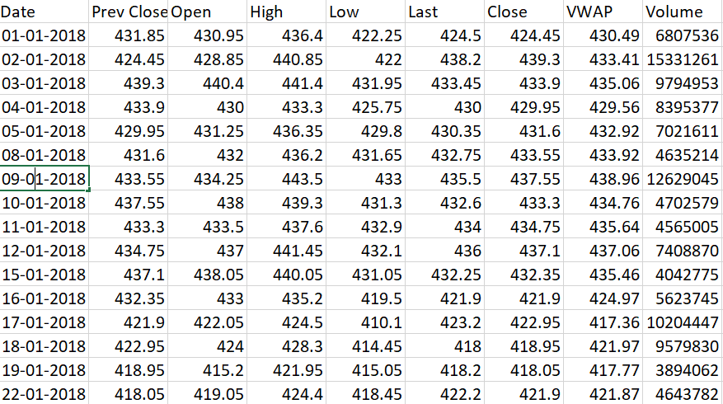
DATA SET
A data set is a collection of related, discrete items of related data that may be accessed individually or in combination or managed as a whole entity. A data set is organized into some type of data structure.
Our team has chosen a sample data set of TATA MOTORS STOCKS.
(website: www.Kaggle.com)

Slide 6
DATA CLEANING
Process:-
Libraries Used:-
Detect unwanted data i.e incorrect, inconsistent data
Remove,correct the data
Verify the correctness
Pandas
Numpy
Matplotlib
Seaborn

Slide 7
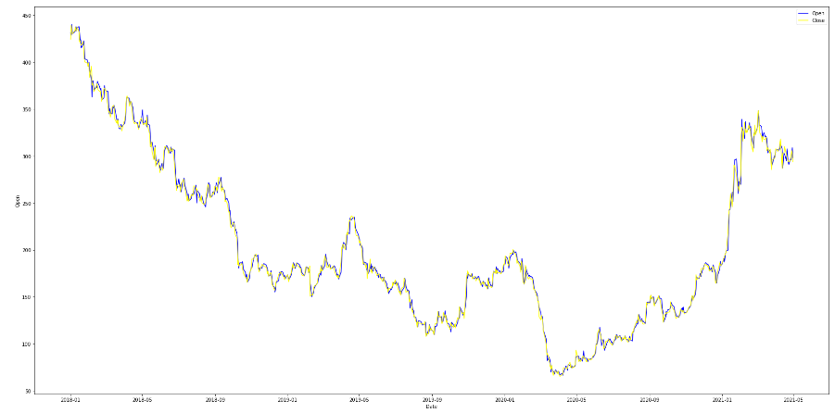
Visualization Of Data
Data visualization is the graphical representation of information and data. By using visual elements like charts, provide an accessible way to see and understand trends, outliers, and patterns in data.
We have visualised data of open-close stock prices prices.

Slide 8
ARIMA MODEL
“AutoRegressive Integrated Moving Average.”
It's a model used in statistics and econometrics to measure events that happen over a period of time. The model is used to understand past data or predict future data in a series.

Slide 9
ARIMA MODEL
ARIMA model is classified as an “ARIMA (p,d,q)” where:
p is the no. of autoregressive terms (AR)(number of time lags), d is the no. of non seasonal differences needed for stationary (I), and q is the no. if lagged forecast errors in the prediction equation (MA).
ARIMA formula:-
y’_{t}=c + ɸ₁y’t₋₁+.......+ɸ_{p}y’_{t-p}+ 𝛉₁ε_{t-1}+.....+𝛉_{q}ε_{t-q}+ε_{t}
intercept
Lags (AR)
Errors (MA)

Slide 10
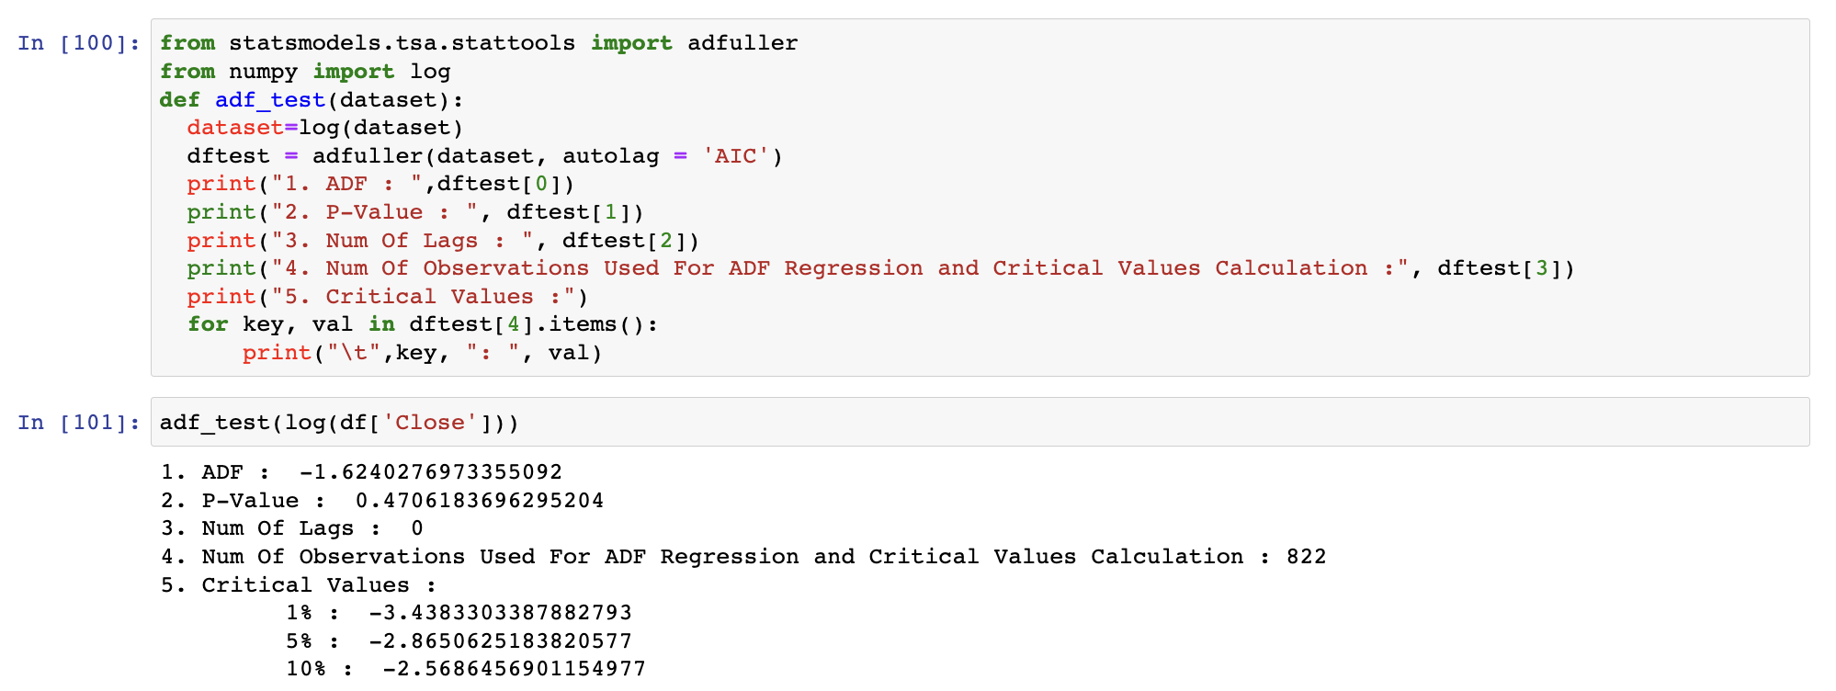
Augmented Dickey–Fuller test (ADF Test)

Slide 11
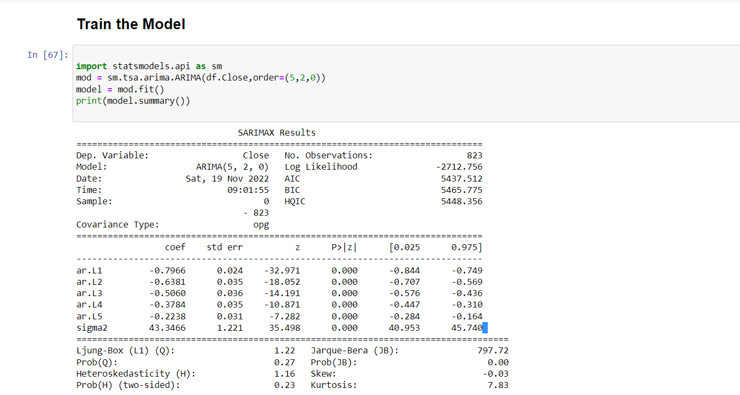
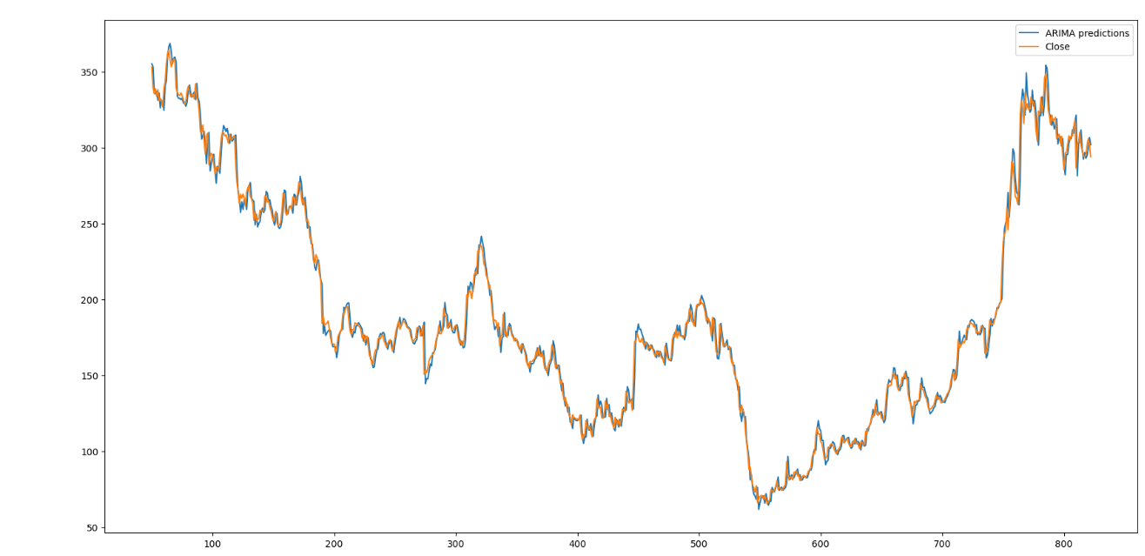

Slide 12

Accuracy Matrix
R2, RMSE and MSE matrix is used in this project.
R2:The residual sum of squares is calculated by the summation of squares of perpendicular distance between data points and the best-fitted line
Mean square error (MSE) :It is the average of the square of the errors.
Root Mean Square Error(RMSE): It is the root of the Mse Value.

Slide 13
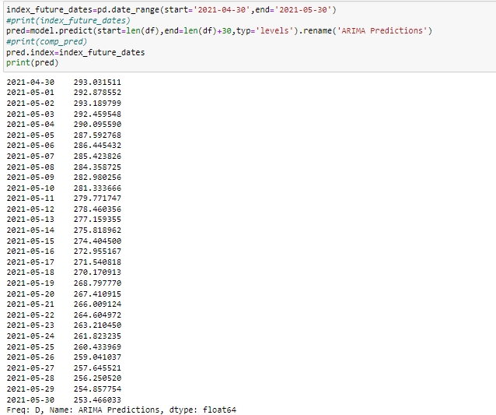
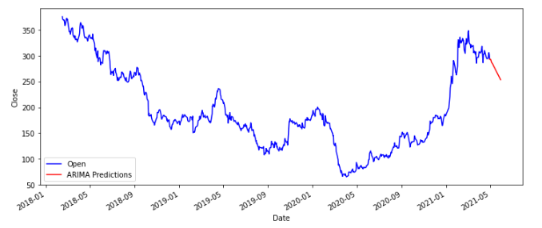
FINAL RESULT
Following shows the relation
between model prediction
and the actual values of the stock
prices.

Slide 14
THANK YOU

