Slide 1
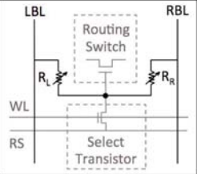
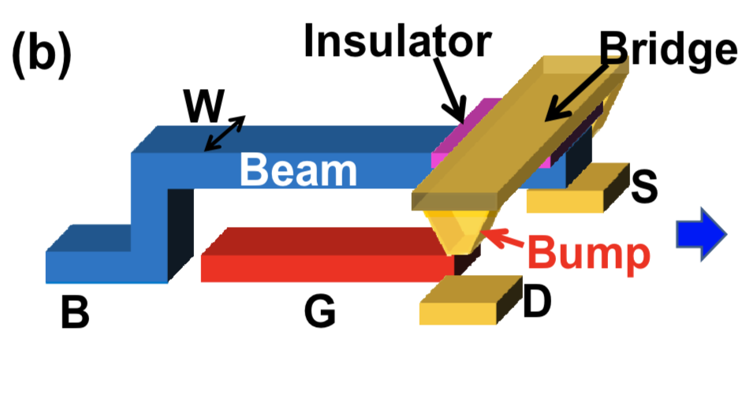
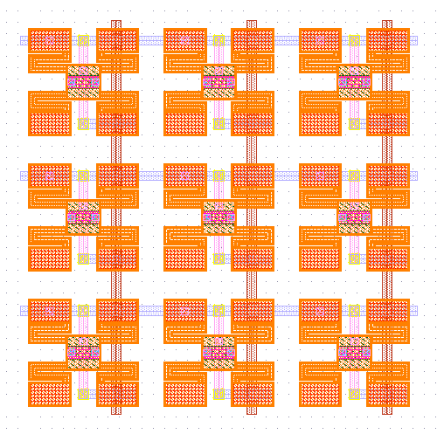
Efficient Non-Volatile Reconfigurable Switches for FPGAs/CGRAs using RRAM and NEM Relays
Author: Akash Levy, Advisor: Priyanka Raina
Notes:
My project is titled Efficient Non-Volatile Reconfigurable Switches for FPGAs/CGRAs using RRAM and NEM Relays
What do these terms mean?
FPGAs are field programmable gate arrays: basically these are reconfigurable digital circuits which can be reprogrammed to implement different functions
RRAM stands for resistive random access memory, which is an emerging non-volatile memory based on variable resistance
NEM Relays are nanoelectromechanical relays that switch mechanically to connect two terminals
My project is to combine the use of these two novel nanotechnologies to make more efficient reconfigurable logic for devices such as FPGAs to make them more competitive with ASICs
Right now reconfigurable devices are way less efficient than non-reconfigurable devices
The high-level idea is that my design uses a crossbar array of RRAM voltage dividers to control the NEM relays, which are used as switches
For more info on how this works, come to my poster! Thank you!

