Slide 1
Hybrid RRAM-NEMS Design for Nonvolatile 3D Routing in CGRAs
Akash Levy

Slide 2
Biggest problem with FPGAs/CGRAs today?
Gap between power/area/performance of FPGAs
LUTs are less efficient than standard cells
Increase area, power, and delay
Less of a problem for CGRAs: fewer LUTs
Unutilized logic components
Increase area
Less of a problem for FPGAs: homogeneity within CLBs
Reconfigurable Routing
Increases area (80-90% of FPGA area is routing!!!)
Increases power (5-12x)
Increases delay (3-4x)
Notes:
Flexibility = agility
Cool… assuming above is true, is that it?
What else can we do? Well basically we want to find a way to reduce reconfigurability overhead.

Slide 3
Reducing reconfigurable routing overhead using emerging nanotechnologies
NEM relays:
Reconfigurable switches monolithically integrated in 3D
Reduce area/power/delay overhead from reconfigurable interconnects
RRAM:
Non-volatile memory monolithically integrated in 3D
Reduce area/power/delay overhead from startup configuration
Result:
Lower routing overhead
No startup reconfiguration cost
Notes:
Result:
CGRAs become competitive with ASICs in terms of performance
CGRAs become competitive with ASICs for “normally off, instantly on”

Slide 4
OFF-state
ON-state
Source
Source
Beam
Beam
Gate
Drain
Electrostatic
force
Gate
Drain
Hysteresis Window
I_{DS}
3-terminal (3T) NEM relay
Infinite subthreshold slope
V_{GS}
V_{po}
V_{hold}
V_{pi}

Slide 5
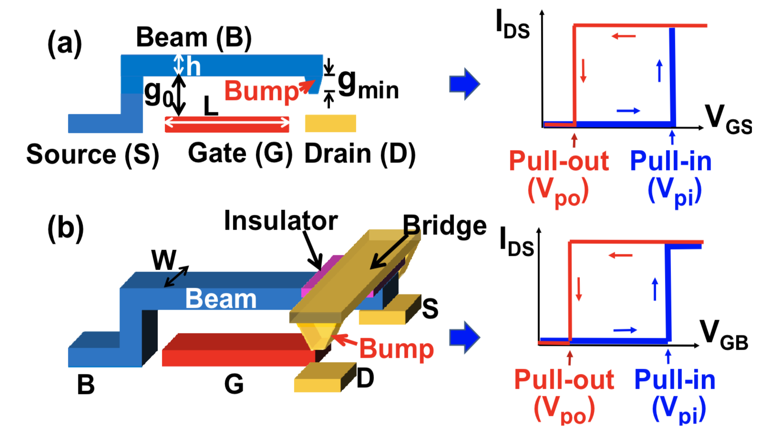
3T & 4T Devices

Slide 6
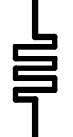
I
Top Electrode
Compliance
Resistive Switching Film
SET
=
HRS
Bottom Electrode
V_{RESET}
V
V_{SET}
RESET
LRS
Bipolar RRAM Cell
Publication & Year | VLSI 2014 | VLSI 2014 | IEDM 2014 | IEDM 2014 | VLSI 2015 | VLSI 2015
2D/3D Geometry | 2D Planar | 3D Vertical | 2D Planar | 3D Vertical | 2D Planar | 2D Planar
Switch Type | Bi | Bi | Bi | Bi | N/A | Bi
Structure | 1T-1R | 1R | 1T-1R | 1R | 1T-1R | 1R
TE/material/BE | Al/AlOx/WOx/W | TiN/HfOx/TiN | TiN/Ti/HfO2/TiN | Pt/HfOx/TiN | Ir/Ta₂O₅/TaO_{x}/TaN | TiN/TiO2/a-Si/TiN
Cell Area (μm²) | 0.0324 (.18um) | 0.000003 | 0.01 (100nm) | 1 (15nm) | 0.0016(40nm) | 0.0013
Speed [ns] | ~1000 | 50 | 40 | 20 | N/A | 10
DC Peak Voltage [V] | N/A | <3 | <3 | <2.5 | N/A | 6.5
DC Peak Current [uA] | N/A | ~500 | ~60 | ~100 | N/A | 5
HRS/LRS Ratio | >180 | >10 | 10 | 100 | 10 | 10
R high [Ω] | 3x10⁷ | 10⁶ | 2x10⁵ | 3x10⁷ | 5x10⁴ | 10⁸
R low [Ω] | 3x10⁴ | 10⁴ | 2x10⁴ | 3x10⁴ | 4x10³ | 10⁷
Endurance | 10⁹ | 10⁴ | 10³ | 10⁸ | >10⁵ | 10⁶
Retention | 10y@ 85℃ | 20000h@ 250℃ | 10y@ 70℃ | 10y@ RT | 10y @ 85℃ | 3y @ 55℃
Many possible materials for resistive switching film
Many possible R/W circuit architectures
Key properties:
Endurance
Retention
Max DC current/voltage
LRS, HRS, resistance ratio
DC peak voltage

Slide 7
How can we synergize RRAM & NEM relays?
KEY IDEA: use RRAM to control gate voltage of NEM relays for actuation
NEM relays have better electrical characteristics than pass transistors

Slide 8
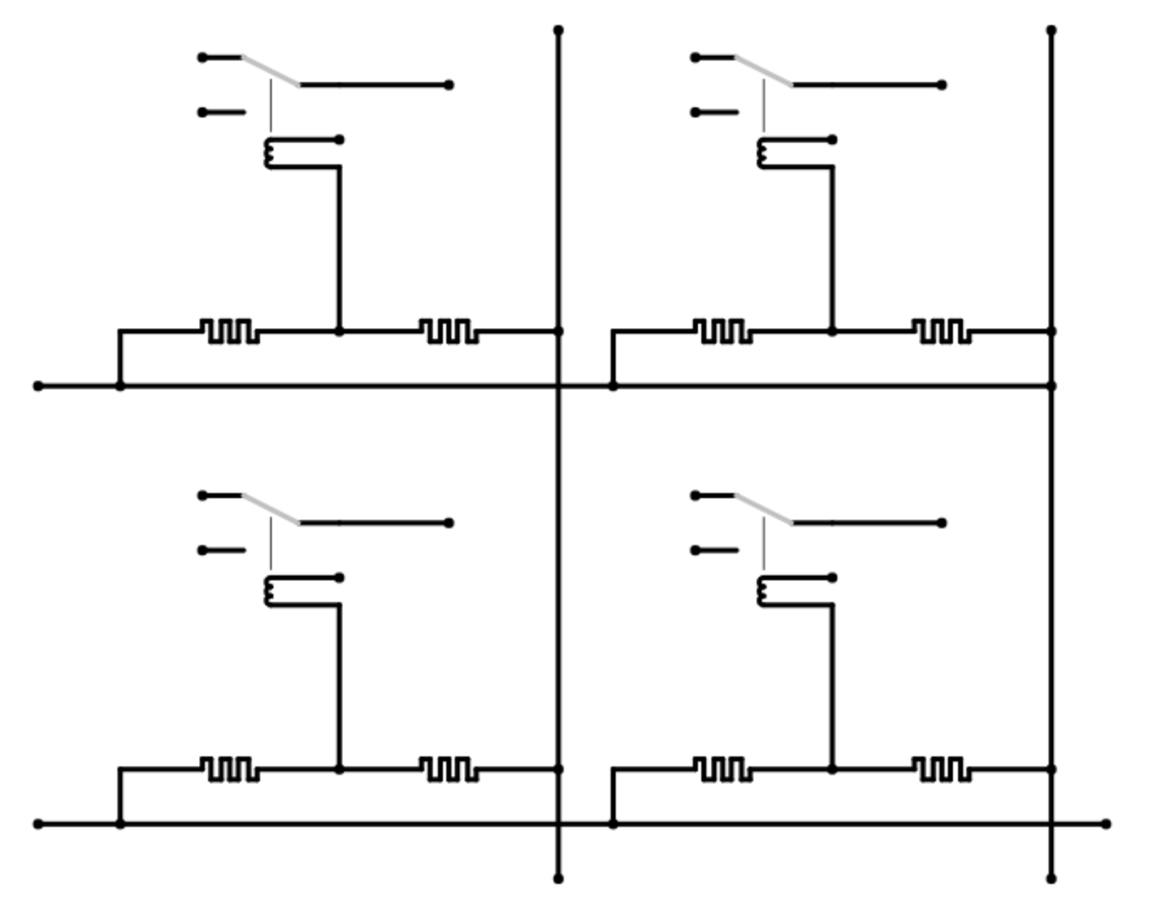
V_{col,1}
V_{col,2}
in_{1,1}
in_{1,2}
out_{1,1}
out_{1,2}
V_{g}
-
+
+
-
V_{row,1}
in_{2,1}
in_{2,2}
out_{2,1}
out_{2,2}
V_{g}
V_{row,2}
out
Hysteretic 3T NEM Router
RRAM Cell

Slide 9
RRAM/NEMS switch BEOL standard cell layout
Fixup: may be able to route row/col rows together…
Also row wire is touching both electrodes!!!
Drain/col wire (L7)
Src
Beam
Src/row wire (L7)
NEM Relay Gate (L7)
Via (L6)
Via (L6)
- Electrode (L5)
+ Electrode (L5)
Resistive Switching Film (L4)
Resistive Switching Film (L4)
V_{col} wire (L1)
Src/row wire (L6)
+ Electrode (L3)
- Electrode (L3)
V_{row} wire (L2)
V_{row} wire (L2)
Via (L2)
L1: V_{col} routing layer
L2: V_{row} routing layer
L3: electrode layer 1
L4: thin film layer
L5: electrode layer 2
L6: row conn. layer
L7: col conn. Layer
Top: vert. NEM relay
…
(Logic circuitry only below here)
Notes:
This is just a draft
Laterally actuated version would have Src/Beam in L7

Slide 10
Next Steps
Array-level SPICE simulations
GDS layout for single device, different bit widths
Parametrizable layout generator for switch box
Parametrizable layout generator for connection box
Evaluate performance improvements using circuit/arch models

