Slide 1
Hybrid RRAM-NEMS Design for Nonvolatile 3D Routing in CGRAs
Akash Levy

Slide 2
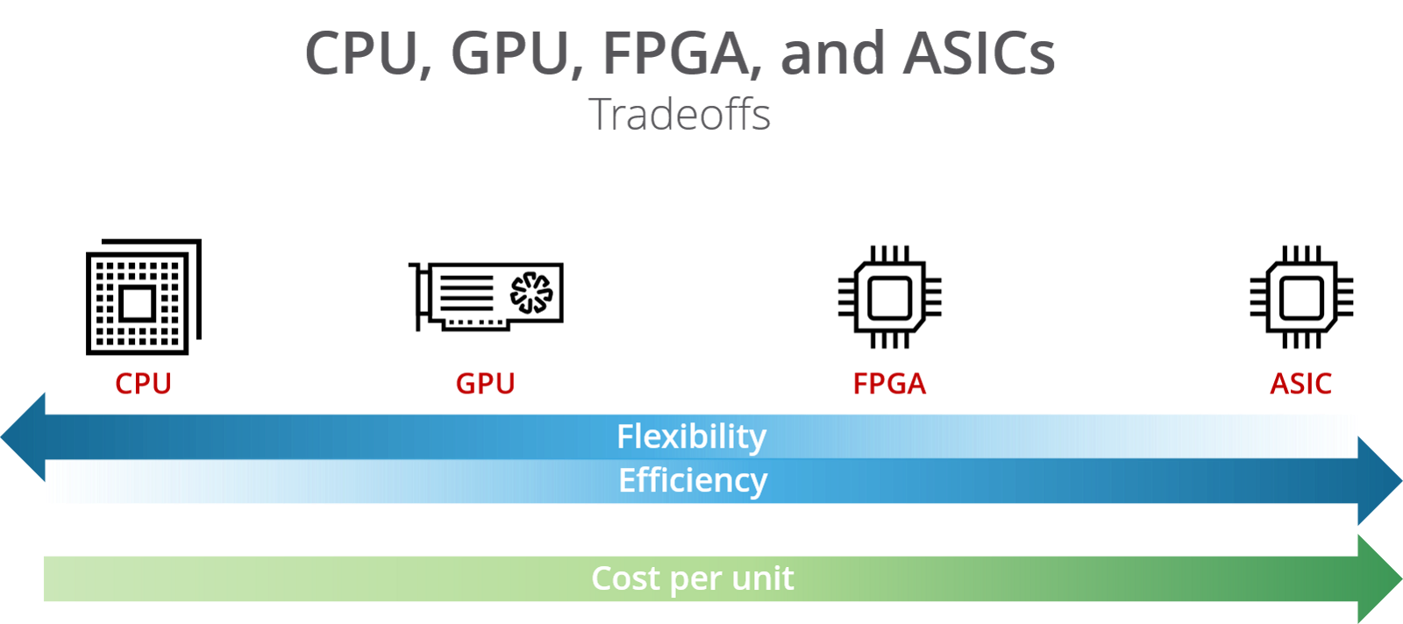
Designing an application today
Design Flow:
Code
CUDA
RTL/HLS
RTL + PNR + Tapeout
CGRA
CGRA*
CGRA
Source: https://hackernoon.com/a-gentle-introduction-to-hardware-accelerated-data-processing-81ac79c2105
* Workload-dependent
Notes:
Today we have many options for designing an application. Here’s a diagram showing the supposed tradeoffs between different application design flows.
Flexibility = What applications can be run on it
Efficiency = EDP
Cost per unit = NRE cost
We have CPUs which you run software on, GPUs which you run CUDA software on, FPGAs which you compile RTL to (or use HLS), and ASICs which have the most complex design flow.
More recently, we also have CGRAs, which are coarse-grained FPGAs, meaning they replace some LUTs with common logic structures. These have a somewhat interesting profile on this scale.
CGRAs are FPGAs that tradeoff a small amount of flexibility for a decent amount of efficiency (depending on workload though)
Same design flow should mean same cost per unit

Slide 3
How can we improve application design?
Want to improve efficiency without adding cost or reducing flexibility
CGRAs are more efficient than FPGAs b/c less reconfigurable
Low-overhead reconfigurability is key to efficiency with low cost and high flexibility
CGRA is (arguably) best tradeoff b/w flexibility and efficiency at architectural level for agile hardware design
So what else might we do to improve FPGAs/CGRAs?
Notes:
Flexibility = agility
Cool… assuming above is true, is that it?
What else can we do? Well basically we want to find a way to reduce reconfigurability overhead.

Slide 4
Well, where does reconfigurability overhead come from?
LUTs are less efficient than standard cells
Increase area
Increases power and delay a little
Less of a problem for CGRAs: fewer LUTs
Unutilized logic components
Increase area
Less of a problem for FPGAs: homogeneity within CLBs
Reconfigurable Routing
Increases area (80-90% of FPGA area is routing!!!)
Increases power (5-12x)
Increases delay (3-4x)
Notes:
So we need to think about what causes this overhead. There are three main causes.

Slide 5
Reducing reconfigurable routing overhead using emerging nanotechnologies
NEM relays:
Reconfigurable switches monolithically integrated in 3D
Reduce area/power/delay overhead from reconfigurable interconnects
RRAM:
Non-volatile memory monolithically integrated in 3D
Reduce area/power/delay overhead from startup configuration
Result:
Lower routing overhead
No startup reconfiguration cost
Notes:
Result:
CGRAs become competitive with ASICs in terms of performance
CGRAs become competitive with ASICs for “normally off, instantly on”

Slide 6
Combining RRAM and NEMS approaches
RRAM and NEM relays have been separately studied for FPGAs
So what is really novel about combining approaches?
KEY POINT: If used together, the electrical properties of RRAM and NEM relays complement each other to cancel essentially all overhead!

Slide 7
NEM Relays
What are they and how do they work?

Slide 8
OFF-state
ON-state
Source
Source
Beam
Beam
Gate
Drain
Electrostatic
force
Gate
Drain
Hysteresis Window
I_{DS}
3-terminal (3T) NEM relay
Infinite subthreshold slope
V_{GS}
V_{po}
V_{hold}
V_{pi}

Slide 9
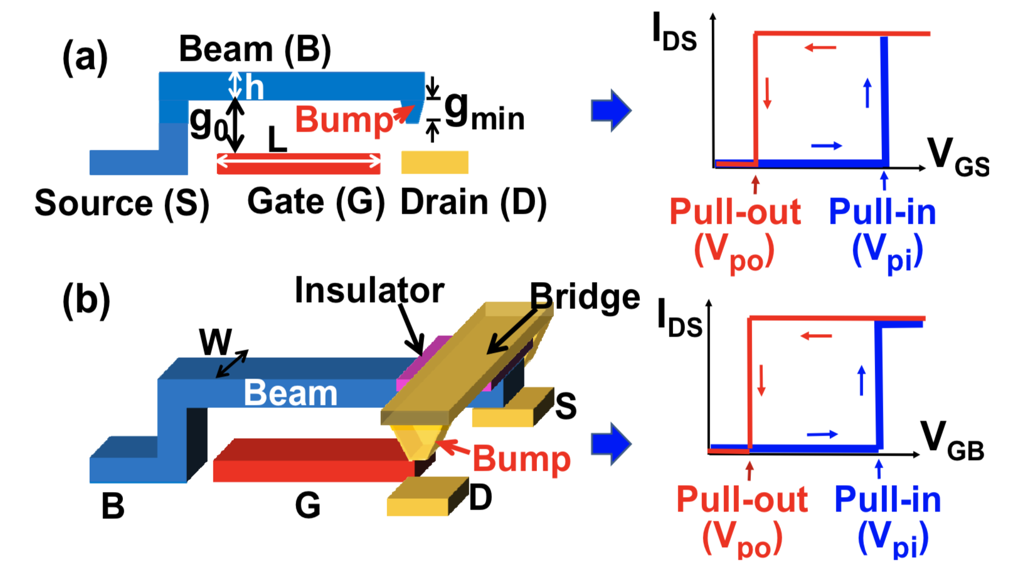
3T & 4T Devices

Slide 10
Previous work on NEM relays for FPGAs
C. Chen, W. S. Lee, R. Parsa, S. Chong, J. Provine, J. Watt, R. T. Howe, H.-S. P. Wong, and S. Mitra, “Nano-electro-mechanical relays for FPGA routing: Experimental demonstration and a design technique,” in Design, Automation & Test in Europe Conference & Exhibition (DATE), 2012, pp. 1361–1366, IEEE, 2012.
3D place-and-route scheme with NEM-based LUTs and routers
Maximum of 41.9% performance gain
Assumed multiple NEMS devices can be viably stacked in 3D (not yet!)
C. Chen, R. Parsa, N. Patil, S. Chong, K. Akarvardar, J. Provine, D. Lewis, J. Watt, R. T. Howe, H.-S. P. Wong, et al., “Efficient FPGAs using nanoelectromechanical relays,” in Proceedings of the 18th annual ACM/SIGDA international symposium on Field programmable gate arrays, pp. 273–282, ACM, 2010.
Half-select programming scheme was used for the NEM relays, verified expt.
Claimed 10-fold reduction in leakage power, 2-fold reduction in dynamic power, and 2-fold reduction in area
Use of a 3T device and a small hysteresis window: bad for pass transistor
Used optimistic device parameters/dimensions… not realized physically

Slide 11
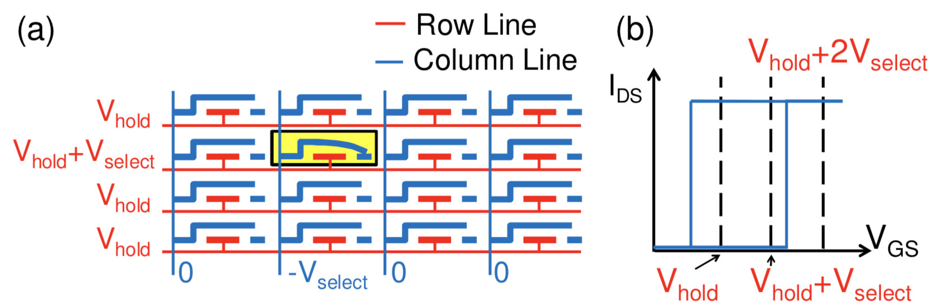
Half-Select Design for NEM Relay R/W

Slide 12
Properties that lead to overhead cancellation
NEM Relays |  | RRAM
Good properties | Bad properties
Infinite subthreshold slope | Storage is volatile
Lower ON-state resistance than transistors | Larger than transistors
Hysteresis enables data storage | Much slower switching than transistors
3D integration | Higher V_{g} req. than CMOS
No leakage current

Slide 13
RRAM
What is it and how does it work?

Slide 14
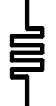
I
Top Electrode
Compliance
Resistive Switching Film
SET
=
HRS
Bottom Electrode
V_{RESET}
V
V_{SET}
RESET
LRS
Bipolar RRAM Cell
Publication & Year | VLSI 2014 | VLSI 2014 | IEDM 2014 | IEDM 2014 | VLSI 2015 | VLSI 2015
2D/3D Geometry | 2D Planar | 3D Vertical | 2D Planar | 3D Vertical | 2D Planar | 2D Planar
Switch Type | Bi | Bi | Bi | Bi | N/A | Bi
Structure | 1T-1R | 1R | 1T-1R | 1R | 1T-1R | 1R
TE/material/BE | Al/AlOx/WOx/W | TiN/HfOx/TiN | TiN/Ti/HfO2/TiN | Pt/HfOx/TiN | Ir/Ta₂O₅/TaO_{x}/TaN | TiN/TiO2/a-Si/TiN
Cell Area (μm²) | 0.0324 (.18um) | 0.000003 | 0.01 (100nm) | 1 (15nm) | 0.0016(40nm) | 0.0013
Speed [ns] | ~1000 | 50 | 40 | 20 | N/A | 10
DC Peak Voltage [V] | N/A | <3 | <3 | <2.5 | N/A | 6.5
DC Peak Current [uA] | N/A | ~500 | ~60 | ~100 | N/A | 5
HRS/LRS Ratio | >180 | >10 | 10 | 100 | 10 | 10
R high [Ω] | 3x10⁷ | 10⁶ | 2x10⁵ | 3x10⁷ | 5x10⁴ | 10⁸
R low [Ω] | 3x10⁴ | 10⁴ | 2x10⁴ | 3x10⁴ | 4x10³ | 10⁷
Endurance | 10⁹ | 10⁴ | 10³ | 10⁸ | >10⁵ | 10⁶
Retention | 10y@ 85℃ | 20000h@ 250℃ | 10y@ 70℃ | 10y@ RT | 10y @ 85℃ | 3y @ 55℃
Many possible materials for resistive switching film
Many possible R/W circuit architectures
Key properties:
Endurance
Retention
Max DC current/voltage
LRS, HRS, resistance ratio
DC peak voltage

Slide 15
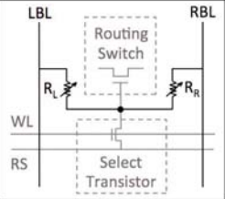
Previous work on RRAM relays for FPGAs
Y. Y. Liauw, Z. Zhang, W. Kim, A. El Gamal, and S. S. Wong, “Nonvolatile 3D-FPGA with monolithically stacked RRAM-based configuration memory,” in Solid-State Circuits Conference Digest of Technical Papers (ISSCC), 2012 IEEE International, pp. 406–408, IEEE, 2012.
1T2R structure with two RRAM cells having opposite resistance states
Voltage divider controlling a pass transistor
Experimentally achieved a 57% smaller die area and a 28% lower energy-delay-product (EDP) than SRAM-based design
Non-volatile configuration memory which enabled quick wake-up

Slide 16
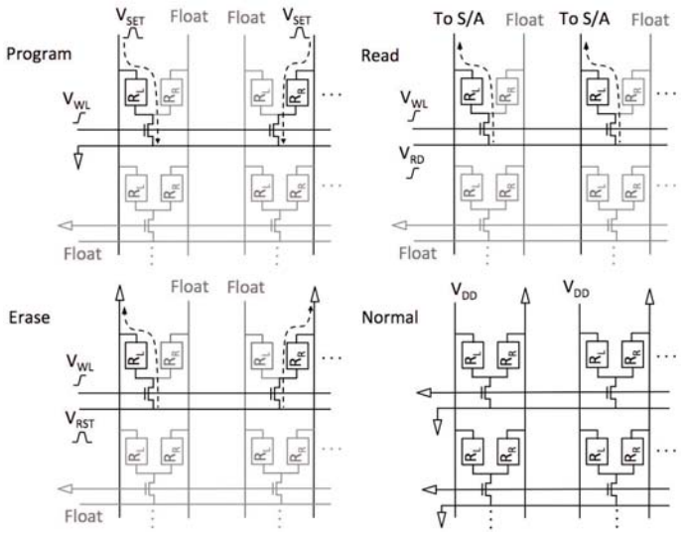
RRAM 1T2R Operation Modes

Slide 17
Properties that lead to overhead cancellation
NEM Relays |  | RRAM
Good properties | Bad properties | Good properties | Bad properties
Infinite subthreshold slope | Storage is volatile | Nonvolatile | Large write energy
Lower ON-state resistance than transistors | Larger than transistors | Lower area than SRAM and proven scalable | Sense amp to decode takes up area
Hysteresis enables data storage | Much slower switching than transistors | Resistance-based storage allows analog design
3D integration | Higher V_{g} req. than CMOS | 3D integration
No leakage current

Slide 18
How can we synergize RRAM & NEM relays?
KEY IDEA: use RRAM to control gate voltage of NEM relays for actuation
More generally: NEM relays are an interesting option for RRAM sense amplification, given their infinite subthreshold slope
NEM relays have better electrical characteristics than pass transistors

Slide 19
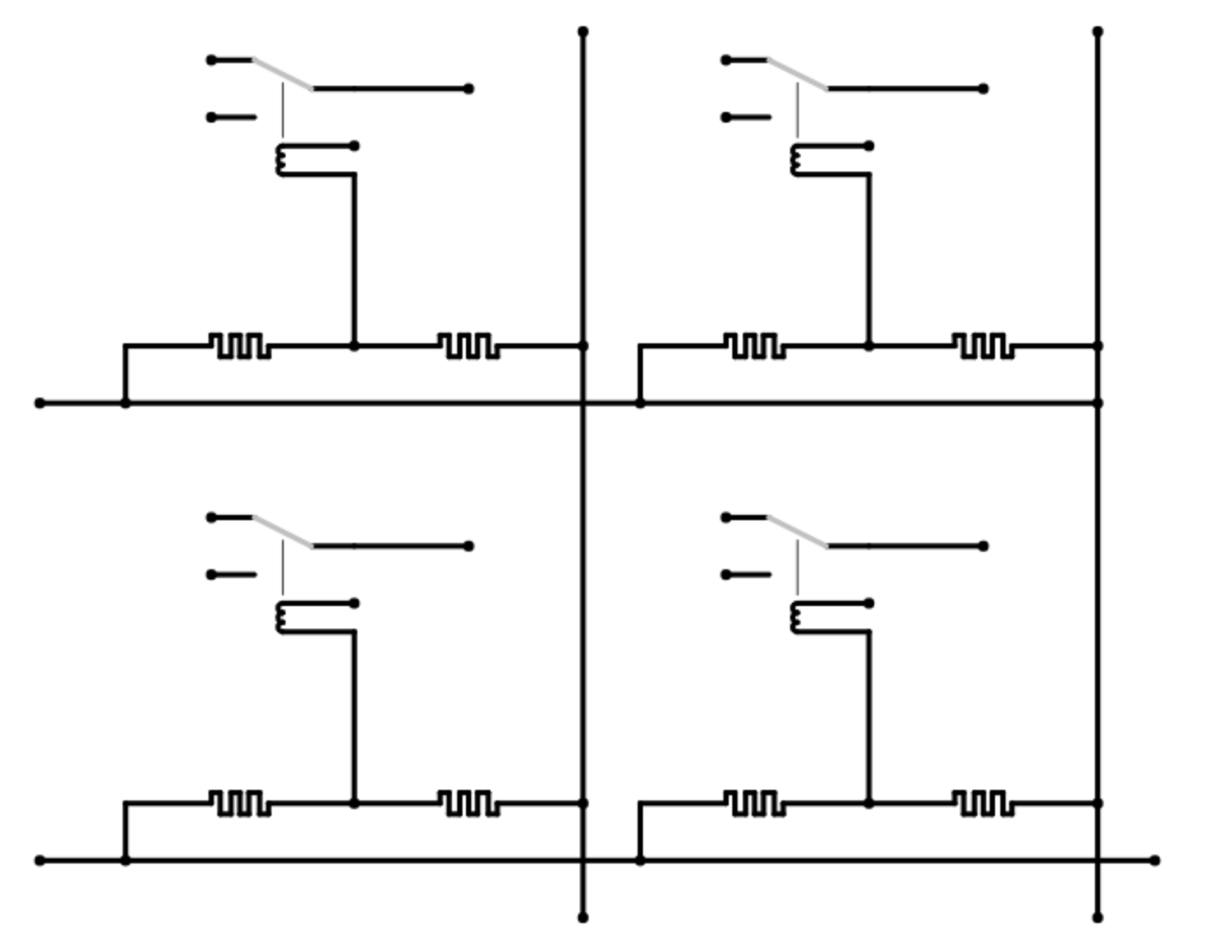
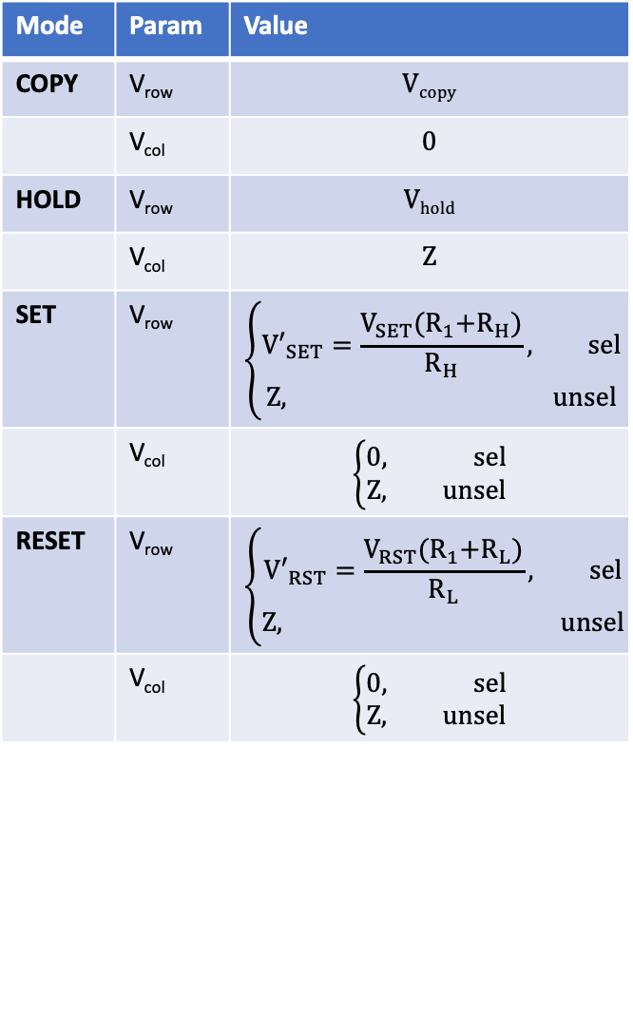
Hybrid circuit architecture
V_{col,1}
V_{col,2}
in_{1,1}
in_{1,2}
Mode | Param | Value
COPY | V_{row} | $$Vcopy$$
 | V_{col} | $$0$$
HOLD | V_{row} | $$Vhold$$
 | V_{col} | $$Z$$
SET | V_{row} | $$\left\{\begin{aligned}{V′}_{SET}=\frac{V_{SET}{{(R}_{1}+R}_{H})}{R_{H}}, sel \\ Z, unsel\end{aligned}\right.$$
 | V_{col} | $$\left\{\begin{aligned}0, sel \\ Z, unsel\end{aligned}\right.$$
RESET | V_{row} | $$\left\{\begin{aligned}{V′}_{RST}=\frac{V_{RST}{{(R}_{1}+R}_{L})}{R_{L}}, sel \\ Z, unsel\end{aligned}\right.$$
 | V_{col} | $$\left\{\begin{aligned}0, sel \\ Z, unsel\end{aligned}\right.$$
out_{1,1}
out_{1,2}
V_{g}
-
+
+
-
V_{row,1}
in_{2,1}
in_{2,2}
out_{2,1}
out_{2,2}
V_{g}
V_{row,2}
out
Hysteretic 3T NEM Router
RRAM Cell
(a)
(b)
(b)
Notes:
Key idea: use RRAM to actuate the NEM relays
Entirely back-end-of-line (0T)
1N1R design
Need a good way to actuate
Poly layers are annoying to get to
RRAM properties have to match NEM relays’

Slide 20
COPY
HOLD
OFF
SET
OFF
COPY
HOLD
OFF
RESET
OFF
COPY
HOLD

Slide 21
Row/col controllers
Mode
2
V_{COPY}
V_{HOLD}
V_{row}
Mode
Mux
V’_{SET}
2
V’_{RESET}
!= HOLD
== COPY or HOLD
== COPY
4:1 Decoder
V_{row,1}
4:1 Decoder
NEM Relay/
PD Transistor
V_{col,1}
NEM Relay/
PU Transistor
NEM Relay
2
NEM Relay/
PU Transistor
V_{row,2}
2
NEM Relay/
PD Transistor
V_{col,2}
Row
Col
NEM Relay
NEM Relay/
PU Transistor
V_{row,3}
NEM Relay/
PD Transistor
V_{col,3}
NEM Relay
V_{row,4}
NEM Relay/
PD Transistor
V_{col,4}
NEM Relay/
PU Transistor
NEM Relay
(a)
(b)
Notes:
(single stream for reduced I/O pin requirement)
Probably want to do this on-chip to reduce pin requirement
Column controller is similar

Slide 22
Properties that lead to overhead cancellation
NEM Relays |  | RRAM
Good properties | Bad properties | Good properties | Bad properties
Infinite subthreshold slope | Storage is volatile | Nonvolatile | Large write energy
Lower ON-state resistance than transistors | Larger than transistors | Lower area than SRAM and proven scalable | Sense amp to decode takes up area
Hysteresis enables data storage | Much slower switching than transistors | Resistance-based storage allows analog design
3D integration | Higher V_{g} req. than CMOS | 3D integration
No leakage current
RESULT: Architecture is entirely free of transistors, so can be implemented 100% in BEOL i.e. 3D
Bad Material Property | Good Material/App Property that Cancels It
NEM relays: much slower switching than transistors | Used for routing only: only switches once on startup, hysteresis enables dual function as memory and router
NEM relays: larger than transistors | Used for routing only and integrated in 3D
NEM relays: storage using hysteresis is volatile | RRAM is nonvolatile: integration enables nonvolatility
NEM relays: higher V_{g} required than CMOS | RRAM variable resistance allows analog control of V_{g}
RRAM: larger write energy | RRAM is used as ROM
RRAM: sense amp to decode takes up area | NEM relays have infinite subthreshold slope, so single relay can act as decoder

Slide 23
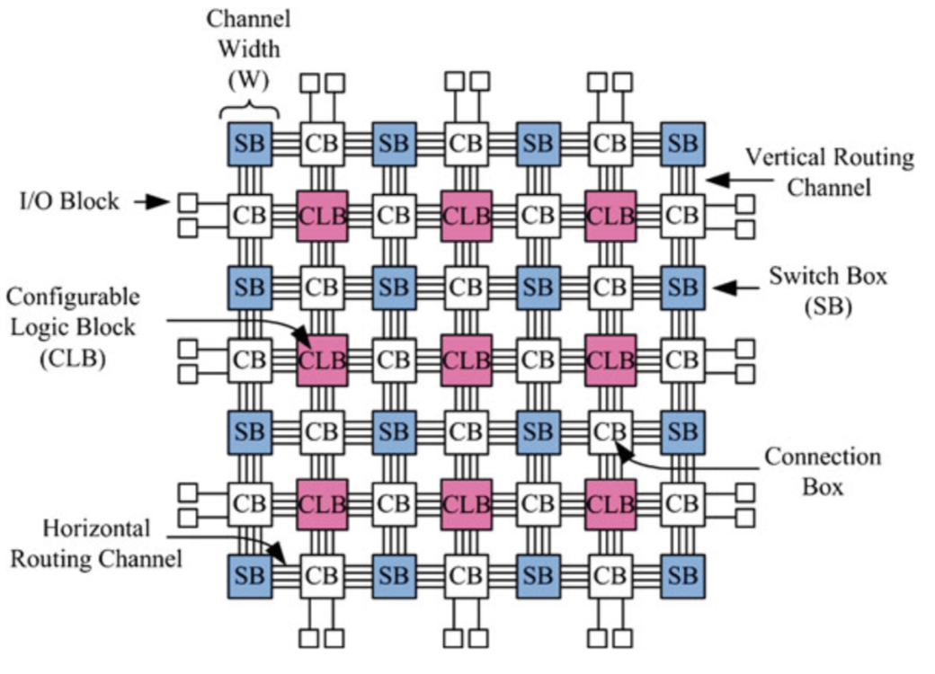
Island-Style Architecture
CB
SB
CLB
CB
One CGRA Tile
Source: FPGA Architectures: An Overview - Springer
Notes:
CLB: configurable logic block
CB: connection box
SB: switch box

Slide 24
Connection boxes
Fc = 0.5
CLB
CLB

Slide 25
RRAM/NEMS switch BEOL standard cell layout
Fixup: may be able to route row/col rows together…
Also row wire is touching both electrodes!!!
Drain/col wire (L7)
Src
Beam
Src/row wire (L7)
NEM Relay Gate (L7)
Via (L6)
Via (L6)
- Electrode (L5)
+ Electrode (L5)
Resistive Switching Film (L4)
Resistive Switching Film (L4)
V_{col} wire (L1)
Src/row wire (L6)
+ Electrode (L3)
- Electrode (L3)
V_{row} wire (L2)
V_{row} wire (L2)
Via (L2)
L1: V_{col} routing layer
L2: V_{row} routing layer
L3: electrode layer 1
L4: thin film layer
L5: electrode layer 2
L6: row conn. layer
L7: col conn. Layer
Top: vert. NEM relay
…
(Logic circuitry only below here)
Notes:
This is just a draft
Laterally actuated version would have Src/Beam in L7

Slide 26
Switch boxes
Flexibility: Fs = 3
Source: http://venividiwiki.ee.virginia.edu/mediawiki/index.php/File:SwitchBo.png

Slide 27
Layout strategy: 3D fold
CB
SB
CB
SB
Ideal…
SB
CB
SB
CB
SB
CLB
CB
CLB
CB
CLB
CLB
CB
CB
CB
SB
CB
SB
CB
SB
CLB
CLB
CB
SB
CB
SB
CB
CB
CB
SB
CB
SB
CB
SB
CLB
CB
CLB
CB
Notes:
Need to get to 1/3 area for full utilization

Slide 28
Device Constraints
RRAM Voltage Control
-V_{N,max}
V_{RST,min}
…
0
V_{po,min}
V_{L,max}
V_{pi,min}
V_{H,min}
V_{SET,min}
V_{N,max}
V_{RST,max}
-V_{H,max}
V_{po,max}
V_{pi,max}
V_{H,max}
V_{SET,max}
Hysteresis Window

Slide 29
Next Steps
Understand architectural options for voltage divider better
GDS layout for single device
Parametrizable layout generator for switch box
Parametrizable layout generator for connection box
Evaluate performance improvements using circuit/arch models
Future projects:
Apply architecture to LUTs
Fabricate RRAM-actuated NEM relay

Slide 30
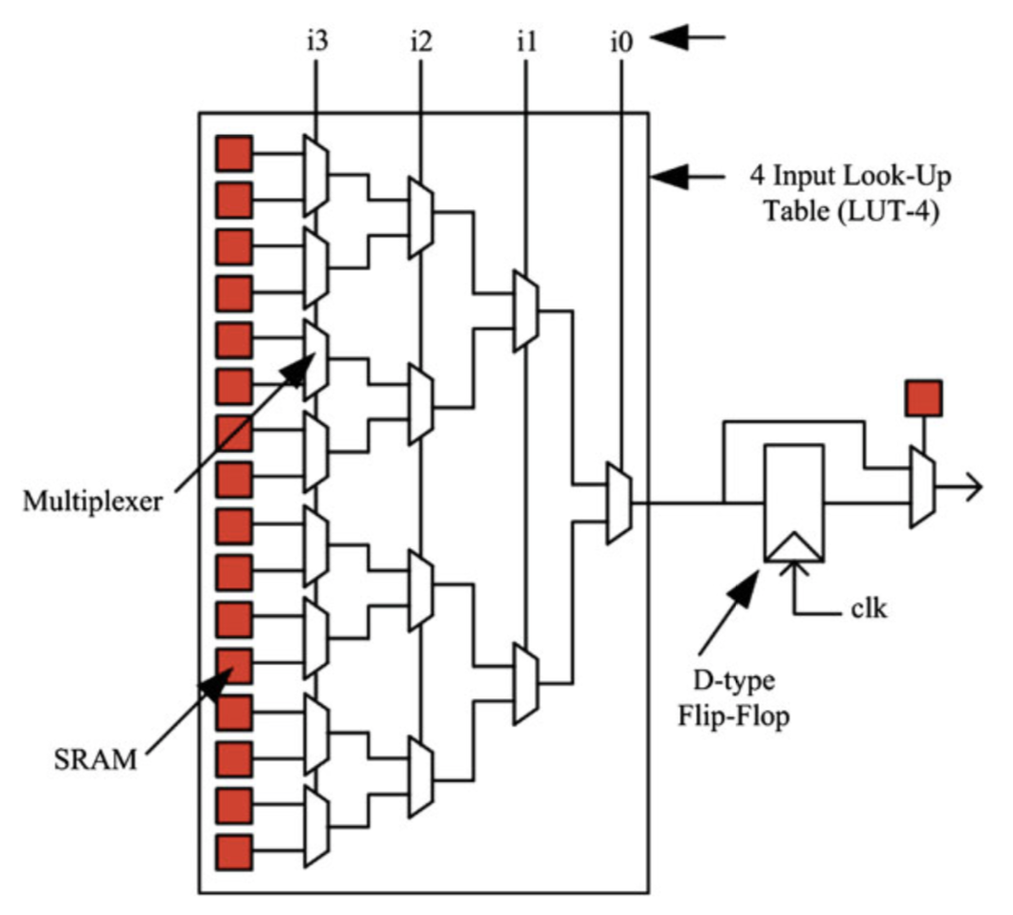
Future Work: LUTs with RRAM/NEMS
Source: FPGA Architectures: An Overview - Springer
Notes:
Ultimately you want all static configuration to use this architecture

Slide 31
Drain 1
Drain 1
Source
Source
Beam
Beam
Gate
Drain 2
Electrostatic
force
Gate
Drain 2
I_{D1S}
I_{D2S}
V_{GS}
V_{GS}
V_{po}
V_{hold}
V_{pi}
V_{po}
V_{hold}
V_{pi}

Slide 32
Summary
RRAM and NEM relays work well together for reconfigurable routing
100% BEOL design enables isolation of layout for routing and logic
That’s all, folks!
Area Improvements | Power Improvements | Delay Improvements
Routing components in 3D | Lower ON-state resistance | Lower ON-state resistance
Routing components require fewer elements | Low-power startup with integrated NVM | Fast startup with integrated NVM
No config registers/SRAM | Shorter wire lengths | Shorter wire lengths
 | No leakage current

Slide 33
I
Compliance
Top Electrode
SET
Resistive Switching Film
=
HRS
V_{RESET}
Bottom Electrode
V
V_{SET}
RESET
LRS
(a)
(b)

