Slide 1

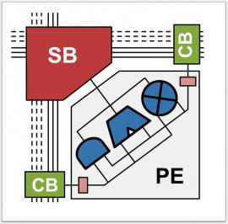

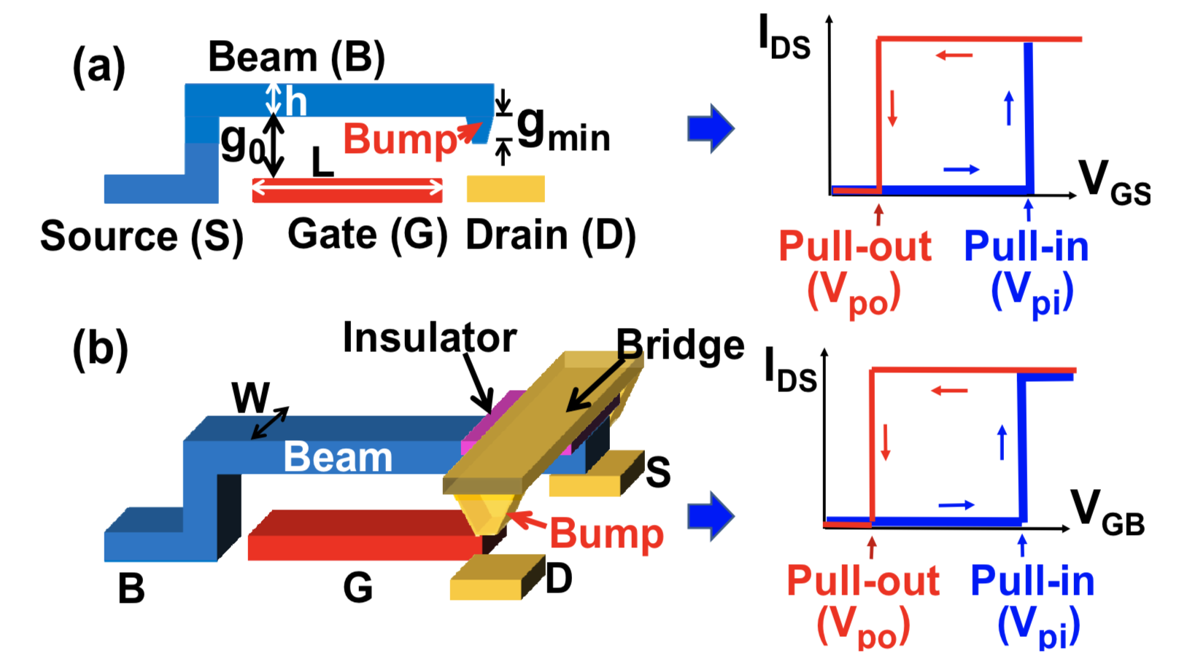
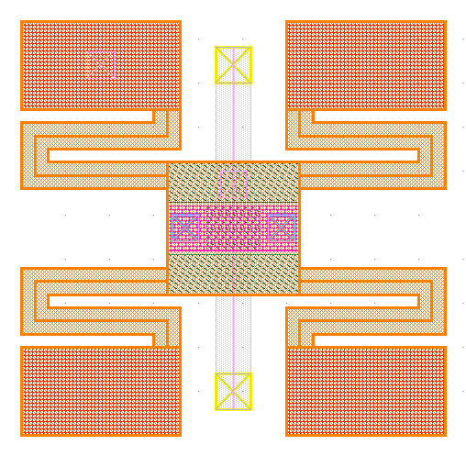
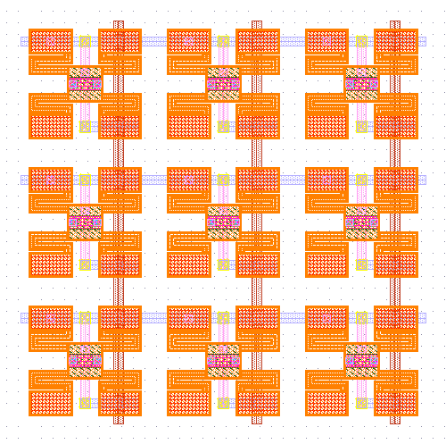
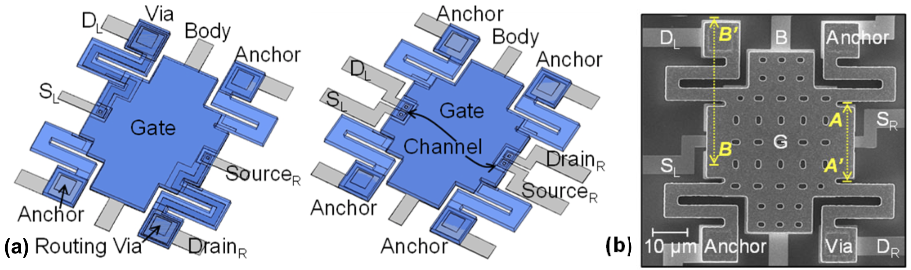
Hybrid RRAM-NEM Relay Design for Nonvolatile 3D Routing in CGRAs
Stanford Accelerate Research Group
Presenter: Akash Levy, Advisor: Priyanka Raina
Department of Electrical Engineering, Stanford University, Stanford, CA 94305, USA
Nanotechnologies for Reconfigurable Routing
Hybrid Design Schematics & Operation
Hybrid Design Draft Layouts
Reconfigurable routing in FPGAs/CGRAs is costly
Increases area (80-90% of FPGA area is routing)
Increases power (5-12x)
Increases delay (3-4x)
Solution: new nanotechnologies
NEM relays (images adapted from [1], [2])
RRAM
Both can be integrated in 3D
Key idea: use two RRAM cells as voltage divider to control gate voltage of NEM relay
Conclusion: top organizations have access to your entire browsing history
Next Steps
Simulation & Modeling
Test with different device parameters/levels of sophistication
Row/column drivers need to be simulated
NEM relay layout optimization
Fabrication & Characterization
Test crossbar array of dual-RRAM SET/RESET and voltage divider properties
Fabricate NEM relays with larger bit widths
VLSI Circuit Design
Integration with AHA project CGRA
Architectural Analysis
Calculate approximately what benefits are (area, energy, delay)
Build a parametrized cost model for system components (average area/energy/delay cost, given switch box parameters, size of array, etc.)
Contact
Acknowledgements
References
Akash Levy
Stanford University, Electrical Engineering
Email: akashl@stanford.edu
Website: akashlevy.com
Phone: (646) 623-0283
I would like to thank Prof. Simon Wong and Prof. H.S. Philip Wong for their input on the RRAM read/write schemes, and their help with device testing.
[1] C. Chen, R. Parsa, N. Patil, S. Chong, K. Akarvardar, J. Provine, D. Lewis, J. Watt, R. T. Howe, H.-S. P. Wong, et al., “Efficient FPGAs using nanoelectromechanical relays,” in Proceedings of the 18th annual ACM/SIGDA international symposium on Field programmable gate arrays, pp. 273–282, ACM, 2010.
[2] Ye, Z. A., S. Almeida, M. Rusch, A. Perlas, W. Zhang, U. Sikder, J. Jeon, V. Stojanović, and T-JK Liu. "Demonstration of 50-mV Digital Integrated Circuits with Microelectromechanical Relays." In 2018 IEEE International Electron Devices Meeting (IEDM), pp. 4-1. IEEE, 2018.
[3] Y. Y. Liauw, Z. Zhang, W. Kim, A. El Gamal, and S. S. Wong, “Nonvolatile 3D-FPGA with monolithically stacked RRAM-based configuration memory,” in Solid-State Circuits Conference Digest of Technical Papers (ISSCC), 2012 IEEE International, pp. 406–408, IEEE, 2012.

