Slide 1
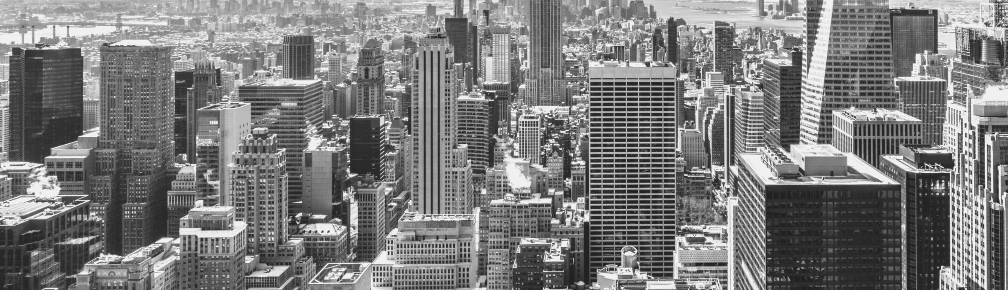
Smart Bill Boards Using IBM Watson
Vasanth Korada
Priyanka Kosana
Harshitha Muddada
Team Synergic

Slide 2
INTRODUCTION:
Billboards, the oldest and least technology-driven of all advertising media, are now being given an Internet-of-things upgrade, as brands and media owners look for new ways to ensure proof of performance.
Out-of-home displays have typically suffered because simple things like torn ads or electric lights not being put on at night affect the usefulness of a campaign. Brands and advertising agencies still rely on people on bikes taking pictures of hoardings to ensure that they are getting what they have paid for.
Smart Bill Boards Using IBM Watson

Slide 3

The use of Smart boards has widely increased these days. The applications that can be developed using these smart boards have been increasing day-by-day. Smart billboards can also target motorists on the highway or pedestrians passing bus shelters. Companies can attract the customers by doing advertisements. These smart bill boards will help them in attracting their customers and make their task easier. In this we can upload the required data on the bill board simply by giving inputs through user interface. And we can check the lamps working status which is connected to bill board through the UI.
PROJECT DESCRIPTION

Slide 4
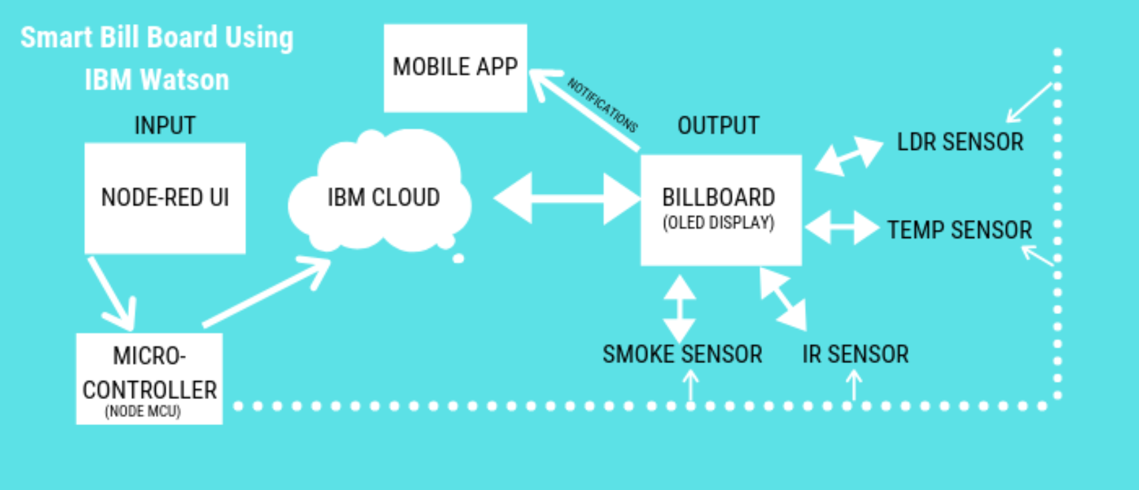
Overview

Slide 5
Integrating the objects around the billboard into your design
Playing with the borders of the board
Adding special effects
Taking advantage of natural lighting
Interacting with people who pass by
Relying on clever visuals
Usage

Slide 6
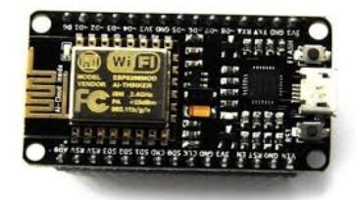
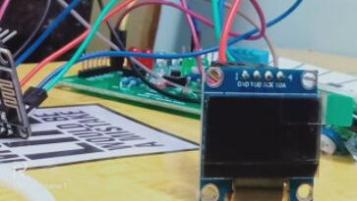
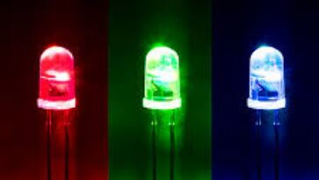

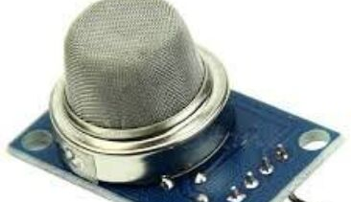
HARDWARE USED
NODE MCU
OLED
LED'S
IR SENSOR
MQ2 GAS SENSOR

Slide 7



SOFTWARE USED
NODE RED
IBM CLOUD
ARDUINO

Slide 8
WORKING
input Should be given from Node-Red UI
The given input get's displayed on the OLED screen.
ADS ON button should be used to activate the BillBoard
ADS OFF button should be used to deactivate the BillBoard.
When BillBoard detects any human it greets in an interactive way.
When BillBoard detects a person smoking it displays a message

Slide 9
ADVANTAGES
Reduces manual effect in advertising.
Data or a particular advertisement can be changed periodically.
Efficient method of publishing advertisement.
Easy to use.
Attractive and interesting
Reduces Man Power

Slide 10
THANK YOU!

