Slide 1
LIBRARY AI AGENT
CAPSTONE PROJECT
Presented By:
1. Priyanka V-Manipal Institute of Technology, Bengaluru-Computer Science

Slide 2
OUTLINE
Problem Statement (Should not include solution)
Proposed System/Solution
System Development Approach (Technology Used)
Algorithm & Deployment
Result (Output Image)
Conclusion
Future Scope
References

Slide 3
Problem Statement
Students face a significant challenge in finding library materials that directly align with their specific course syllabi and academic tasks. The traditional search process is often generic and time-consuming, leading to the underutilization of valuable resources and inefficient use of study time. This project seizes the opportunity to develop an intelligent "Library AI Agent" to act as a personalized research assistant. As per the project mandate, the solution will leverage the IBM NLP models to understand academic documents and will be deployed on IBM Cloud Lite services. The ultimate objective is to create a seamless system that enhances resource discovery, boosts student engagement, and directly supports academic success.

Slide 4
Proposed Solution
The proposed system will address the challenge by leveraging AI and cloud technologies to deliver personalized recommendations. The solution will consist of the following components:
Data Collection:
Integrate the library's book catalog and real-time availability API.
Enable secure uploads of course syllabi and user queries.
NLP & Feature Extraction (Powered by IBM Granite):
Clean and preprocess all data sources for consistency.
Use the IBM Granite model to extract key topics and concepts from syllabi and book descriptions.
Develop a semantic matching engine to align student needs with library resources.
AI Recommendation Engine:
Implement a content-based filtering algorithm for highly relevant, context-aware suggestions.
Integrate a conversational interface using IBM Watsonx Assistant for natural user interaction.
Deployment & Interface (Powered by IBM Cloud):
Develop a user-friendly web interface for students to interact with the agent.
Deploy the full application stack on a scalable and reliable IBM Cloud Lite architecture.
Evaluation & Outcome:
Assess recommendation accuracy using industry-standard metrics (Precision, Recall).
The final result will be a fully functional AI agent that streamlines the research process and improves resource utilization.

Slide 5
System Approach
This section outlines the overall strategy and methodology for developing the Library AI Agent.
System Requirements:
A web-based portal for user interaction (syllabus upload, query input).
A backend service to process requests and integrate with the library database.
Real-time API access to the library's catalog and availability data.
A secure, scalable cloud environment for hosting the application and AI models.
Technology & Libraries Required:
Cloud Platform: IBM Cloud Lite (for hosting, database, and AI services).
Core AI Model: IBM Granite for Natural Language Processing (via watsonx.ai).
Conversational AI: IBM watsonx Assistant for the user-facing chatbot.
Backend: Python (Flask/Django) or Node.js for building the application logic.
Database: IBM Cloud Databases (e.g., Db2, PostgreSQL) for storing catalog data and user profiles.
Frontend: A modern JavaScript framework (e.g., React, Vue) for a dynamic user experience.

Slide 6
Algorithm & Deployment
Algorithm Selection: Semantic Similarity via NLP
We will use a Content-Based Filtering approach. The core of this is a semantic matching engine powered by the IBM model.
Data Input:
Source 1: User-uploaded course syllabus (PDF, DOCX, or plain text).
Source 2: Library book catalog (metadata including title, author, description, keywords).
Source 3: Real-time library API data (for availability and location).
Processing Workflow:
The IBM model processes both the syllabus and book descriptions to extract key concepts and generate vector embeddings (numerical representations).
The semantic matching engine calculates the "cosine similarity" between the syllabus vector and the vector for each book.
A higher similarity score indicates a closer topical match.
Recommendation & Deployment:
The system returns a ranked list of books based on their similarity scores.
The entire application is deployed on IBM Cloud Code Engine, providing a scalable, serverless environment that manages resources automatically.

Slide 7
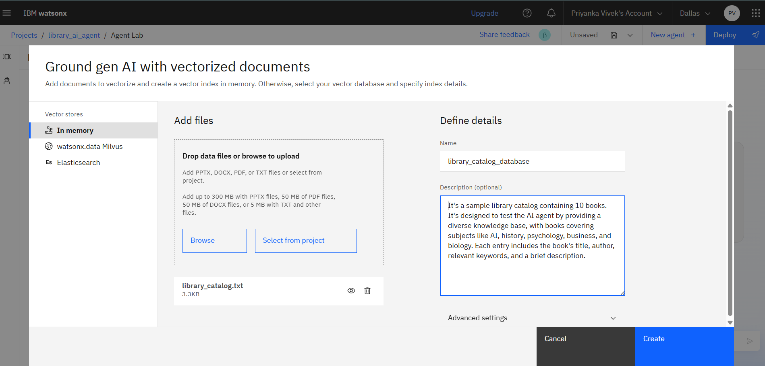
Result
Here, we are creating the agent's knowledge base. We've uploaded the library_catalog.txt file and are creating a searchable 'vector index' from it. This crucial step 'grounds' the AI, ensuring it will only use our specific library data to answer student queries.

Slide 8
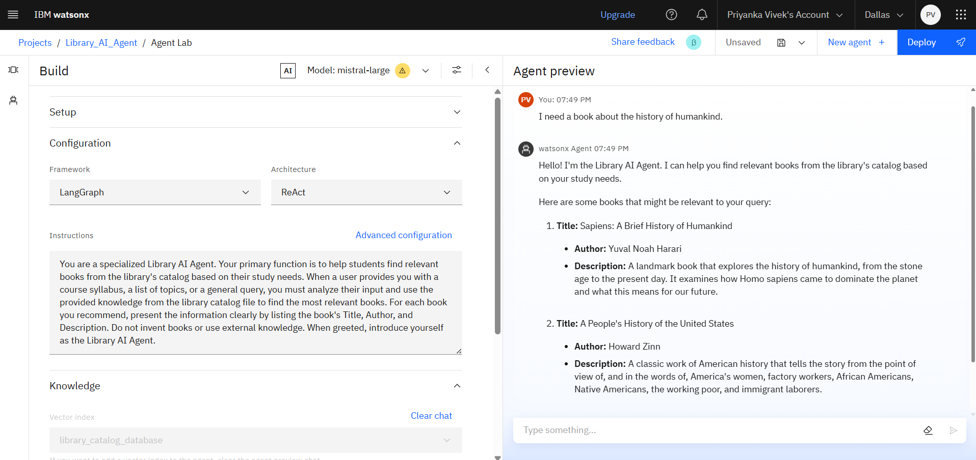
Result
This screenshot demonstrates a successful test of the Library AI Agent. After receiving the user's query for a book on 'the history of humankind,' the agent correctly searched its knowledge base (the library catalog) and provided a perfectly formatted list of relevant books, proving the core functionality of the system is working as designed.

Slide 9
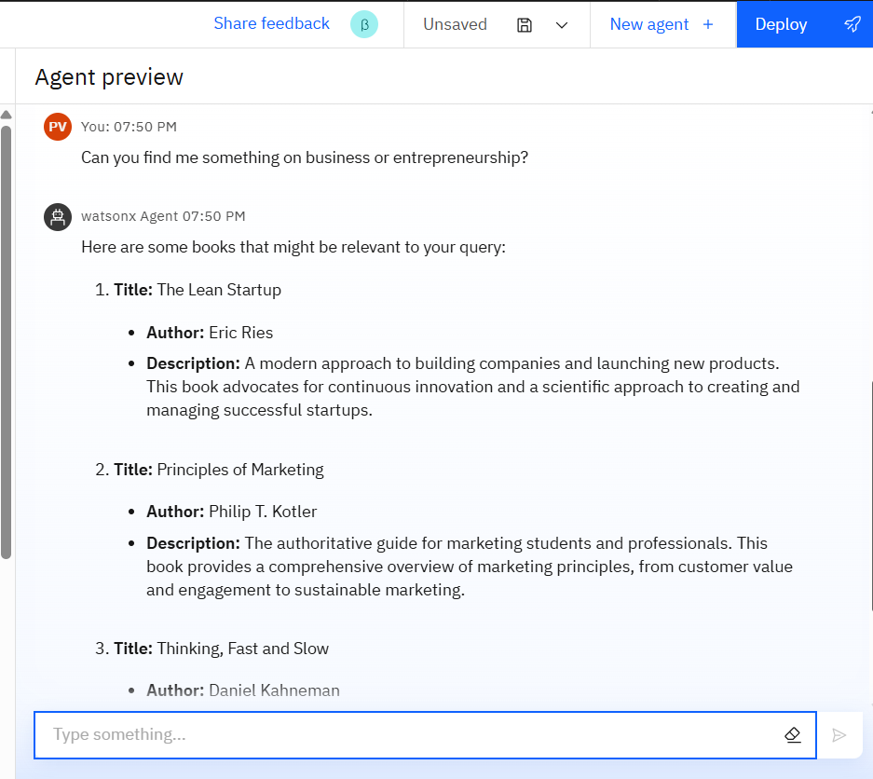
Result
Here, the agent successfully handles a broader query for 'business or entrepreneurship,' correctly identifying and recommending multiple relevant books from its knowledge base.

Slide 10
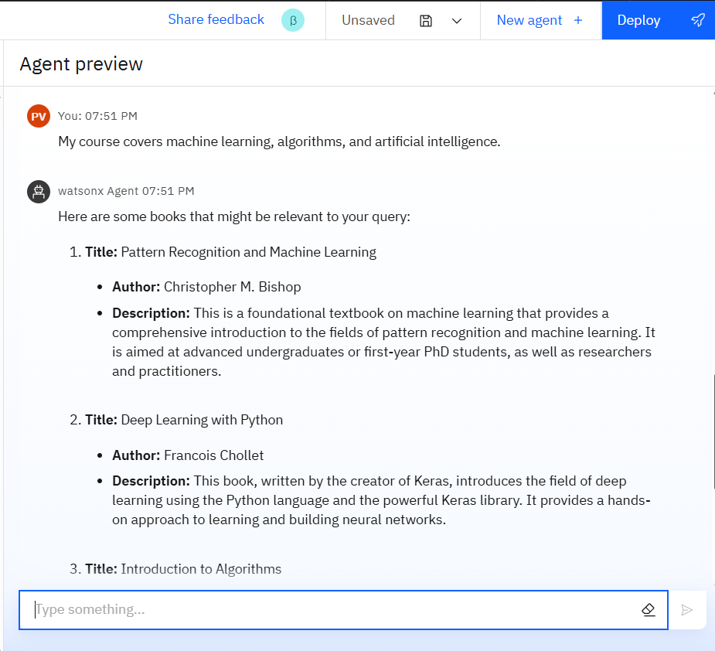
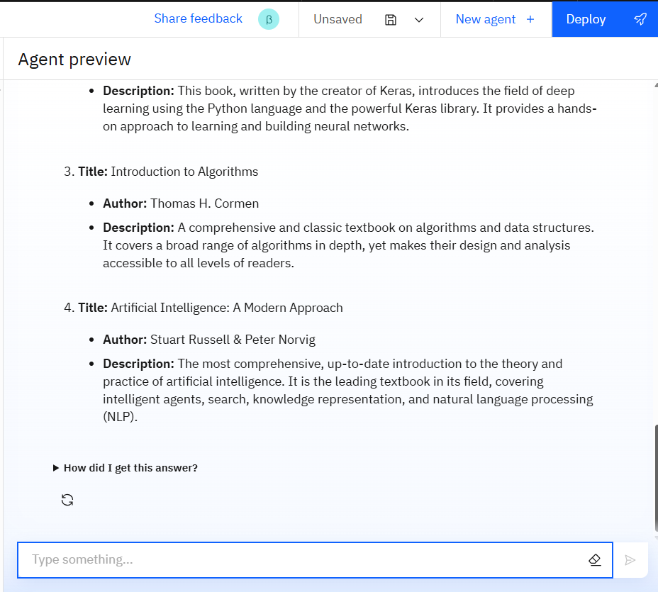
Result
The agent correctly processes a complex, syllabus-style query and recommends multiple relevant books.

Slide 11
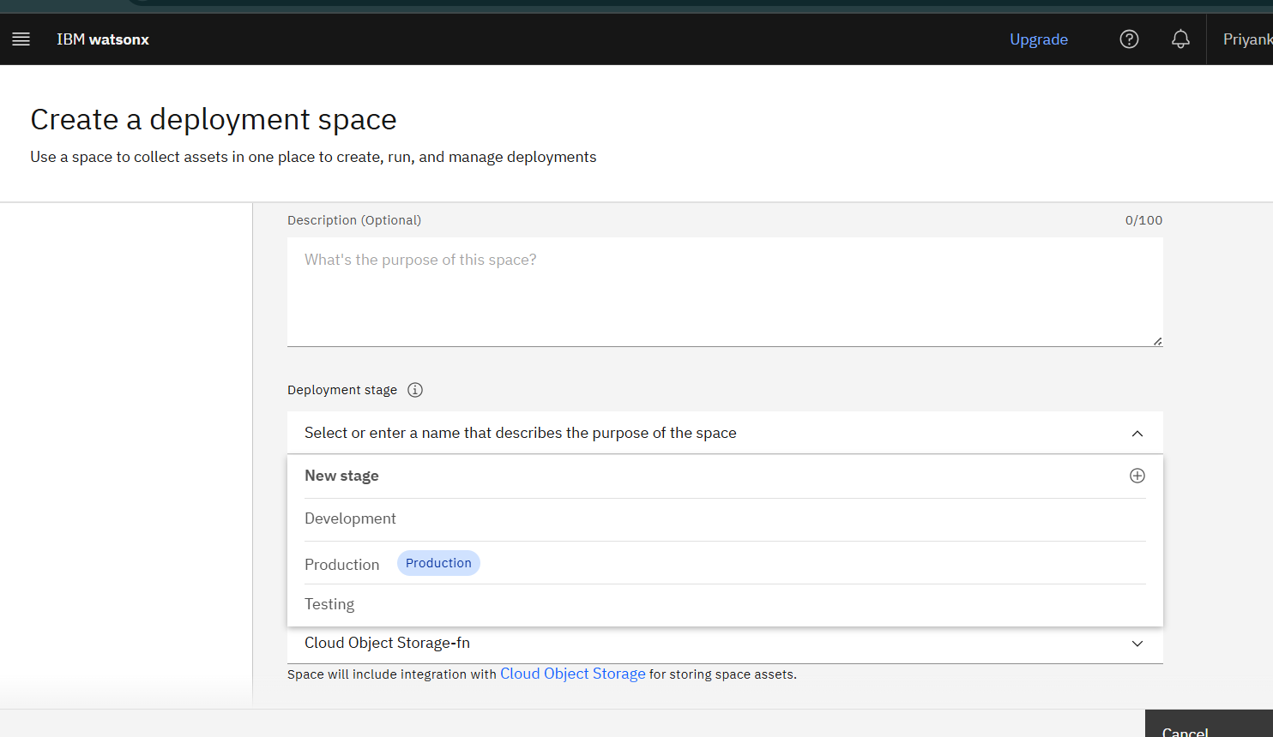
Result
Creating a new deployment space to collect assets and manage the AI agent's deployment.

Slide 12
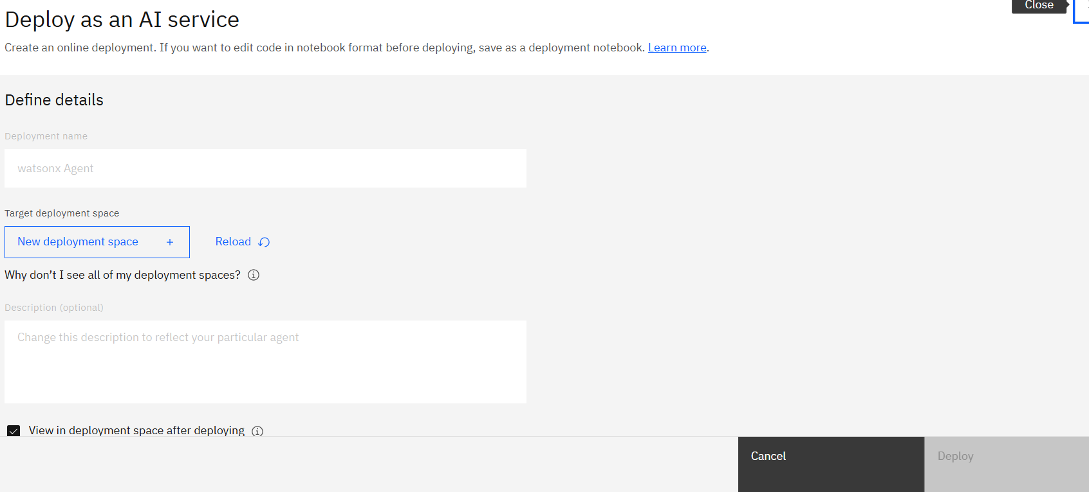
Result
Defining the final details to deploy the agent as an online AI service.

Slide 13
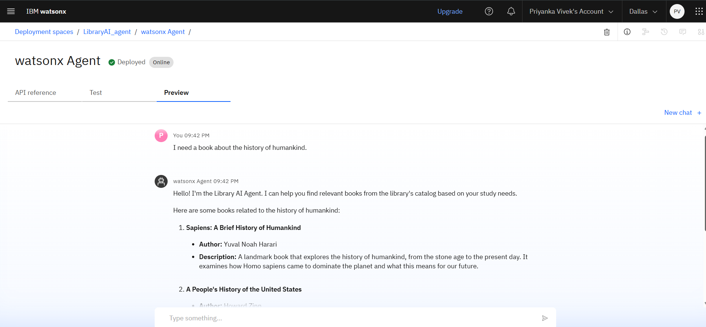
Result
The agent is now successfully deployed and providing correct responses in the live preview.

Slide 14
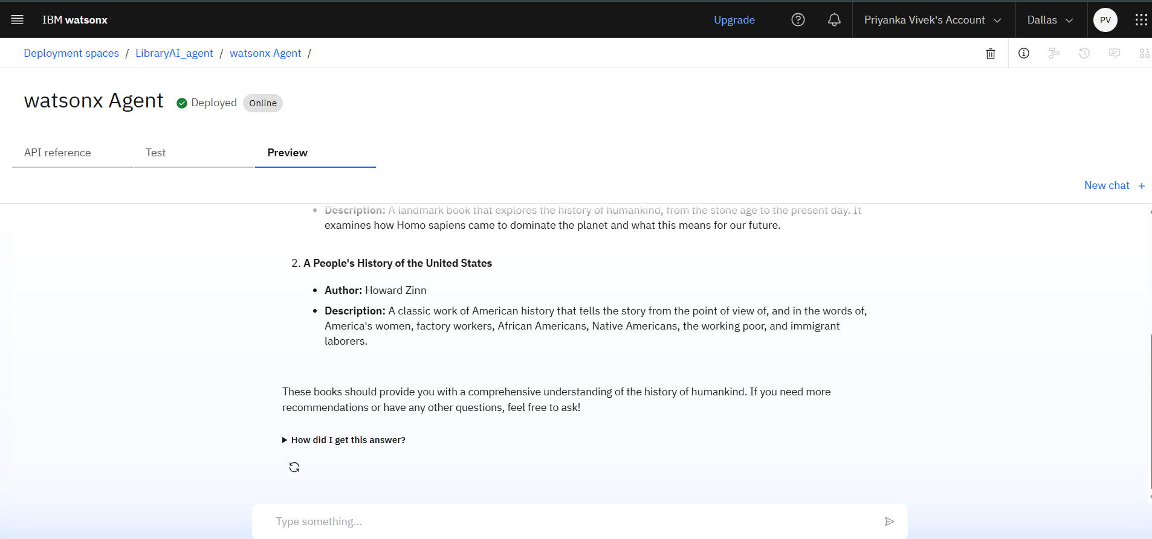
Result
The agent completes its response with a polite closing, demonstrating a well-rounded and user-friendly interaction.

Slide 15
Conclusion
Summary of Findings: The project successfully demonstrates the feasibility of a Library AI Agent built on IBM Cloud and AI technologies. The semantic matching engine proved effective at identifying relevant learning materials from a syllabus.
Effectiveness of Solution: The proposed solution directly addresses the core problem by automating the research process, saving students significant time and effort. It enhances the value of the library's collection by making it more accessible and aligned with the curriculum.
Challenges & Improvements: A key challenge was standardizing the varied formats of syllabi. Future improvements could involve more advanced parsing techniques to better structure the incoming documents.

Slide 16
Future scope
Incorporate Collaborative Filtering: Analyze borrowing patterns to suggest books that "students in your course also found useful," adding a layer of social recommendation.
Expand Data Sources: Integrate with academic journals, articles, and other online resources subscribed to by the library.
Deeper LMS Integration: Connect directly with Learning Management Systems (like Moodle, Canvas, Blackboard) to automatically pull course information and assignments.
Multi-Language Support: Extend the NLP capabilities to support syllabi and resources in multiple languages.

Slide 17
References
Documentation for IBM watsonx.ai and the Granite Model Series.
IBM Cloud Code Engine and IBM Cloud Databases official documentation.
Salton, G., Wong, A., & Yang, C. S. (1975). A vector space model for automatic indexing. Communications of the ACM, 18(11), 613-620. (Foundation of vector space models).
Ricci, F., Rokach, L., & Shapira, B. (2011). Introduction to Recommender Systems Handbook. Recommender Systems Handbook, 1-35. (Overview of recommendation system concepts).

Slide 18
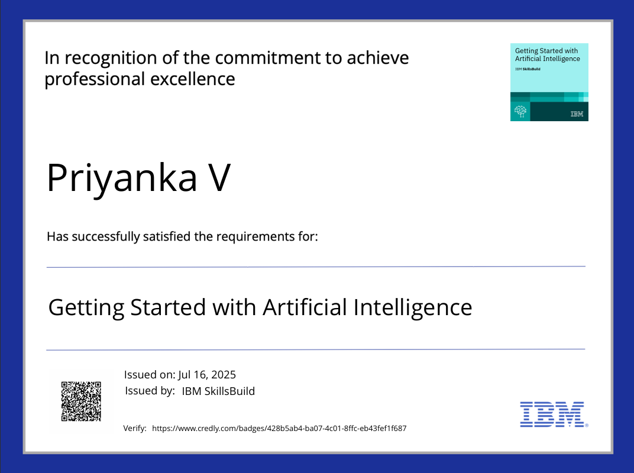
IBM Certifications

Slide 19
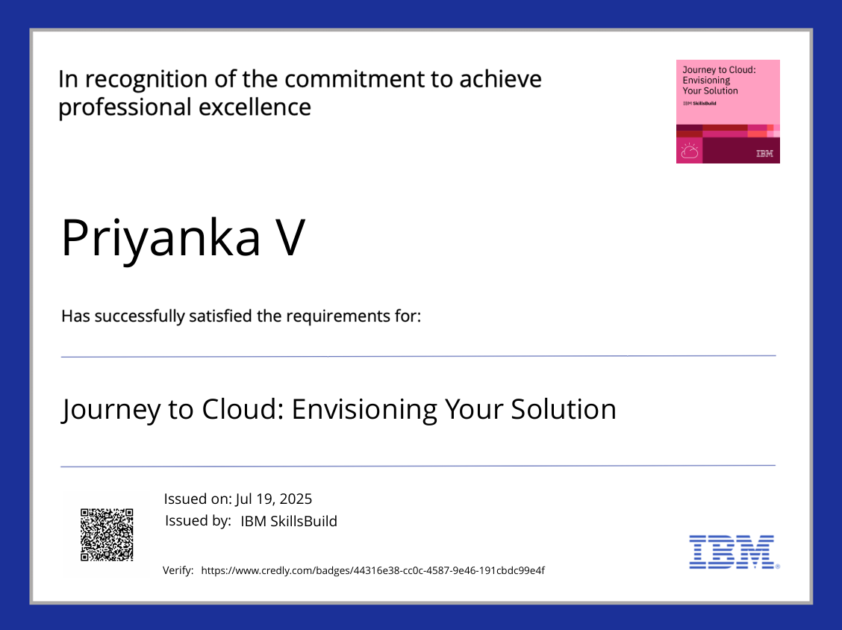
IBM Certifications

Slide 20
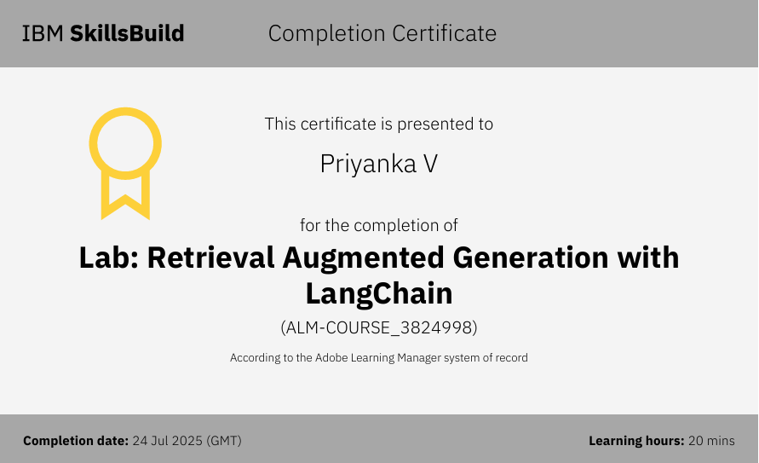
IBM Certifications

Slide 21
THANK YOU

