Slide 1
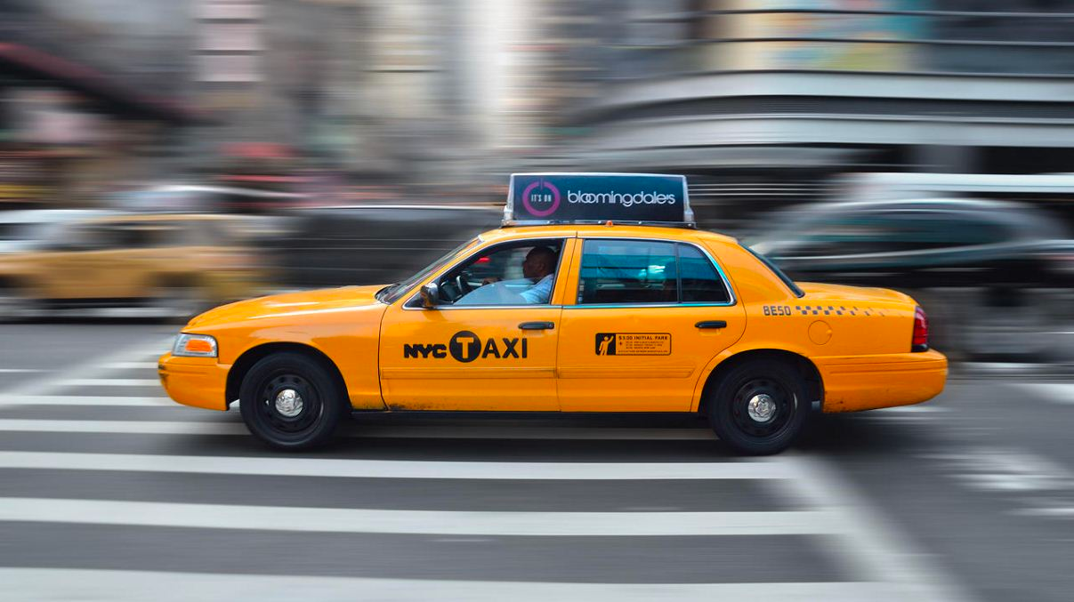
Yellow Taxi Cabs Data Analysis
Presented by:
Group2 (PN2357 ,NH2668)

Slide 2

Objectives
Overview & Problem Statement
Data Analysis
Spatial Analysis
Cost Analysis
Clustering Analysis
Recommendations & Conclusions
Limitations
Q&A

Slide 3
Overview & Problem Statement
Overview
New York City is known as the taxi capital of America and home of the classic yellow taxicab. Traditional taxi industry is facing challenges from other ride share apps in the market. So overall this analysis was carried out to identify how we can help yellow taxi cab drivers
Data for one month was considered to conduct the analysis
Problems Addressed
Overall Cost Analysis & Are yellow taxi cabs able to meet the threshold income?
How can we optimize overall fleet for taxi drivers?

Slide 4
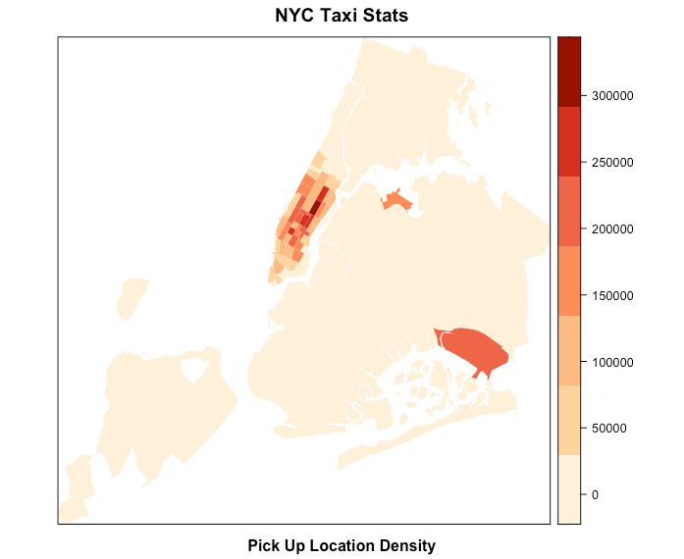
Data Analysis: Spatial Analysis
Spatial Analysis:
This approach was used in order to drive the overall NYC taxi statistics with regards to pick up location density.
Outcomes:
Main locations:
Upper East Side North
Upper East Side South
Midtown Center
Time Square /Theatre Districts
JFK/LaGuardia

Slide 5
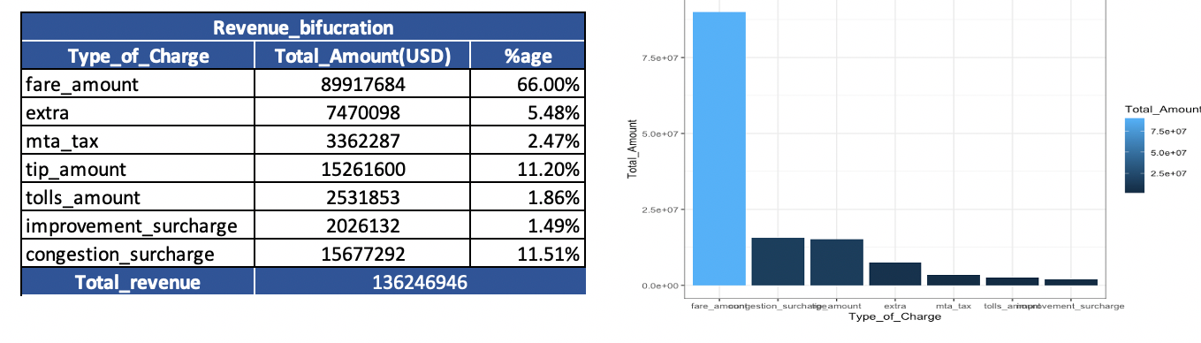
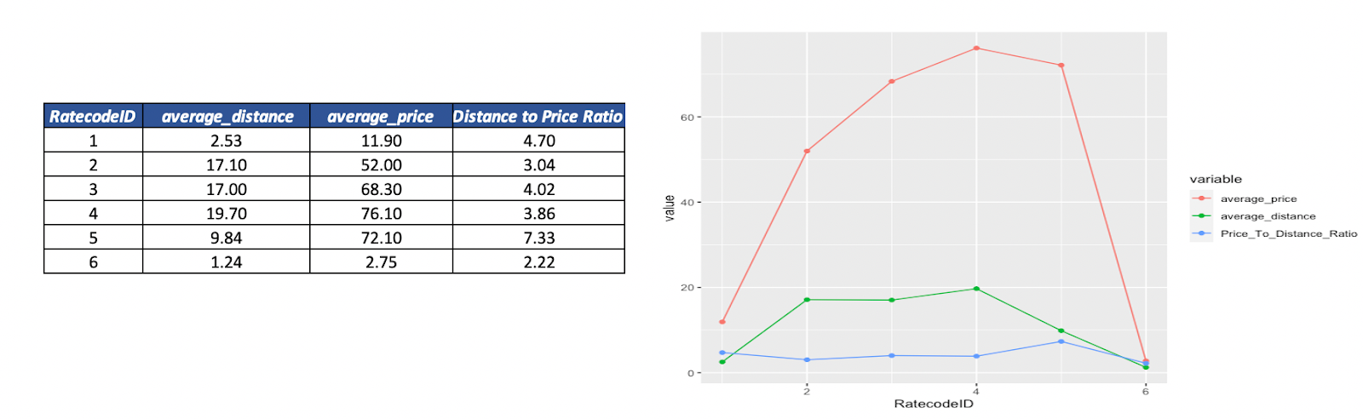
Data Analysis: Cost Analysis
Overall revenue Bifurcation
Profitable routes identified by Rate Code ID

Slide 6
Data Analysis: Cost Analysis - cont.
Details on factors used for operating costs
Variables | Count/cost
Count of Taxis | 1387
Fuel cost | 2.5(miles per galloon)
occupancy factor | 1.5
Mileage | 15
Insurance cost | 87.5(USD per month)
maintenance cost | 166.6667(USD per month)
License cost | 3000(USD per month)
Depreciation cost | 777.7778(USD per month)
Overall operational costs for a single taxi per month is 44.70%
Various operating costs are considered based on external sources
Income for a single taxi excluding all costs is approx. 29%
Cost Analysis per Taxi
Variable | Cost (in USD)
Total revenue monthly per taxi | 9832.355
Total Tolls/Taxes Monthly per taxi | 1702.935
Average tip (Only credit card/recorded ones included) | 1101.364
Monthly Revenue single Cab | 7028.057
Operational cost | 4394.667 | 44.70%
Income per taxi | 2946.238 | 29.96%
Tax Percentage | 1702.935 | 17.32%

Slide 7
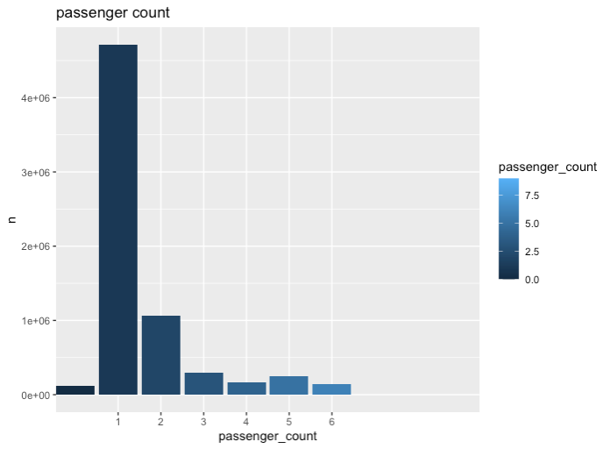
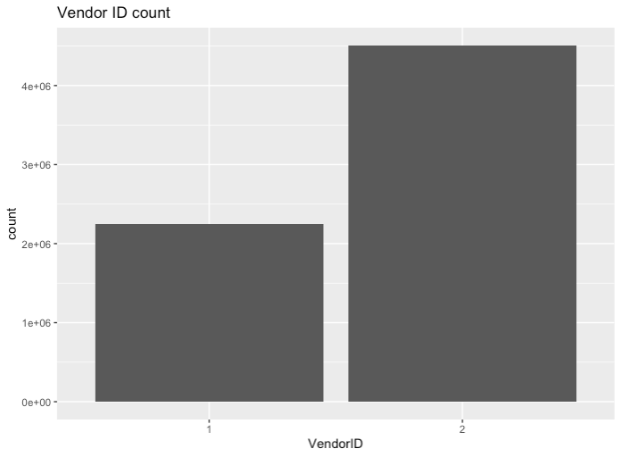
Data Analysis: Clustering Analysis
Clustering Analysis was used to segment the trips in order to further drill down data:
Majority of the trips only have one passenger.
Vendor ID 1 (boro taxi) has only half of the number of yellow cab rides due to the fleet size

Slide 8
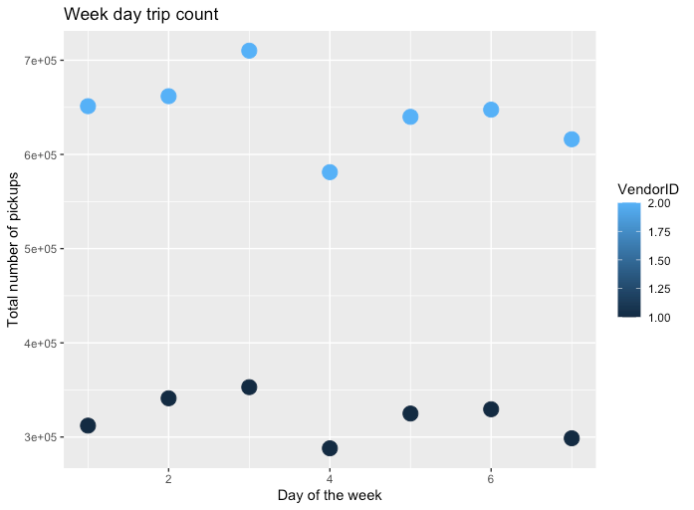
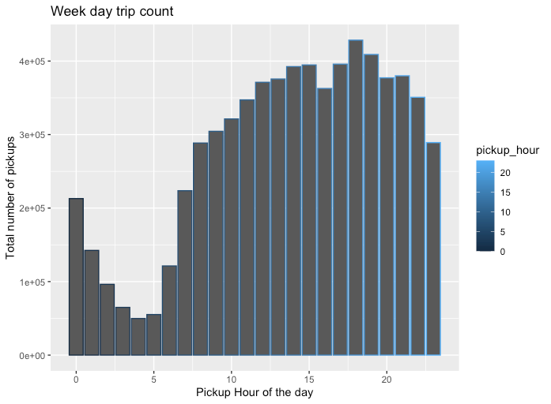
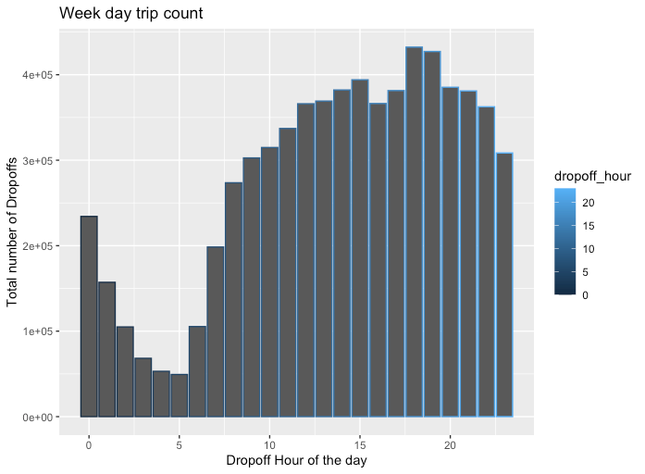
Data Analysis: Clustering Analysis-Cont.
Tuesdays turns out to be the busiest days
Evening timings around 6 PM are peak hours
h = 6 is the best fit

Slide 9
Recommendations , Conclusions & Limitations
Conclusions
Single taxi cab is only able to earn 29.96% of the overall revenue
Yellow taxi cabs are not able to even meet the lowest bracket of income of a driver’s salary
Routes with Rate code ID 5 are more profitable routes
Pickup and drop-off numbers are at peak in evening at 6pm
Recommendations
Carpool Recommended
Overlap driver’s working shifts in the evening time in order to optimize the fleet.
Cab drivers shall move to nearest of the central locations namely Upper East Side North, Upper East Side South, Midtown Center, Time Square /Theatre Districts, LaGuardia, JFK locations to fetch a pickup
For taking a break, Wednesdays as the recommended due to lowest trip numbers
Limitations
Dataset for only one month considered
With Pandemic, situation might have changed
Dataset was not clean so many observations were dropped
Variable License cost
Number of cars considered can vary on month to month based on availability

Slide 10
Reference
Source of dataset: https://www1.nyc.gov/site/tlc/about/tlc-trip-record-data.page
Majaski, C. (2020, March 07). Uber vs. Yellow Cabs in New York City: What's the Difference? Retrieved August 13, 2020, from https://www.investopedia.com/articles/personal-finance/021015/uber-versus-yellow-cabs-new-york-city.asp
Crudele, J. (2017, September 19). The challenges of driving a yellow cab in the age of Uber. Retrieved August 13, 2020, from https://nypost.com/2017/09/18/the-challenges-of-driving-a-taxi-in-the-age-of-uber/
NYC Taxi & Limousine Commision,(2013, June) "Guide to understanding the Street Hail Livery (SHL) Service Rules and Requirements
Retrieved December 18, 2013, from
https://web.archive.org/web/20180927204255/http://www.nyc.gov/html/tlc/downloads/pdf/shl_guide.pdf
*Occupancy factor: Occupancy factor is considered with the fact that every time a taxi does not have rider & they may have to commute more to pick up ride so no amount is paid for that trip
Count of Taxis : Sugar, R. (2017, January 17). Uber and Lyft cars now outnumber yellow cabs in NYC 4 to 1. Retrieved August 13, 2020, from https://ny.curbed.com/2017/1/17/14296892/yellow-taxi-nyc-uber-lyft-via-numbers
Fuel cost : New York Times. (2006, May 10). Calculate how much your gas really costs. Retrieved August 13, 2020, from https://archive.nytimes.com/www.nytimes.com/packages/html/business/20060510_LEONHARDT/cost_per_mile.html?scp=115
Mileage: Voelcker, J. (2010, July 29). Cities Want High-Mileage Hybrid Taxis; Judge Says It's Illegal. Retrieved August 13, 2020, from https://www.greencarreports.com/news/1047703_cities-want-high-mileage-hybrid-taxis-judge-says-its-illegal
Insurance cost: Reitz, J. (2016, August 03). Cost Of Owning A Car In New York State. Retrieved August 13, 2020, from https://lite987.com/cost-of-owning-a-car-in-new-york-state/
maintenance cost: NYC Taxi & Limousine Commision, (2013). The Cost Of Maintaining A Taxi Vehicle In The U.S. & The Alternative Fuel Vehicle Myth Retrieved August 13, 2020, from http://www.tlc-mag.com/archive/pre_2013_site/tlpa_jan10.html
License cost : A, H. (2019, August 27). What is a taxi medallion worth? Retrieved August 13, 2020, from https://www.cityandstateny.com/articles/personality/interviews-profiles/what-are-taxi-medallions-worth.html
Depreciation cost : Chang, S. (2020, May 18). Thinking About Getting A Car In NYC? Think Again. Retrieved August 13, 2020, from https://gothamist.com/news/thinking-about-getting-car-nyc-think-again Salaries: Salary.com, . (2020, July 27). Taxi Driver Salary in New York, NY. Retrieved August 13, 2020, from https://www.salary.com/research/salary/benchmark/taxi-driver-salary/new-york-ny Deductibles: .IRS, (2019, December 31). IRS issues standard mileage rates for 2020. Retrieved August 13, 2020, from https://www.irs.gov/newsroom/irs-issues-standard-mileage-rates-for-2020

Slide 11
THANK YOU

