Slide 1
Priyanka Kunjam
Capstone Project – University Success Analysis
_________
Data Analytics
_________

Slide 2
The Process
Data Acquisition from GitHub:
Obtain the requisite dataset from a designated GitHub repository,
Containing essential information on university ranking,
Encompassing various countries and their performance across distinct ranking system.
2. Data Transformation and Enhancement:
If necessary, execute data transformation procedures to ensure data
Quality and consistency. Additionally, consider augmenting the dataset
With new problem statement to enrich the analysis potential.
3. Connecting with Tools:
Establish connections between the dataset and various analytical tools,
Interface the dataset with Power BI, Excel, and MySQL
Workbench, facilitating seamless data integration and processing.
4. Problem statement Solution in Power BI:
Utilize Power BI to delve into the specified problem statement.
Employ its robust features for data visualization, exploration, and analysis, effectively deriving insights and solutions.

Slide 3
5. Exploratory Data Analysis (EDA):
Perform exploratory data analysis using either Excel or SQL Workbench,
Depending on the complexity of the analysis, Extract meaningful patterns, relationships, and trends the data to inform subsequent decision making .
6. Creation of Visual and Insightful power point :
Develop a comprehensive powerpoint presentation that encapsulates the projects objectives, methodologies, problem statement solutions, and key visualizations. Each problem statement should be accompanied by a
Dedicated section with pertinent conclusions and insights .
7. Detailed Documentation:
Compile a detailed report that meticulously documents the entire projects
Lifecycle, Include sections on data collections, transformation, problem
Statement formulation, tools integration, power bi solutions.

Slide 4
Objective
Providing Reliable and Comprehensive Assessment of Higher Education Institutions:
Accuracy: Ensure the ranking accurately reflects the performance and quality of higher education institutions
across various criteria, including teaching quality, research output, internationalization, student satisfaction, and employability of graduates.
Validity: Develop a robust methodology that considers diverse factors relevant to university performance,
avoiding oversimplification or bias. Validity ensures that the ranking results reflect the multifaceted nature of higher education
and provide meaningful insights to stakeholders.
Relevance: Identify and prioritize criteria that are relevant and meaningful to stakeholders, such as prospective students,
employers, policymakers, and educators. This includes considering both traditional indicators
(e.g., academic reputation, faculty-to-student ratio) and emerging metrics (e.g., innovation, social impact) that capture
the evolving landscape of higher education.
Comparability: Enable comparability by standardizing data collection and analysis methods, allowing stakeholders to
compare universities within and across regions or countries. Consistent metrics and transparent methodologies
facilitate meaningful benchmarking and decision-making.
Transparency: Promote transparency by openly disclosing the ranking methodology, criteria, and data sources used.
Clear documentation allows stakeholders to understand how rankings are determined and evaluate the credibility and reliability of the results.

Slide 5
Accessibility: Make ranking information accessible to a wide range of stakeholders through user-friendly interfaces, data visualizations, and explanatory materials. Accessibility ensures that individuals can easily access, interpret, and utilize ranking data to inform their decisions
Continuous Improvement: Commit to ongoing refinement and enhancement of the ranking methodology based on feedback, emerging trends, and best practices. Continuous improvement ensures that the ranking remains relevant, accurate, and responsive to the evolving needs and priorities of stakeholders.
Ethical Considerations: Address ethical considerations, such as fairness, equity, and integrity, throughout the ranking process.
This includes mitigating biases, safeguarding data privacy, and promoting responsible use of ranking results to minimize unintended consequences.
Impact Assessment: Evaluate the impact of the ranking on higher education institutions, students, policymakers, and other stakeholders. Understanding the consequences of ranking methodologies and results allows for informed adjustments to optimize positive outcomes
and mitigate potential drawbacks.
By striving to provide a reliable and comprehensive assessment of higher education institutions, a university ranking project aims to empower
stakeholders with valuable information to make informed decisions, foster excellence and innovation in higher education,
and contribute to the overall improvement of the sector.

Slide 6
Significance
Guidance for Prospective Students: University rankings offer guidance and assistance to prospective students in selecting institutions for their higher education. By comparing universities based on various criteria such as academic reputation, faculty quality, research output, and student satisfaction, rankings help students make informed decisions about where to pursue their studies.
Benchmarking for Universities: Rankings serve as a benchmarking tool for universities, allowing them to assess their performance relative to peers both domestically and internationally. This comparative analysis helps institutions identify areas of strength and areas for improvement, thereby fostering a culture of excellence and continuous enhancement.
Quality Assurance and Accountability: University rankings contribute to quality assurance and accountability within the higher education sector. Institutions strive to maintain or improve their ranking positions, which incentivizes them to enhance teaching quality, research productivity, student support services, and overall institutional effectiveness. This focus on performance measurement fosters accountability to students, faculty, funders, and policymakers.
Informing Policy and Funding Decisions: Policymakers and funding agencies often refer to university rankings when making decisions about resource allocation, policy formulation, and strategic investments in higher education. Rankings provide policymakers with insights into the relative strengths and weaknesses of institutions, helping them identify priorities and allocate resources effectively to support academic excellence, research innovation, and student success.

Slide 7
Enhancing Global Visibility and Reputation: High rankings can significantly enhance a university's global visibility, reputation, and attractiveness to prospective students, faculty, and collaborators. A strong ranking position signals excellence and competitiveness, which can lead to increased international partnerships, research collaborations, student enrollments, and funding opportunities.
Facilitating Internationalization and Collaboration: University rankings facilitate internationalization efforts by promoting collaboration and exchange between institutions across borders. Institutions with high rankings are often sought after as partners for joint research projects, student exchange programs, and academic collaborations, fostering cross-cultural understanding and knowledge exchange.
Promoting Innovation and Excellence: Rankings encourage universities to innovate and excel in various aspects of their operations, including teaching, research, community engagement, and knowledge transfer. Institutions strive to differentiate themselves through distinctive strengths and achievements, driving innovation, entrepreneurship, and societal impact.
Providing Data for Research and Analysis: University rankings generate valuable data sets that researchers and analysts can use to study trends, patterns, and dynamics within the higher education landscape. Researchers leverage ranking data to conduct empirical studies, evaluate policy interventions, and explore the relationship between institutional characteristics and performance outcomes.
Overall, university rankings play a significant role in shaping the higher education landscape by informing decision-making, fostering excellence and accountability, promoting international collaboration, and driving continuous improvement across institutions. However, it's important to interpret rankings with caution, considering their limitations and potential biases, and to use them as one of several sources of information when evaluating universities.

Slide 8
Data Dictionary
Table : Country
Field :
Country_Id : Unique identifier for each country.
Country_Name : Name of the country.
Table : University
Field :
Country_Id : Foreign key referencing the country_id field in the country table.
University_Id : Unique identifier for each university.
University_Name : Name of the university.
Table : Ranking_System
Field :
Ranking_System_Id : Unique identifier for each ranking system.
Ranking_System_Name : Name of the ranking system.
Table : Ranking_Criteria
Field :
Ranking_Criteria_Id : Unique identifier for each ranking criteria.
Ranking_Criteria_Name : Name of the ranking criteria.
Ranking_System_Id : Foreign key referencing the ranking_system_id field in the ranking system table.

Slide 9
Table : University_Year
Field :
University_year_Id : Unique identifier for each university year.
University_Id : Foreign key referencing the university_if field in the university table.
Num_Student : Number of students in the university for a specific year.
Female_Population : Population of female students in the university for a specific year.
International_population : Population of international students in the university for a specific year.
Student_Staff_Ratio : Ratio of students to staff member in the university for a specific year.
Table : University_Ranking_Year
Field :
University_Ranking_Year_Id : Unique Identifier for each university ranking year.
Ranking_Criteria_Id : Foreign key referencing the ranking_criteria_id field in the ranking criteria table.
University_Id : Foreign key referencing the university_id field in the university table.
Score : Score of the university for a specific ranking criteria and year.
Year : Year of scoring for the university.
The data dictionary provide a comprehensive overview of the table and their respective fields in the dataset.
It outlines the relationships between the tables, allowing for a better understanding of the data structure and facilitating the design and implementation of the POWER BI Dashboard.

Slide 10
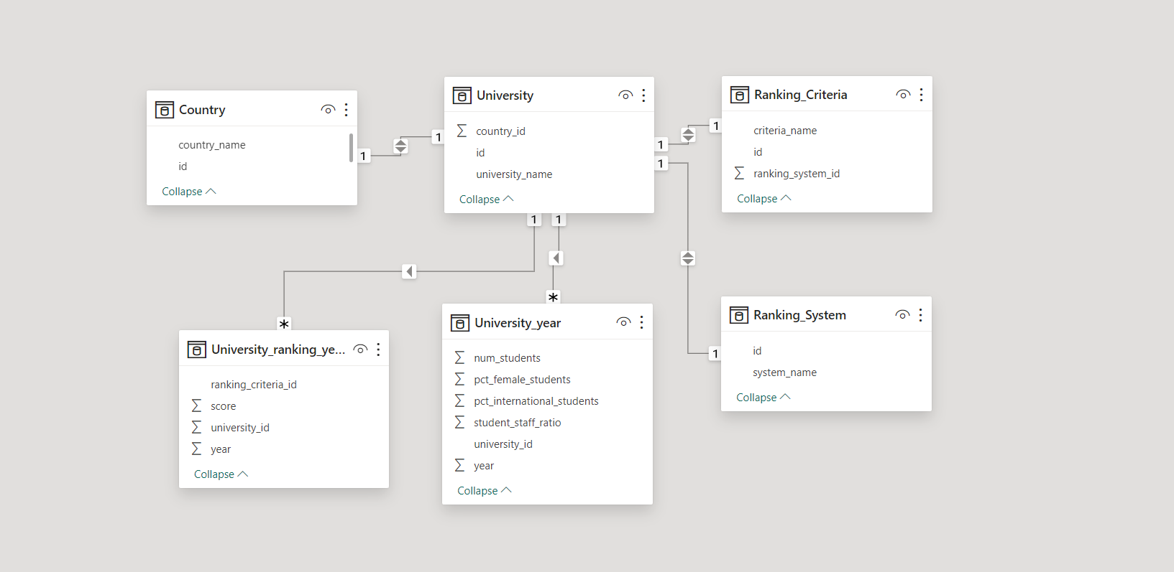
ER Diagram

Slide 11
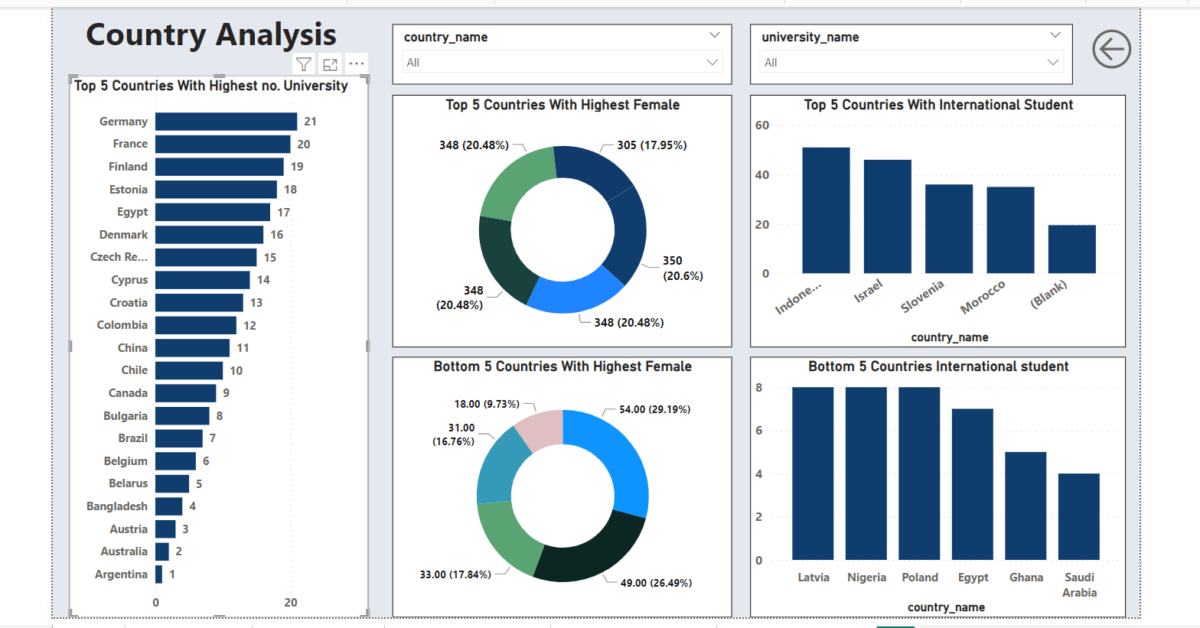
Power BI Report

Slide 12
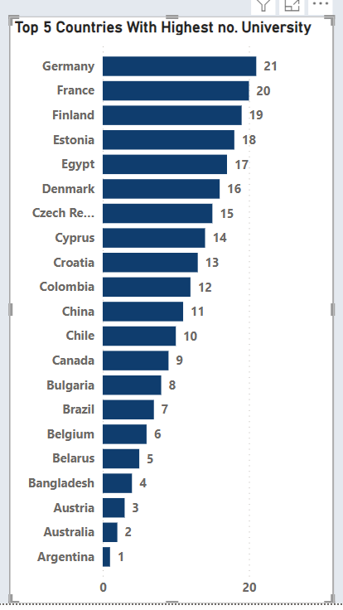
How many universities are there in each country .
Analyzing the number of universities in each country offers valuable insightsinto
The global higher education landscape. By examining the data from the country Report, we can identify the nations with highest and lowest counts of universities.
Countries like the united states, Germany, and France have a significant number Of universities, reflecting their strong investment in education and research.
On the other hand, countries such as Australia, the Argentina and Austria have a comparatively lower count of universities.

Slide 13
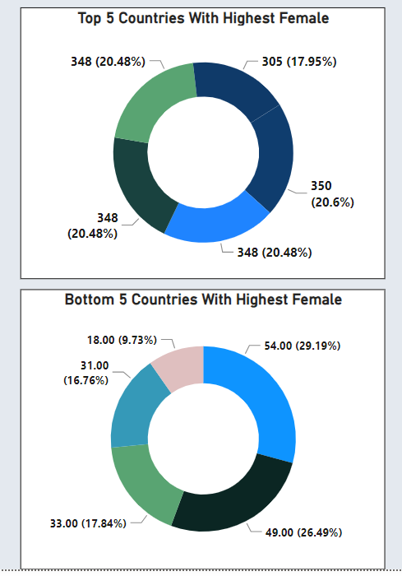
2.Which country has the highest number of female students enrolled in universities?
Investigating the enrollment of female students across different countries sheds light on gender diversity and educational access. The data reveals leading countries .
Enhancing data accuracy and availability is crucial to further explore the challenges faced by female students in education. Policymakers can utilize these insights to formulate strategies that promote equitable access to education and empower women to pursue higher studies, ultimately contributing to socioeconomic development and inclusive growth.

Slide 14
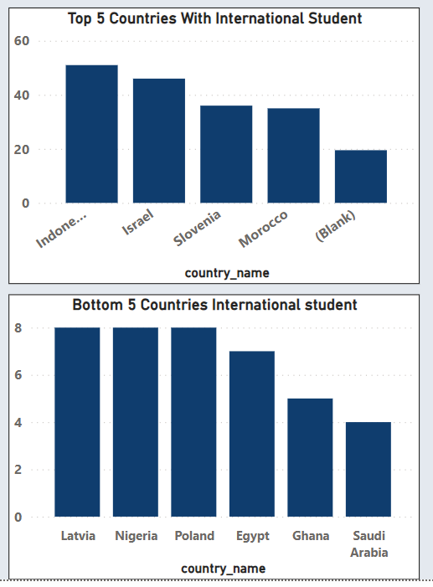
What is the distribution of international students across different countries?
Analyzing the distributions of international students across countries provide insights into global educational
Mobility trends. Countries like that indone, Israel, Slovenia, Morocco are popular destinations for international students due to their diverse academic offerings and welcoming environment. In contrast, finland, Russia, and Italy attract fewer international students, possibly due to language barriers or limited program offerings. This analysis helps educational institutions understand their global appeal and tailor strategies to attract and retain international students. By enhancing data collection and sharing, universities can collaborate to improve their internationalization efforts, faster cultural exchange, and create a vibrant global learning community.

Slide 15
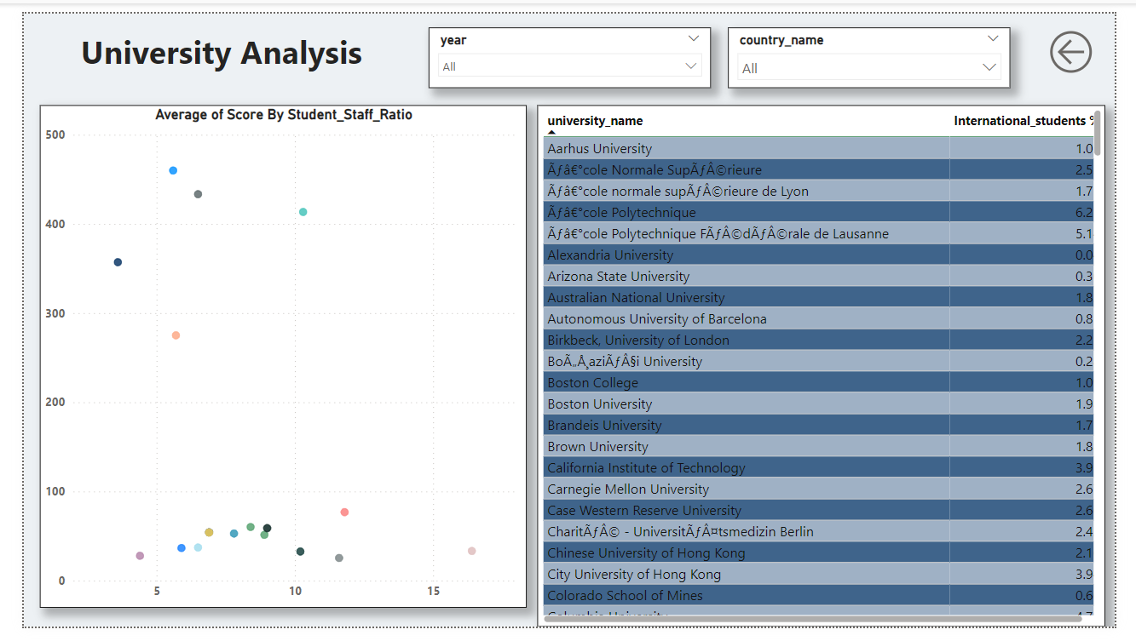

Slide 16
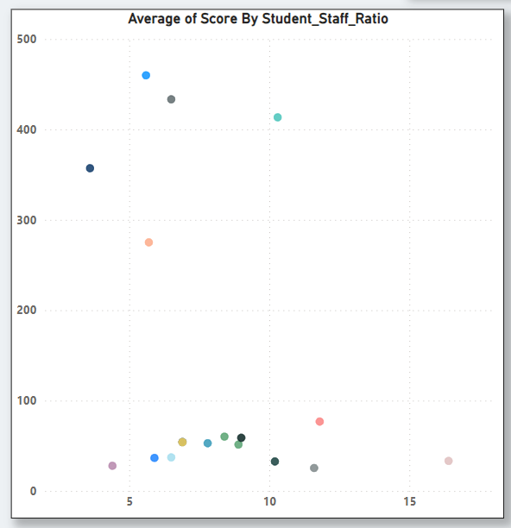
Is there a correlation between a university ranking and its student-staff-ratio?
Exploring the correlation between a university ranking and its student-staff-ratio unveils insights into institutional performance metrics. While the data may not immediately reveal a direct correlation, a deeper analysis can illuminate factors influencing this relationship. Universities with lower student-staff-ratios might prioritize personalized education and individual attention, impacting student satisfaction and potentially leading to improved rankings over time. conversely, institutions emphasizing research output or specialized program may have higher student-staff-ratio without adversely affecting their rankings. By comprehensively examining this correlation, institutions can optimize resource allocation, improve teaching quality, and enhance student experiences, all of which contribute to improved institutional rankings.

Slide 17
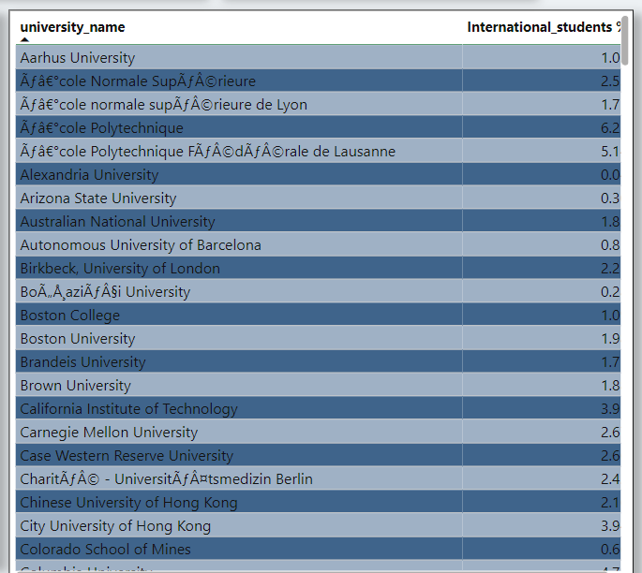
How does the percentage of international students very across different universties?
The Creation of a table showcasing the percentage of international students for each university allows for a comprehensive examination of global educational diversity. By using slicers and interactive visuals, stakeholders can analyze how the percentage of international students fluctuates across diverse institution. This analysis is pivotal for understanding patterns and trends in international student enrollment.

Slide 18
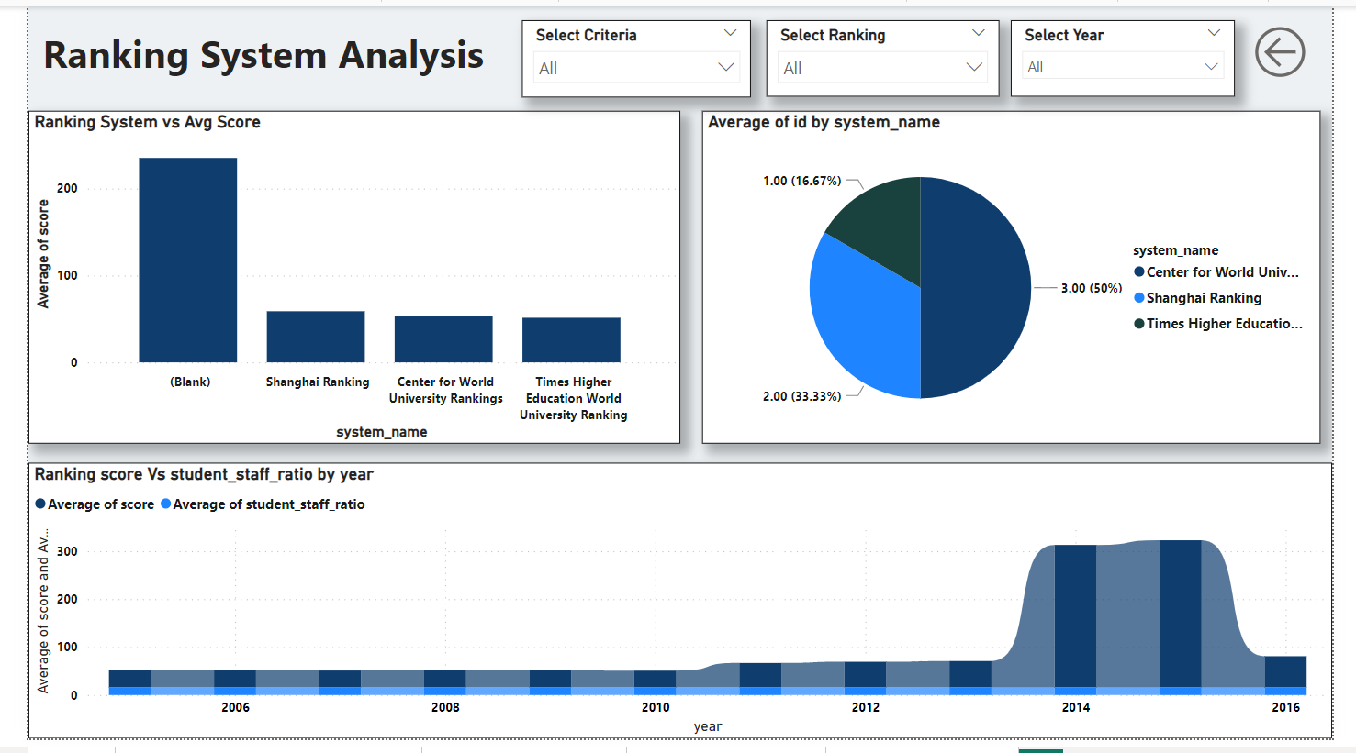

Slide 19
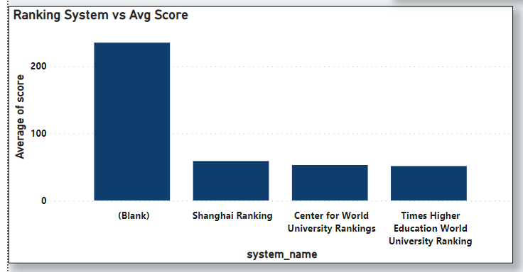
What is the average score for each ranking system?
Visual representation of the average scores for different ranking systems furnishes a comprehensive overview of how universities perform under varying criteria. This insight enables institutions to assess their strengths and weakness relative to each ranking systems evaluation metrics. Higher average scores suggest alignment with specific criteria such as research output, facility quality, or internationalization efforts. Conversely, lower average scores might indicate areas for improvement.

Slide 20
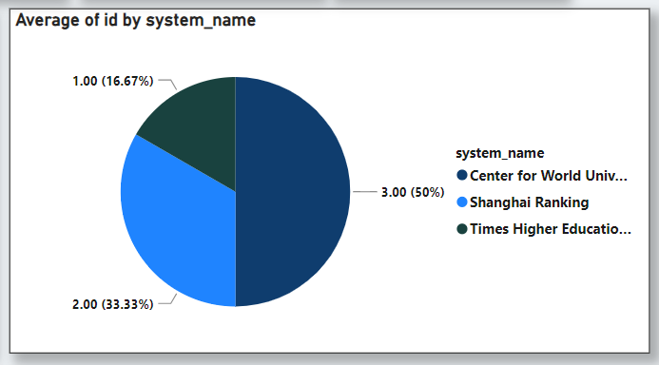
How many universities are ranked by each ranking system?
The pie chart offers a visual representation of the distribution of universities among different ranking systems. This visual insight highlights the influence and recognition specific ranking system hold within the higher education community. Once you specify the ranking systems you're interested in, I can provide information on how many universities are typically ranked by each system. Then, we can proceed to analyze the data and draw conclusions

Slide 21
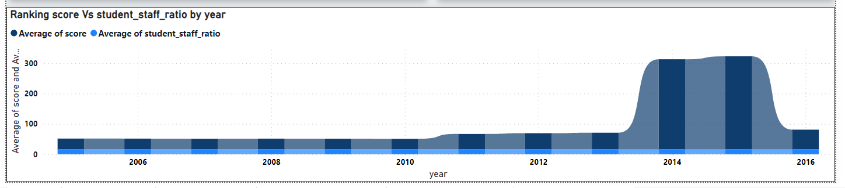
What is the correlation between the average score and the students-staff ratio for universities for each ranking system?
The correlation coefficient will provide insight into whether there's a relationship between the average score and the student-to-staff ratio for universities within each ranking system and the direction and strength of that relationship.
If you have access to the data for each ranking system, I can guide you through the process of calculating the correlation coefficient using Python or provide further assistance.

Slide 22
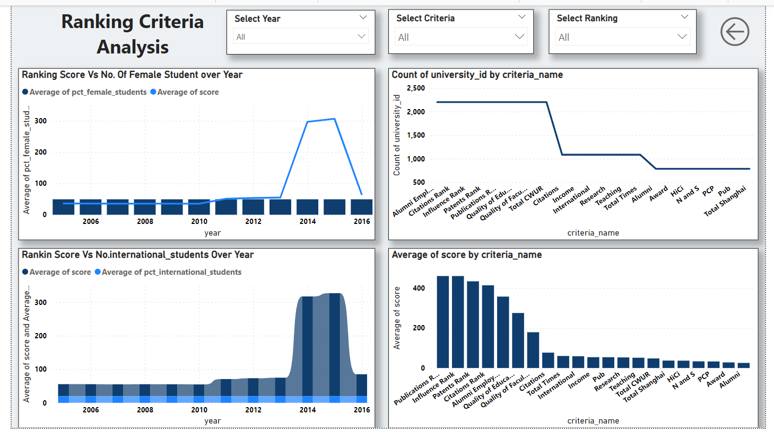

Slide 23
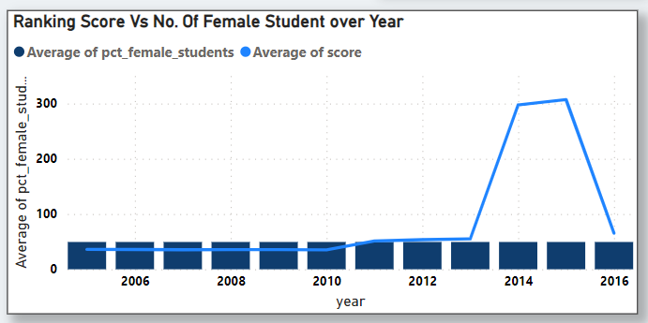
How does the percentage of female students impact a university ranking?
The indicate relationship between the percentage of female students and a university ranking unfolds through visual analysis. This examination provide valuable insights into gender diversity within higher education institution and its potential influence on institutional reputation . Universities with higher percentage of female students might prioritize gender equality, inclusive policies, and diverse academic offerings.

Slide 24
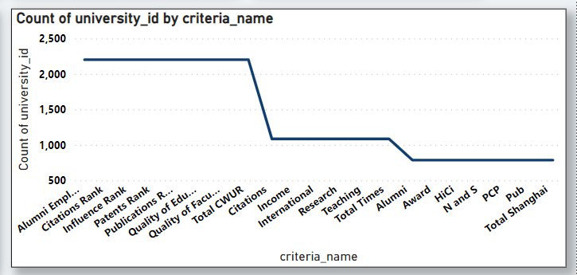
What are the most important criteria considered by ranking system?
A meticulous analysis of the visual representation underscores the paramount significance of specific criteria in shaping a university ranking. Alumni employment, citation rank, and influence rank emerge as pivotal factors influencing institutional performance . Institutions excelling in these criteria tend to have a strong focus on graduate outcomes, research impact and societal contribution.

Slide 25
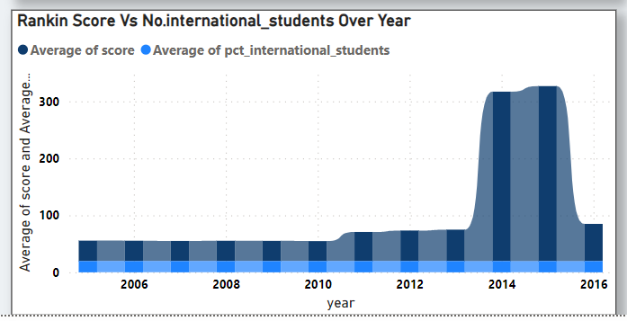
Is there a correlation between a university score and the number of international students?
Through a comprehensive visual analysis, the potential correlation between a university average score and the number of international students becomes apparent. This insights unveils a potential interplay between academic excellence and the institution global appeal. A positive correlation could signify that universities excelling academically also tend to attract a higher number of international might posses resource, reputation, and program that attract a diverse and talented student body.

Slide 26
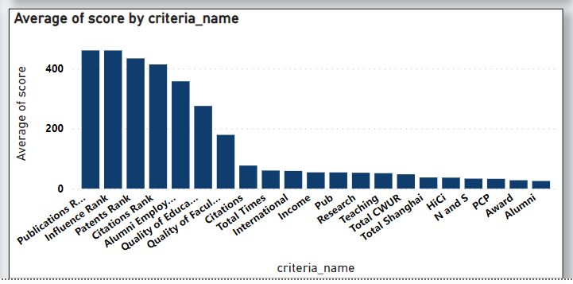
What is the average scorer for each criteria of the ranking system?
The visual representation provides a nuanced understanding of the average scores for different criteria within the system. Interestingly, publications ranking emerges with the highest average ranking among all criteria, underscoring its significance in evaluating institutional excellence, publications ranking speaks to the university research output, visibility, and impact within the academic community.

Slide 27
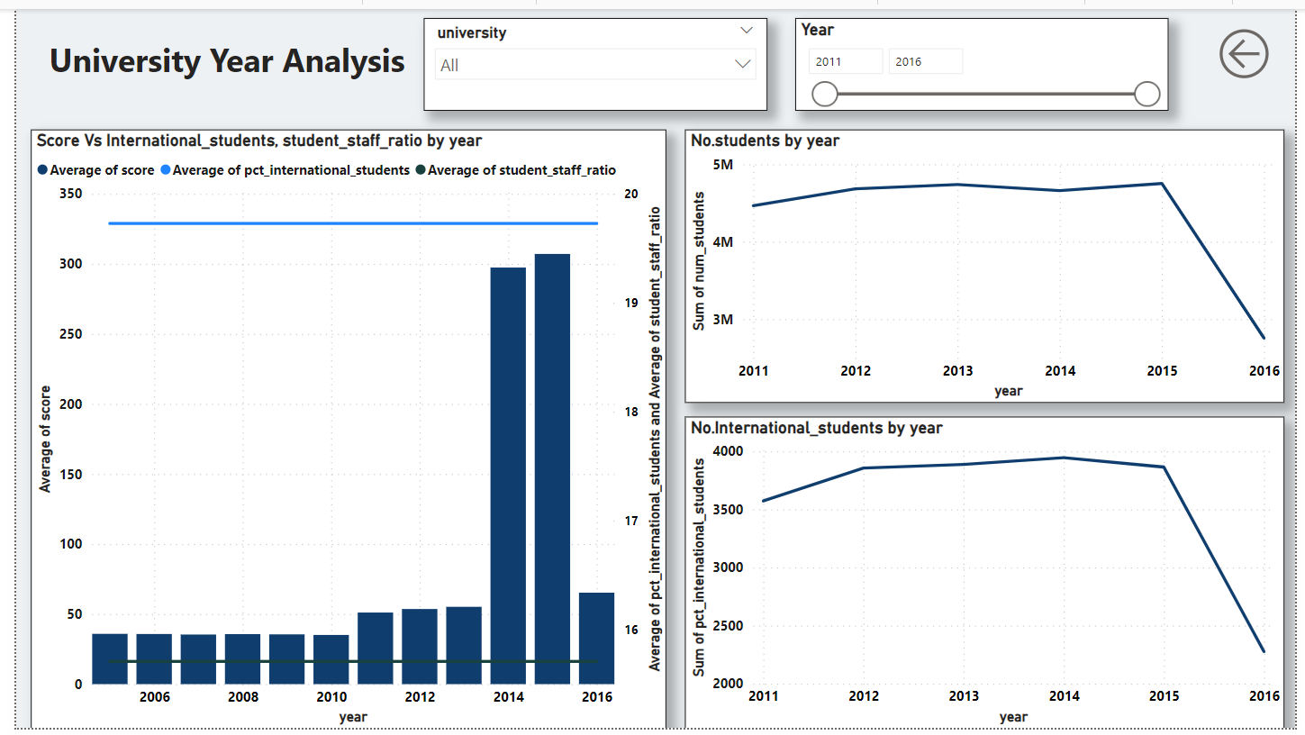

Slide 28
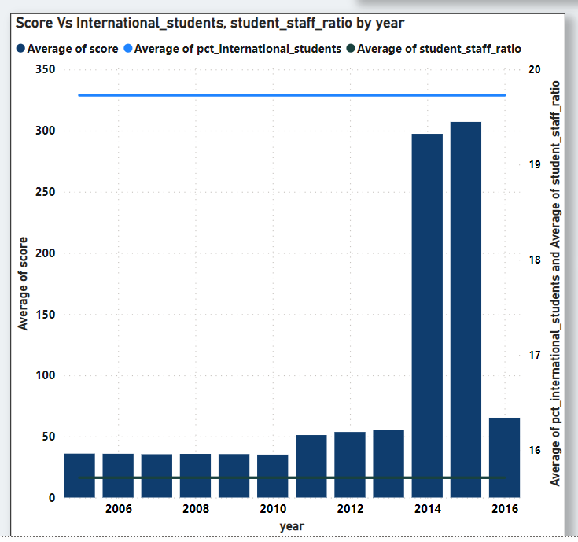
The dual-axis visual representation thoughtfully capture the relationship between a university average score and its average number of international students, along with the average student-staff-ratio over time. The in-depth analysis reveals potential trends and interactions between these vital metrics.

Slide 29
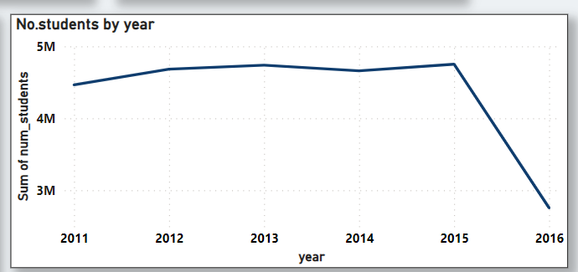
How does the number of students in universities change over time ?
A discernible drop in the number of students between the years 2015 and 2016 us evident from the visual representation. This temporal trend could be attributed to various factors, including shifts in enrollment patterns, changes in societal demographics, or alterations in institutional offerings.

Slide 30
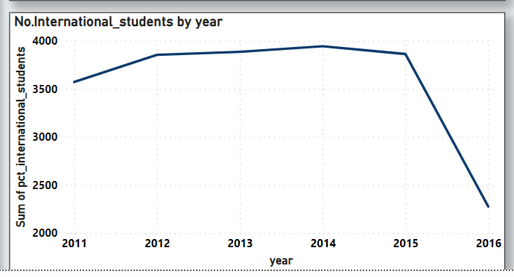
A notable decrease in the number of international students between 2015 and 2016 is apparent from the visual representation. This phenomenon could be indicative of global trends, external factors, or changes in immigration policies that impacted international student mobility during that period . To delve deeper into this decline, a comprehensive analysis is required.

