Slide 1
Captones Project – Demographic analysis

Slide 2
Introduction
Demographic analysis is the process of collecting and studying information about the general traits of a group of people. It is the study of a group based on age, race, and gender. This report presents statistical data on employment, education, income, rates of marriage, rates of birth and mortality, and other socioeconomic indicators.
The population estimates from demographic analysis don’t depend on the decennial census. The results are used to estimate the net coverage error, which is the precent difference between the number of people counted in the census and the number of people estimate by the DA.

Slide 3
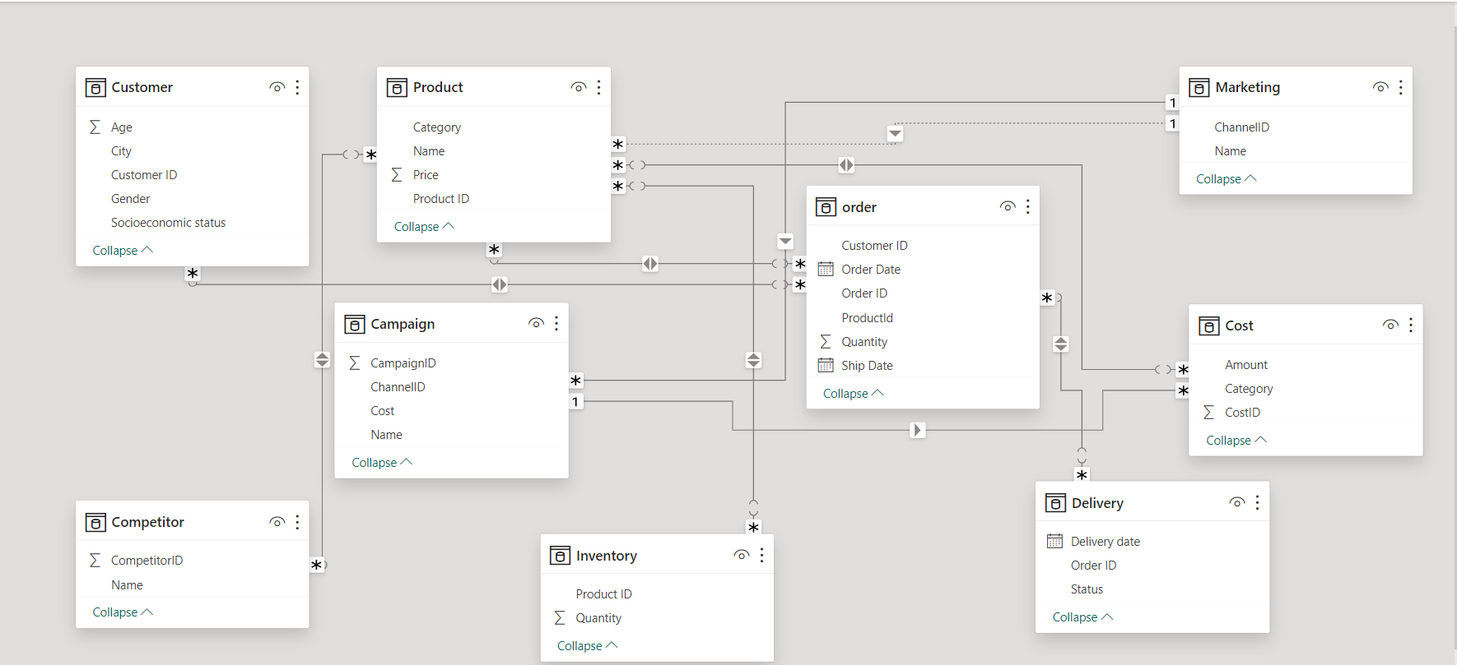
ER DIAGRAM

Slide 4
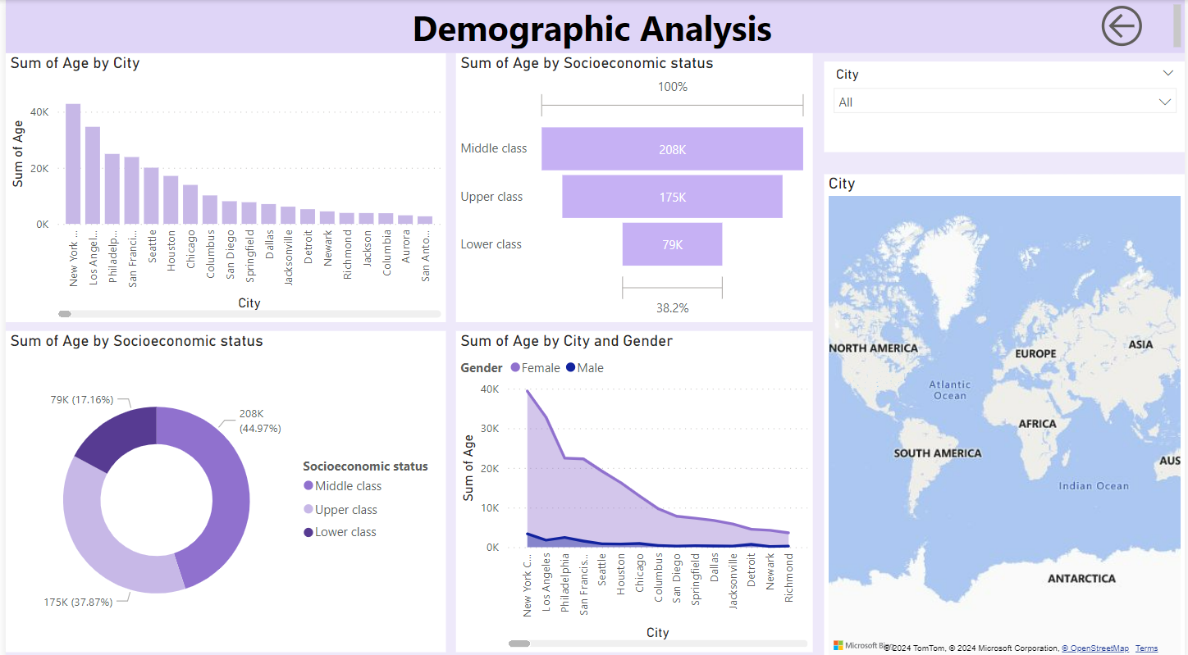

Slide 5
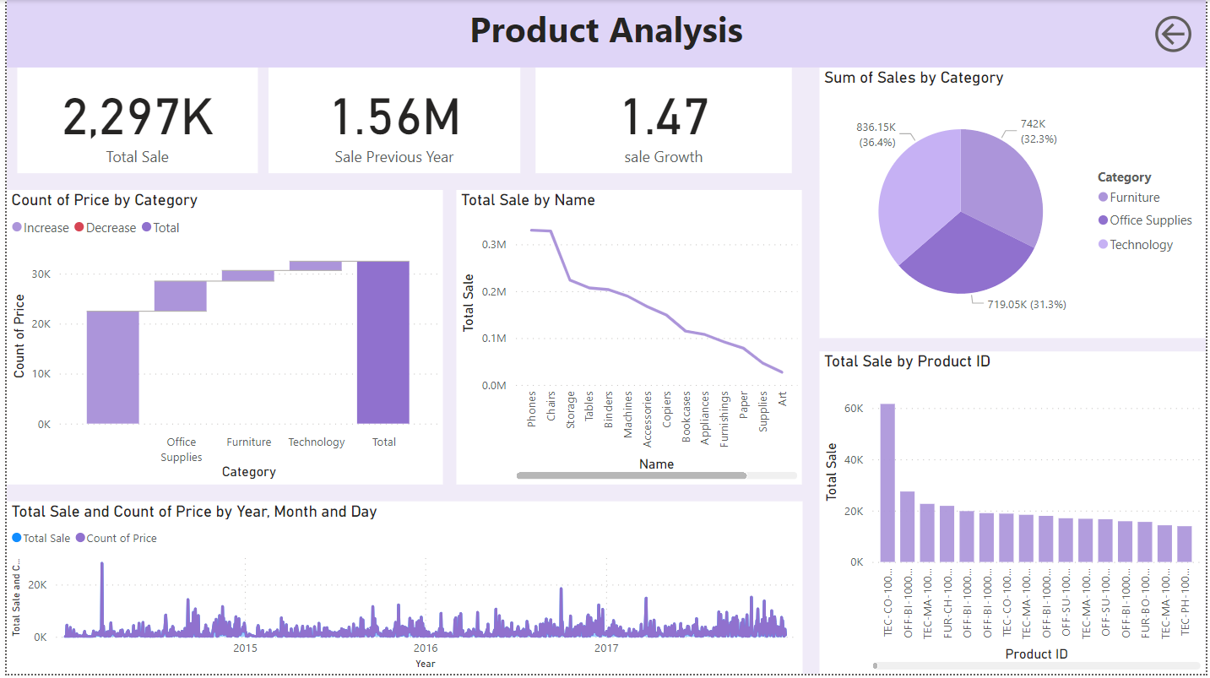

Slide 6
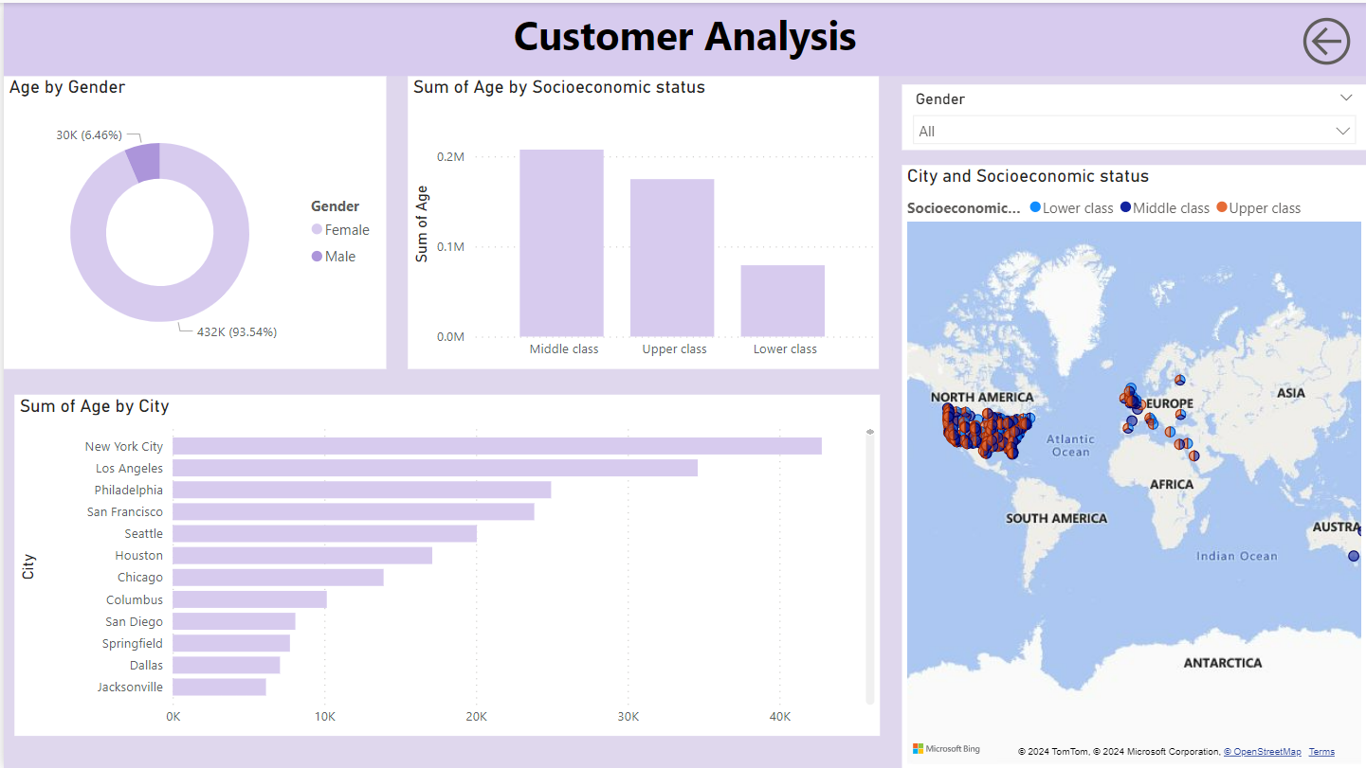

Slide 7
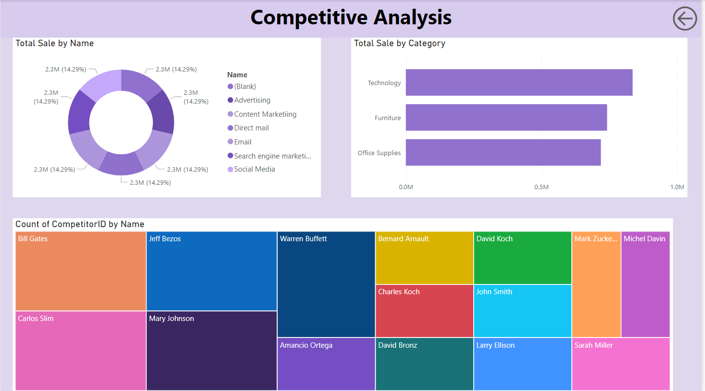

Slide 8
