Slide 1
100 Days code challenge
DAY 2
NAME: PRIYANKA GUPTA
REG NO.: 22MCA10082

Slide 2
PROBLEM
Given an array of integers nums which is sorted in ascending order, and an integer target, write a function to search target in nums. If target exists, then return its index. Otherwise, return -1.
You must write an algorithm with O(log n) runtime complexity.
Example 1:
Input: nums = [-1,0,3,5,9,12], target = 9 Output: 4 Explanation: 9 exists in nums and its index is 4
Link : https://leetcode.com/problems/binary-search/

Slide 3
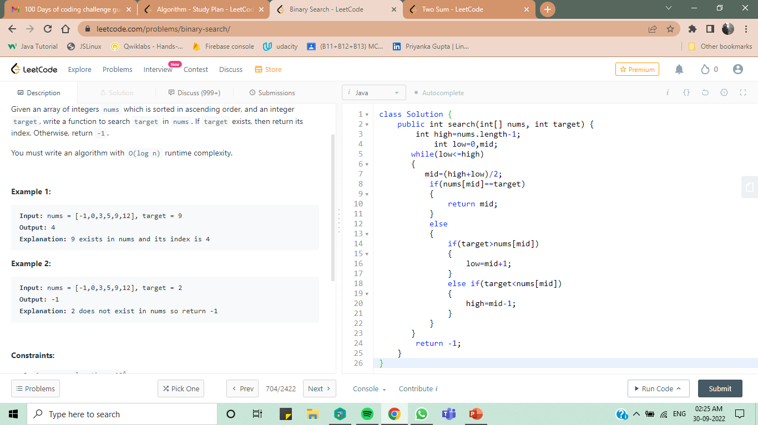
SOLUTION

Slide 4
LEARNING
In this problem we have taken an array of integers and searched for a target element given by the user.
We have divided the array into two parts and checked whether our target is equal to mid element.
If not we will change the high and low of our array and again have the mid element and will check if it is equal to the target.
Once we find the element we will return the index of the element.
If the element is not present we will return -1

Slide 5
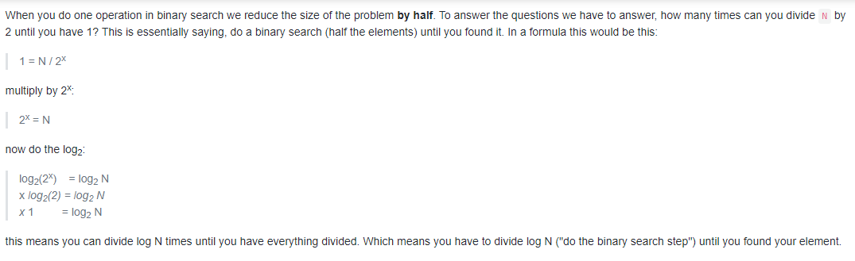
SOME INTERVIEW QUESTIONS RELATED TO BINARY SEARCH
Explain why complexity of Binary Search is O(log n)?

Slide 6
Recursive and Iterative Binary Search: Which one is more efficient and why?
Focusing on space complexity:
The iterative approach is more efficient since we are allocating a constant amount O(1) of space for the function call and constant space for variable allocations.
There have been concerns around the recursive version regarding the function stack it is going to use. However, once you see it carefully, the recursive version is a tail recursion. Most of the modern compiler converts the tail recursion into iterative program. Thus, there won't be any issue regarding the usage of the function stack.
With regard to time complexity, recursive and iterative methods both will give you O(log n) time complexity, with regard to input size, provided you implement correct binary search logic.

Slide 7

Compare Binary Search vs Linear Search
Binary search requires the input data to be sorted; linear search doesn’t
Binary search requires an ordering comparison (like >, <); linear search only requires equality comparisons (=)
Binary search has complexity O(log n); linear search has complexity O(n)
Binary search requires random access to the data; linear search only requires sequential access

