Slide 1
Fundamentals For Interviews
Day 1
Name: Priyanka Gupta
Reg no.: 22MCA10082

Slide 2
JAVA(Basic level)
1. What is Java?
Java is a high-level programming language. Java is a platform independent programming language.
It is different from other programming languages like C and C++ which needs a platform to be executed. Java comes with its platform on which its code is executed.
IF ASKED A COUNTER QUESTION ABOUT WHAT IS PLATFORM DEPENDENT AND PLATFORM INDEPENDENT.
Platform Dependent: It means the same as "hardware dependent" or "machine dependent" and refers to applications that run in only one hardware series with the operating system not being relevant.
In contrast, "platform independent" means that the application can run in different operating environments.

Slide 3
2. How does Java enable high performance?
Java uses Just In Time compiler to enable high performance. It is used to convert the instructions into bytecodes.
3. What is Just In Time Compiler?
The Just-In-Time (JIT) compiler is an essential part of the JRE i.e. Java Runtime Environment, that is responsible for performance optimization of java based applications at run time.
The compiler is one of the key aspects in deciding the performance of an application for both parties i.e. the end-user and the application developer.
4. What are the features of JAVA?
Features of Java are
OOP concepts
Object-oriented
Inheritance
Encapsulation
Polymorphism
Abstraction
Platform independent:
High Performance:
Multi-threaded: A flow of execution is known as a Thread. JVM creates a thread which is called the main thread. The user can create multiple threads by extending the thread class or by implementing the Runnable interface.

Slide 4
DATA STRUCTURE(Basic level)
1. What is data-structure?
Data structure is a way of defining, storing & retrieving of data in a structural & systematic way. A data structure may contain different type of data items.
2. What are various data-structures available?
Data structure availability may vary by programming languages. Commonly available data structures are list, arrays, stack, queues, graph, tree etc.
3. What is algorithm?
Algorithm is a step by step procedure, which defines a set of instructions to be executed in certain order to get the desired output.
4. Why we need to do algorithm analysis?
A problem can be solved in more than one ways. So, many solution algorithms can be derived for a given problem. We analyze available algorithms to find and implement the best suitable algorithm
5. What are the criteria of algorithm analysis?
An algorithm are generally analyzed on two factors − time and space. That is, how much execution time and how much extra space required by the algorithm.

Slide 5
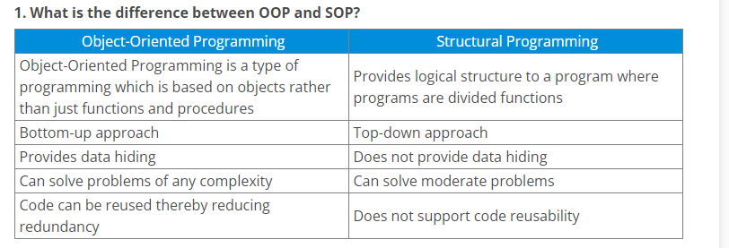
OBJECT ORIENTED VS STRUCTURAL PROGRAMMING

