Slide 1
PIP4004 - INTERNSHIP Review-3 Presentation Amazon Sales Analysis
Student Details
Name | S Priyanka
Roll No | 20211CSE0694
Section | 8CSE07
Batch No. | PSCS145
Under the Supervision of,
Mr. Tamilselvan Thangavel
Assistant Professor
School of Computer Science and Engineering
Presidency University
Name of the Program: Computer Science and Engineering
Name of the HoD: Dr. Asif Mohammad
Name of the Program Project Coordinator: Mr. Amarnath
Name of the School Internship/Project Coordinators: Mr. Md Ziaur Rahman /
Dr. Sampath A K /

Slide 2
Content
About Company or Organization
Working domain or the technology
About your team and reporting Manager
Challenges Faced in Internship
Objectives of the work
Internship Roadmap
Github Link

Slide 3
Problem Statement
Sales management has gained importance to meet increasing competition and the need for improved methods of distribution to reduce cost and to increase profits. Sales management today is the most important function in a commercial and business enterprise.
Do ETL : Extract-Transform-Load some Amazon dataset and find for me Sales-trend -> month wise , year wise , yearly-month wise
Find key metrics and factors and show the meaningful relationships between attributes.

Slide 4
About Company or Organization
UptoSkills is an Indian Skill-Tech company focused on training individuals in various technical and professional skills to enhance employability.
Founded: 2016
Headquarters: New Delhi, India
Mission: To empower youth with industry-relevant skills for successful careers.
Services:
Internship programs
Skill development training
Job placement assistance

Slide 5
About Company or Organization
Industries Served:
Computer Science
Mechanical Engineering
Electronics Engineering
Civil Engineering
Notable Achievements:
Trained over 1.2 million students across India.
Strong industry collaborations for skill development.

Slide 6
Working domain or the technology
Domain: Data Analytics
Technology Used: Power BI
What is Power BI?
A business intelligence (BI) tool used for data visualization, reporting, and analytics.
Key Features:
Data Importing: Connects with various databases (Excel, SQL, etc.).
Data Cleaning & Transformation: Using Power Query.
Data Visualization: Creates dashboards with interactive charts.

Slide 7
About your team and reporting Manager
Team Structure:
Our team consists of 90 members which is divided into sub groups of 12 members led by a team leader.
Tasks are assigned individually but the team will be working on the same topic.
Reporting Manager:
Provided guidance on Data Mining and Power BI dashboard creation and analytics and reporting to team leader everyday.
Collaboration:
Attended virtual meetings for feedback on daily basis for around an hour.
Shared progress updates via emails or project tracking tools.
Reporting Manager Ms. Priya Kaushal

Slide 8
Challenges Faced in Internship
Finding the Internship:
Searching for opportunities that matched skillset and interests.
Cracking the Interview:
Answering data-related questions and demonstrating Power BI knowledge.
Learning Curve:
Understanding real-world datasets and handling complex visualization

Slide 9
Literature Review
Methods | Advantages | Limitations
Excel for Data Mining | Easy to use, widely available, supports basic analysis | Limited for large datasets, lacks automation
SQL-based Data Mining | Efficient for structured data handling, supports complex queries | Requires SQL knowledge, not ideal for unstructured data
Python (Pandas, NumPy, Matplotlib, Seaborn) | Flexible, automates workflows, supports advanced analytics and visualization | Requires programming knowledge, can have performance issues with extremely large datasets
R for Data Analytics | Powerful for statistical analysis, widely used in academia | Steep learning curve, less user-friendly for beginners
Power BI/Tableau | Excellent visualization tools, supports interactive dashboards, easy to integrate with databases | Limited data transformation features, can be expensive for enterprise use
Apache Spark for Big Data | Handles massive datasets, supports distributed computing | Requires technical expertise, complex setup

Slide 10
Objectives of the work
Purpose:
Analyze and visualize datasets to extract meaningful insights.
Improve data reporting efficiency using Power BI.
How it Helps UptoSkills:
Helps in monitoring student enrollments and training progress.
Assists decision-making by identifying trends in training programs.
Key Skills Gained:
Data Cleaning & Processing
Creating Interactive Dashboards
Understanding Business Intelligence

Slide 11
Proposed work
Data Collection - Gathering industry-specific data from company databases and external sources.
Data Cleaning & Preparation - Handling missing values, standardizing formats, and transforming data for analysis.
Data Visualization - Using Power BI to create dashboards with interactive elements like maps, graphs, and charts.
Analysis & Insights Generation - Interpreting patterns, trends, and key metrics.
Reporting & Presentation - Preparing comprehensive reports for stakeholders to aid in decision-making.
Comparison with Advanced Tools – Evaluating Python/Power BI for insights.
Internship Deliverables - Finalizing dashboards, submitting reports, and presenting findings.

Slide 12
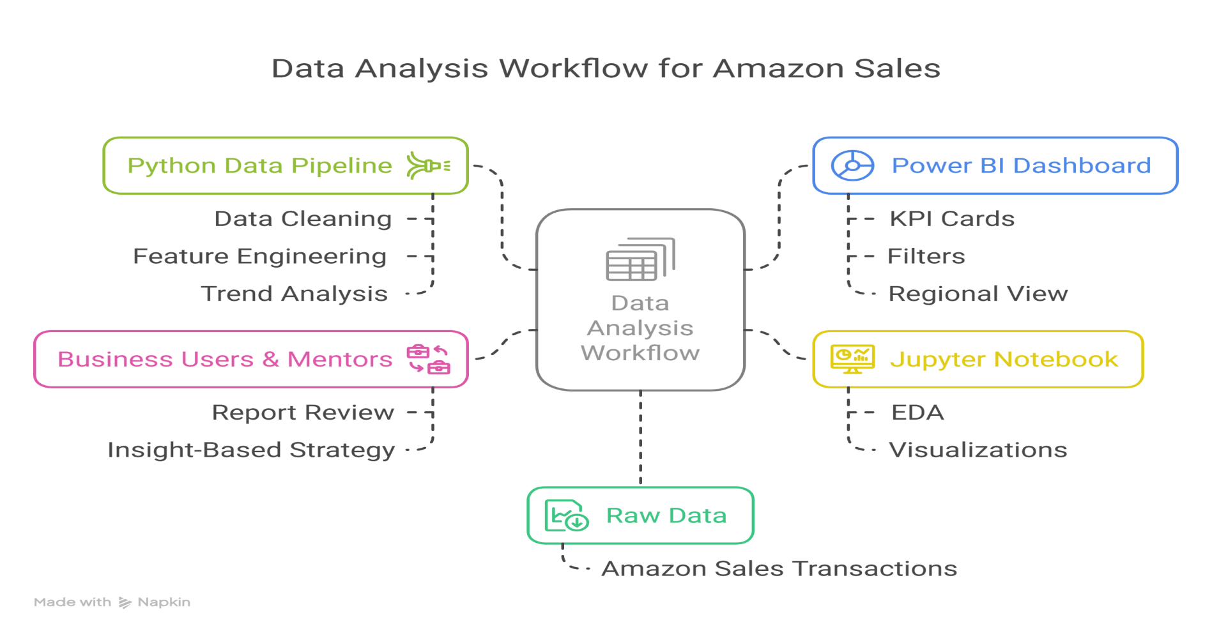
Architecture Diagram

Slide 13
Software and Hardware Details
Software Requirements
Python 3.10+ for data analysis and scripting
Jupyter Notebook for code execution and EDA
Pandas, Matplotlib, and Seaborn for data processing and visualization
Power BI Desktop for dashboard creation
Power BI Service for publishing and sharing dashboards online
Microsoft Excel for initial data checks and formatting
Windows 10 or 11 as the operating system
Hardware Requirements
Intel i5 / Ryzen 5 processor or higher
Minimum 8 GB RAM (16 GB recommended for smoother Power BI performance)
SSD storage (at least 256 GB, 500 GB preferred)
Stable internet connection for uploading dashboards to Power BI Service
Basic integrated or dedicated graphics card (optional)

Slide 14
Internship Road Map
Review 0
Review 1
We will work on the cleaning and processing of the data collected
Review 2
Getting to learn about power bi and analysing the data
Our first task is to mine data of different colleges
we will collaboratively work on the assigned task using frameworks
Review 3

Slide 15
Expected Outcomes
Technical Skills:
Data cleaning and transformation using SQL and Excel.
Data visualization and dashboard creation in Power BI.
Report generation and insight extraction.
Analytical Skills:
Identifying trends in workforce and business data.
Understanding the impact of employment patterns on industry growth.
Professional Development:
Effective data-driven decision-making.
Presenting analytical findings to the Team.
Managing real-world datasets efficiently.

Slide 16
Github Link
https://github.com/priyanka200419/PIP4004_Internship_DataAnalytics

Slide 17
Thank you !!

