Slide 1
Financial Fraud Detection
Data Analysis with Azure Ml and Spark ml
Group H: Bhagyashree Bhagwat, Niklas Melcher, Priyanka Purushu
Under the guidance of Dr. Jongwook Woo

Slide 2
Content
Overview
Dataset Specification
Work Flow
Azure ML
IBM / Databricks
Summary
Reference

Slide 3
Overview
This project aims at analyzing data and providing insights on Financial Fraud Detection using Data analysis tools like Spark ml and Azure ml.
Mobile money transactions based on a sample of real transactions extracted from one month of financial logs from a mobile money service

Slide 4
Dataset Specification
URL: https://www.kaggle.com/ntnu-testimon/paysim1
Size: 470 MB
Attributes: 11
Target Column: ‘isFraud’

Slide 5
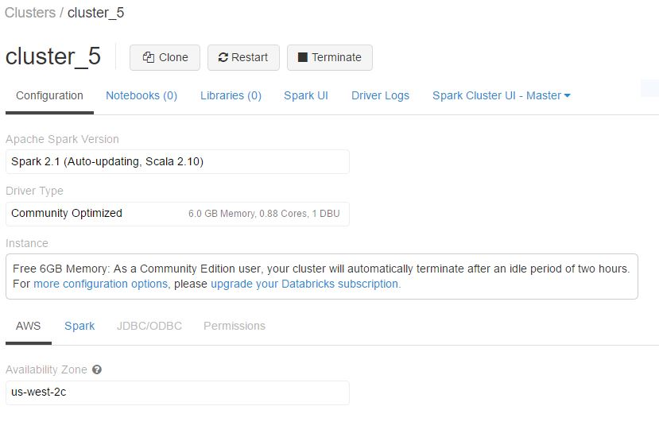
H/W Specifications
Apache Spark Version: Spark 2.1 (Auto-updating, Scala 2.10)
File System : Data Bricks File System
Memory : 6GB Memory (As a Community Edition user)

Slide 6

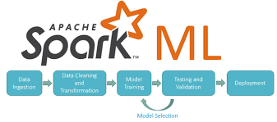

Tools Used

Slide 7
Work Flow
1. Data understanding
2. Data preparation
3. Model building and validation
4 Model evaluation
5. Model interpretation

Slide 8
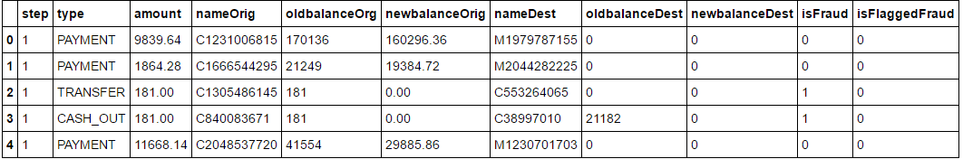
Data Understanding
Numeric attributes:
amount, oldbalanceOrg, newbalanceOrg, oldbalanceDest, newbalanceDest
Categorical attributes:
step, type, isFraud, isFlaggedFraud
String attributes:
nameOrig, nameDest

Slide 9
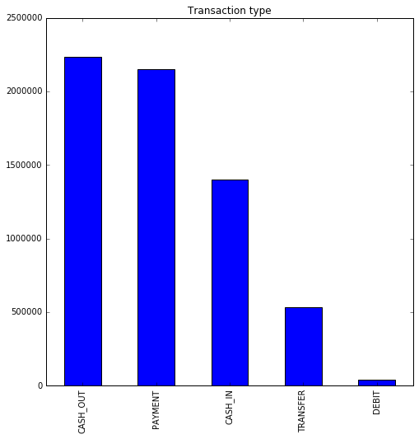
Transaction Types

Slide 10
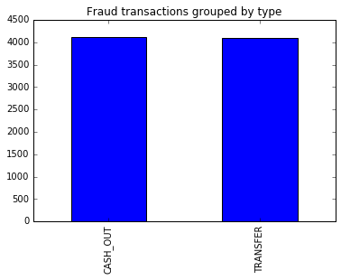
Fraud Transactions Grouped By Type

Slide 11
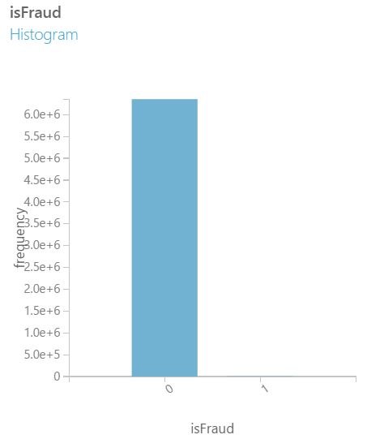
isFlaggedFraud helping us
Out of 6362620 rows, ‚isFlaggedFraud‘ is only 16 times positive
→ It‘s not helpful in detecting a fraud transaction

Slide 12
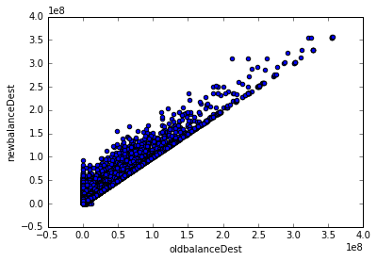
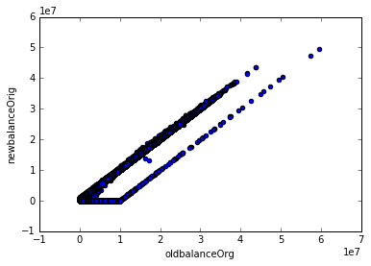
Correlations?

Slide 13
Data Preparation
Columns Dropped | Columns Kept
step | amount
nameDest | oldbalanceOrg
nameOrig | newbalanceOrig
isFlaggedFraud | newbalanceDest
 | oldbalanceDest
Conclusion:
Classification Problem
Is the transaction a fraud or not?

Slide 14
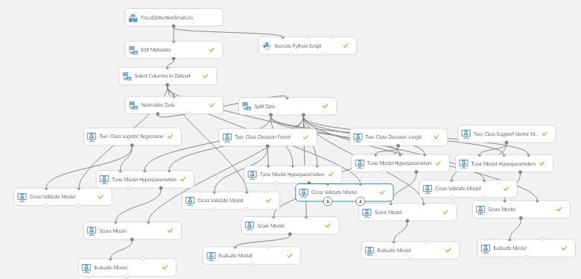
Experiment in Azure ML

Slide 15
Workflow in Azure ML
Starting of with a small subset of the data
Data preparation
Edit metadata: Make attributes categorical
Select columns: Launch column selector
Normalize and split the data
Model bulding and validation
Tune Hyperparameters
Cross Validate
Model evaluation
Score model
Evaluate model

Slide 16
Model evaluation
Accuracy = (TP + TN) / Total
Presicion = TP / (TP + FP)
Recall = TP / (TP + FN)
In this case, we are interested in the recall to capture the most fraudelent transactions
Bad Recall: We predict the transaction as normal but it is a fraud = many false negative ones
Good Recall: We predict the transaction as fraud and it is a fraud = many true positive ones

Slide 17
Results
Model | Accuracy | Precision | Recall
Two Class Logistic Regression | 0.991 | 1.000 | 0.100
Two Class Decision Forest | 0.995 | 0.727 | 0.800
Two Class Decision Jungle | 0.997 | 1.000 | 0.700
Two Class Support Vector Machine | 0.993 | 1.000 | 0.300
Conclusion:
We use the Decision Forest in IBM/Databricks to proceed ahead, because of the recall value. Also, it takes much less time than the Decision Jungle.

Slide 18
Experiment with Databricks
Load the data source
Select the columns
Split the data
Define a pipeline
Train the models
Evaluate

Slide 19
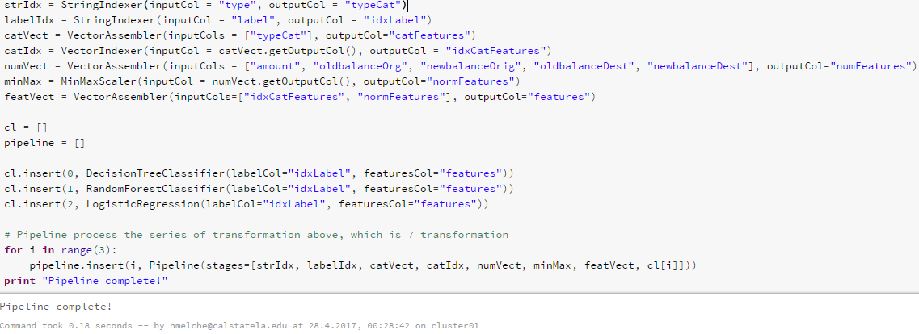
Define the pipeline

Slide 20
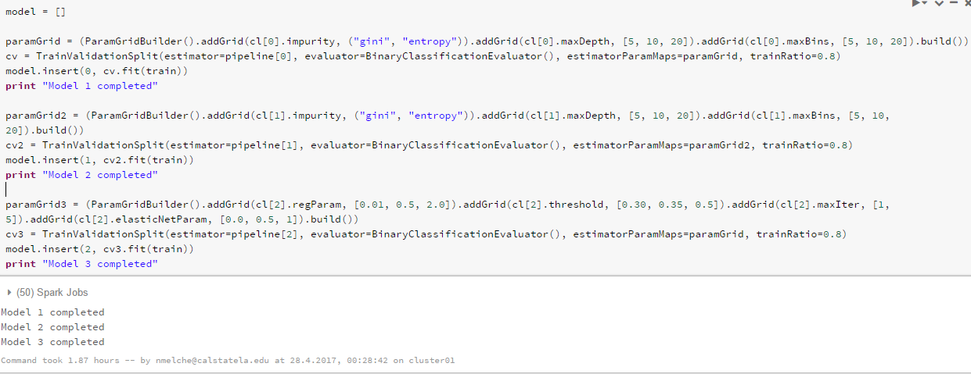
Train the models
Time taken: 2 hours 27 minutes

Slide 21
Results
Model | Area under ROC | Precision | Recall
DecisionTreeClassifier | 0.839343 | 0.965338 | 0.678716
RandomForestClassifier | 0.85963 | 0.92674 | 0.719334
LogisticRegression | 0.726389 | 0.845979 | 0.452884
Conclusion:
The RandomForestClassifier has the best recall score as compared to DecisionTreeClassifier and LogisticRegression.

Slide 22
Results (continued)
Confusion Matrix | Predicted: NO | Predicted: YES
Actual: NO | TN = 1905940 | FP = 78
Actual: YES | FN = 644 | TP = 1761

Slide 23
Summary
The Random Forest classifier algorithm of the classification model proves to be the best algorithm in terms of our analysis.
We have very good model in case of detecting non-fraud transactions, since the specificity (TN / (TN + FP) is about 0.99
Nevertheless, when detecting fraud transactions we have some errors, since the recall score is about 0.73
Github URL: https://github.com/nmelche/IntroductionToBigDataScience

Slide 24
Reference
How to choose algorithms for Microsoft Azure Machine Learning
https://docs.microsoft.com/en-us/azure/machine-learning/machine-learning-algorithm-choice
Big Data Analysis using Spark for Collision Rate Near CalStateLA By Manik Katyal, Parag Chhadva, Shubhra Wahi & Jongwook Woo
https://globaljournals.org/GJCST_Volume16/1-Big-Data-Analysis-using-Spark.pdf
Spark Programming Guide
http://spark.apache.org/docs/latest/programming-guide.html

