Slide 1

Yelp data analysis

Slide 2
Group e
Bhagyashree Bhagwat
Manali Joshi
Priyanka Purushu
Under the guidance of
Dr. Jongwook Woo

Slide 3
cONTENTS
1
Introduction
2
Dataset Specification
3
Work Flow
4
System Specification
5
Insights
6
Summary
7
Github
8
Reference

Slide 4
Overview
This project aims at performing data analysis and providing insights
on Yelp's Dataset using HIVE, PIG and presenting visualization on
Microsoft Excel - Power view, 3D maps and Tableau.
Dataset includes data from the following U.S cities:
Pittsburgh
Charlotte
Urbana-Champaign
Phoenix
Las Vegas
Madison

Slide 5
DATA SPECIFICATION
Data-set : Yelp Dataset
Data Source url : https://www.yelp.com/dataset_challenge
Data Size : 2.62 GB
Data Files : Business
Review
User

Slide 6
System specification
Cluster Type - Hadoop IBM Big Insights
No. of Data Nodes – 1 node | vCPU = 4( 24 GB RAM )
No. of Management Nodes – 1 node | vCPU = 12 ( 48 GB RAM )
Data Disk - 1 TB SATA | Data Storage- 244 GB
CPU Speed - 2.30 GHz
Version - IOP 4.2 [IBM Open Version Platform]
Operating System - CentOS 6.6 [Linux]
Data Centre - Washington DC

Slide 7



Tools used

Slide 8
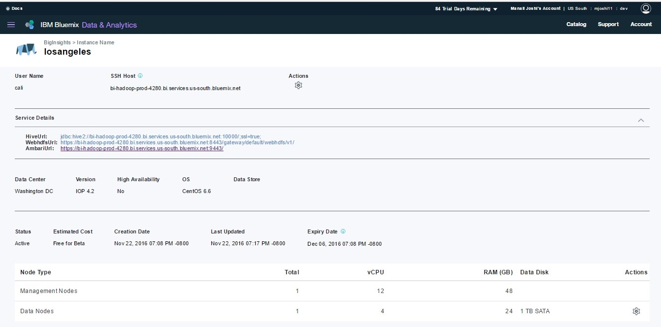
IBM BLUEMIX Cluster

Slide 9
WORK FLOW
Step 1 - Extract Dataset from Json to CSV using Pig & Hive
Step 2 - Data cleaning in Pig
Step 3 - Upload Dataset to HDFS
Step 4 - Analysing data and building queries
Step 5 - Run commands in Hive and Pig
Step 6 - Visualize results using Tableau, Excel Power View &
3D Maps .
Step 7 - Summarize the desired output.

Slide 10
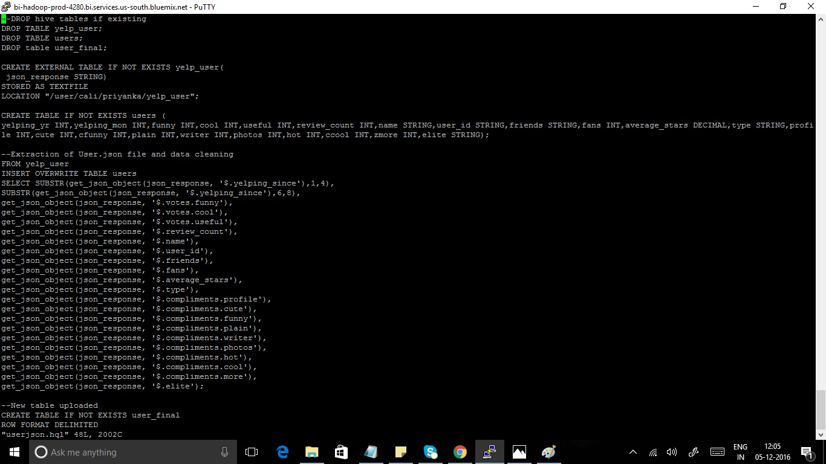
Data (json) extraction & cleaning with hql

Slide 11
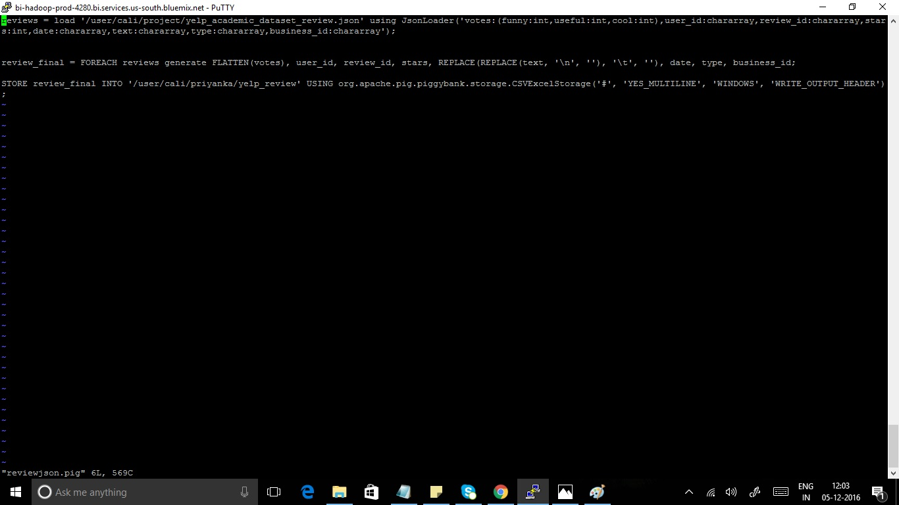
Data (json) extraction & cleaning with pig

Slide 12
INSIGHTs
In which year Yelp has got maximum number of users?
Forecast of users joining Yelp in coming years.
Who are the most active users on Yelp ?
Which users’ review is the most popular based on votes?
Which city has the maximum no of closed business?
Sentiment Analysis on Top 8 food chains in the USA based on user reviews.
Best suited restaurants for tourists.

Slide 13
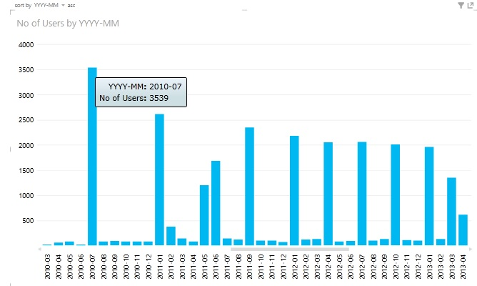
In which year Yelp has got maximum number of users?

Slide 14
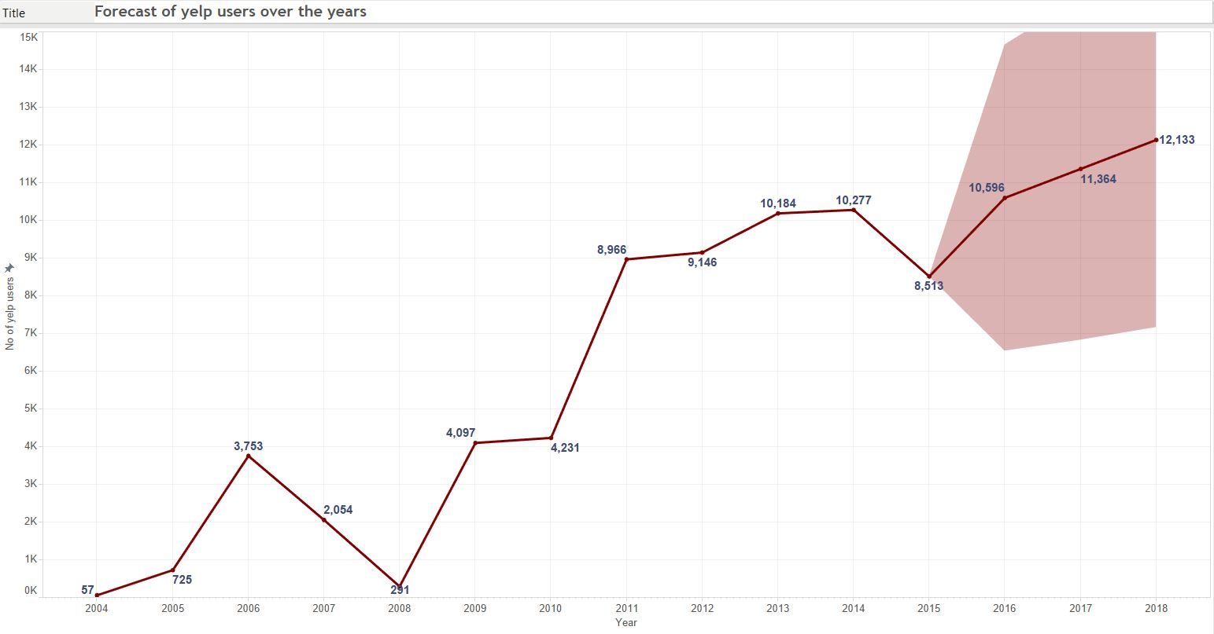
Forecast of users joining Yelp in coming years.

Slide 15
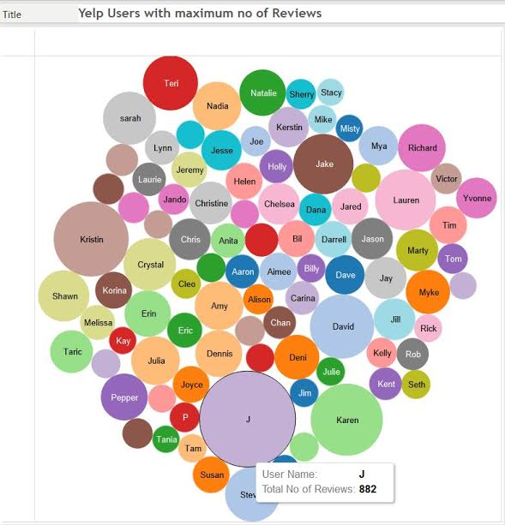
The most active Yelp users (for writing reviews).

Slide 16
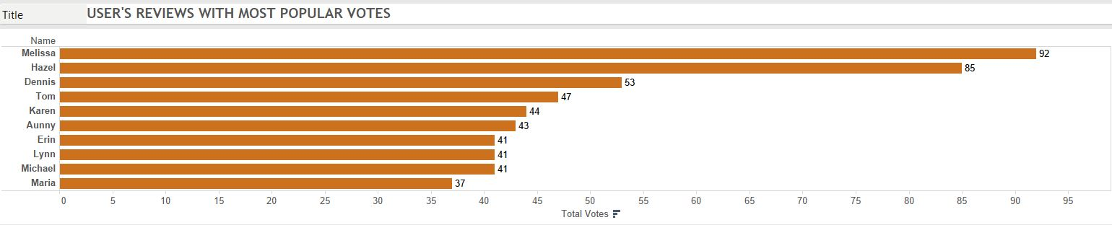
Most popular users’ review based on votes

Slide 17
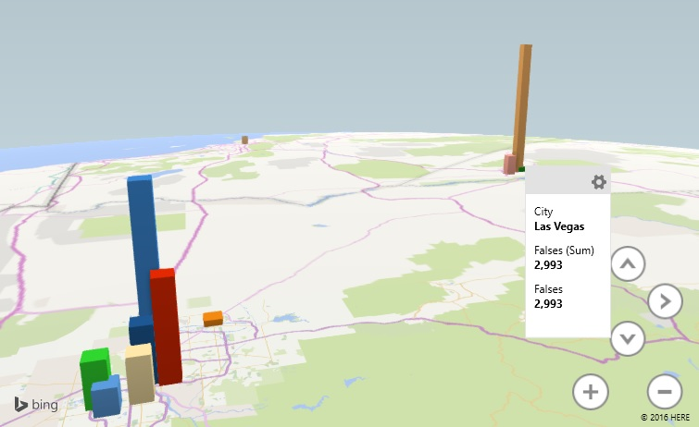
Which city has the maximum no of closed business?

Slide 18
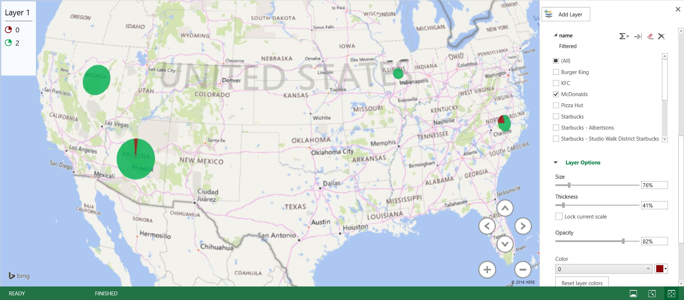
QUERY 5
Sentiment Analysis on Top 8 food chains in the USA based on user reviews.

Slide 19
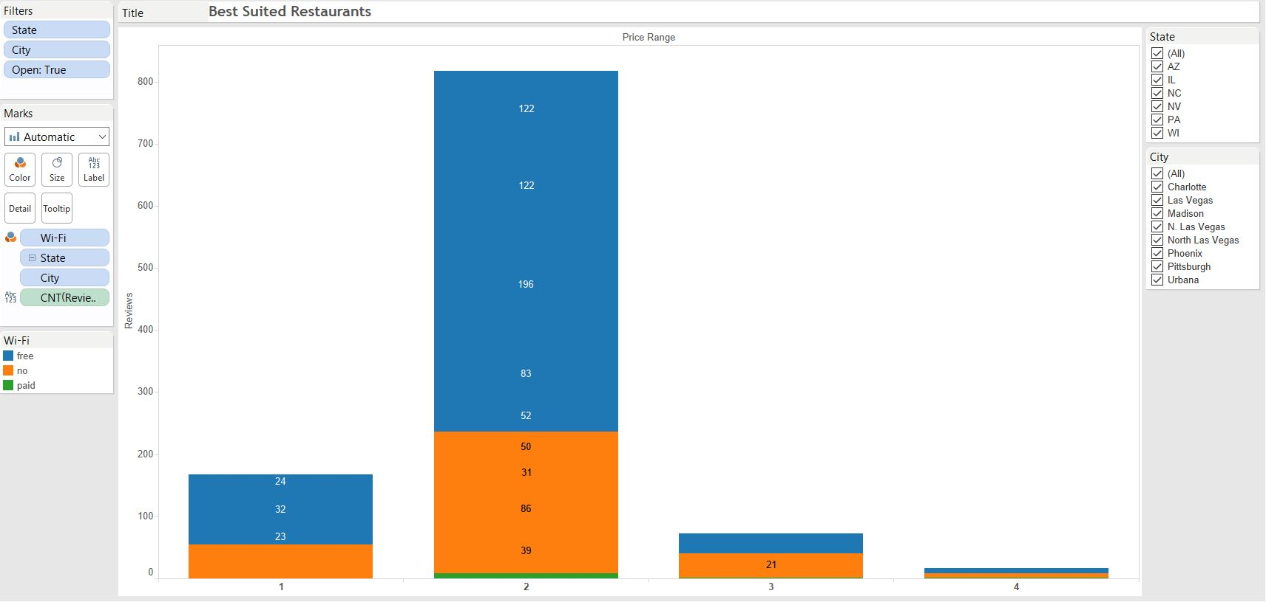

Slide 20
Conclusion of insights
During our analysis we learned that, Yelp got the max no of users in the month of July 2010.
Further, we displayed a forecast of new Yelp users joining in the coming years .
We displayed Top 100 most active users in the Bubble chart.
Top 10 user reviews which got more popular on Yelp.
On the 3D Map, we visualised that Las Vegas city has the max no of closed businesses.
Sentiment analysis which includes positive, neutral & negative reviews about top 5
restaurants based on geo location. We only displayed for McDonalds.
List of Best suited restaurants for tourists in terms of Price range, City, State, Wi-fi
Connection and Parking

Slide 21
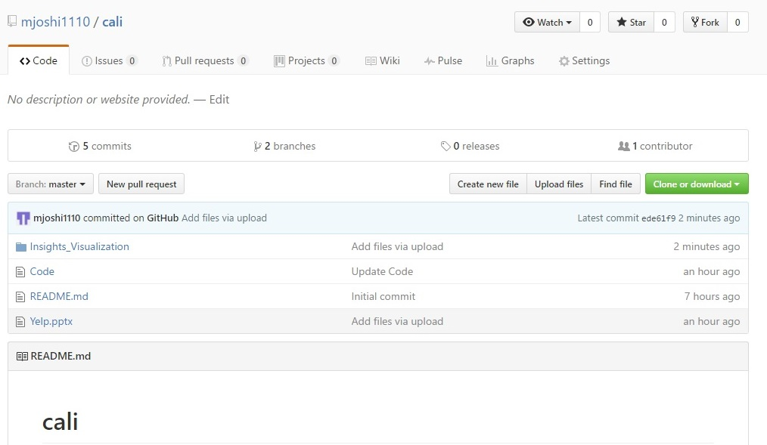
GITHUB details
Url - https://github.com/mjoshi1110/cali/

Slide 22
REFERENCES
https://calstatela.edu/jwoo5/classes/2016/fall/cis5200/
https://www.yelp.com/dataset_challenge
https://console.ng.bluemix.net/catalog/services/biginsights-for-apache-hadoop
https://www.tableau.com

Slide 23
THANK YOU

