Slide 1
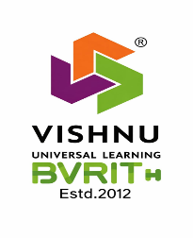
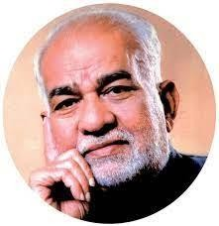

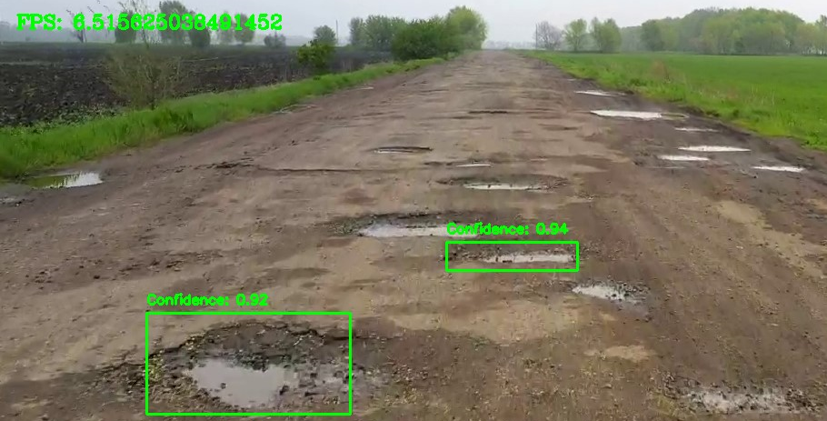
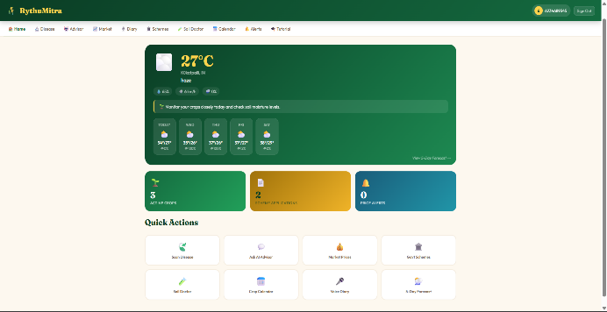
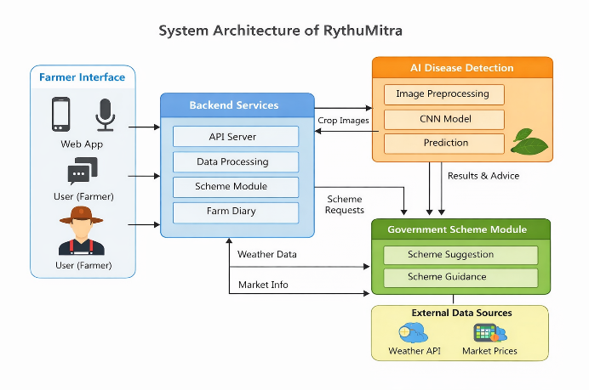
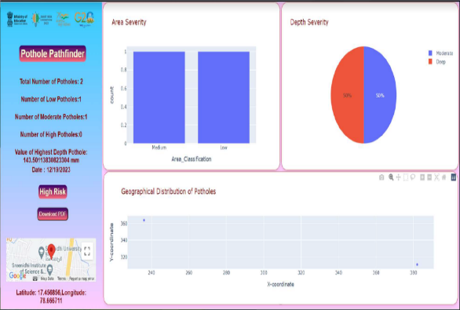
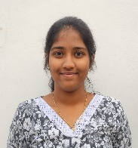
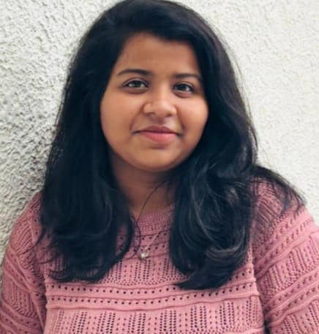
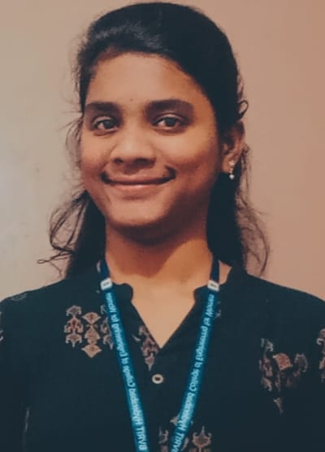
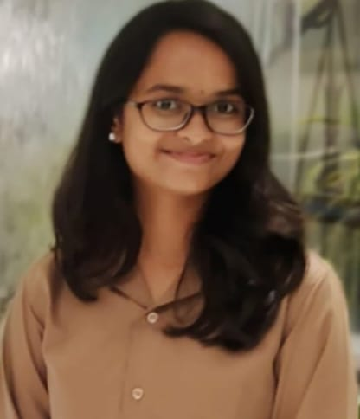
BVRIT HYDERABAD
College of Engineering for Women
(UGC Autonomous)
Department of Information Technology
RythuMitra: A Multilingual Voice-First AI Farming Companion
10
ABSTRACT
RythuMitra is a voice-first AI farming system that enables multilingual interaction and real-time crop disease detection using deep learning. It provides personalized recommendations and integrates blockchain for secure scheme applications. With access to market and weather
It supports efficient farming.
Dashboard
Architecture
UNIQUENESS
Voice-first interaction | Multilingual support
Scheme support | Farmer-friendly UI
METHODOLOGY
The methodology uses CNN models for crop disease detection, optimizing predictions through image preprocessing and classification. NLP-based voice interaction enables multilingual communication, while blockchain ensures secure scheme processing. This helps in accurate and efficient farming decisions.
REFERENCES
[1] ICAR, “Plant disease identification using deep learning,” Indian Council of Agricultural Research, Survey Paper.
[2] IJERT, “AI-based farming chatbot for farmer assistance using NLP, TTS, and STT,” International Journal of Engineering Research & Technology.
SOCIETAL USE
RythuMitra supports sustainable agriculture by enabling early crop disease detection, reducing losses, and improving farmer productivity. Its voice-first multilingual design makes technology accessible to low-literacy users, while blockchain ensures transparent scheme access. The system contributes to digital empowerment of farmers and supports Sustainable Development Goals like Zero Hunger and Industry Innovation.
SDG -11
GITHUB LINK
https://github.com/priyanka22wh1a1264/major_project
22WH1A1262 22WH1A1263 22WH1A1264 22WH1A1265
Ch. Pranavi P. Neha S. Priyanka K. Siri Sanjana Faculty Mentor : Mr. Ch. Anil Kumar Email Id: anilkumar.ch@bvrithyderabad.edu.in

