Slide 1
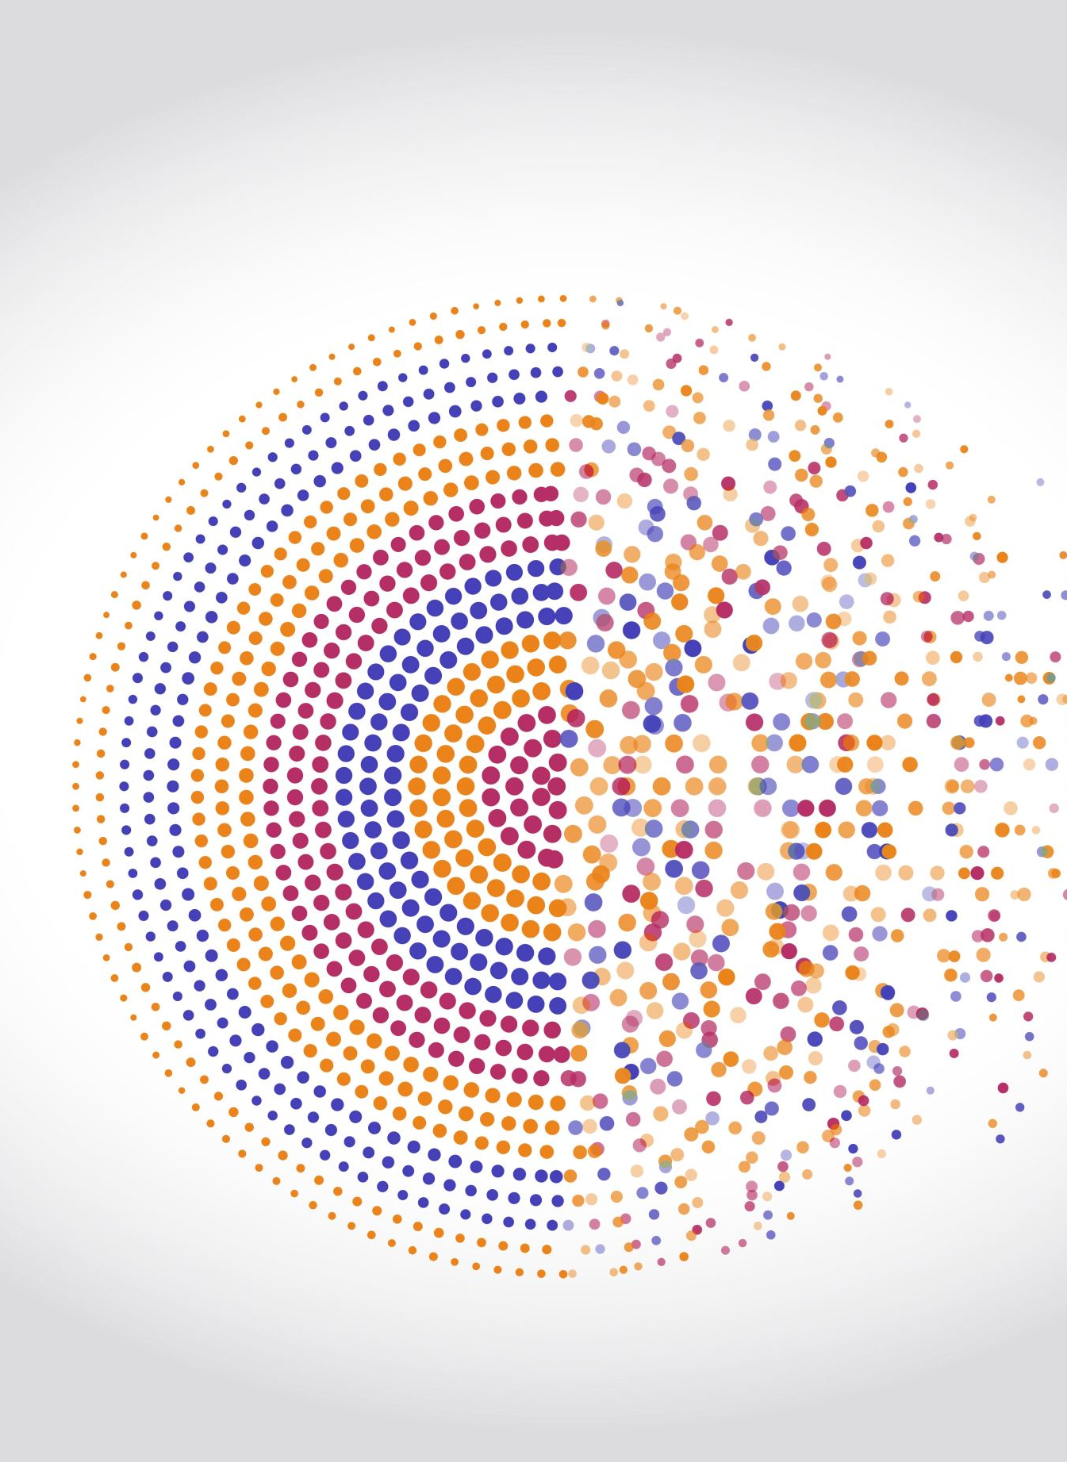
Blockchain
By
Priyanka S

Slide 2
Index
What is Blockchain
Need of Blockchain
Who uses the Blockchain?
How does Blockchain works?
Application of Blockchain
Conclusion

Slide 3
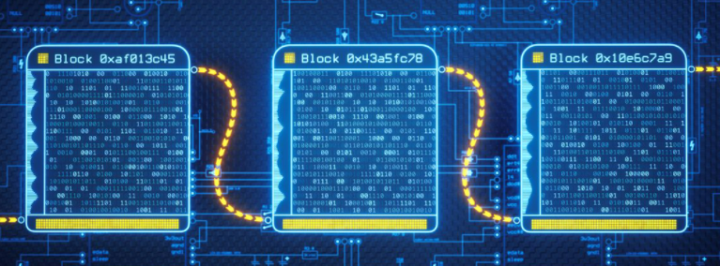
What is Blockchain
It is continuous growing list of records/block in which blocks are cryptographically linked.
Decentralized
Distributed database
Immutable ledger

Slide 4
Who uses the blockchain?
Blockchain technology can be integrated into multiple areas. The primary use of blockchains is as a distributed ledger for cryptocurrencies.
It uses in business application Banking, Finance, Government, Healthcare, Insurance, Media and Entertainment, Retail, etc.

Slide 5
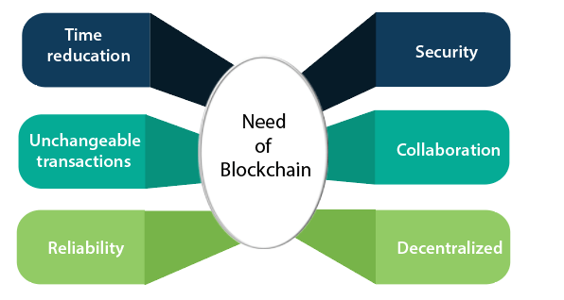
Need of Blockchain

Slide 6
How does Blockchain works?
Blockchain
Mining
Peer to peer distributed network
Bitcoins
Transactions

Slide 7
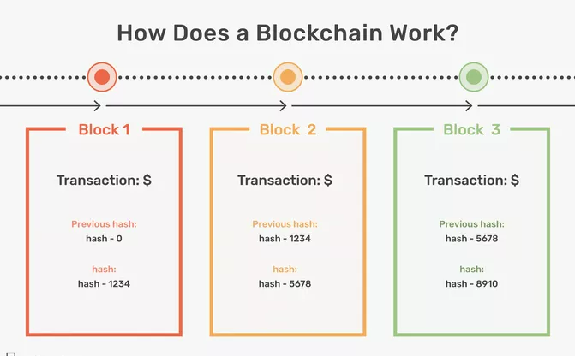
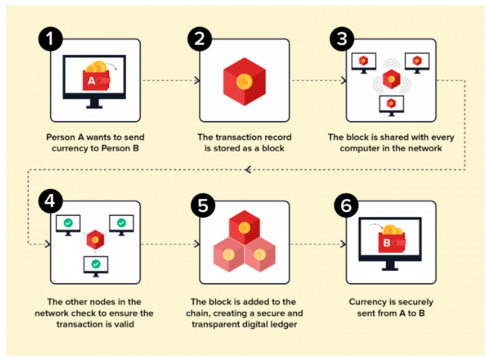
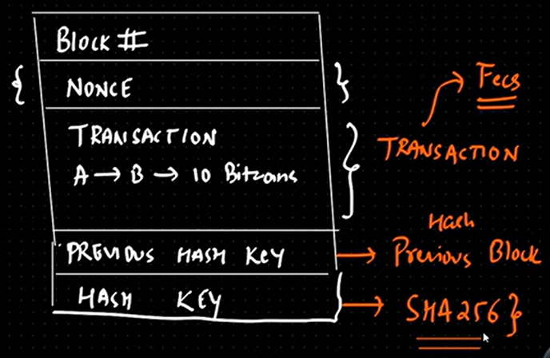

Slide 8
Application of Blockchain
House, Property, Car, Vehicle sales.
Electronic Voting
Food Supply Chain (Any supply chain usecase)
Cryptocurrency (Bitcoin, Ripple……etc)
Blockchain in Healthcare

Slide 9
Conclusion
The Bitcoin is the first successful implementation of blockchain. Today, the world has found applications of blockchain technology in several industries, where the trust without the involvement of a centralized authority is desired. So welcome to the world of Blockchain.

