Slide 1
QUIZ MANIA
Presented by:
BALWANT SINGH(2016UCP1411)
PRIYANKA MEENA(2016UCP1437)

Slide 2
ABSTRACT:
SOFTWARE: intellij(javaFx)
DBMS: xampp,phpmyadmin,mysql
OBJECTIVE:
quiz mania is a simple quizing project which has 5 on each subject. user can register into it and start the quiz. Registered user can login, being compared through a leaderboard.

Slide 3
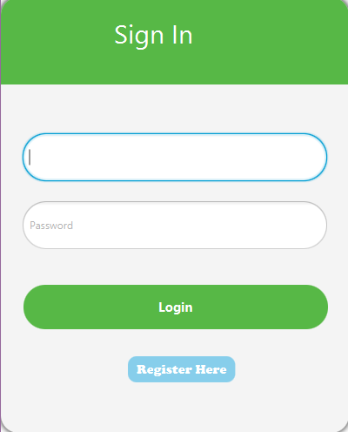
Sign in
username
password
Login button
Register button

Slide 4
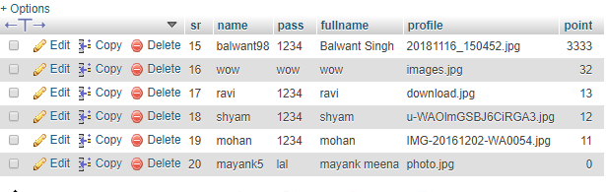
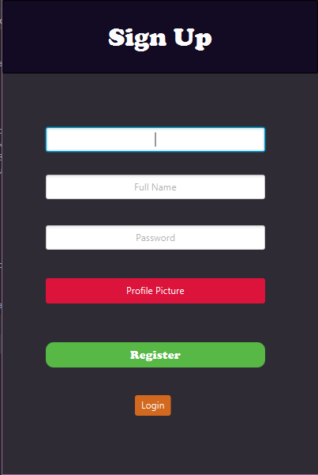
Already registered user in database
Sign up
Username enter his/her detail like full-name, password, upload profile picture. Click on register button.
user successfully registered!!

Slide 5
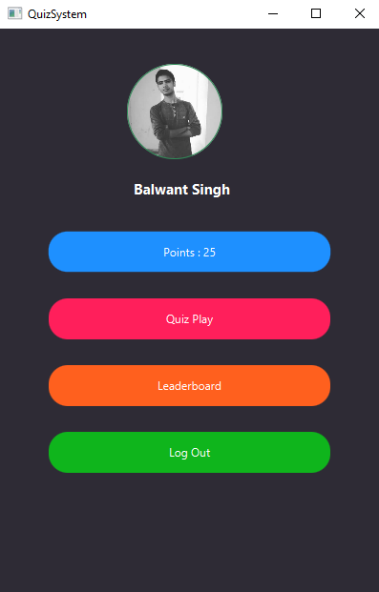
Profile
Total Earned points
play quiz
Leaderboard
Logout button

Slide 6
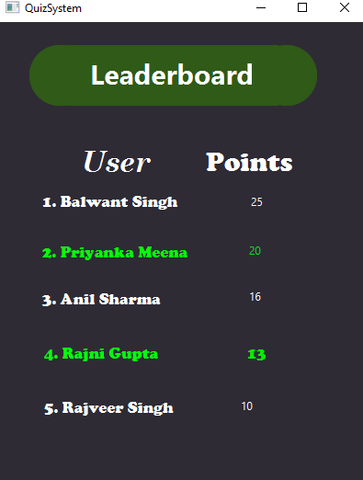
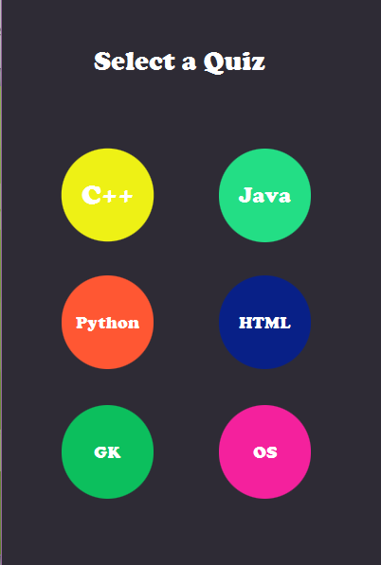
Leaderboard
Quiz menu
Comapring user to others

Slide 7
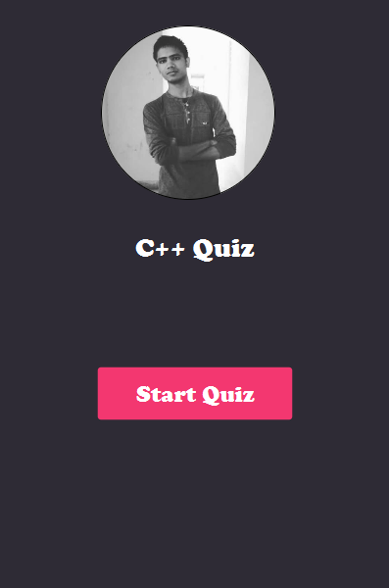
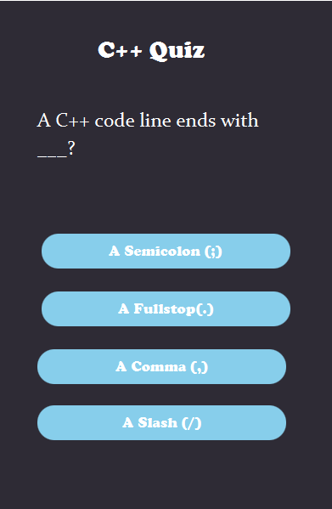
C++ quiz
To start the quiz…
Questions on c++

Slide 8
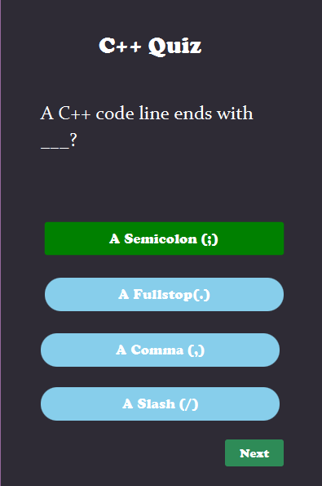
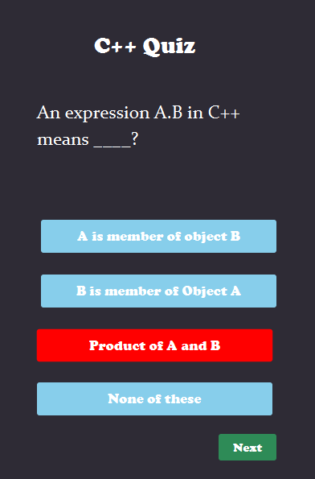
Right Answer and Wrong Answer

Slide 9
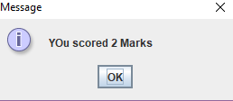
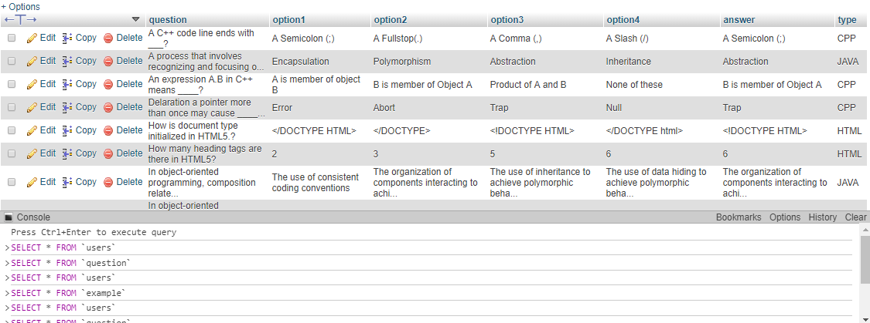
Total score:
After completing quiz a message pops up to show the result
Database of questions

Slide 10
Thank You

