Slide 1


iOS Event Planning App
This presentation outlines the development approach for an iOS application designed to help users effortlessly plan and manage events, streamlining the process from guest list creation to budget management.
by Priyanka Pal
B.Tech CSD 3rd Year

Slide 2
Approach to Building the App
Ideation & Requirements Gathering
1
Thoroughly understand user needs and event planning pain points. Define core features and functionalities.
2
Design & Prototyping
Create user-friendly wireframes and interactive prototypes to visualize the app's flow and interactions.
Development & Implementation
3
Build the app using Swift, adhering to Apple's Human Interface Guidelines for a seamless user experience.
4
Testing & Quality Assurance
Rigorous testing to ensure functionality, performance, and stability across different iOS devices and versions.
Deployment & Launch
5
Publish the app on the App Store, incorporating marketing strategies for user acquisition.
6
Maintenance & Updates
Continuously monitor app performance, gather user feedback, and release updates to enhance features and address issues.

Slide 3

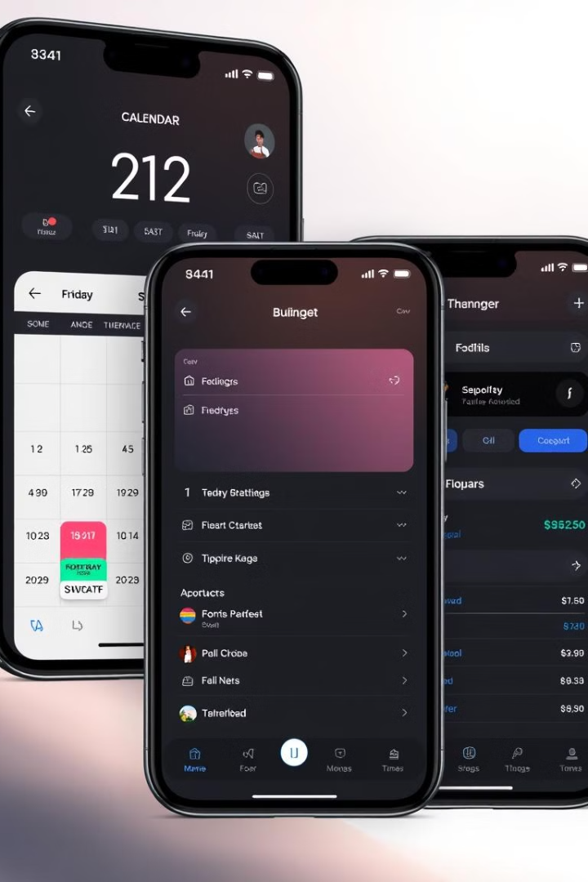
Key Features of the Event Planning App
1
2
Guest List Management
Calendar Integration
Easily add and manage your guest list, track RSVPs, and send personalized invitations.
Synchronize with your calendar to schedule events, set reminders, and avoid scheduling conflicts.
3
4
Budgeting and Expense Tracking
Vendor Management
Connect with vendors, manage contracts, and track payments all within the app. Catering, Entertainment, Photography, Floral Design Rental Equipment, Transportation, Decor and Lighting Security.
Keep track of your event budget, manage expenses, and receive real-time updates on your spending.

Slide 4

Types of Events
1
Weddings
2
Corporate Events
From intimate ceremonies to grand celebrations, we help create your dream wedding.
We plan successful conferences, meetings, team-building activities, and product launches.
3
Social Events
4
Non-profit Events
We organize birthday parties, holiday celebrations, anniversaries, and other special occasions.
We support non-profit organizations with fundraising galas, awareness campaigns, and community events.

Slide 5
Event Planning Workflow
Idea Generation
1
Start by brainstorming your event concept, theme, and goals.
2
Guest List & Invitations
Create your guest list, send personalized invitations, and track RSVPs.
Venue Selection
3
Choose a suitable venue that meets your needs and budget.
4
Vendor Booking
Connect with vendors, negotiate terms, and secure bookings.
Budgeting & Expense Tracking
5
Create a detailed budget, track expenses, and stay within your financial limits.
6
Event Day Management
Organize event details, schedule activities, and ensure a smooth execution.
Post-Event Evaluation
7
Gather feedback from guests, analyze results, and plan for future improvements.

Slide 6
Sitemap of the Event Planning App
1
2
3
4
5
6
7
8
9
10
Login Page
Sign-up
Home Page
Event Creation
Guest Management
Task Management
Budget Tracking
Updates events
Notification
Completion Page
Users can add, organize, and send invites to guests. Send invitations (via email or SMS), Track RSVPs in real-time Guest list.
A dedicated page to track notifications related to even.
Users log into the app (email/username and password) or via social logins (Google, Facebook)
Users get an overview of app features and quick links to start or manage events. Buttons like Create Event, Manage Existing Events, Upcoming event previews, Notifications (RSVPs, deadlines.
Users can track expenses, manage the event budget, and receive financial insights.
This page shows a final summary of the event after all tasks are complete and budgets are balanced.
Users can create new events by filling in essential details like event name, date, location, guests, and budget
Update events such as RSVP status changes or task deadlines.
Provides options for new users to create an account
Users can assign and manage tasks related to the event, such as catering, decoration, etc.

Slide 7

Technical Architecture
User Interface (UI)
Business Logic
Built using Swift, providing a modern and responsive user interface by using Xcode and stimulator for developing ,testing and debugging.
Handles core application logic, including event creation, data validation, and interaction with backend services.
Data Access Layer
Backend Services
Manages communication with data storage, including local database (Core Data) and remote cloud databases.
Cloud-based services (Firebase, AWS) for user authentication, data synchronization, and push notifications.

Slide 8
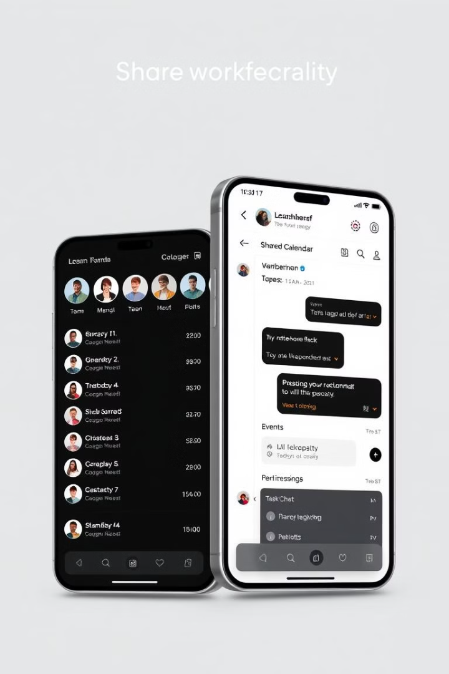
Database Design and Data Management
Table Name
Columns
Relationships
Events
Event ID, Name, Date, Time, Location, Budget, Description
One-to-many with Users,
Tasks, Expenses
Users
User ID, Email, Password, Name
One-to-many with Events
Guests
Guest ID, Event ID, Name, Email, RSVP Status
Many-to-one with Events
Tasks
Task ID, Event ID, Description, Deadline, Status
Many-to-one with Events
Budget
Expense ID, Event ID, Category, Amount, Date
Many-to-one with Events
1
Local Data Storage
Core Data framework for efficient storage of event details, guest information.
2
Cloud Sync
Real-time data synchronization using Firebase or AWS, ensuring data consistency.
3
Data Security
Implement encryption and authentication protocols, to protect user data.
4
Data Backup & Recovery
Regular backups and data recovery mechanisms to prevent data loss and ensure data integrity.

Slide 9




User Interface and User Experience
Intuitive Calendar View
Task Management System
A visually appealing calendar interface for creating and viewing events, with clear color-coding and event details.
A task list for managing event-related tasks with deadlines and progress indicators.
Visual Budget Tracker
Guest List Management
A visual representation of the budget, displaying spending against the allocated amount.
A dedicated section for managing guest lists, sending invitations, and tracking RSVPs.

Slide 10




Integrations and Third-Party Services
Calendar Integration
Payment Gateway
Seamless integration with iOS Calendar to schedule events and send invitations to guests.
Secure integration with payment gateways like Stripe or PayPal for handling event payments and contributions.
Location Services
Email & Messaging
Map integration to easily add event locations, share directions, and allow guests to find the venue.
Integration with email and messaging services for sending event notifications, reminders, and updates to guests.

Slide 11

Conclusion and Next Steps
This iOS event planning app will revolutionize how users plan and manage their events. Future development includes adding features for catering, RSVP management, and collaborative planning. I will focus on improving user experience.

