Slide 1
A DATA SCIENCE / MACHINE LEARNING PROJECT
CineMatch
A Content-Based Movie Recommendation System Using Machine Learning
Rohan Yadav | Enrollment No. 230022 Under the guidance of Priyanka Pal, Data Science Trainer Department of Computer Science • Starex University July 2026

Slide 2
Agenda
01
Introduction & Problem
What this presentation covers, from problem to deployed application.
02
Objectives & Literature
03
Dataset & EDA
04
Methodology
05
Implementation
06
Results & Analysis
07
Evaluation & Future Scope
CineMatch — Content-Based Movie Recommendation System
2

Slide 3
01 · INTRODUCTION
The Information Overload Problem
Digital catalogues have grown far beyond what users can browse manually. Streaming and e-commerce platforms must proactively surface relevant content rather than rely on search. Recommender systems fall into three broad families:
Why CineMatch Uses
Content-Based Filtering
The TMDB dataset provides rich item metadata — genre, rating, popularity, vote counts — but no per-user rating history.
That makes a KNN model over engineered movie features the most practical, directly-applicable approach.
1
Collaborative Filtering
Learns from patterns across many users' ratings — powerful, but needs history and suffers cold-start.
2
Content-Based Filtering
Recommends from an item's own attributes (genre, cast, plot) — works with zero user history.
3
Hybrid Methods
Built as: offline notebook pipeline → serialised model bundle → interactive Streamlit app.
Combines both approaches once interaction data becomes available.
CineMatch — Content-Based Movie Recommendation System
3

Slide 4
01 · INTRODUCTION
Problem Statement
Given only item-level movie metadata — no user history — how can a system generate recommendations for a chosen genre that are simultaneously:
1
2
3
4
Genre-Consistent
Statistically Reliable
Popularity-Aware
Accessibly Delivered
Results must genuinely belong to the requested genre, not just loosely related titles.
A high rating from a handful of votes shouldn't outrank a well-established, broadly-voted film.
Rankings should reflect real audience reach, not rating alone.
Through an interactive interface — not a static script or notebook.
CineMatch — Content-Based Movie Recommendation System
4

Slide 5
02 · OBJECTIVES
Project Objectives
1
Collect, clean, and prepare the TMDB Top 10,000 Movies dataset for analysis and modelling.
5
Implement and validate a reusable recommend_by_genre() function on representative genres.
2
Design a statistically sound weighted-rating metric using a Bayesian-average formulation.
6
Perform EDA and visualise the feature space (distributions, correlation, PCA) to verify behaviour.
3
Engineer numeric feature vectors combining one-hot genre encoding with scaled popularity & rating.
7
Serialise the pipeline and deploy it via an interactive Streamlit web application.
4
Train a k-Nearest Neighbours model with cosine similarity for genre-consistent retrieval.
CineMatch — Content-Based Movie Recommendation System
5

Slide 6
02 · LITERATURE REVIEW
Grounding in Prior Work
Adomavicius & Tuzhilin (2005)
Foundational survey classifying content-based, collaborative, and hybrid approaches; motivated a content-based design given no user history.
Delimayanti et al. (2022)
KNN + cosine similarity on genre-based content filtering outperformed content similarity alone — directly informs CineMatch's architecture.
Ahuja, Solanki & Nayyar (2019)
K-means clustering before KNN search — identified as future work as the catalogue scales.
Badugu & Manivannan
Cosine and correlation-based neighbourhoods gave strong accuracy — reinforced the choice of cosine distance.
A key gap: most published KNN/collaborative recommenders use MovieLens or Netflix Prize data with rich user histories. TMDB Top 10K has item-level metadata only — the basis for this project's purely content-based design.
CineMatch — Content-Based Movie Recommendation System
6

Slide 7
03 · DATASET
Dataset Description
10,000
9,658
9
18
raw records
cleaned unique movies
raw columns → 12 with derived
distinct genres
Source: TMDB “Top 10K Movies” dataset (Kaggle) — id, title, genre, original_language, overview, popularity, release_date, vote_average, vote_count.
Descriptive Statistics
Data Quality Fixes
Mean vote_average 6.62 (σ = 0.77), range 4.6–8.7
vote_count heavily right-skewed: 200 – 31,917 (mean 1,547)
popularity even more skewed: 0.6 – 10,000+ (mean ≈ 34.7)
Release years span 1902–2022; 78.1% English-language titles
Drama and Comedy are the most frequent genres
3 records missing genre 13 records missing overview (filled, not modelled) 339 duplicate titles removed (first kept) 342 rows removed total → 9,658 clean records
CineMatch — Content-Based Movie Recommendation System
7

Slide 8
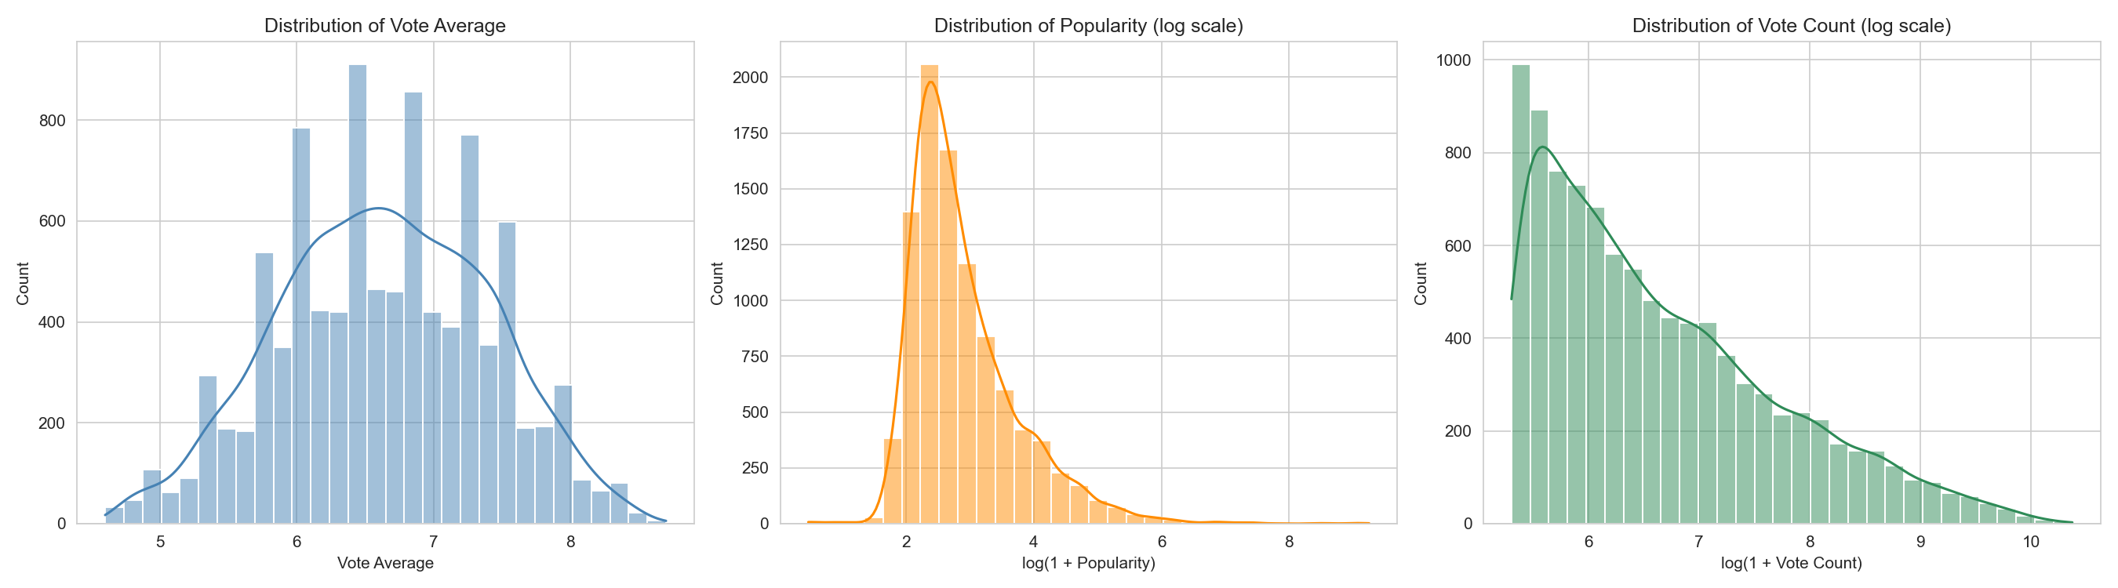
03 · EXPLORATORY DATA ANALYSIS
Distribution of Key Rating Metrics
Vote average is roughly bell-shaped around 6.6, while popularity and vote count are strongly right-skewed even on a log scale — motivating MinMax scaling before these features enter the model.
CineMatch — Content-Based Movie Recommendation System
8

Slide 9
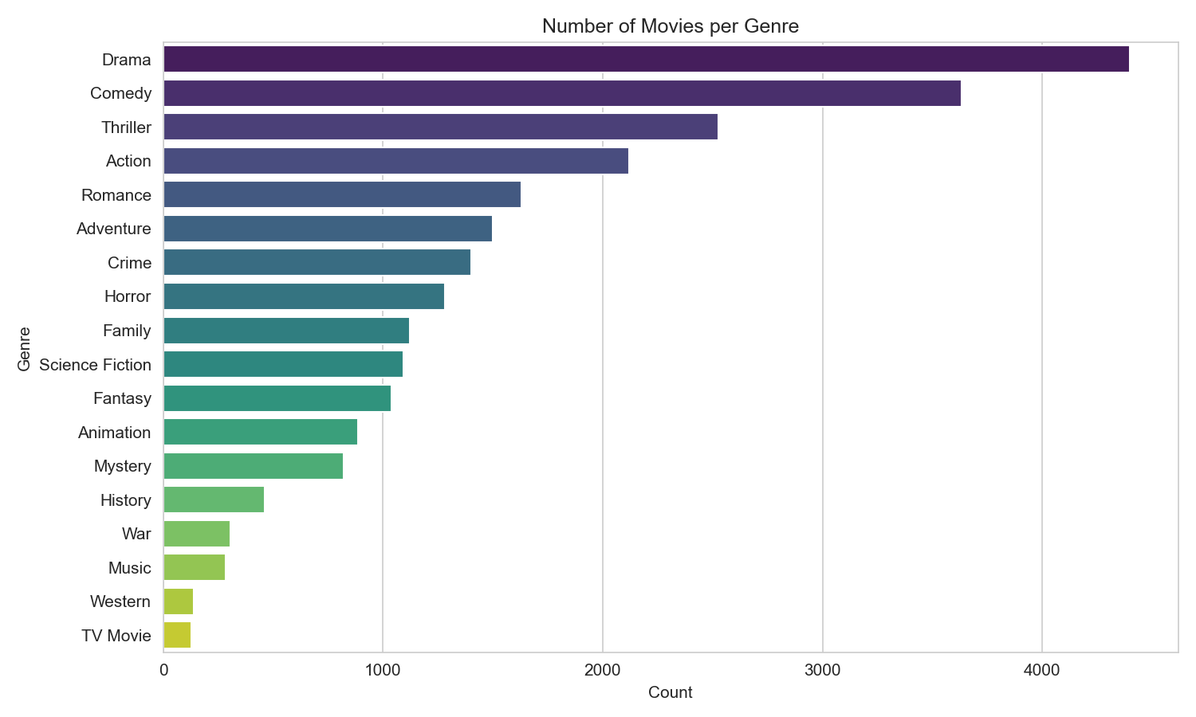
03 · EXPLORATORY DATA ANALYSIS
Genre Composition of the Catalogue
Drama (~4,400) and Comedy (~3,650) dominate the catalogue. 18 distinct genres occupy 18 of the 20 model feature dimensions, so genre is the primary axis the KNN search organises movies along.
CineMatch — Content-Based Movie Recommendation System
9

Slide 10
04 · METHODOLOGY
Weighted Rating — Bayesian Average
Ranking purely by vote_average is unreliable for low-vote titles. CineMatch uses IMDB's Bayesian-average formulation:
WR = ( v ÷ (v + m) ) × R + ( m ÷ (v + m) ) × C
R
Movie's own vote_average
v
Movie's vote_count
C
Mean vote_average across dataset = 6.636
m
Min-votes threshold (75th percentile) = 1,454
Effect: a movie with very few votes (v ≪ m) is pulled toward the dataset mean C, while a movie with many votes (v ≫ m) is scored close to its own rating R — preventing small-sample outliers from dominating rankings.
CineMatch — Content-Based Movie Recommendation System
10

Slide 11
04 · METHODOLOGY
Feature Engineering & Model Training
20-Dimensional Feature Vector
recommend_by_genre()
18 one-hot genre columns
(MultiLabelBinarizer)
popularity ×1.5
rating ×1.5
1
Build an “ideal profile” query vector — a 1 for the requested genre, plus configured popularity / rating weights.
Genres are one-hot encoded; popularity & vote_average are MinMax-scaled to [0,1] then weighted, so both signals shape similarity without one implying the other.
2
kneighbors() retrieves up to 200 nearest candidates by cosine distance.
Final matrix shape: (9658, 20)
Filter candidates to those tagged with the genre and meeting the minimum vote_count.
3
Model & Recommendation Function
NearestNeighbors(metric="cosine", algorithm="brute", n_neighbors=50) — angle-based similarity suits a feature space dominated by sparse binary genre indicators.
Sort by weighted_rating, then popularity; return the top_n results.
4
CineMatch — Content-Based Movie Recommendation System
11

Slide 12
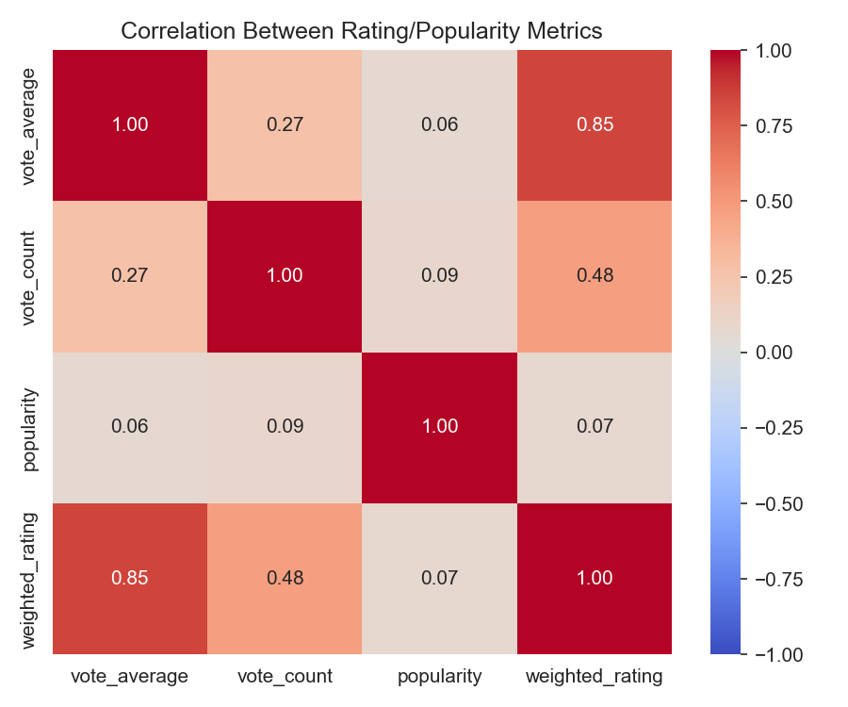
03 · EXPLORATORY DATA ANALYSIS
Correlation Between Rating & Popularity Metrics
weighted_rating ↔ vote_average: r = 0.85 — expected, since one derives from the other. popularity ↔ vote_average: r = 0.06 — nearly independent. This justifies including both popularity and rating explicitly in the feature vector, rather than assuming one implies the other.
popularity ↔ weighted_rating: r = 0.07 — also weak, reinforcing that popularity and quality are separate signals in this dataset.
CineMatch — Content-Based Movie Recommendation System
12

Slide 13
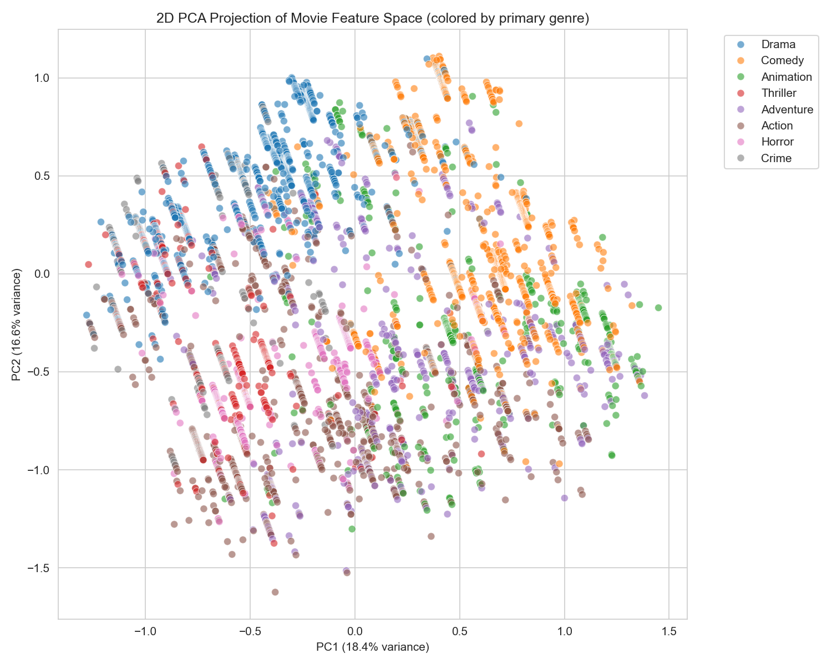
03 · EXPLORATORY DATA ANALYSIS
2D PCA Projection of the Feature Space
The 20-D feature matrix, coloured by primary genre, projected to 2 dimensions. Distinct genres form loosely separated regions — most visibly Animation, Horror, and Thriller. Confirms that genre one-hot encoding (18 of 20 dimensions) dominates the neighbourhood structure the KNN model searches over.
CineMatch — Content-Based Movie Recommendation System
13

Slide 14
05 · IMPLEMENTATION
Technology Stack & Notebook Pipeline
Technology Stack
Eight-Stage Notebook Pipeline
pandas / NumPy
Data handling
1
Load raw CSV
2
Data cleaning
scikit-learn
MultiLabelBinarizer, MinMaxScaler, NearestNeighbors, PCA
3
Compute weighted rating
Matplotlib / Seaborn
Exploratory visualisation
4
Build one-hot + scaled feature matrix
pickle
Pipeline serialisation
5
Train NearestNeighbors model
Streamlit + Plotly
Interactive web application
6
Define recommendation function
7
Run example recommendations (sanity check)
8
Serialise final bundle
CineMatch — Content-Based Movie Recommendation System
14
Each stage prints a labelled progress summary — the notebook is self-documenting and easy to re-run end-to-end.

Slide 15
05 · IMPLEMENTATION
The CineMatch Streamlit Application
Styled with a “late-night cinema” theme — dark navy, gold and velvet-red accents. Model bundle (movies1.pkl) loaded once via st.cache_resource.
9,658
18
6.6 / 10
Action
Films in Library
Genres Tracked
Avg. Rating
Now Screening
1
Build Your Screening
2
Dual Result Views
Sidebar: genre, pick count, min votes, release-year range, sort order (best match / highest rated / most popular / newest / oldest), grid/list layout.
Interactive Plotly scatter (rating vs popularity, size = votes, colour = weighted rating) plus illustrated 'movie ticket' cards.
3
Session Watchlist
4
CSV Export & Landing View
Every card has an Add-to-Watchlist checkbox; the sidebar tracks saved titles via st.session_state.
Full result set exportable as CSV; landing view shows a library-wide genre-distribution chart before any query is run.
CineMatch — Content-Based Movie Recommendation System
15

Slide 16
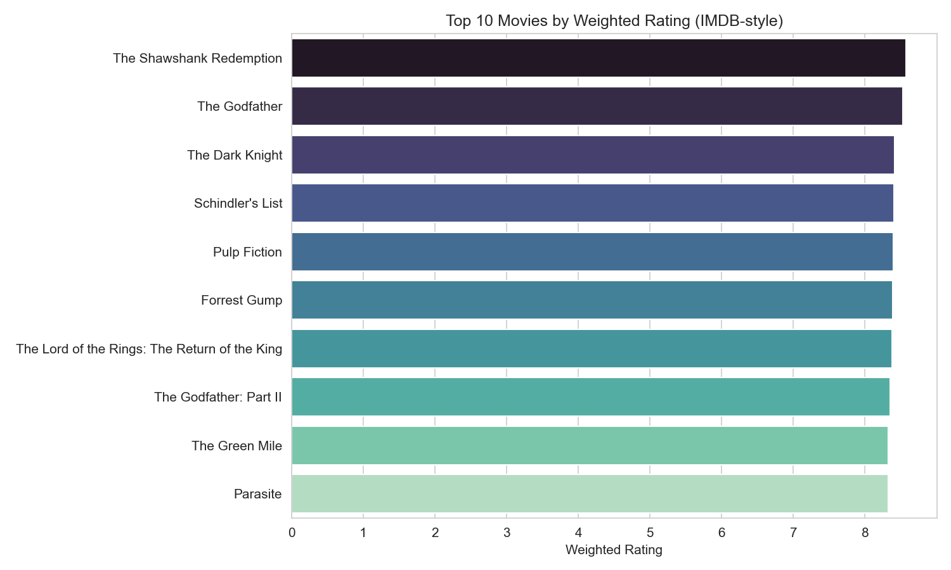
06 · RESULTS & ANALYSIS
Top 10 Movies by Weighted Rating
The Shawshank Redemption and The Godfather top the list — all entries are widely-recognised, high-vote-count titles. Confirms the Bayesian correction successfully suppresses low-vote-count outliers that could otherwise dominate a plain average-rating ranking.
CineMatch — Content-Based Movie Recommendation System
16

Slide 17
06 · RESULTS & ANALYSIS
Example Recommendations — Genre: Action
Validated against three representative genres (Action, Comedy, Animation). In every case, top results are well-known, critically regarded titles for that genre.
Title | Year | Rating | Popularity | Weighted
The Lord of the Rings: The Return of the King | 2003 | 8.5 | 134.71 | 8.373
Inception | 2010 | 8.4 | 111.76 | 8.323
The Lord of the Rings: The Fellowship of the Ring | 2001 | 8.4 | 168.45 | 8.287
The Lord of the Rings: The Two Towers | 2002 | 8.4 | 162.72 | 8.271
The Empire Strikes Back | 1980 | 8.4 | 28.32 | 8.238
Comedy top pick: Life of Brian (1979) · Animation top pick: Spirited Away (2001)
CineMatch — Content-Based Movie Recommendation System
17

Slide 18
07 · EVALUATION & FUTURE SCOPE
How It Was Evaluated — and What's Next
Evaluation Approach
Future Scope
No user-interaction history exists, so standard metrics like RMSE or precision@k are inapplicable. Two proxy checks were used instead:
→
Hybrid model combining content-based + collaborative filtering once interaction data exists
→
K-means clustering before search to cut query latency as the catalogue grows
Genre Consistency
Guaranteed by construction — results are filtered to require genre membership before ranking.
→
Richer features: cast, director, keywords, or plot embeddings (TF-IDF / sentence embeddings)
Qualitative Rating Validation
→
Formal offline evaluation via genre-holdout / precision@k protocol
Confirms returned titles are well-regarded, high-vote-count films, not statistical anomalies.
→
“Similar to X” query using the existing fitted encoder
→
Persistent, account-backed watchlists with public deployment
CineMatch — Content-Based Movie Recommendation System
18

Slide 19
CONCLUSION
A Working, Deployable
Recommendation Pipeline
CineMatch demonstrates that a purely content-based KNN pipeline — a Bayesian-adjusted weighted rating, a 20-D engineered feature space, and cosine-similarity search — can deliver genre-consistent, statistically reliable, and popularity-aware recommendations, end-to-end, through an interactive Streamlit application.
Thank You
Rohan Yadav · Enrollment No. 230022 · Starex University

