Slide 1
Pizza Sales
Data
(Dashboard creation in Microsoft Excel and verification of the dashboard using queries in Microsoft SQL Server)

Slide 2
Problem Statement
As a data analyst, I have been tasked with creating a comprehensive pizza sales dashboard to provide actionable insights and improve decision-making for a pizza company. The company's management recognizes the need to leverage data-driven strategies to optimize sales performance and enhance customer satisfaction. The goal is to develop a user-friendly and visually appealing pizza sales dashboard .By leveraging data visualization techniques, the dashboard will enable stakeholders to track sales performance, identify popular pizza flavours and toppings, analyse customer preferences and identify opportunities for growth and improvement.

Slide 3
KPI requirement
We need to analyse key indicators for our pizza sales data to gain insights into our business performance.
Specifically we want to calculate the following metrics:-
Total revenue : sum of total price of all the pizza orders
Average Order value: average amount spent per order, calculated by dividing the total revenue by the total number of orders
Total pizzas sold: sum of the quantities of all the pizza sold
Total orders: total number of orders placed
Average pizzas per order : average number of pizzas sold per order, calculated by dividing the total number of pizzas sold by the total number of orders

Slide 4
Charts requirement
We would like to visualize various aspects of our pizza sales data to gain insights and understand key trends.
We have identified the following requirements for creating charts:-
Daily trend for total orders : created a bar chart that displays the daily trend of total orders over a specific time period. This chart will help us identify any fluctuations in order volumes on a daily basis.
Hourly trend for total orders: created a line chart that displays the hourly trend of total orders throughout the day. This chart will allow us to identify peak hours or periods of high order activity.
Percentage of sales by pizza category: created a doughnut chart that shows the distribution of sales across different pizza categories which provides an insight into the popularity of various pizza categories and their contribution to overall sales.
Percentage of sales by pizza size: generated a pie chart that represents the percentage of sales by different pizza sizes which helps to understand customer preferences for pizza sizes and their impact on sales.
Total pizzas sold by pizza category: created a funnel chart that represents the total number of pizzas sold for each pizza category. This chart will allow us to compare the sales performance of different pizza categories.
Top 5 best sellers by total pizzas sold: Generated a stacked bar chart highlighting the top 5 best – selling pizzas based on the total number of pizzas sold which identified the most popular pizza options.
Bottom 5 worst sellers by total pizzas sold: Generated a bar chart showing the bottom 5 worst – selling pizzas based on the total number of pizzas sold which identified the less popular pizza options.

Slide 5
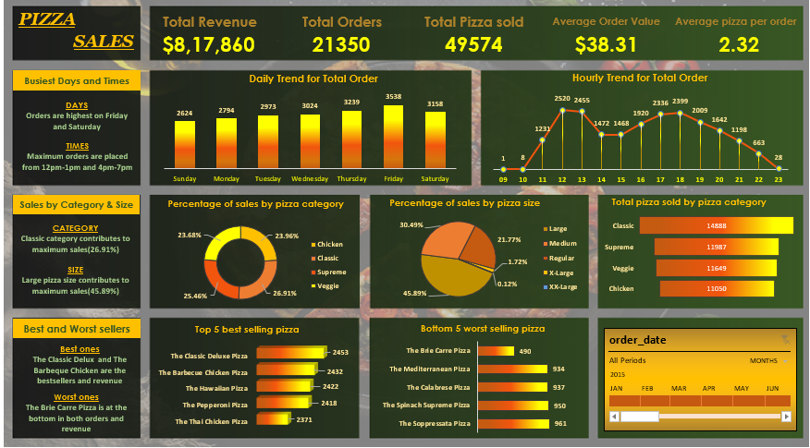

Slide 6
Problem statement
As a data analyst, my objective is to verify the accuracy and integrity of the pizza sales dashboard that I have made for the pizza company using SQL queries. It is crucial to ensure that the data is reliable and trustworthy to support informed decision-making and analysis. However, there are concerns regarding potential data inconsistencies, errors, or discrepancies within the database that may impact the validity of the sales data. I will import the pizza sales dataset in Microsoft SQL Server and verify the values are correct or not so that the user should only get the correct insights.

Slide 7

1. What is the Total Revenue generated?
SELECT SUM(total price) AS Total_Revenue FROM pizzadb.dbo.pizza_sales ;

Slide 8

2. What is the Average Order Value?
SELECT (SUM(total_price) / COUNT(DISTINCT order_id)) AS Avg_order_Value
FROM pizzadb.dbo.pizza_sales;

Slide 9

3. What is the Total number of Pizzas Sold?
SELECT SUM(quantity) AS Total_pizza_sold FROM pizzadb.dbo.pizza_sales;

Slide 10

4. What are the Total number Orders placed?
SELECT COUNT(DISTINCT order_id) AS Total_Orders FROM pizzadb.dbo.pizza_sales;

Slide 11

5. What is the Average number of Pizzas Per Order?
SELECT CAST(CAST(SUM(quantity) AS DECIMAL(10,2)) /
CAST(COUNT(DISTINCT order_id) AS DECIMAL(10,2)) AS DECIMAL(10,2)) AS Avg_Pizzas_per_order
FROM pizzadb.dbo.pizza_sales;

Slide 12
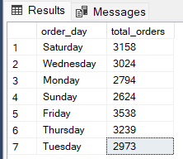
6. Daily Trend for Total Orders SELECT DATENAME(DW, order_date) AS order_day, COUNT(DISTINCT order_id) AS total_orders
FROM pizzadb.dbo.pizza_sales
GROUP BY DATENAME(DW, order_date);

Slide 13
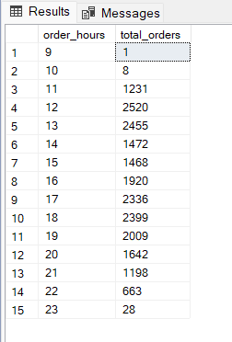
7. Hourly Trend for Orders
SELECT DATEPART(HOUR, order_time) as order_hours, COUNT(DISTINCT order_id) as total_orders FROM pizzadb.dbo.pizza_sales
GROUP BY DATEPART(HOUR, order_time) ORDER BY DATEPART(HOUR, order_time);

Slide 14
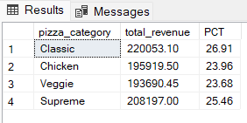
8. What is the total percentage of Sales by Pizza Category?
SELECT pizza_category, CAST(SUM(total_price) AS DECIMAL(10,2)) as total_revenue,
CAST(SUM(total_price) * 100 / (SELECT SUM(total_price) from pizzadb.dbo.pizza_sales) AS DECIMAL(10,2)) AS PCT
FROM pizzadb.dbo.pizza_sales GROUP BY pizza_category;

Slide 15
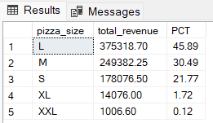
9. What is the total percentage of Sales by Pizza Size?
SELECT pizza_size, CAST(SUM(total_price) AS DECIMAL(10,2)) as total_revenue,
CAST(SUM(total_price) * 100 / (SELECT SUM(total_price) from pizzadb.dbo.pizza_sales) AS DECIMAL(10,2)) AS PCT FROM pizzadb.dbo.pizza_sales
GROUP BY pizza_size ORDER BY pizza_size;

Slide 16
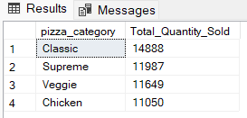
10. What is the Total number of Pizzas Sold by Pizza Category?
SELECT pizza_category, SUM(quantity) as Total_Quantity_Sold FROM pizzadb.dbo.pizza_sales
WHERE MONTH(order_date) = 2
GROUP BY pizza_category ORDER BY Total_Quantity_Sold DESC;

Slide 17
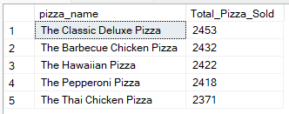
11. Top 5 Best Sellers by Total Pizzas Sold
SELECT Top 5 pizza_name, SUM(quantity) AS Total_Pizza_Sold FROM pizzadb.dbo.pizza_sales
GROUP BY pizza_name ORDER BY Total_Pizza_Sold DESC;

Slide 18
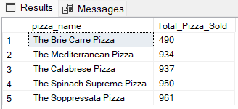
12. Bottom 5 Worst Sellers by Total Pizzas Sold
SELECT TOP 5 pizza_name, SUM(quantity) AS Total_Pizza_Sold FROM pizzadb.dbo.pizza_sales
GROUP BY pizza_name ORDER BY Total_Pizza_Sold ASC;

Slide 19
NOTE:
If you want to apply the Month, Quarter, Week filters to the above queries you can use WHERE clause. Follow some of below examples
SELECT DATENAME(DW, order_date) AS order_day, COUNT(DISTINCT order_id) AS total_orders
FROM pizzadb.dbo.pizza_sales
WHERE MONTH(order_date) = 1
GROUP BY DATENAME(DW, order_date)
*Here MONTH(order_date) = 1 indicates that the output is for the month of January. MONTH(order_date) = 4 indicates output for Month of April.
SELECT DATENAME(DW, order_date) AS order_day, COUNT(DISTINCT order_id) AS total_orders
FROM pizzadb.dbo.pizza_sales
WHERE DATEPART(QUARTER, order_date) = 1
GROUP BY DATENAME(DW, order_date)
*Here DATEPART(QUARTER, order_date) = 1 indicates that the output is for the Quarter 1. MONTH(order_date) = 3 indicates output for Quarter 3.

