Slide 1
Selenium Capstone Project -SauceDemo TestNG&Cucumber
By Lakshmi Priyanka
JavaSelenium
(Batch-03)

Slide 2
Introduction-SauceDemo
E-commerce sites need robust testing to ensure quality
Manual testing is time-consuming and error-prone
Goal : Build an automation test suite for SauceDemo web app

Slide 3
Objectives
Automate Login, Sorting, Cart, and Checkout flows.
Apply Behavior-Driven Development (BDD) with Cucumber.
Run tests using TestNG.
Generate HTML Reports.

Slide 4
Tools & Technologies
Language: Java
Automation Tool: Selenium WebDriver
Frameworks: TestNG + Cucumber (BDD)
Build Tool: Maven
IDE: Eclipse
Version Control: Git

Slide 5
Project Architecture
Page Object Model (POM) + Step Definitions
Feature files → Written in Gherkin (scenarios)
StepDefs → Implemented in Java (Selenium code)
Runner → Executes features with TestNG
Hooks → Open/Close browser per scenario
Reports → Cucumber HTML / TestNG reports

Slide 6
Test Scenarios
LoginFeature
SortingFeature
CartFeature
CheckoutFeature

Slide 7
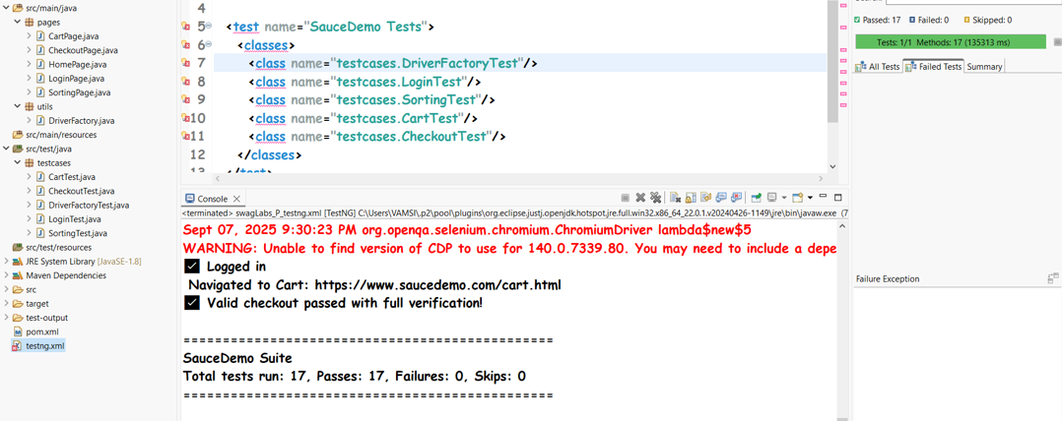
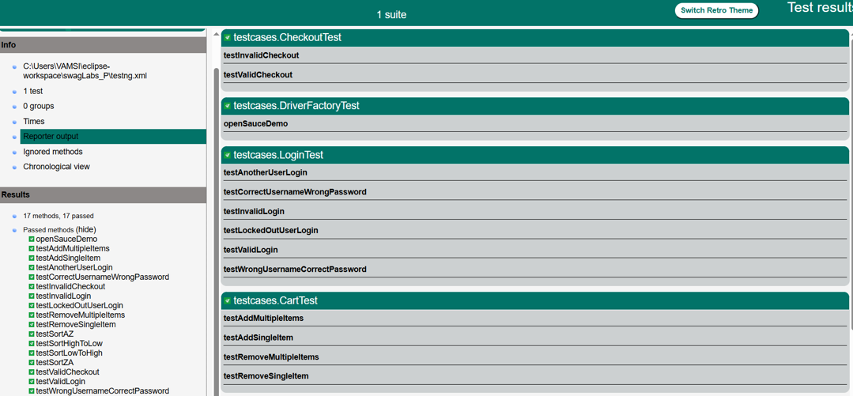
TestNG Reports

Slide 8
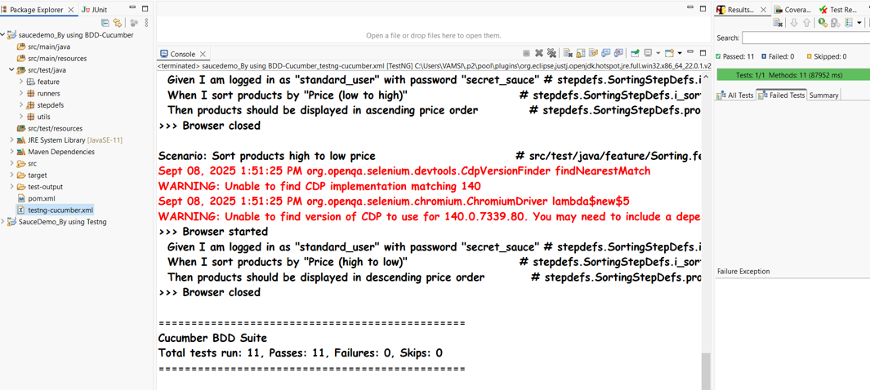
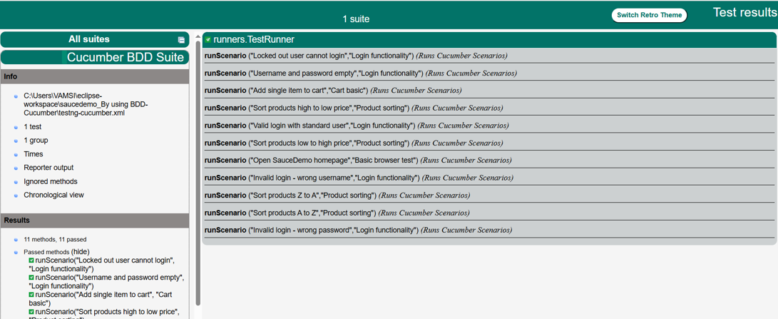
BDD-Cucumber Reports

Slide 9
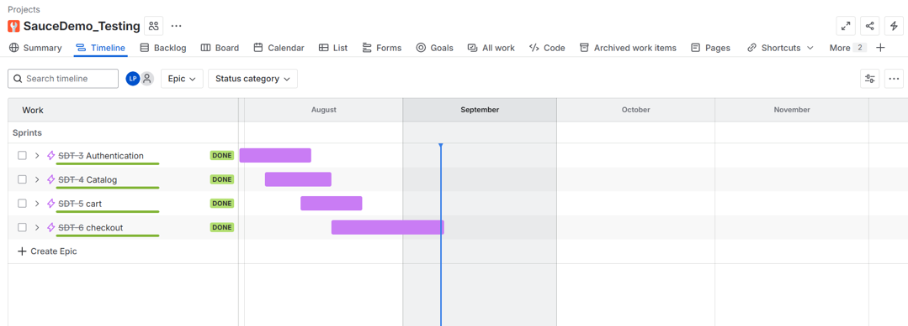
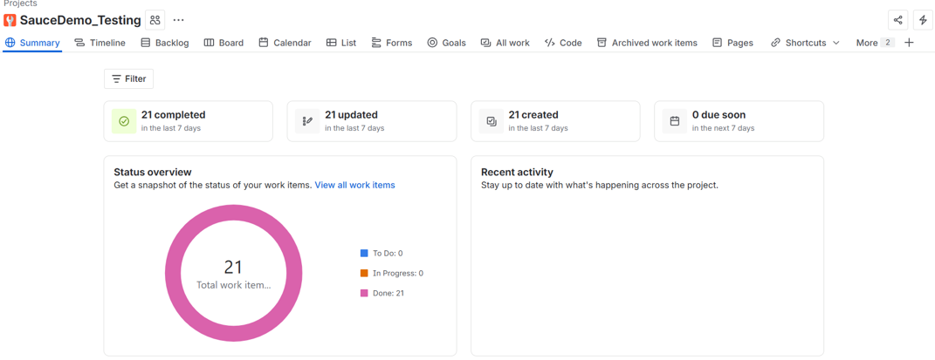
Jira Reports

Slide 10
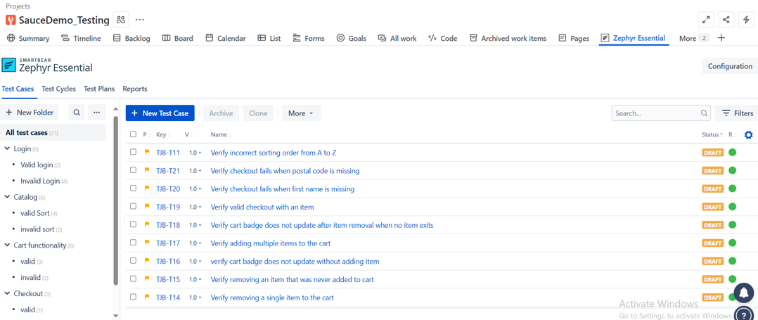
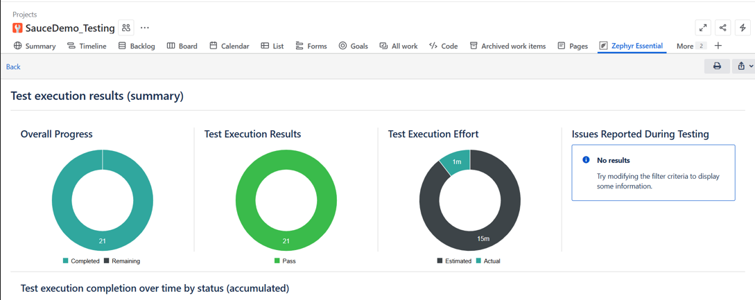
Zephyr Reports

Slide 11
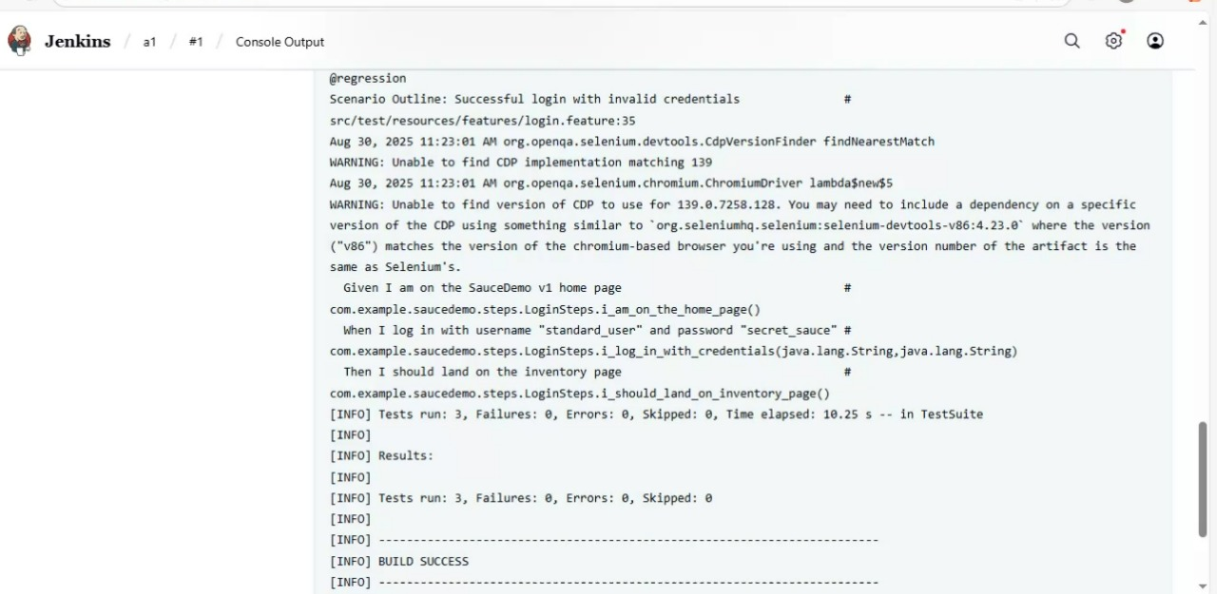
Jenkins

Slide 12
THANK YOU

