Slide 1
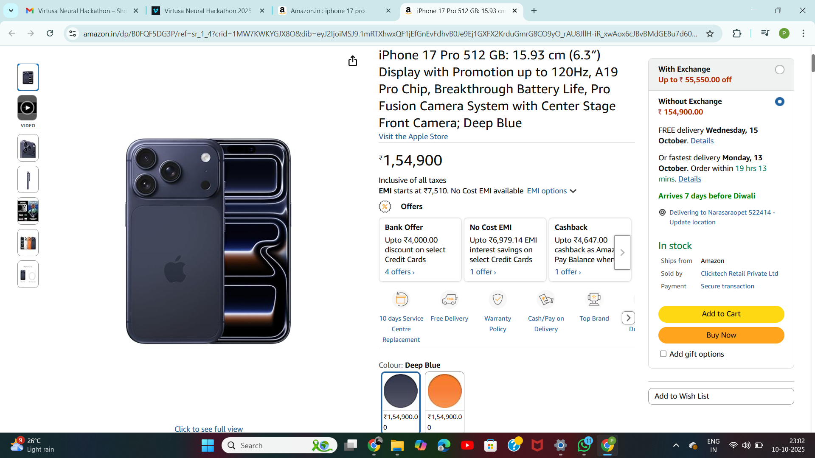
Assignment-1 Operators

Slide 2
.
1) Arithmetic Operators Used to perform mathematical operations.
`+` → Indicates increase (e.g., “up to 120Hz”)
`-` → Used as a hyphen or subtraction sign
`%` → Represents percentage (e.g., 120%)
`/` → Appears in URLs (`amazon.in/dp/...`)
2) Comparison (Relational) Operators
• `<=` → “Up to ■4,000 off” means price reduction ≤ 4000
3) Logical Operators
`or` → “With Exchange or Without Exchange”
`and` → “Ships from Amazon and sold by ClickTech Retail Pvt Ltd”
4) Assignment Operator
• `=` → Seen in URL parameters (e.g., `crid=1MW7KWKYGJX8O...`)
* Summary of Operators Identified is `+ - % / . <= == = and or`

