Slide 1
Deep_Ensemble_Learning_With_Pruning_for_DDoS_Attack_Detection_in_IoT_Networks

Slide 2
Abstract
Cyber Attack is one of the important security in today’s cyber world. Lot of techniques have been developed which are based on machine learning approaches.
So for identifying the intrusion we have designed the different machine learning algorithms such as CNN , LSTM , Ensemble CNN and LSTM. The experimental results shows that the accuracy algorithms.
A Network based Intrusion Detection System (NIDS) is usually placed at network points such as a gateway and routers to check for intrusions in the network traffic.
In this process, CICIDS-2017 was taken from dataset repository. Then, we have to implement the pre-processing, data splitting and classification.

Slide 3
Objectives
The main objective of our project is,
To classify or predict the attacks effectively for the dataset.
To implement the different machine learning algorithms for comparing the better performances.
To enhance the overall performance for classification algorithms by means of the accuracy.

Slide 4
Introduction
Hacking incidents are increasing day by day as technology rolls out. A large number of hacking incidents are reported by companies each year. Distributed Denial of Service (DDoS) attack was launched against Estonian websites in 2007.On June 17, 2008, Amazon started receiving some authenticated request from multiple users in one of its location.
The requests began to increase significantly causing the servers slow down. On Jan 2013, European Network and Information Security Agency (ENISA) reported that Dropbox was attacked by DDoS and suffered a substantial loss of service for more than 15 hours affecting all users across the globe.
Facebook was hit by suspected distributed denial of service attack on Sept 28, 2014. Reported that some form of network scanning activity precedes 50% of the attacks against cyber systems

Slide 5
Existing System
In existing system, our main focus is on Network Intrusion Detection Systems (NIDS); hence, this paper reviews existing NIDS implementation tools and datasets as well as free & open-source network sniffing software.
Then, it surveys, analyses and compares state-of-the-art NIDS proposals in the IoT context in terms of architecture, detection methodologies, validation strategies, treated threats and algorithm deployments.
The review deals with both traditional and machine learning (ML) NIDS techniques and discusses future directions.
In this survey, our focus is on IoT NIDS deployed via Machine Learning since learning algorithms have a good success rate in security and privacy.

Slide 6
Disadvantages
The results is low when compared with proposed
It doesn’t efficient for large volume of data’s
It didn’t implement the deep learning algorithm.
Theoretical limits.

Slide 7
Proposed System
In this system, CICIDS-2017 dataset was taken as input. The input data was taken from the dataset repository. Then, we have to implement the data pre-processing step.
In this step, we have to handle the missing values for avoid wrong prediction, and to encode the label for input data. Then, we have to split the dataset into test and train.
Training portion is used to evaluate the model and testing portion is used to predicting the model.
The algorithms such as CNN , LSTM , Ensemble CNN and LSTM neighbour for predicting and classifying the attacks.
Finally, the experimental results shows that the performance metrics such as accuracy, precision and recall.

Slide 8
Advantages
It is efficient for large number of datasets.
The experimental result is high when compared with existing system.
Time consumption is low.

Slide 9
Flow Diagram

Slide 10

Overall Flow
CICIDS-2017 Dataset
Load the Dataset
Trained Model
Pre-processing
Prediction Phase
Test Data
Train Test Split
Performance Metrics
CNN , LSTM , Proposed Model
Classification Algorithms

Slide 11
Modules
Data selection
Preprocessing
Data splitting
Classification
Result generation

Slide 12
Modules Description

Slide 13
Data Selection
The input data was collected from dataset repository.
In our process, the cicids-2017 dataset is used.
The data selection is the process of detecting the attacks.
The input dataset was taken from dataset repository such as UCI repository.
The dataset contains the information such protocol, duration, host error rate, label and so on.

Slide 14
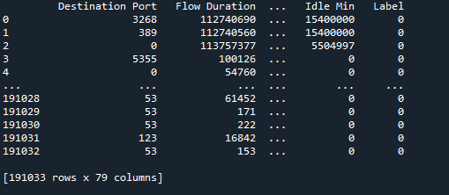
Data Selection

Slide 15
Data Preprocessing
Data pre-processing is the process of removing the unwanted data from the dataset.
Pre-processing data transformation operations are used to transform the dataset into a structure suitable for machine learning.
Missing data removal: In this process, the null values such as missing values and Nan values are replaced by 0.
Encoding Categorical data: That categorical data is defined as variables with a finite set of label values.

Slide 16

Data Preprocessing

Slide 17
Data Splitting
During the machine learning process, data are needed so that learning can take place.
In addition to the data required for training, test data are needed to evaluate the performance of the algorithm in order to see how well it works.
In our process, we considered 70% of the our dataset to be the training data and the remaining 30% to be the testing data.
Data splitting is the act of partitioning available data into two portions, usually for cross-validator purposes.
One Portion of the data is used to develop a predictive model and the other to evaluate the model's performance.

Slide 18
Classification
In our process, we have to implement the machine learning algorithm such as CNN , LSTM , Integrate CNN AND LSTM.
CNN – A Convolutional Neural Network (CNN) is a deep learning algorithm designed for image analysis. It uses convolutional layers to detect patterns, pooling layers to reduce dimensionality, and fully connected layers for classification. CNNs are highly effective for tasks like image recognition and object detection.
LSTM- Long Short-Term Memory (LSTM) is a type of recurrent neural network (RNN) designed to handle long-term dependencies. It uses memory cells, gates (input, forget, and output) to control information flow, making it effective for sequence prediction tasks like language modeling and time-series forecasting.

Slide 19
Classification
* Proposed : Integrating CNN and LSTM combines their strengths: CNNs extract spatial features from image data, while LSTMs capture temporal dependencies. This hybrid model processes input sequences, such as video frames, by first using CNN layers for feature extraction, followed by LSTM layers to analyze the sequential information, enhancing tasks like video analysis.

Slide 20
Performance
The Final Result will get generated based on the overall classification and prediction. The performance of this proposed approach is evaluated using some measures like,
Accuracy
Accuracy of classifier refers to the ability of classifier. It predicts the class label correctly and the accuracy of the predictor refers to how well a given predictor can guess the value of predicted attribute for a new data.
AC= (TP+TN)/ (TP+TN+FP+FN)

Slide 21
Performance
Precision
Precision is defined as the number of true positives divided by the number of true positives plus the number of false positives.
Precision=TP/ (TP+FP)
Recall
Recall is the number of correct results divided by the number of results that should have been returned. In binary classification, recall is called sensitivity. It can be viewed as the probability that a relevant document is retrieved by the query.
Recall=TP/ (TP+FN)

Slide 22
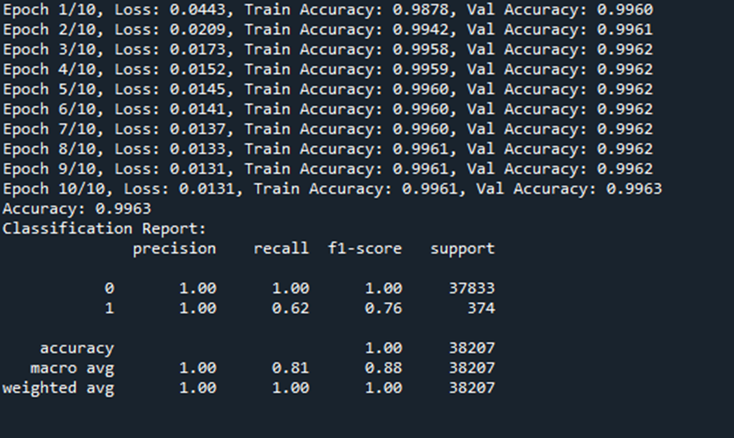
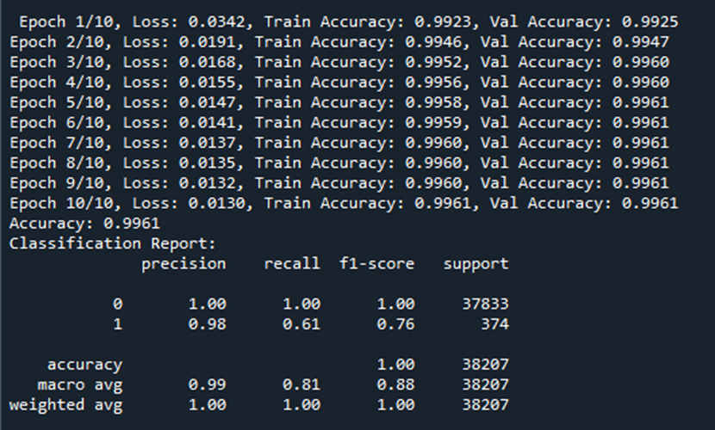
Result
CNN :
Proposed :

Slide 23

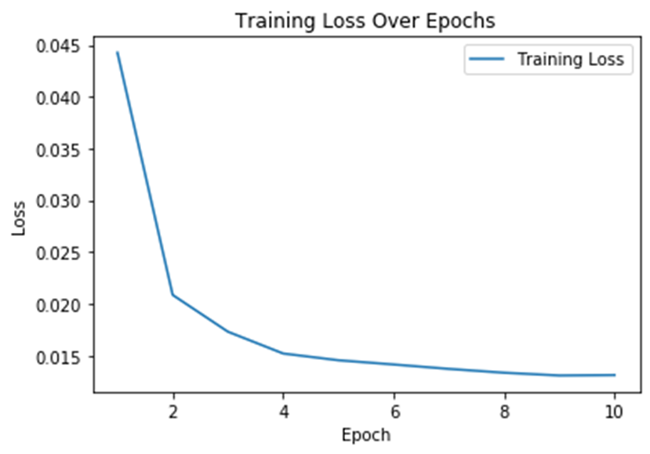
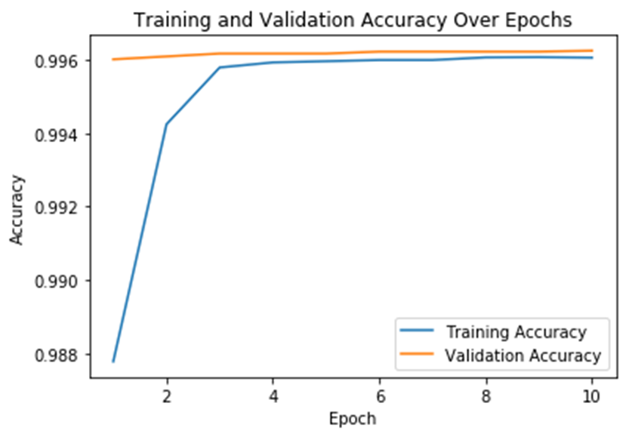
Result

Slide 24
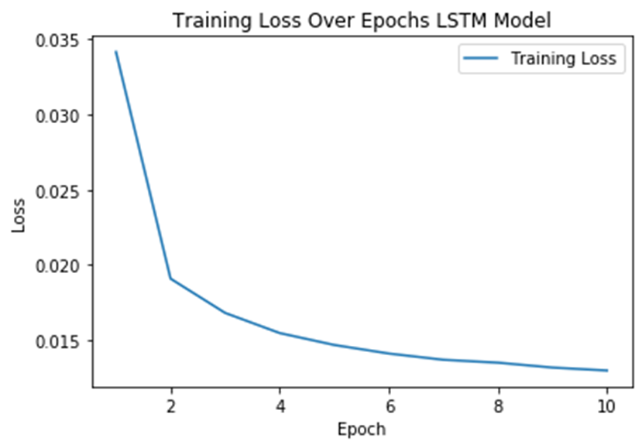
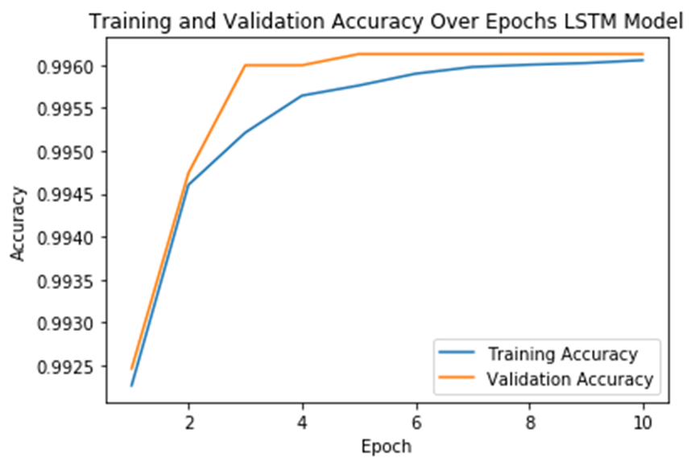
LSTM :

Slide 25
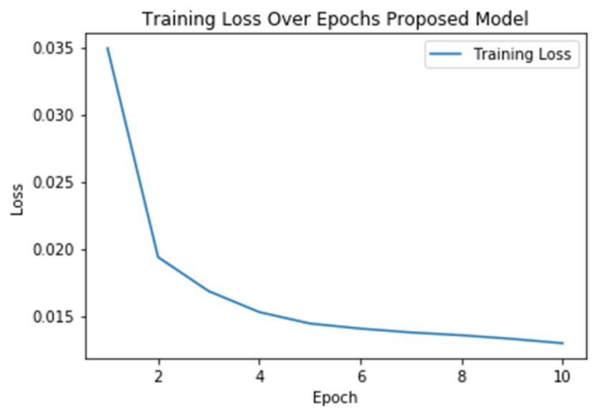
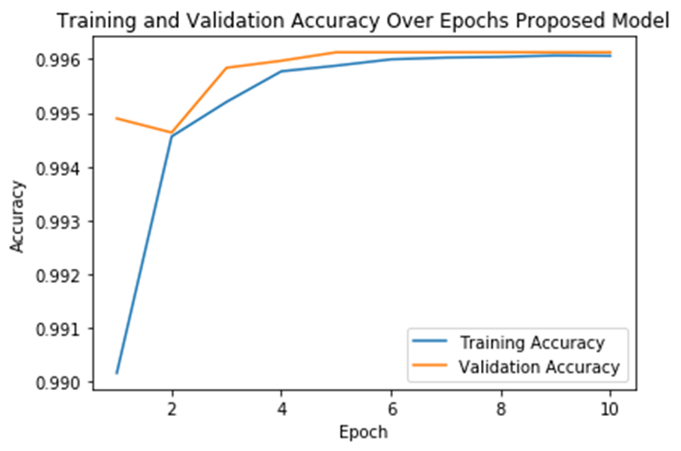
Proposed :

Slide 26
System Requirements
SOFTWARE REQUIREMENTS:
O/S : Windows 7.
Language : Python
Front End : Spyder
HARDWARE REQUIREMENTS:
System : Pentium IV 2.4 GHz
Hard Disk : 200 GB
Mouse : Logitech.
Keyboard : 110 keys enhanced
Ram : 4GB

Slide 27
Literature Survey

Slide 28
Title | Year | Author | Methodology | Advantages | Disadvantages
Toward generating a new intrusion detection dataset and intrusion traffic characterization | 2018 | I. Sharafaldin, A. H. Lashkari, and A. A. Ghorbani, | A lack of traffic diversity and volumes, some of them do not cover the variety of attacks, while others anonymized packet information and payload which cannot reflect the current trends, or they lack feature set and metadata. This paper produces a reliable dataset that contains benign and seven common attack network flows, which meets real world criteria and is publicly avaliable. | Statistical techniques do not require prior knowledge of network attacks. | The main disadvantages of various feature learning systems is their complexity and are expensive to implement.

Slide 29
Title | Year | Author | Methodology | Advantages | Disadvantages
A performance overview of machine learning-based defense strategies for advanced persistent threats in industrial control systems | 2023 | M. Imran, H. U. R. Siddiqui, A. Raza, M. A. Raza, F. Rustam, and I. Ashraf,, | Cybersecurity incident response is a very crucial part of the cybersecurity management system. Adversaries emerge and evolve with new cybersecurity tactics, techniques, and procedures (TTPs). It is essential to detect the TTPs in a timely manner to respond effectively and mitigate the vulnerabilities to secure business operations. | The advantage of this system is malicious network events using IDS signatures and follows their development as consecutive events, finding matches in terms of IP address or port | An attacker does not need to follow a precise order for executing a multi-step attack, so the set of possible sequences of actions can be very complex

Slide 30
Title | Year | Author | Methodology | Advantages | Disadvantages
A LSTM-FCNN based multi-class intrusion detection using scalable framework | 2022 | S. K. Sahu, D. P. Mohapatra, J. K. Rout, K. S. Sahoo, Q.-V. Pham, and N.-N. Dao | The growing number of connected Internet of Things (IoT) devices has led to the daily growth of network botnet attacks. The networks of compromised devices controlled by a single entity can be used for malicious purposes such as denial of service distributed IoT botnet attacks and theft of personal information. The weak security measures of many IoT devices make them easy targets for compromise and inclusion in botnets. | The spark iterative computation architectural enables large-scale machine learning algorithms to achieve high level efficiency in results, and spark.ml API for pipeline offers developers with extensive range of new module to integrate with their architecture. | Small and slow-ramped attacks can bypass the statistical techniques by keeping the impact of attack under statistical thresholds.

Slide 31
Title | Year | Author | Methodology | Advantages | Disadvantages
‘Hybrid intrusion detection system based on combination of random forest and autoencoder | 2023 | C. Wang, Y. Sun, W. Wang, H. Liu, and B. Wang, | he hybrid model operates in two steps. In particular, in the first step, we utilize the probability output of the RF classifier to determine whether a sample belongs to attack. The unknown attacks can be identified with the assistance of the probability output. In the second step, an additional AE is coupled to reduce the false positive rate. To simulate an unknown attack in experiments, we explicitly remove some samples belonging to one attack class from the training set | XGBoost ensembles have been used to detect malicious traffic and intrusions with high accuracy. | The main Disadvantage of this problem of signature based method is that the database signature needs to be updated as the new signatures become available and therefore it is not suitable for the real-time network anomaly detection

Slide 32
Title | Year | Author | Methodology | Advantages | Disadvantages
Building Machine Learning and Deep Learning Models on Google Cloud Platform | 2019 | E. Bisong and E. Bisong, ‘‘Google colaboratory | Building Machine Learning and Deep Learning Models on Google Cloud Platform is divided into eight parts that cover the fundamentals of machine learning and deep learning, the concept of data science and cloud services, programming for data science using the Python stack, Google Cloud Platform (GCP) infrastructure and products, advanced analytics on GCP, and deploying end-to-end machine learning solution pipelines on GCP. | The main advantage of SVM is a machine learning model with the advantages of high detection rate of small samples and strong generalization ability, which is suitable for handling high-dimensional and non-linear Shodan traffic from a small amount of Shodan scanners. | Small and slow-ramped attacks can bypass the statistical techniques by keeping the impact of attack under statistical thresholds.

Slide 33
Title | Year | Author | Methodology | Advantages | Disadvantages
Anomaly detection in networks using machine learning,’’ Res. Proposal | 2018 | K. Kostas | The Anomaly-based approach is an alternative solution to the network attacks and has the ability to detect zero-day attacks as well. In this study, it is aimed to detect network anomaly using machine learning methods. In this context, the CICIDS2017 has been used as dataset because of its up-todatedness, and wide attack diversity | These can accurately detect the attacks which cause an abrupt and highly deviated changes in the network traffic | High dimensionality and variation in network traffic can affect the performance of statistical intrusion detection systems. It is difficult to compute the statistics of normal network traffic.

Slide 34
Title | Year | Author | Methodology | Advantages | Disadvantages
Network intrusion detection system: Machine learning approach | 2022 | A. S. Jaradat, M. M. Barhoush, and R. B. Easa | The model first acquires the data set and transforms it in the proper format, then performs feature selection to pick out a subset of attributes that worth being considered. After that, the refined data set was processed by the Konstanz information miner (KNIME). To gain better performance and a decent comparative analysis, three different classifiers were applied. The anticipated classifiers have been executed and assessed utilizing the KNIME analytics platform using (CICIDS2017) datasets. | The main advantage is Heterogeneity among the actual Sensors, IDSs, Analyzers, or even SIEMs can be beneficial for Intrusion Detection where detection accuracy can be improved | It is difficult to provide adequate security in distributed systems because the nodes as well as the connections need to be secured.

Slide 35
Conclusion
We conclude that, the dataset CICIDS-2017 was taken as input. The input dataset was mentioned in our research paper.We are implemented the classification algorithms
Then, algorithms such as CNN , LSTM , Integrate CNN and LSTM . Finally, the result shows that the accuracy for above mentioned algorithm and estimated the performances metrics such as accuracy, precision, recall and f1 score.

Slide 36
Future Work
In the future, we should like to hybrid the two different machine learning or to hybrid two deep learning algorithms. In future, it is possible to provide extensions or modifications to the proposed clustering and classification algorithms to achieve further increased performance.
Apart from the experimented combination of data mining techniques, further combinations and other clustering algorithms can be used to improve the detection accuracy. Finally, the sentiment analysis detection system can be extended as a prevention system to enhance the performance of the system.

Slide 37
References
M. S. I. Alsumaidaie, K. M. A. Alheeti, and A. K. Al-Aloosy, ‘‘Intelligent detection system for a distributed denial-of–service (DDoS) attack based on time series,’’ in Proc. 15th Int. Conf. Develop. eSyst. Eng. (DeSE), Jan. 2023, pp. 445–450.
S. Siva Shankar, B. T. Hung, P. Chakrabarti, T. Chakrabarti, and G. Parasa, ‘‘A novel optimization based deep learning with artificial intelligence approach to detect intrusion attack in network system,’’ Educ. Inf. Technol., Jun. 2023.
R. Salama, F. Al-Turjman, C. Altrjman, and D. Bordoloi, ‘‘The ways in which artificial intelligence improves several facets of cyber security—A survey,’’ in Proc. Int. Conf. Comput. Intell., Commun. Technol. Netw. (CICTN), Apr. 2023, pp. 825–829.

Slide 38
References
Z. Pelletier and M. Abualkibash, ‘‘Evaluating the CIC IDS-2017 dataset using machine learning methods and creating multiple predictive models in the statistical computing language R,’’ Science, vol. 5, no. 2, pp. 187–191, 2020.
T. Elmasri, N. Samir, M. Mashaly, and Y. Atef, ‘‘Evaluation of CICIDS2017 with qualitative comparison of machine learning algorithm,’’ in Proc. IEEE Cloud Summit, Oct. 2020, pp. 46–51.
V. Gustavsson, ‘‘Machine learning for a network-based intrusion detection system: An application using Zeek and the CICIDS2017 dataset,’’ Tech. Rep., 2019.

Slide 39
Thank You…

