Slide 1
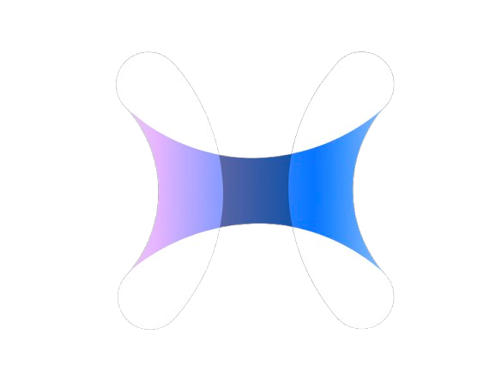
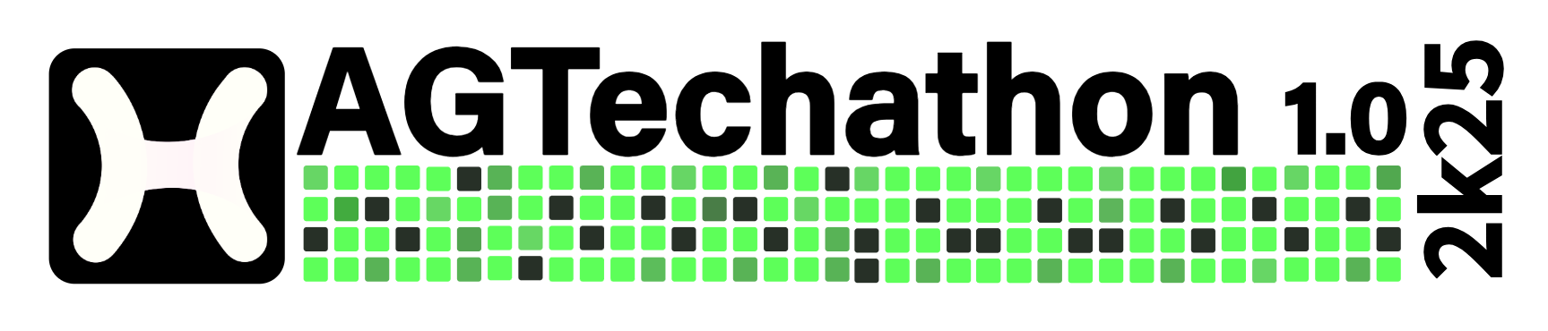
INDEX
Problem Statement Title - AI-Powered Smart Travel Planner: Automating Personalized Itineraries for Seamless Exploration
Theme – Open Innovation
Domain – Software
PS Category – Open Innovation
Team Name (As per Registration) – The RouteCoders

Slide 2
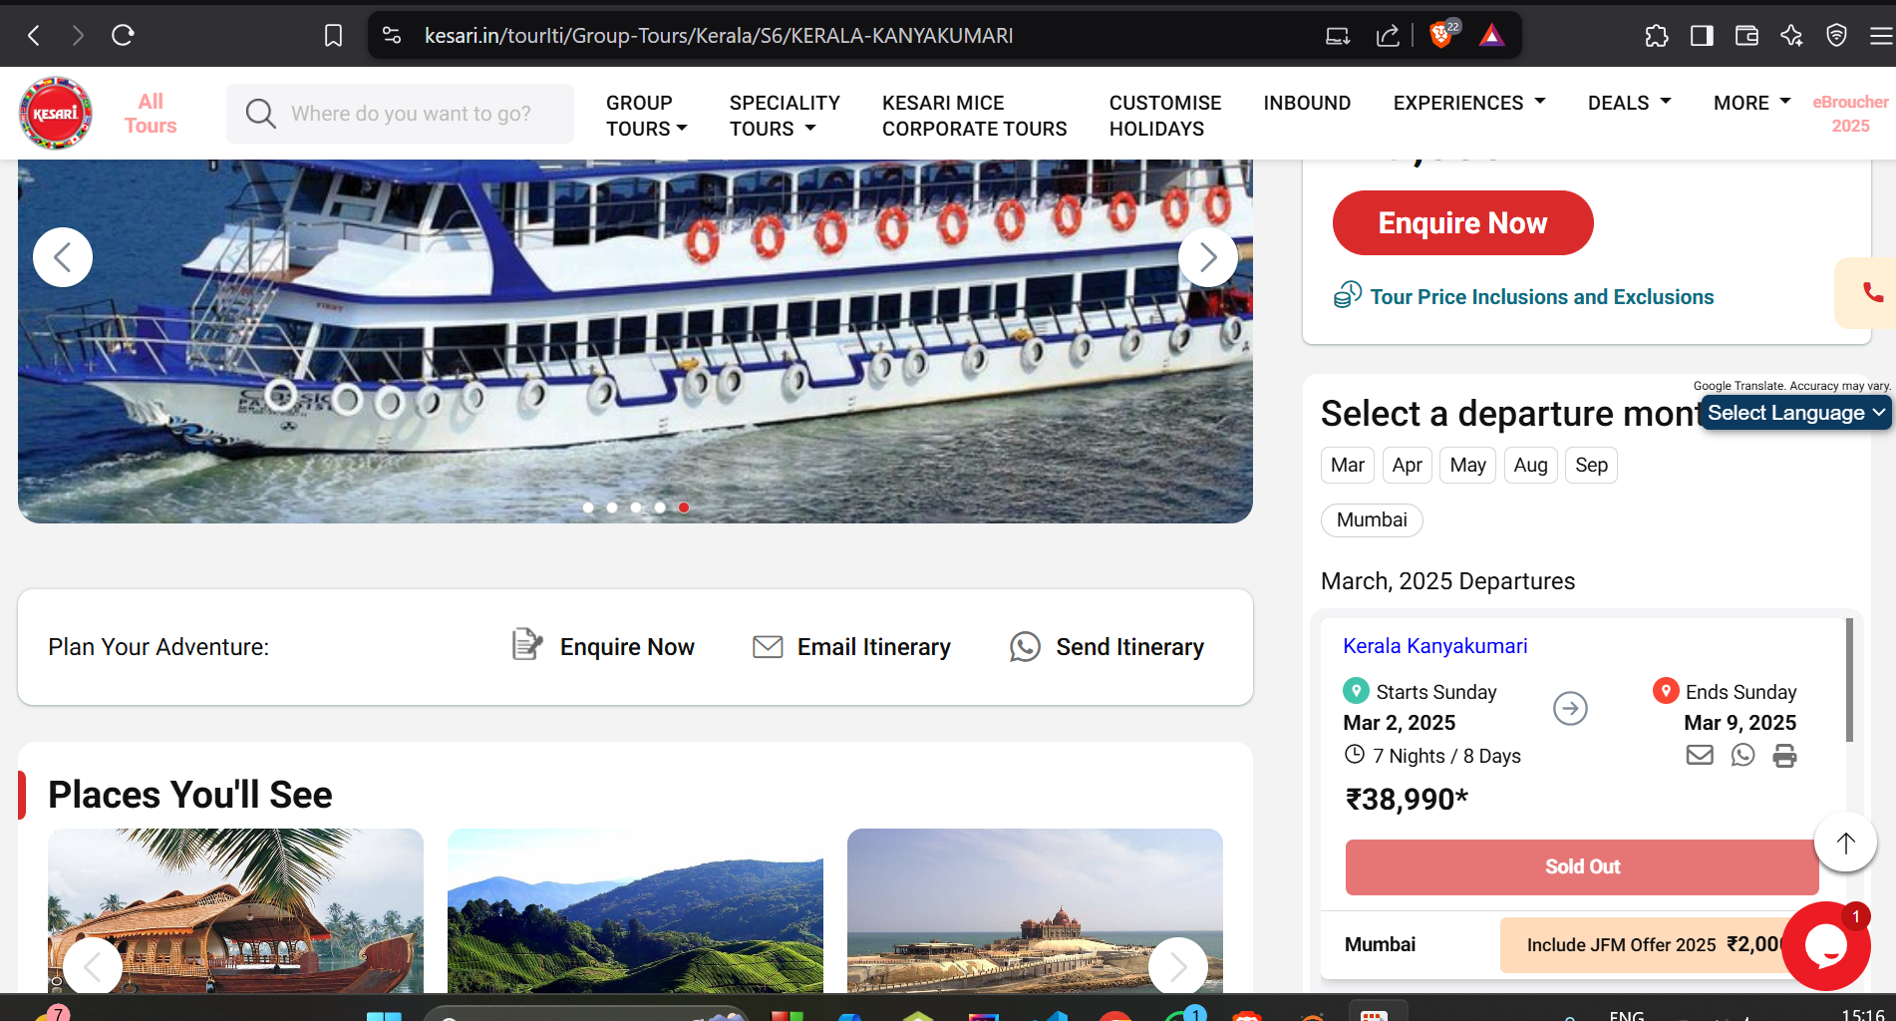
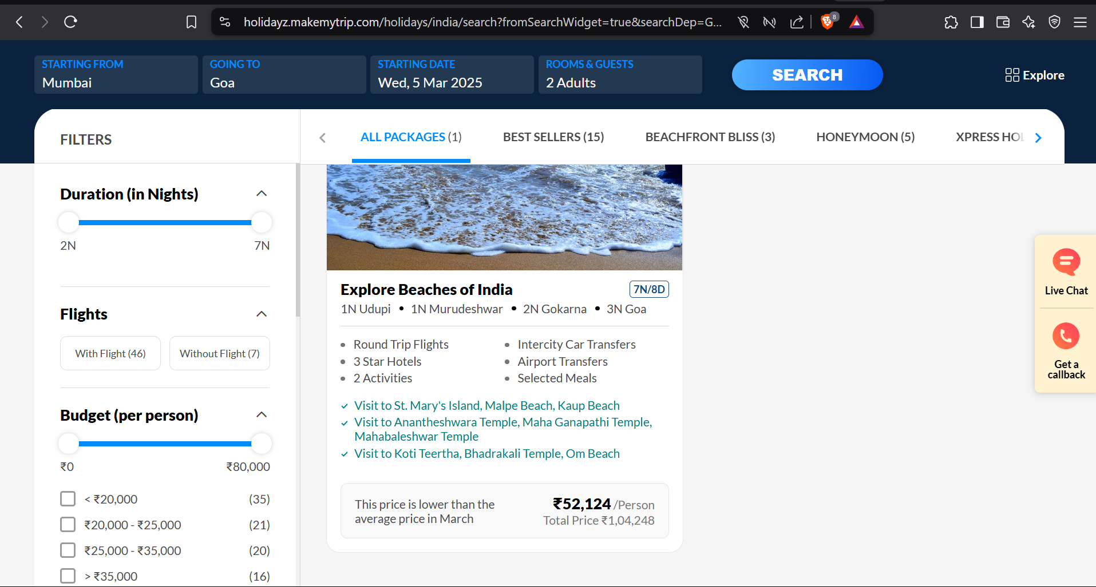
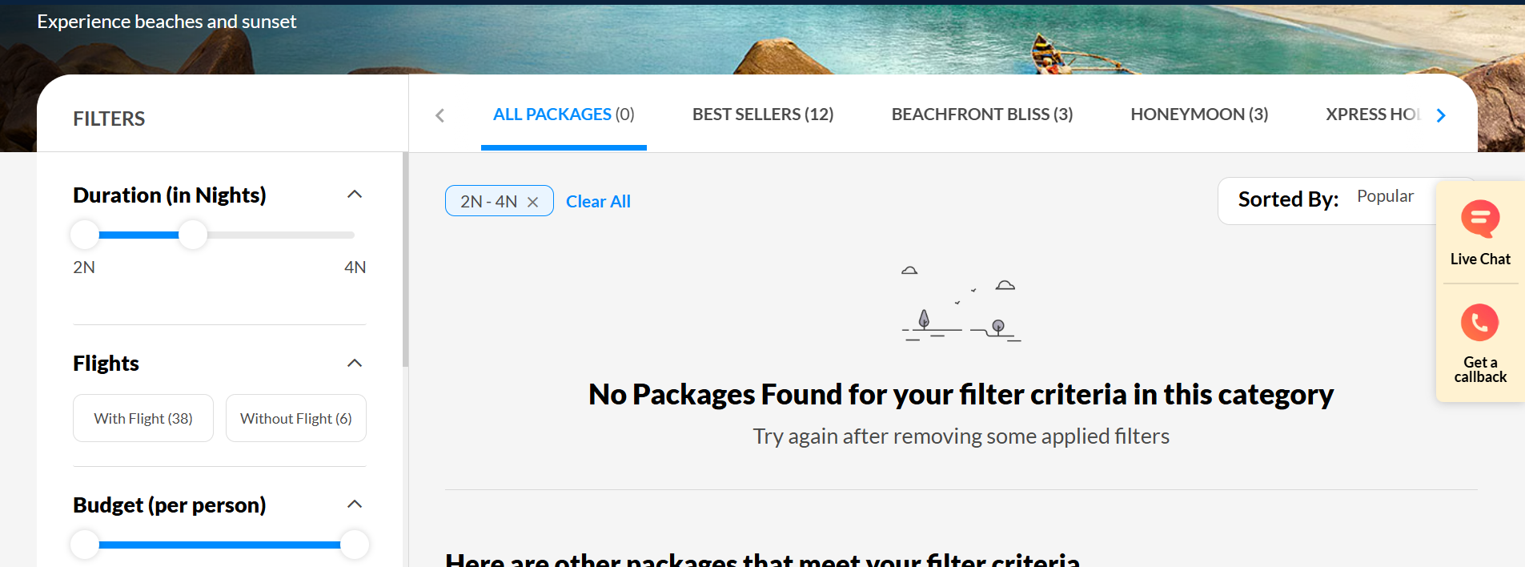
Problem Statement
Planning a trip can be overwhelming due to extensive research on destinations, budgets, and many more conditions.
Travelers face challenges with unexpected changes, lack of personalized recommendations, and difficulty collaborating.
A smart solution is needed to simplify planning, enhance personalization, and adapt in real time for a hassle-free experience.
Last moment plans sold out😱
No packages available as per our preference😓
High prices!!!!!!!

Slide 3
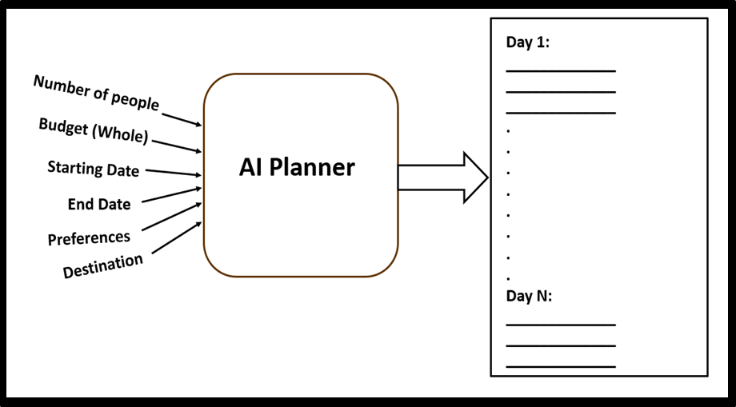
Proposed Solution
Unique Features
Trip Craft simplifies planning by handling research, adapting to real-time changes, and enabling collaboration effortlessly.​
AI-Powered Travel Itinerary Planner:
AI-driven tool that adjusts travel itineraries in real time based on trending travel hotspot patterns.
Smart & Adaptive Planning
Flexible & Effortless
Seamless Collaboration
Budget-Friendly Travel
Engaging Travel Community
Plan from Scratch: Enables travelers to build fully custom itineraries manually, offering total control over every destination, activity, and time slot.
Snap Safari :
Users can post travel photos, similar to an Instagram-style experience.
Live Itinerary Collaboration:
Enables multiple users to co-create, edit, and share travel plans in real-time, ensuring seamless
coordination and
personalized itineraries
for group trips.
Trip Craft makes travel planning effortless, personalized, and stress-free—so users can focus on enjoying their journey.​

Slide 4
Feasibility
Viability
Use of Proven Tech Stack: Relies on tried-and-tested technologies like MongoDB, Python/Node.js, REST APIs, and cloud deployment, ensuring stability and scalability.
User Onboarding is Simple: The interface will be intuitive, as travel apps are widely used—making adoption easier.
Cross-Platform Deployment: Can be developed as a web app first, and later adapted into a mobile app using frameworks like React Native or Flutter.
Modular Development Possible: Each feature (planner, friend finder, language translation) can be developed and tested independently.
Market Demand: Addresses common user pain points—budget constraints, last-minute planning, and lack of personalization—making it a relevant and in-demand solution.
Scalability: The platform is extendable—from solo users to groups, across domestic and international travel, with minimal rework.
Monetization Potential: Partnering with travel agencies, eco-stays, or running ads on the app can generate sustainable revenue streams.
Community Growth Factor: The engaging community feature can attract and retain users by fostering trust, tips, and shared experiences—leading to organic growth.

Slide 5
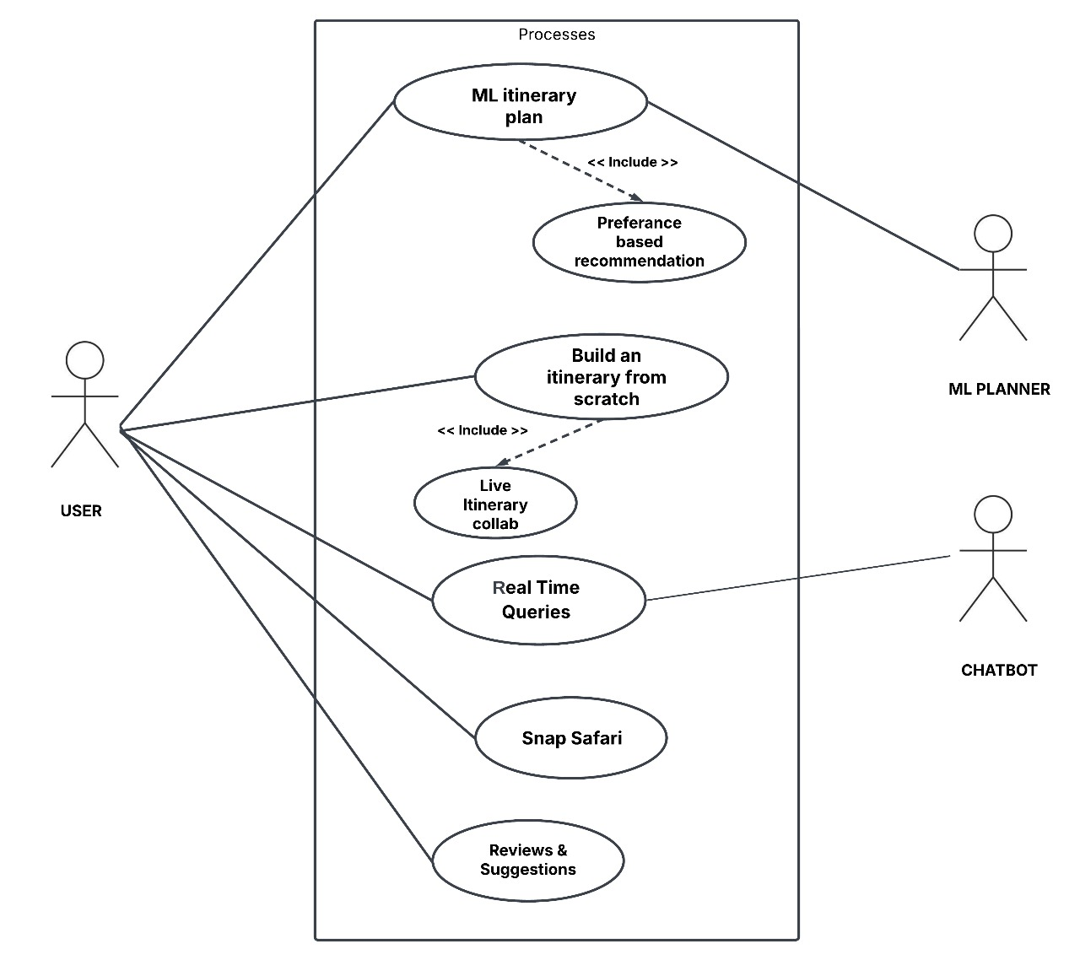
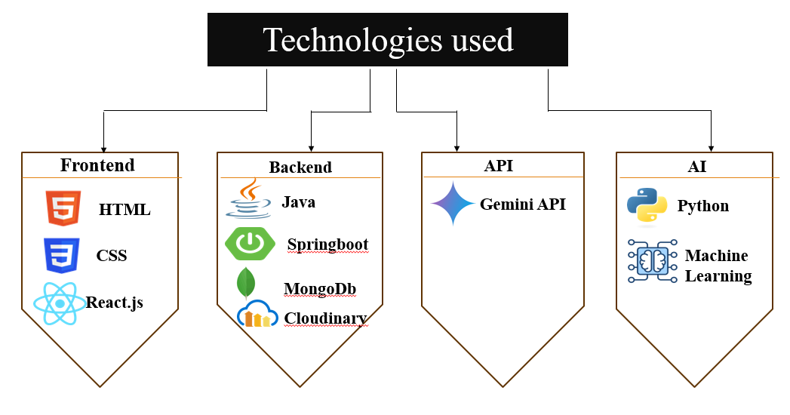
Technical Approach
Use case diagram

Slide 6
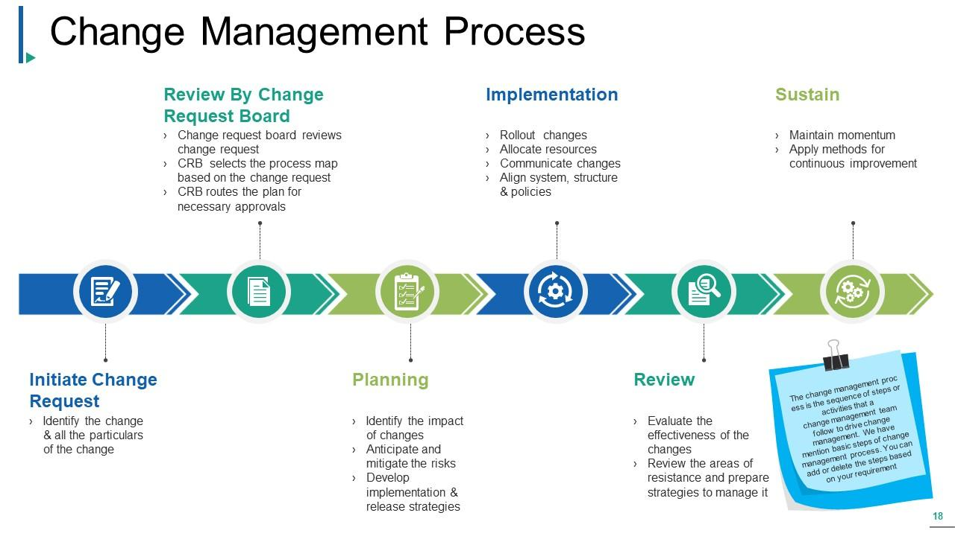




IMPACTS
Reduced Planning Stress
More Personalized Experiences
Improved Last-Minute Planning
BENEFITS
Saves Money Travel Expenses:
Predicts the best time to book flights and hotels.
Enhances Travel Experience – Allows travelers to focus on experiences rather than money management.
Improves Trip Planning Efficiency:
Reduces time spent on budgeting and booking.
Reduces Financial Stress – Eliminates worries about running out of money during trips.

Slide 7
Research & References
Make my trip :
https://www.makemytrip.com/holidays-india/
Kesari :
https://www.kesari.in/
Yatri :
https://www.yatra.com/
ScienceDirect:
https://www.sciencedirect.com/science/article/pii/S1877050924008585
MongoDB – NoSQL Database
https://www.mongodb.com/docs/manual/introduction/

