Slide 1
AWS
(Amazon Web Services)

Slide 2
Content:
Introduction.
Different web services provider.
AWS over other service providers.
List of different services that we cover in this sessions.
How to create AWS account.

Slide 3
1. Introduction.
Amazon Web Services (AWS) is a comprehensive and widely-used cloud computing platform provided by Amazon, the e-commerce giant. It offers a wide range of services that allow individuals, businesses, and organizations to build and manage applications, store and process data, and deploy various types of software applications without having to invest in physical hardware.
Here are some key aspects of AWS:
Global Infrastructure: AWS operates in multiple regions around the world, each containing multiple availability zones. This extensive global network enables users to deploy applications in various geographic locations to reduce latency and increase redundancy.
Pricing Model: AWS operates on a pay-as-you-go pricing model, which means you only pay for the services you use. This can be beneficial for startups and businesses as it eliminates the need for large upfront investments in hardware.
Security and Compliance: AWS places a strong emphasis on security. They offer a variety of security services and features to help protect data, applications, and infrastructure. AWS is also compliant with various industry standards and certifications.
Scalability and Flexibility: AWS allows users to easily scale resources up or down based on demand. This is particularly useful for applications that experience fluctuating levels of traffic.

Slide 4
5. Service Offerings: AWS provides a vast array of services across categories including computing power, storage solutions, databases, machine learning, analytics, content delivery, Internet of Things (IoT), security, and more. Some of the core services include:
Amazon EC2 (Elastic Compute Cloud): Provides resizable compute capacity in the cloud, allowing users to run virtual servers for a wide range of applications.
Amazon S3 (Simple Storage Service): Offers scalable object storage designed to store and retrieve any amount of data from anywhere on the web.
Amazon RDS (Relational Database Service): Managed relational database service that supports multiple database engines like MySQL, PostgreSQL, Oracle, and more.
Lambda: Allows you to run code without provisioning or managing servers. It's often used for event-driven applications and microservices.
Amazon DynamoDB: A managed NoSQL database service designed for high availability and performance at any scale.
AWS SageMaker: A fully-managed service for building, training, and deploying machine learning models.

Slide 5
6. Ecosystem and Marketplace: AWS has a vast ecosystem of partners and third-party applications that can be integrated with their services. The AWS Marketplace offers a wide range of pre-configured software packages that can be deployed on the platform.
7. Management Tools: AWS provides a suite of management tools, including AWS Management Console, AWS CLI (Command Line Interface) , and AWS SDKs (Software Development Kits) for various programming languages.
8. Support and Documentation: AWS offers different levels of support plans and has extensive documentation, tutorials, and forums to help users get started and troubleshoot any issues.
Whether you're a developer, a startup, or an established enterprise, AWS provides a robust and flexible cloud computing platform that can meet a wide range of computing needs. It's worth exploring AWS's extensive suite of services to see how they can benefit your specific use case or business requirements.

Slide 6
2. Different Web Service Providers.
Certainly! There are several web services providers that offer a wide range of services to individuals and businesses. Here are some popular web services providers:
Amazon Web Services (AWS): AWS is one of the largest and most comprehensive cloud computing platforms, offering a vast array of services including computing power, storage, databases, machine learning, analytics, and more.
Microsoft Azure: Azure is Microsoft's cloud computing platform that provides a variety of services like virtual machines, databases, AI and machine learning, and more. It's known for its integration with Microsoft products like Windows Server and Office 365.
Google Cloud Platform (GCP): GCP offers a suite of cloud computing services, including computing, storage, databases, machine learning, and data analytics. It's known for its expertise in data analytics and machine learning.
IBM Cloud: IBM offers a range of cloud services including computing, storage, databases, AI, and blockchain. They also provide enterprise-level solutions and services.

Slide 7
Oracle Cloud: Oracle's cloud platform provides a variety of cloud services including computing, storage, databases, analytics, and enterprise applications.
DigitalOcean: DigitalOcean is known for its simplicity and developer-friendly approach. They specialize in providing cloud infrastructure services, including scalable compute platforms and object storage.
Alibaba Cloud: Alibaba Cloud is the cloud computing arm of Alibaba Group and is one of the leading cloud providers in Asia. They offer a wide range of cloud services including computing, databases, networking, and more.
Heroku: Heroku is a cloud platform as a service (PaaS) that simplifies application deployment and management. It's popular among developers for its ease of use and support for multiple programming languages.
Cisco Cloud: Cisco offers a range of cloud and hybrid cloud solutions for networking, security, collaboration, and more.
NVIDIA Cloud: NVIDIA provides cloud-based solutions for artificial intelligence, data science, and high-performance computing.

Slide 8
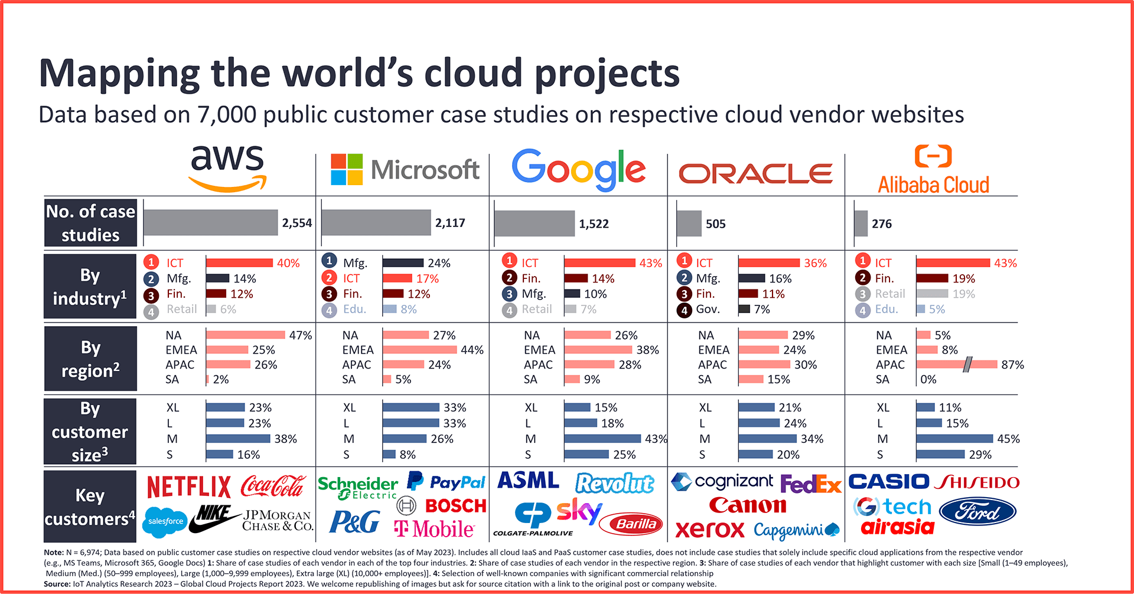
3. AWS over other service providers.

Slide 9
Certainly! Amazon Web Services (AWS) is one of the largest and most widely used cloud service providers in the world. When comparing AWS with other cloud services, it's important to consider factors like service offerings, market share, pricing, global reach, and specific strengths or focus areas. Here's are some of the reasons why AWS is most popular over other services :
Service Offerings: Both AWS and Azure offer a comprehensive suite of cloud services, including computing, storage, databases, AI, machine learning, IoT, and more.
Market Share: AWS and Azure are the top two cloud service providers, with AWS historically holding a larger market share.
Global Reach: AWS has a vast global network of data centers (regions) spread across the world.
Pricing: Pricing models can be complex and depend on the specific services used. In some cases, they offers competitive pricing, and different services have various pricing options including pay-as-you-go, reserved instances, and more.
Strengths: AWS is known for its vast ecosystem of services and strong presence in industries like e-commerce, gaming, and media.

Slide 10
4. List of different services that we cover in this session.
Compute Services:
EC2 (Elastic Compute Cloud): Provides resizable compute capacity in the cloud, allowing users to run virtual servers (known as instances).
Lambda: Allows you to run code without provisioning or managing servers. It's a serverless computing service.
Storage Services:
S3 (Simple Storage Service): Object storage that allows you to store and retrieve any amount of data.
EBS (Elastic Block Store): Provides block-level storage volumes for use with EC2 instances.
Databases:
RDS (Relational Database Service): Managed service for SQL databases like MySQL, PostgreSQL, MariaDB, Oracle, and Microsoft SQL Server.

Slide 11
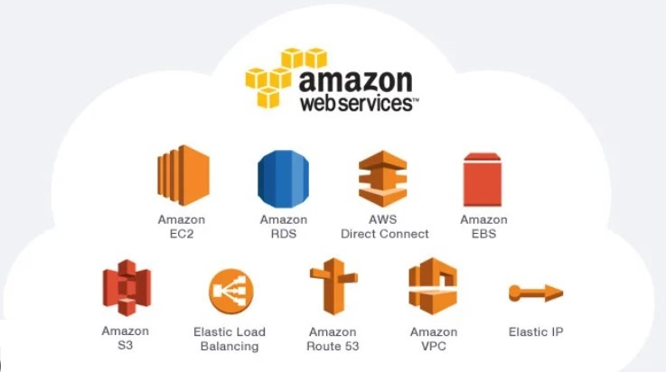
Security and Identity:
IAM (Identity and Access Management): Allows you to manage users and their level of access to the AWS platform.
Management and Monitoring:
CloudWatch: Provides monitoring for AWS resources and applications, as well as the capability to collect and track metrics.

Slide 12
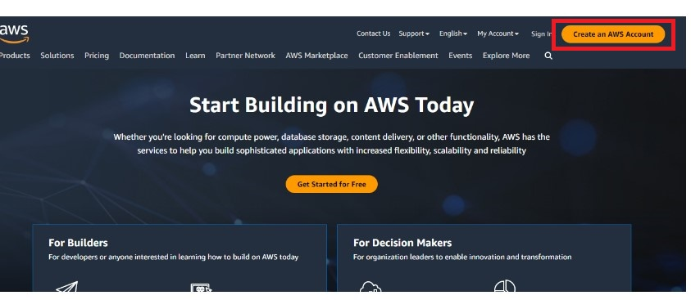
5. How to create AWS account.
You would need to create AWS account to access AWS services. Below are the steps to follow to create AWS account.
Access "http://aws.amazon.com/" portal from your favorite browser and click on "Create an AWS Account".

Slide 13
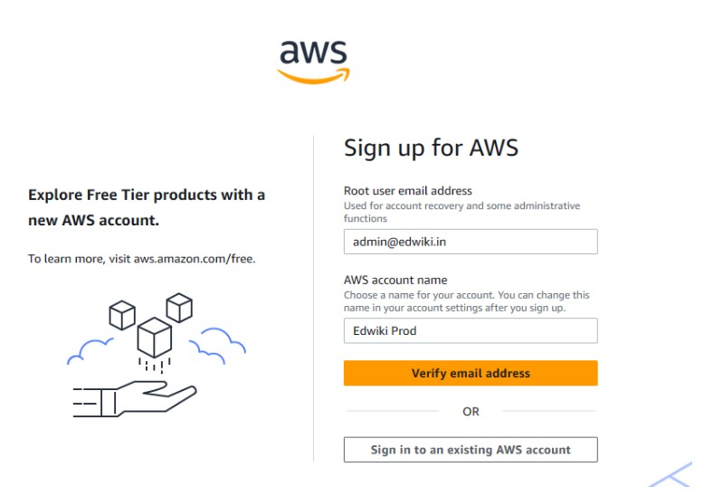
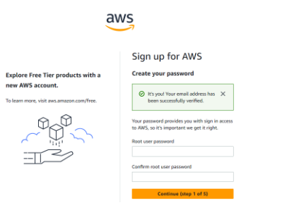
Provide E-Mail address, AWS account name in the next page and click on "Continue".
Provide root account password that you can use later to login to AWS console.

Slide 14
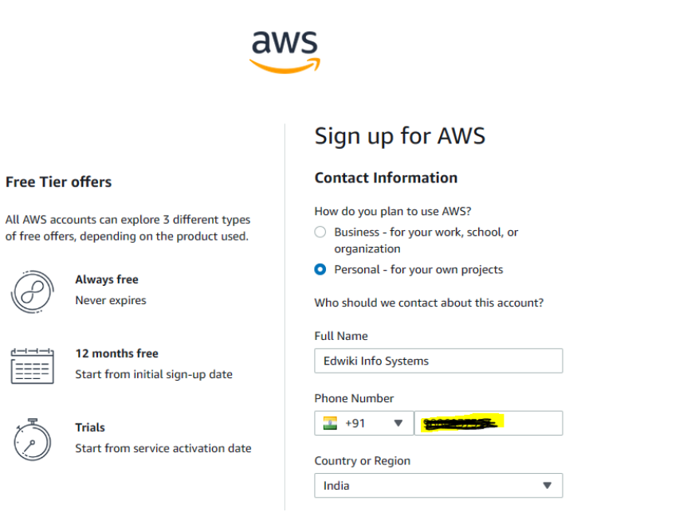
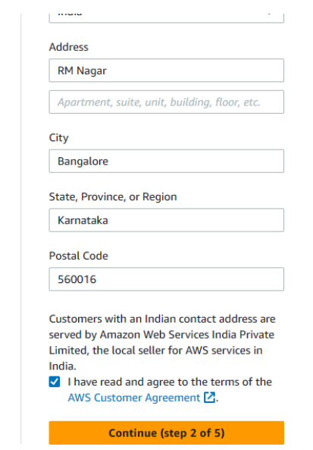
Provide Contact Information like, Full Name, Phone Number, Country, Postal Address in the below page and click on Continue.

Slide 15
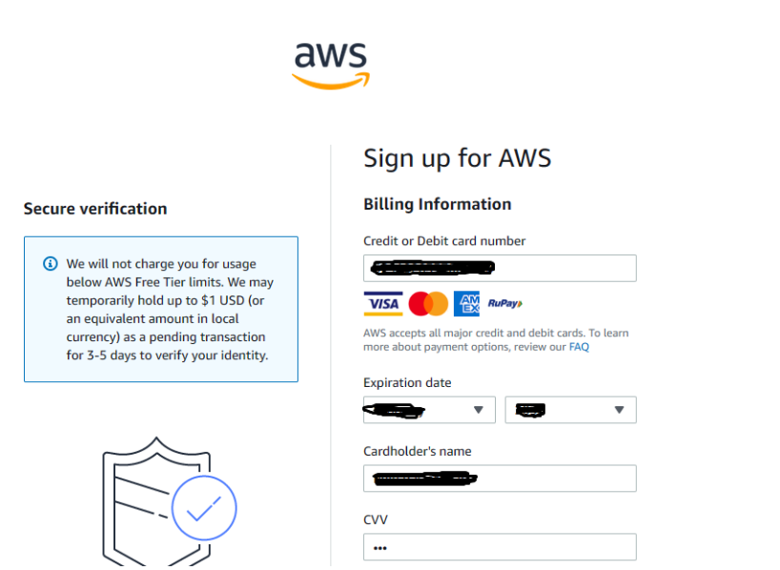
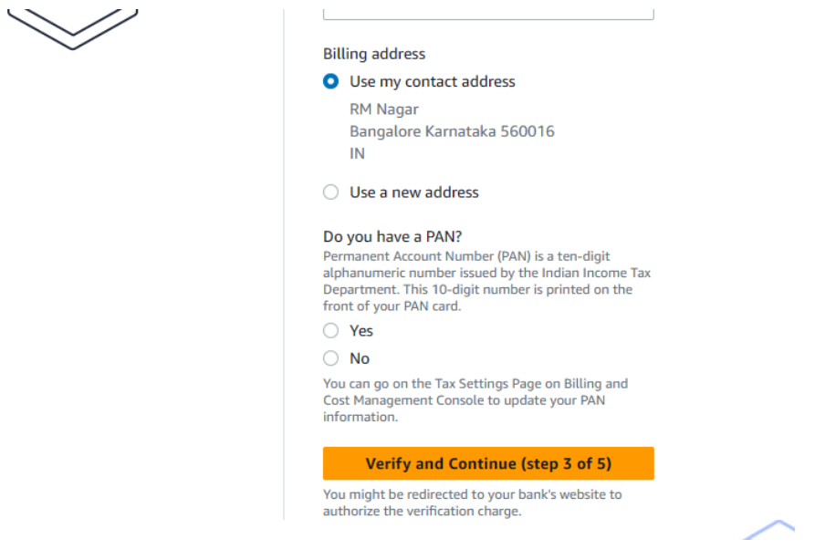
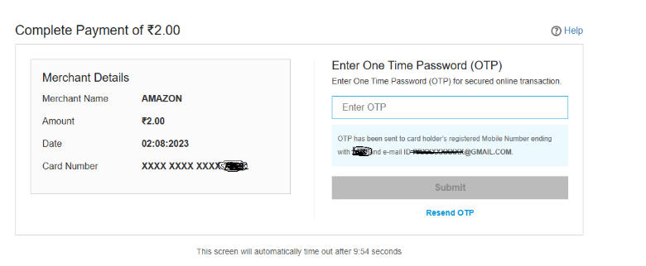
You are required to validate payment method. Hence need to Provide Billing Information like, Credit/Debit card information, Billing address details in the below fields. Note that PAN is optional to mention here. Once provided the details click on Verify and Continue.
Then, provide OTP to validate the payment method. Note that AWS deduct only $1 to validate the payment and will be credited back after 3 or 5 working days.

Slide 16
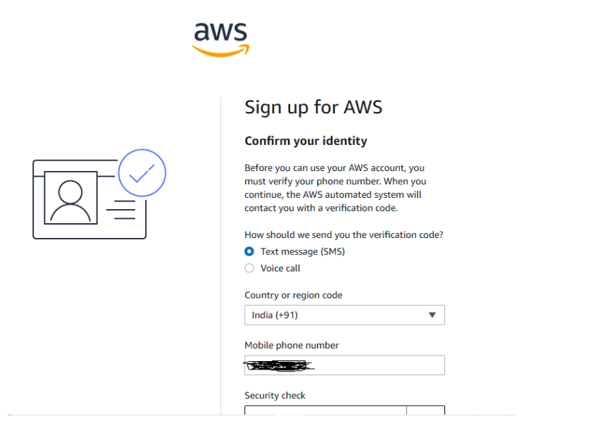
Then, validate contact phone number with either voice call or SMS mode as per the below instructions.

Slide 17
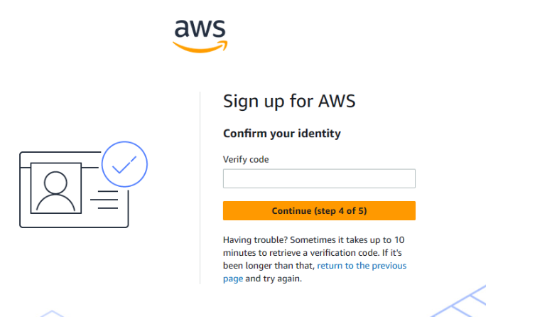
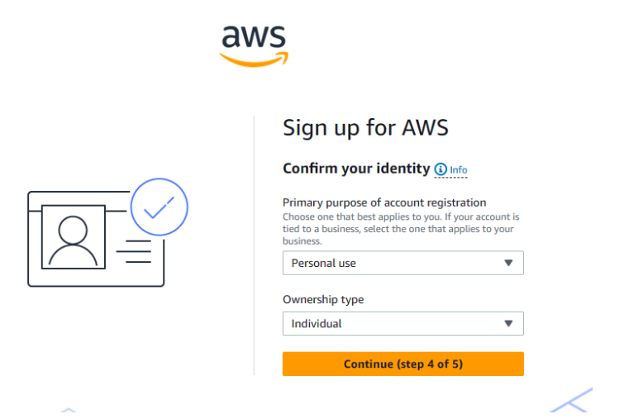
Provide OTP received on Mobile to validate the Phone Number in the below OTP field.
Then, Provide more information about the purpose of AWS Account.

Slide 18
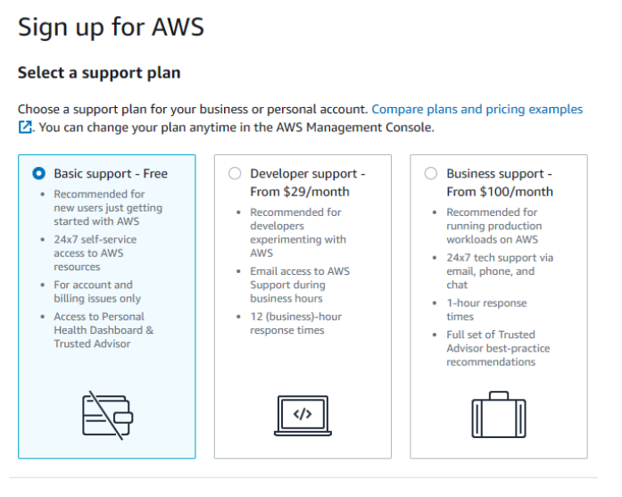
Then, Select Support Plan. Amazon as cloud service provider responsible in supporting any technical challenges and advised how to use AWS services. However AWS has various support plans to provide support for technical queries. Select the Support plan from the below page to get the support from AWS.
Note that "Basic Support - Free" - You have to select to avoid the support fee on monthly basis. You are not eligible to raise technical queries if you are choosing Basic Support.

Slide 19
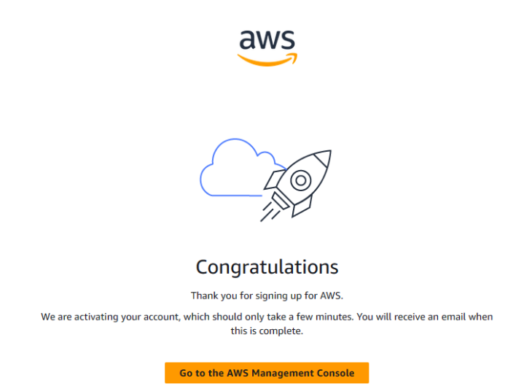
Once provided all the required information then click on "Complete Sign Up" and then you can see "Congratulation" page as shown below.

Slide 20
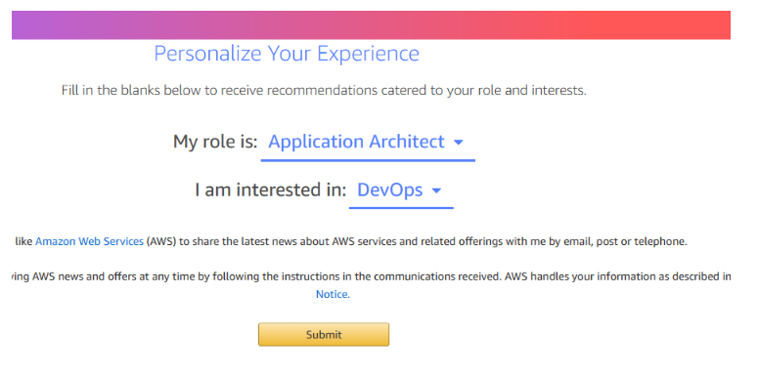
Just, click on "Go to the AWS Management Console" to complete the setup and login. Then provide more details about how you want to use AWS account.
Now, Just click on Sign in to the Console and provide login information.
Congratulations!! You have successfully create AWS account. You can have 12 Month free tier access to AWS services.

Slide 21
Thank you

