Slide 1
AWS EC-2
(Amazon Elastic Compute Cloud)

Slide 2
Content:
Introduction.
Types of EC2 Computing Instances.
Steps to create EC2 instance..
Example for Instance Creation.
Connect to EC2 instance using SSH and PuTTY.
How to terminate instance.

Slide 3

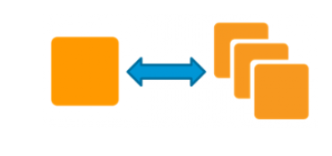
1. Introduction
Amazon Elastic Compute Cloud, EC2 is a web service from Amazon that provides re-sizable compute services in the cloud. They are re-sizable because you can quickly scale up or scale down the number of server instances you are using if your computing requirements change.
An instance is a virtual server for running applications on Amazon’s EC2. It can also be understood like a tiny part of a larger computer, a tiny part that has its own Hard drive, network connection, OS etc. But it is actually all virtual. You can have multiple “tiny” computers on a single physical machine, and all these tiny machines are called Instances.

Slide 4
Features of EC2:
Amazon EC2 has lots of features. Some of them are listed below:
Amazon EC2 provides virtual computing environments also known as instances.
AWS EC2 has preconfigured templates for your instances, also called Amazon Machine Images or AMIs, that package the operating system as well as some additional software.
EC2 offers multiple configurations of CPU, memory, storage, and networking capabilities for your instances.
With Amazon EC2, you can securely log in to your instances using key pairs that keep the instances safe from unwanted access.
Amazon EC2 has various storage volumes for temporary data that is deleted when you stop, hibernate, or terminate your instance. This is also known as instance store volumes.
Amazon EC2 has Persistent storage volumes for your data using Amazon Elastic Block Store (Amazon EBS).
Amazon EC2 has multiple physical locations for your resources, such as instances and Amazon EBS volumes

Slide 5
2. Types of EC2 Computing Instances
Computing is a very broad term. The nature of your task decides what kind of computing you need. Therefore, AWS EC2 offers 5 types of instances which are as follows:
General Instances
For applications that require a balance of performance and cost.
E.g email responding systems, where you need a prompt response as well as the it should be cost-effective, since it doesn’t require much processing.
Compute Instances
For applications that require a lot of processing from the CPU.
E.g analysis of data from a stream of data, like Twitter stream
Memory Instances
For applications that are heavy in nature, therefore, require a lot of RAM.
E.g when your system needs a lot of applications running in the background i.e multitasking.

Slide 6
Storage Instances
For applications that are huge in size or have a data set that occupies a lot of space.
E.g When your application is of huge size.
GPU Instances
For applications that require some heavy graphics rendering.
E.g 3D modelling etc.
Now, every instance type has a set of instances which are optimized for different workloads:
General Instances | Compute Instances | Memory Instances | Storage Instances | GPU Instances
t2 m4 m3 | c4 c3 | r3 x1 | i2 d2 | g2

Slide 7
3. Steps to create EC2 instance.
Step 1: Login to AWS
Step 2: Choose region which is near ? ( Asia pacific - Mumbai )
Step 3: Services -- EC2
( If any keypairs -- delete )
( If any security groups - delete, except default )
Services -- EC2 --- Launch Instance
Stage 1 -- Select AMI ( Note: Select free tier eligible ) Win Server 2012
Stage 2 -- t2.micro
Stage 3 -- No of instances -- 1
Stage 4 -- Storage - 30GB ( Observation - we have root - it is same as C Drive)
Stage 5 -- Add Tag -- Giving name to the machine
Add Name Tag
Value - MyWindows

Slide 8
Stage 6 -- Security group -- ( It deals with ports )
We have 0 to 65535 ports
Every port is dedicated to special purpose
RDP -- 3389
SSH -- 22
HTTP -- 80
HTTPS - 443
For windows machine , we need to open RDP port ( Remote Desktop Protocol )
Here by default , we have RDP
Stage 7 Just observe the warnings, Just verify the options, Launch

Slide 9
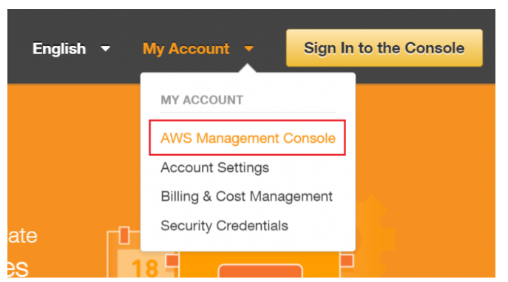
4. Example for Instance Creation
Let’s understand the whole EC2 instance creation process through a use case in which we’ll be creating an Amazon Linux instance for a test environment.
Login to AWS Management Console.

Slide 10
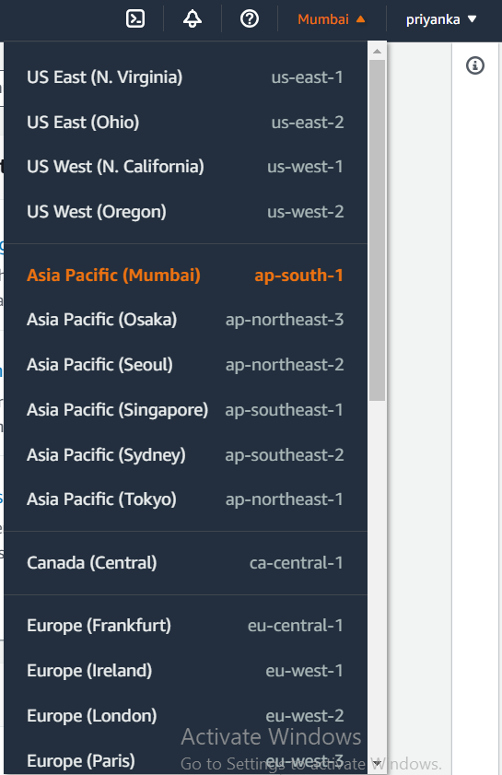
Select your preferred Region. Next, Select a region from the drop down present at the right top, the selection of the region can be based on the nearest region (more about AWS Regions is explained in the end of this session).

Slide 11
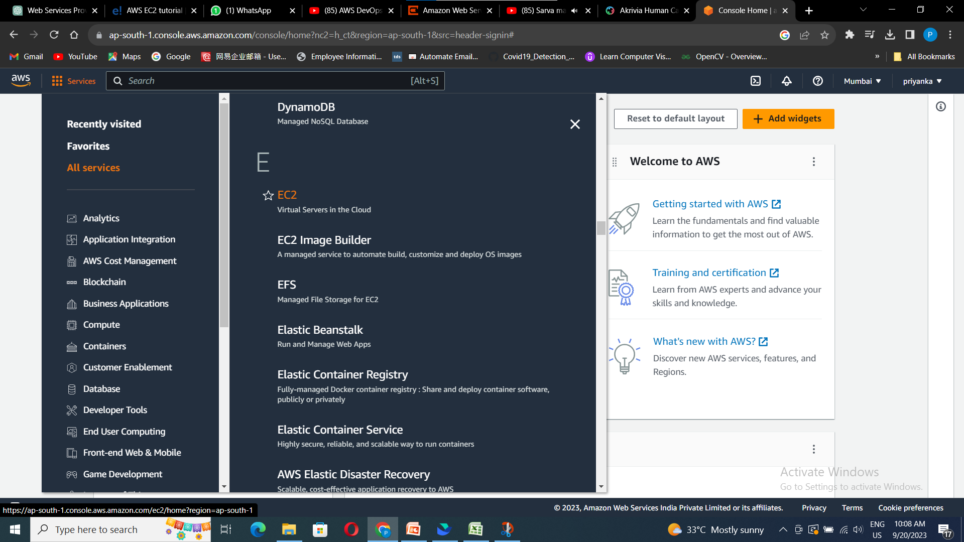
Select EC2 Service Click EC2 under Compute section. This will take you to EC2 dashboard.

Slide 12
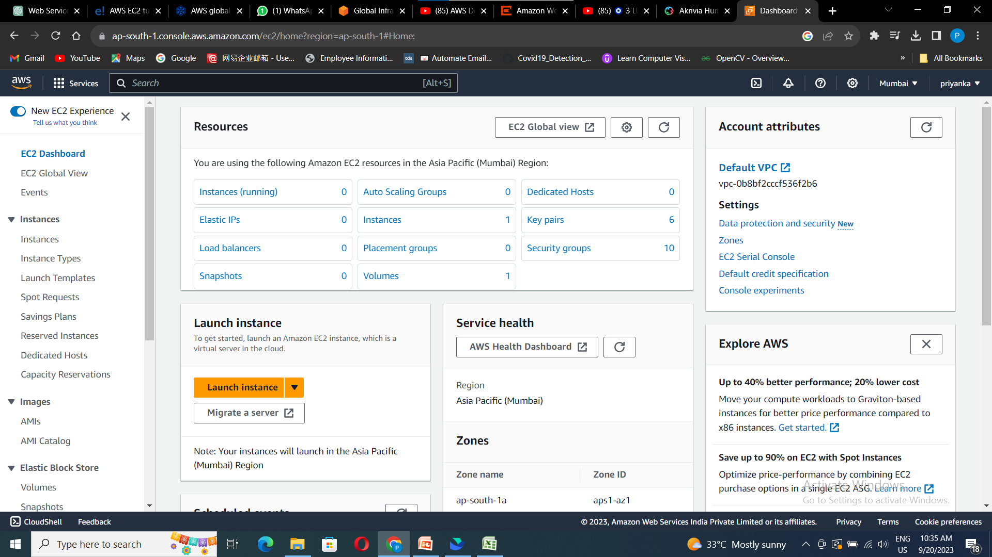
Click Launch Instance.

Slide 13
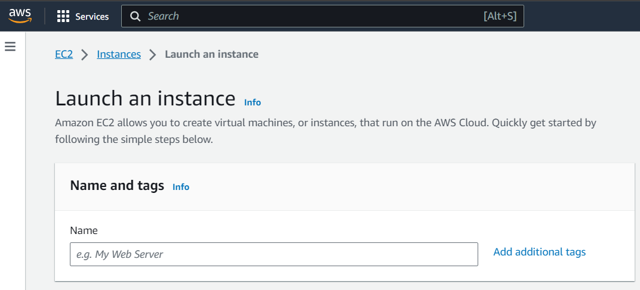
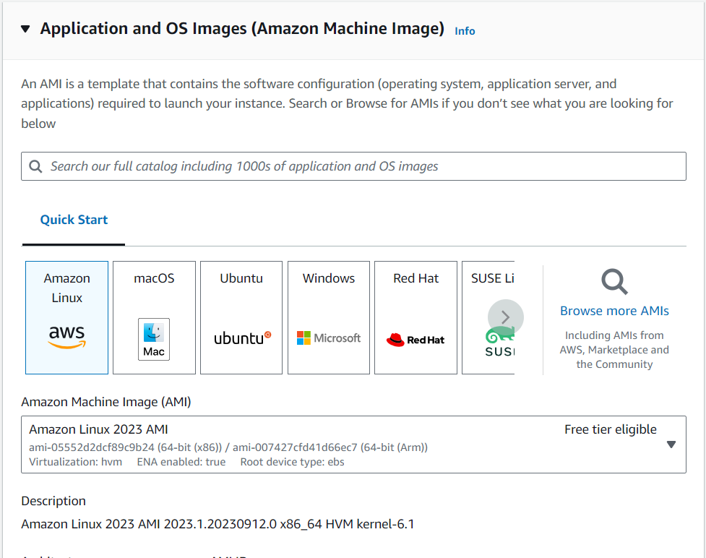
In name and tags, give a name to your instance.
Select an AMI (Amazon Machine Image) : because you require a Linux instance, in the row for the basic 64-bit Amazon Linux 2023 AMI, Select free tier eligible AMI this service will not be charged.

Slide 14
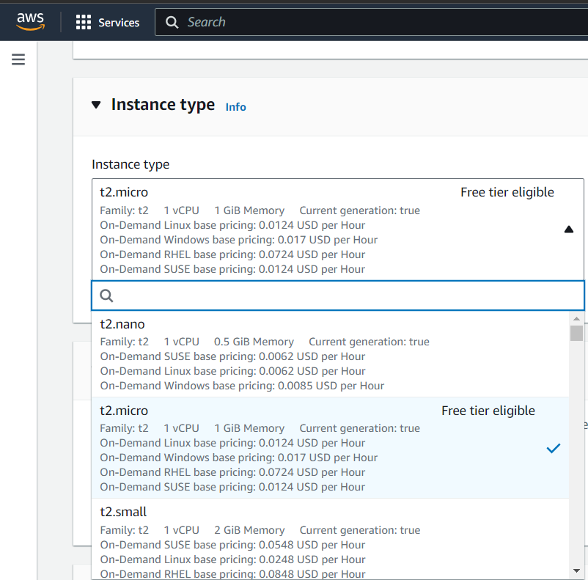
Select instance type t2.micro, as we are creating a basic instance and it is eligible for free tier.
Here you can see that t2.micro instance is providing us 1CPU, 1GB memory.

Slide 15
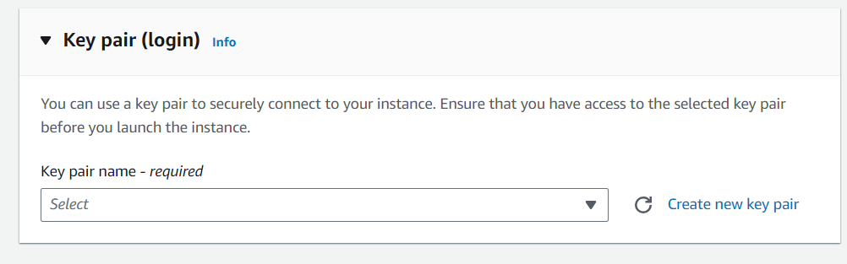
Create new key pair.
A key pair, consisting of a public key and a private key, is a set of security credentials that you use to prove your identity when connecting to an Amazon EC2 instance. Amazon EC2 stores the public key on your instance, and you store the private key. For Linux instances, the private key allows you to securely SSH into your instance. As an alternative to key pairs, you can use AWS Systems Manager Session Manager to connect to your instance with an interactive one-click browser-based shell or the AWS Command Line Interface (AWS CLI).

Slide 16
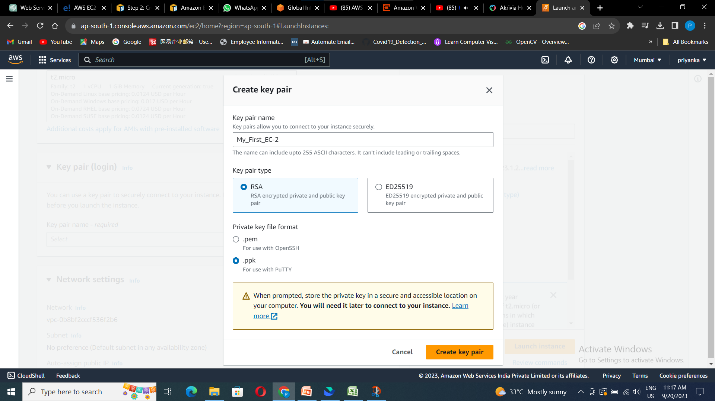
Create key pair console will be opened.
Enter a key pair name.
Select Key pair type as RSA.
Select private key file format:
If your using local Desktop as windows select “.ppk” (PuTTY private key) it supports to launch instance through putty.
If your local desktop is linux select “.pem” (Privacy Enhanced Mail) file use with OpenSSH on the linux command.
Click on create key pair, your selected format file will be automatically downloaded in the downloads folder of your local PC

Slide 17
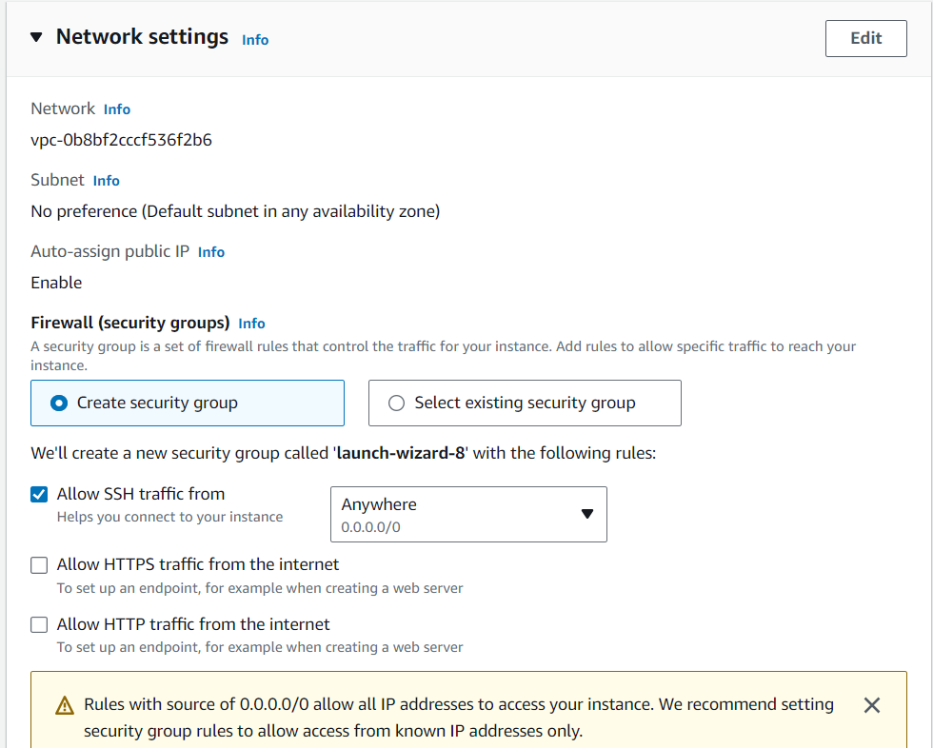
Now select create security group if your creating it for the 1st time, else select “existing security group” if you already have security group.
A security group controls the traffic that is allowed to reach and leave the resources that it is associated with. For example, after you associate a security group with an EC2 instance, it controls the inbound and outbound traffic for the instance.
Select SSH option to connect to your instance.
HTTPS and HTTP are used while you are hosting web servers

Slide 18
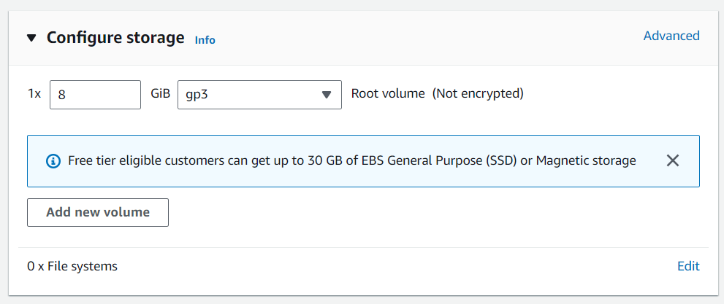
Configure storage:
Select 8 GB .
Root volume as gp3.
Where both are eligible for free tier.
Now click on launch instance.

Slide 19
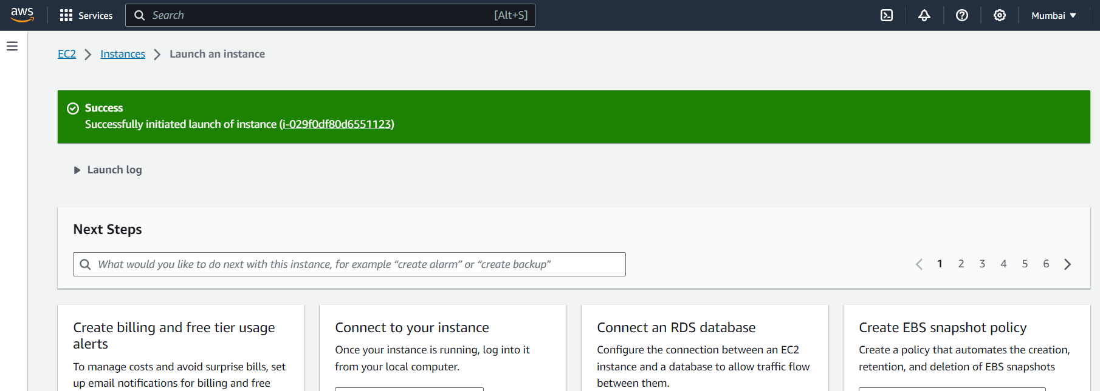
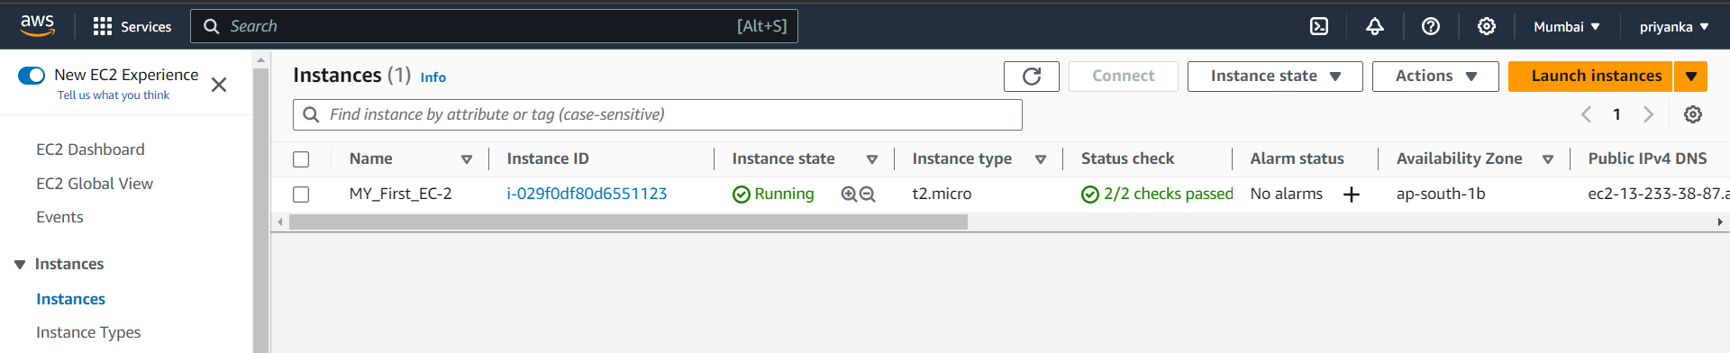
Your instance is created successfully.
You can view your created instance in your EC2 -> Instances Dashboard.

Slide 20
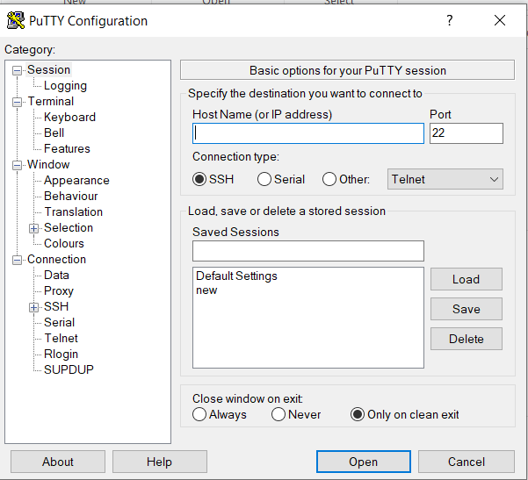
5. Connect to EC2 instance using SSH and PuTTY
Download PuTTY from https://www.putty.org/
Open PuTTY.exe
To connect to EC2 instance you need following content.
HostName or IP Address.
For putty authentication you need key pair that we have downloaded while creating the instance.

Slide 21
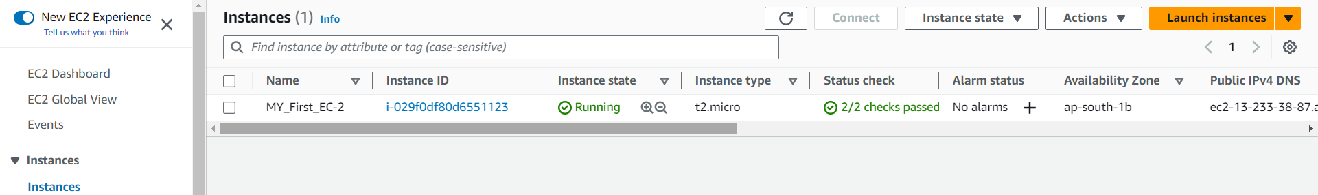
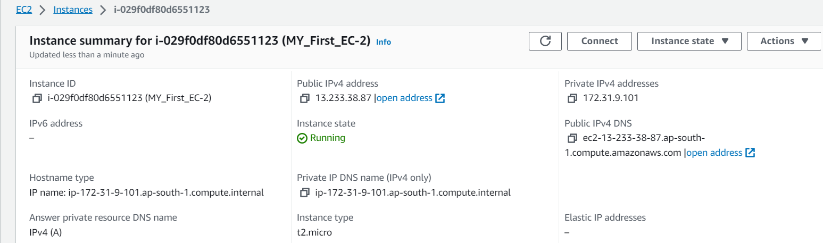
Get IP Address.
Go to the AWS Console -> Services -> EC2 -> Instance.
Click on Instance ID
Copy Public IP Address, this is your host name or IP Address.

Slide 22
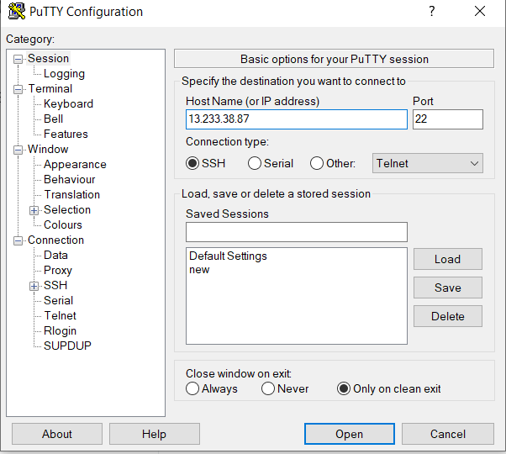
Paste your public IP Address in the HostName.
Select SSH Connection Type
For SSH Port number is 22

Slide 23
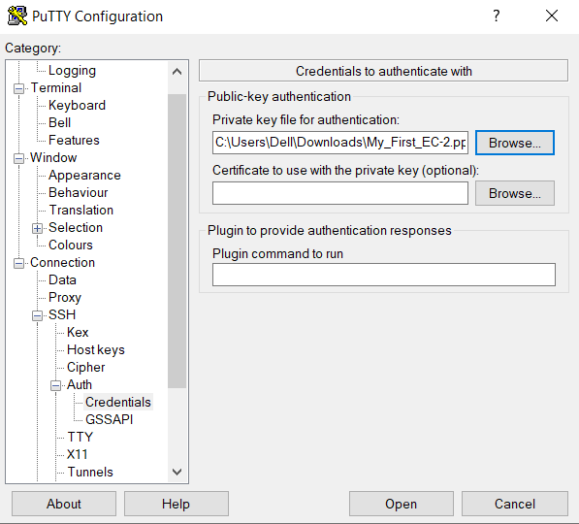
Now in Connection -> SSH -> Auth
In Auth select Credentials.
Now here in “Private key file for authentication” browse the downloaded “.ppk” file.

Slide 24
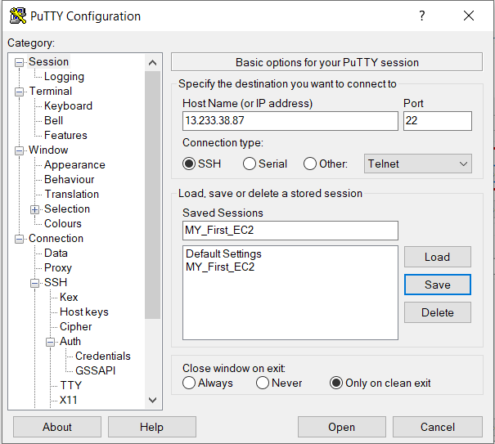
Go back to Session save the session with the Session name for further use (i.e when ever you want open EC2 “MY_first_instance” your corresponding key file will be saved you can just select the saved session name and start using it. Only IP address will be changed).
Click on Save your session will be saved.
Enter a session name according to your convince

Slide 25
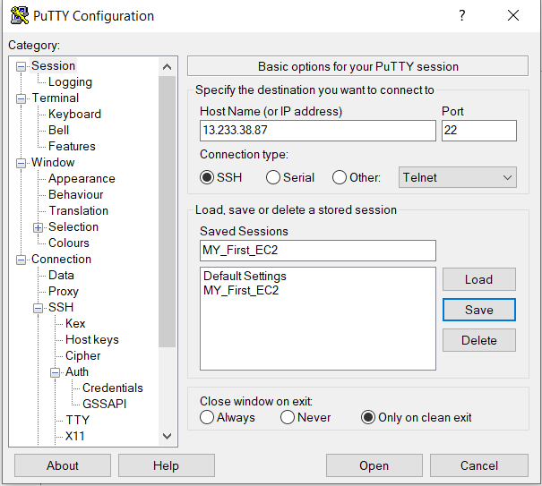
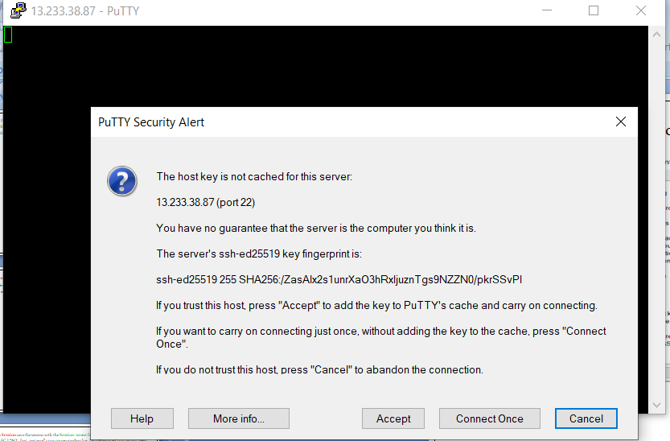
Now everything is set click on open, a now linux terminal will be opened.
Click on Accept.

Slide 26
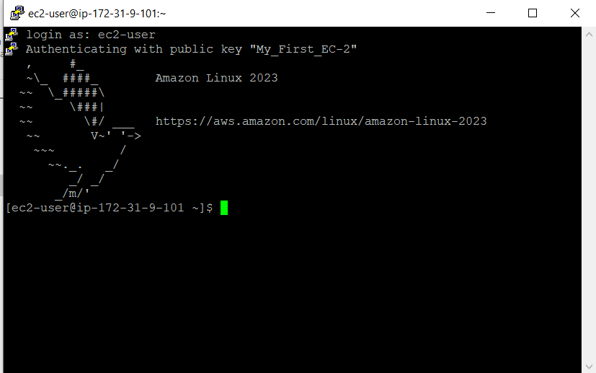
As we are trying to open a Amazon Linux enter “ec2-user” in the terminal.
Your Amazon linux machine is ready to use.

Slide 27
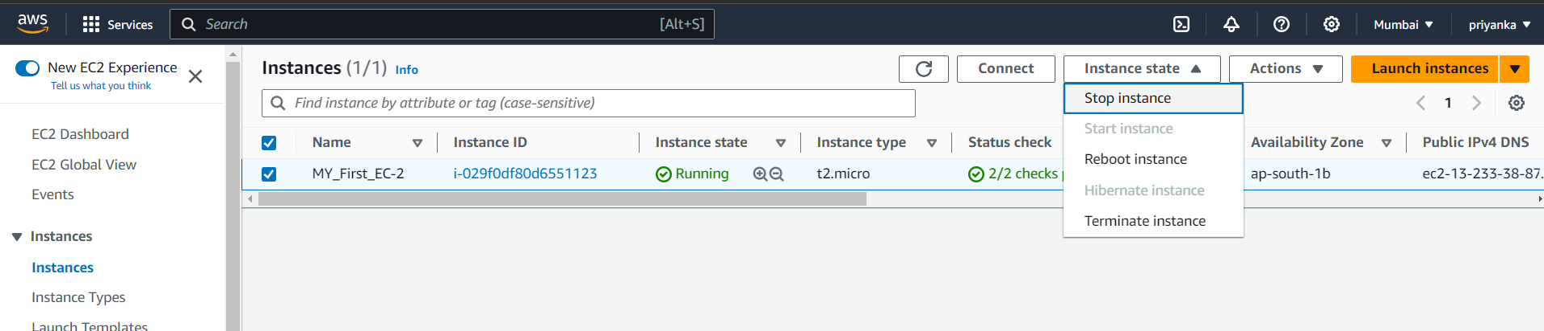
6. How to terminate instance.
Go to the AWS Console -> Services -> EC2 -> Instance.
1. Click on the check box select the instance.
2. Click instance state.
* Stop instance : to stop running the instance.
* Reboot instance: to stop the instance and automatically start the instance.
* Terminate Instance: to delete the instance (once deleted cannot be retrieved back)
3. Click stop instance.
1.

Slide 28
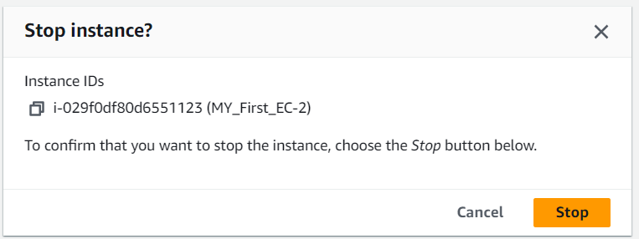
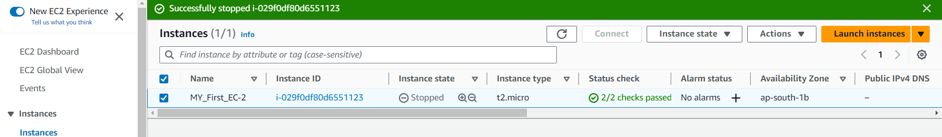
Click on stop.
Your instance is stopped successfully.

Slide 29
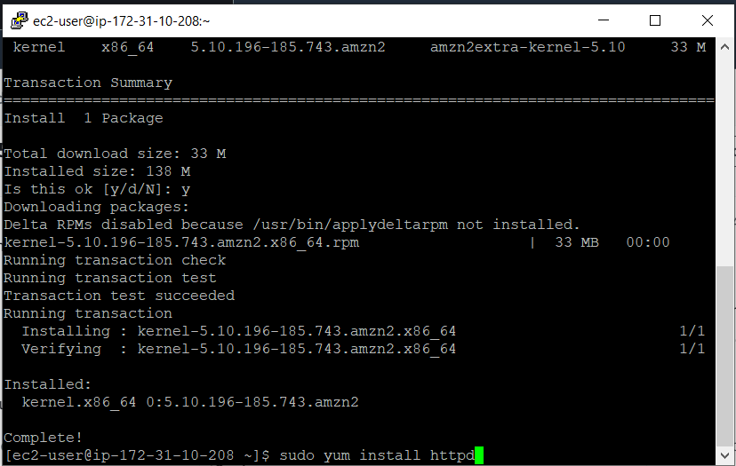
7.Web Hosting
Webhosting in EC2 can be done in two ways.
Manual implementation in ec2 server.
User data while launching.
Lets start with the manual implementation.
Step 1: launch ec2 instance, connect your ec2 instance through your putty
Step 2: install httpd in linux server (if you have launched ubuntu instance then install apache server)

Slide 30
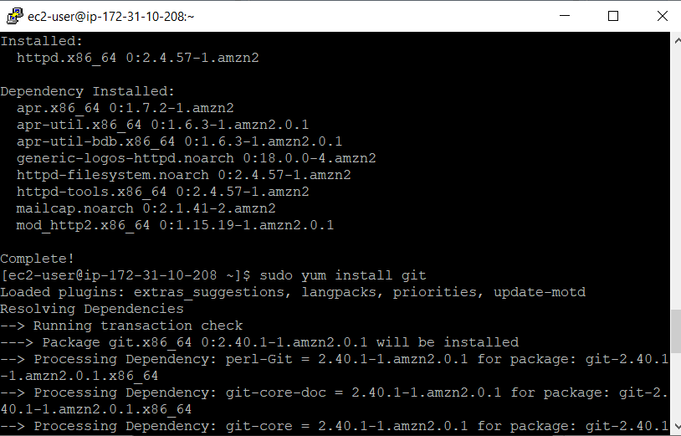
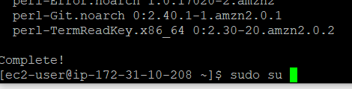
Step 3: install git.
Step 4: go to root.
sudo su.

Slide 31
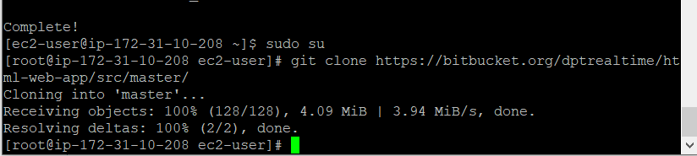
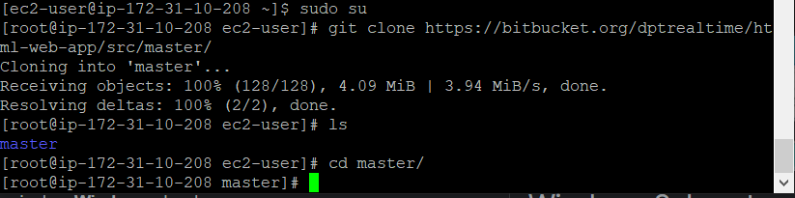
Step 5: clone the project from the repo.
git clone https://bitbucket.org/dptrealtime/html-web-app/src/master/
You can see that the project is cloned in the master folder.
Step 6: go to the master folder.
cd master.

Slide 32
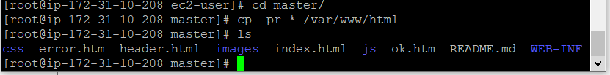
Step 7: copy all the files and folders present in the master to /var/www/html
cp -pr * /var/www/html
* - all files.
-pr

Slide 33
END of EC-2 Instance

