Slide 1
AWS IAM
(Amazon Identity and Access Management)

Slide 2
Content:
Introduction.
Create IAM User account.

Slide 3
1. Introduction
Its related to administration.
AWS Identity and Access Management (IAM) is a service that helps you securely control access to AWS resources. You use IAM to control who is authorized (has permissions) to use resources.
When you first create an AWS account,it has complete access to all AWS services. This identity is called the root user.
Using IAM , We can
1) create users.
2) create groups.
3) Assign permissions to groups and users.

Slide 4
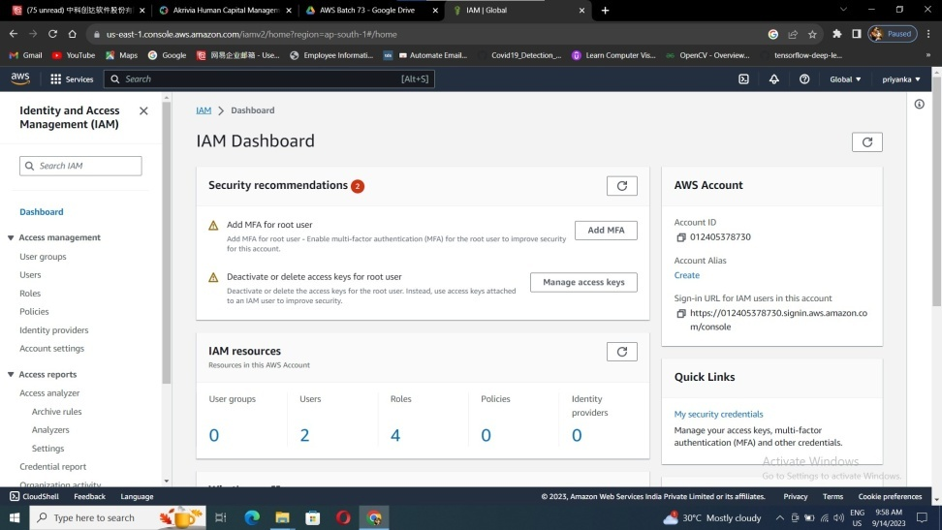
2. Create IAM User account
Go to IAM service in the AWS console.

Slide 5
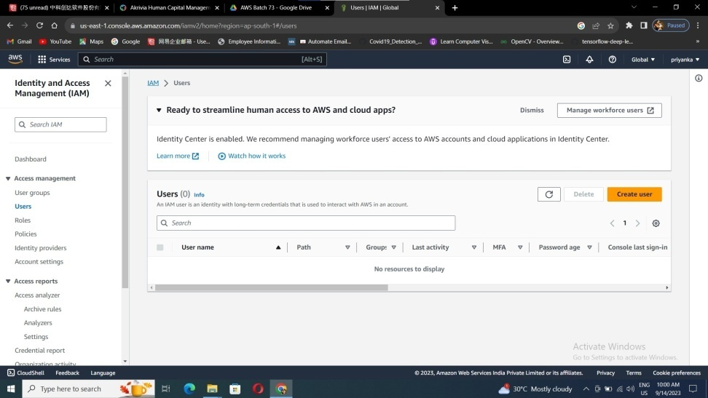
Click on users and Create user

Slide 6
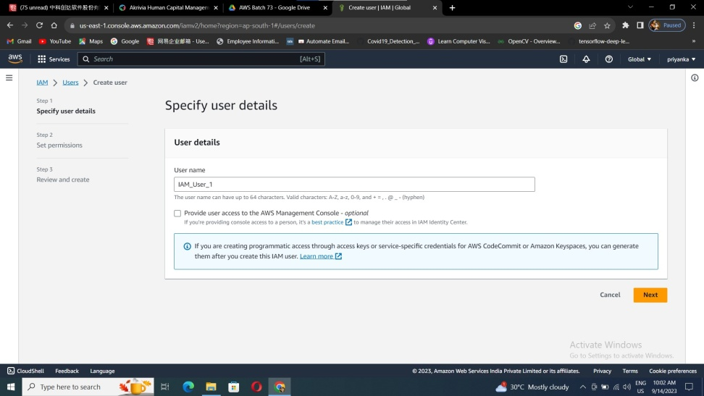
Enter a user name, here I have given user name as IAM_User_1

Slide 7
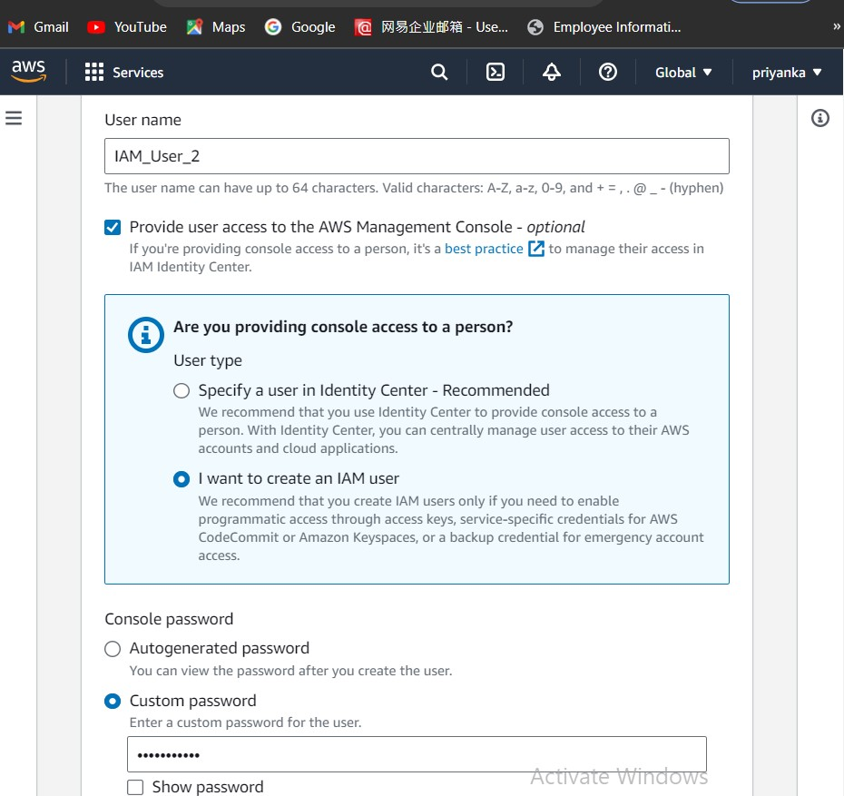
4. Give permission to the AWS management console, and create IAM User with custom password.

Slide 8
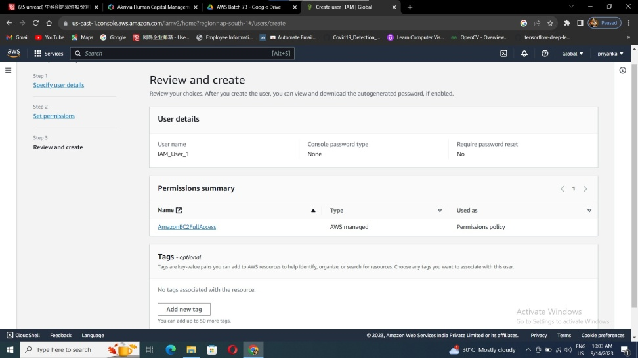
In a permission summary give a CLI permission, and give access to the required service (here I have given to the AWSEC2FullAccess).
Click create user, now IAM user account is ready to use, with user id and the password given by the administrator.

Slide 9
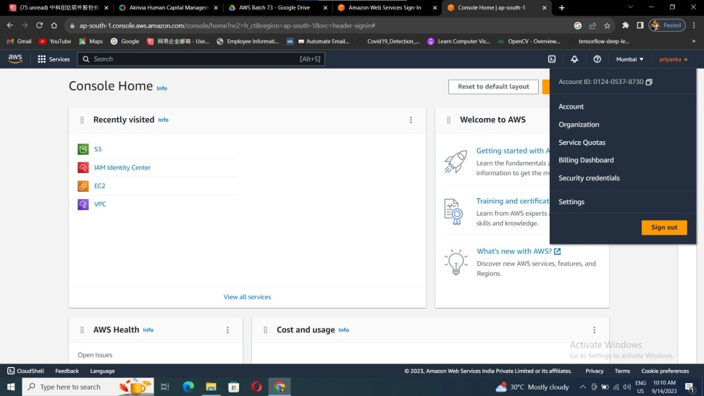
Copy the root administrator Id, from the account details.

Slide 10
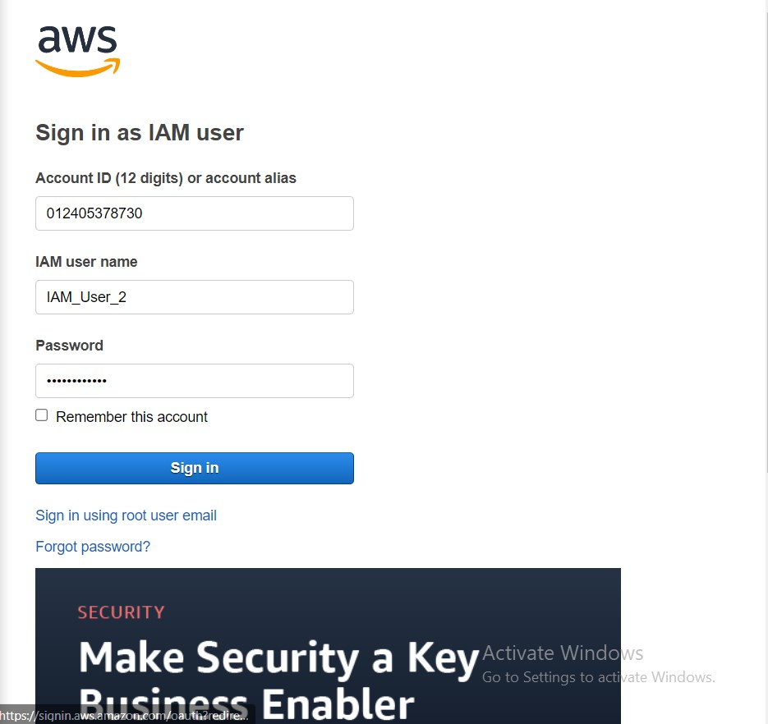
Sign in to the IAM user from the AWS Console.
Enter the Root admin id, IAM_User name and the password generated by the root user.

Slide 11
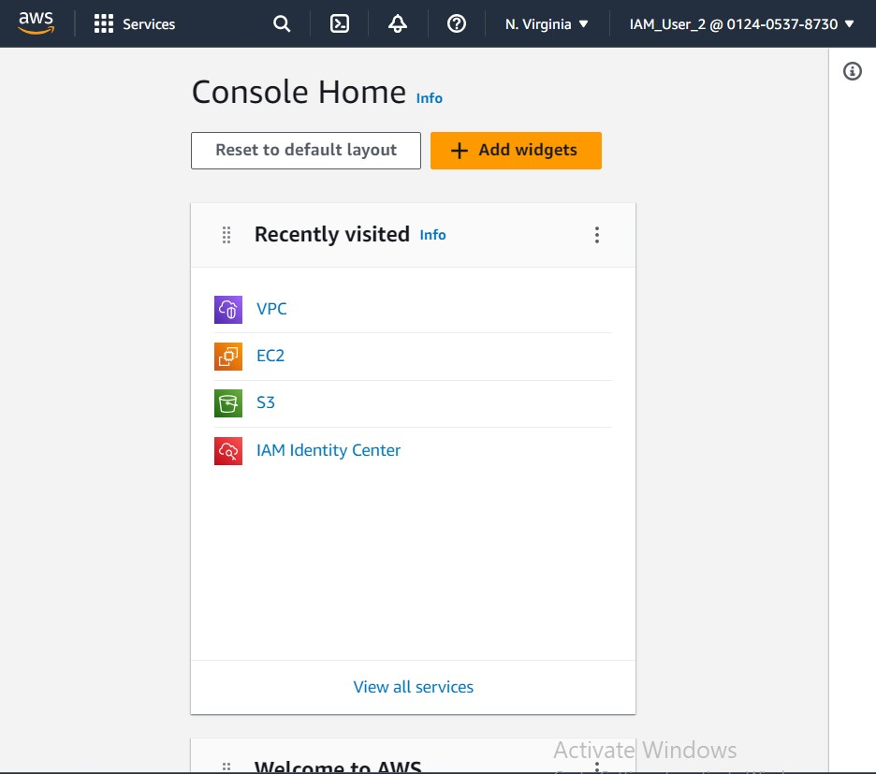
Here is the you can find the IAM_User name with admin id.
So now your into the IAM user account as this account is permitted with only EC2 service so this user can access only EC2 service.

