Slide 1
AWS Service via IAM Roles

Slide 2
Content:
Introduction.
How to create IAM Role.
How To Connect IAM Roles.
How To Connect IAM Roles.

Slide 3
1. Introduction
While policies cannot be directly given to any of the services accessible through the Amazon dashboard, IAM roles are similar to IAM users in that they may be assumed by anybody who requires them. By using roles, we can provide AWS Services access rights to other AWS Services.
Example
Consider Amazon EKS. In order to maintain an auto scaling group, AWS eks needs access to EC2 instances. Since we can’t attach policies directly to the eks in this situation, we must build a role and then attach the necessary policies to that specific role and attach that particular role to EKS.
Use of Roles:
Consider the Scenario in which we want to grant access to our account to third parties which can perform operations such as audits of our resources or consider another scenario in which we want to access users who have identities prior outside the Aws like in our corporate Directory.
So we can use the roles for access to users’ services or applications that don’t have access to AWS resources.

Slide 4
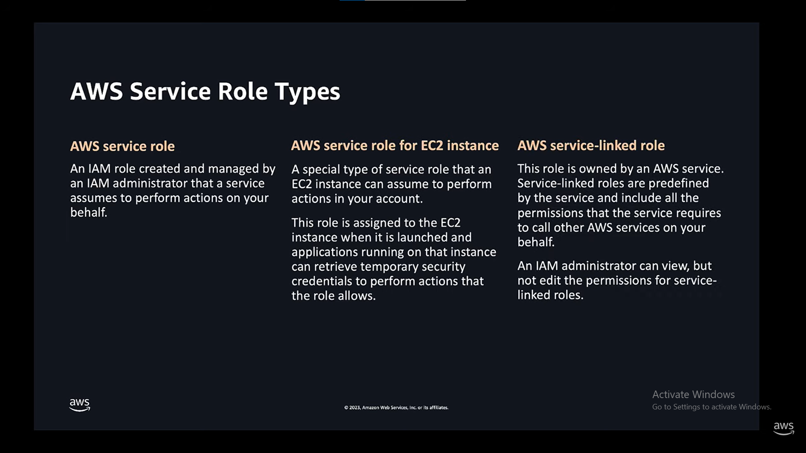

Slide 5
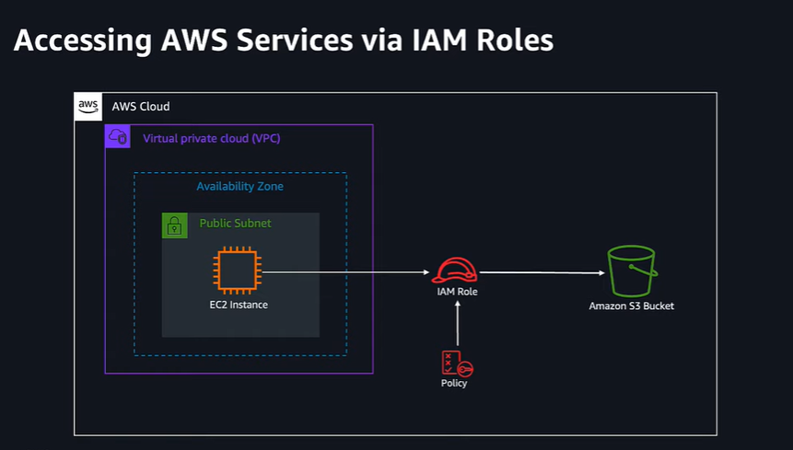
2. How To create IAM Roles
The followings are the methods for using Roles:
AWS Management Console.
Assume-Role CLI.
Assume-role-with-web-identity.
Console URL Construct with AssumeRoleWithSAML.

Slide 6
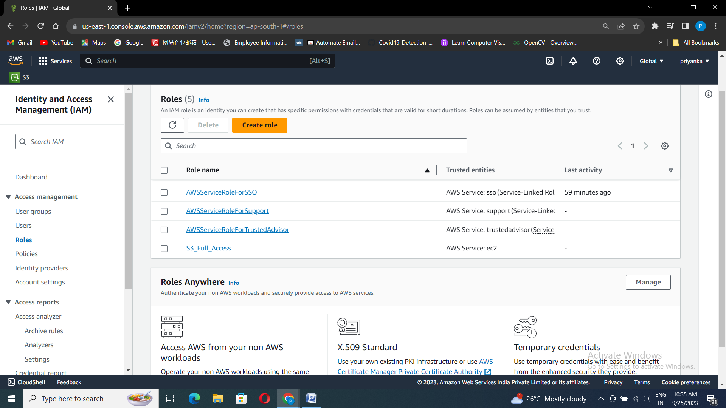
Go to IAM Dashboard >> Roles >> Create role.

Slide 7
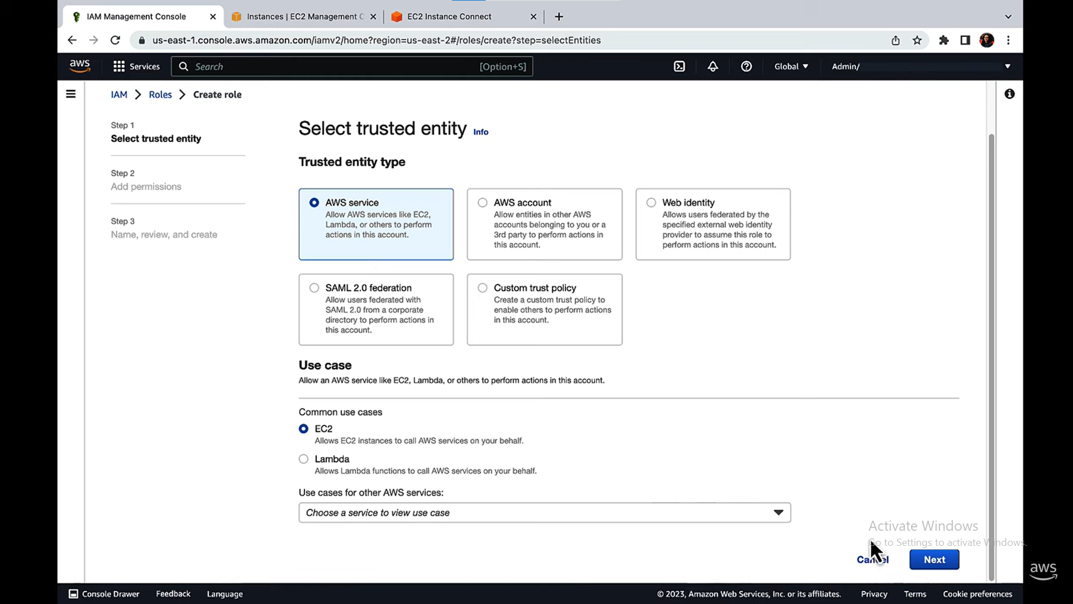
In this scenario the trusted entity is EC2.
As it is a AWS service choose AWS Service as trusted entity type.

Slide 8
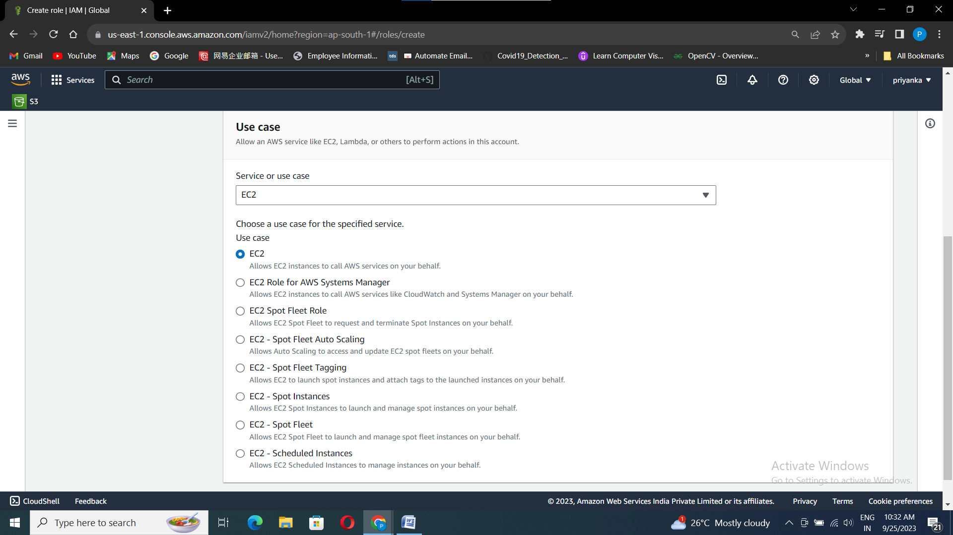
Select any Use Case according to your requirement.
Here my use case is EC2.

Slide 9
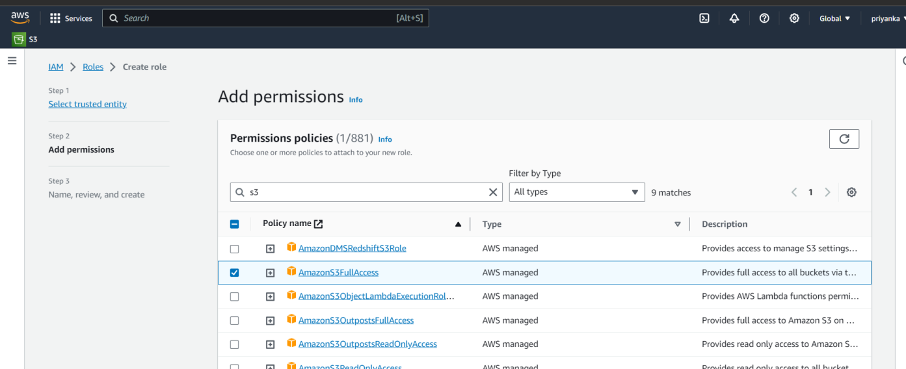
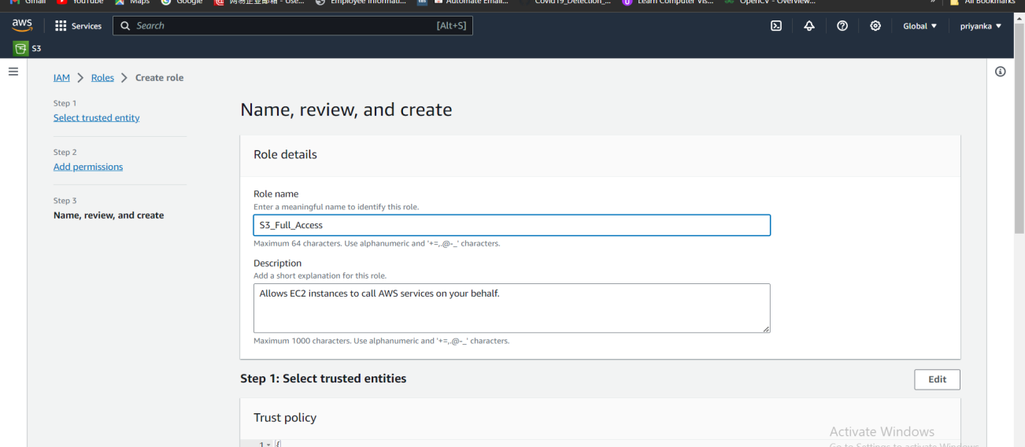
Lets give EC2 to access permissions of S3.
Here I am giving S3 Full Access, nick on next.
Give Role name, here I have give as “S3_Full_Access”.

Slide 10
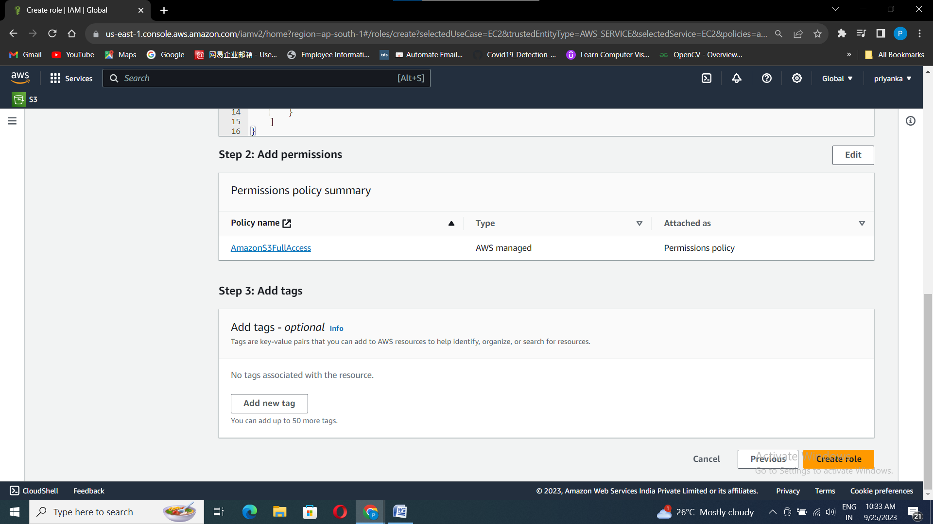
Check the details and click on Creat role.
Your IAM Role With the name “S3_Full_Access” is created.

Slide 11
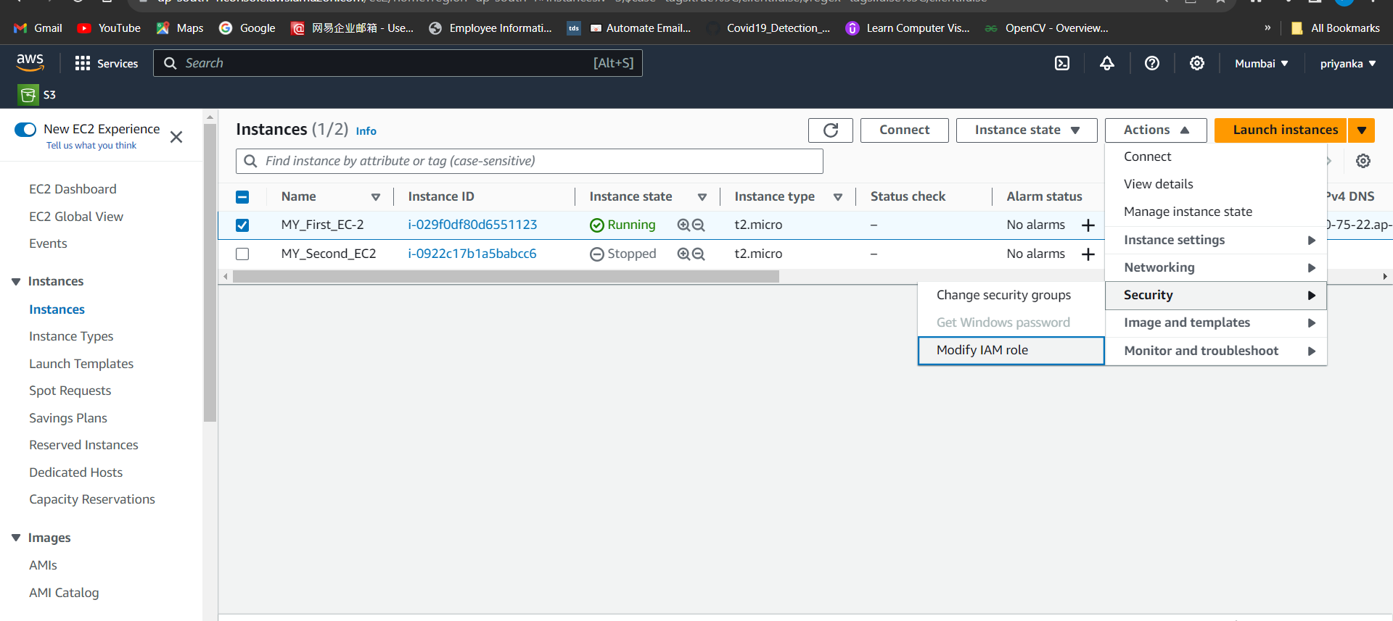
3. How To Connect IAM Roles
As we already have EC2 instance created, lets connect IAM Role to it.
Go to EC2 instance Dashboard, select the created instance, click on Actions>>Security>>Modify IAM role.

Slide 12
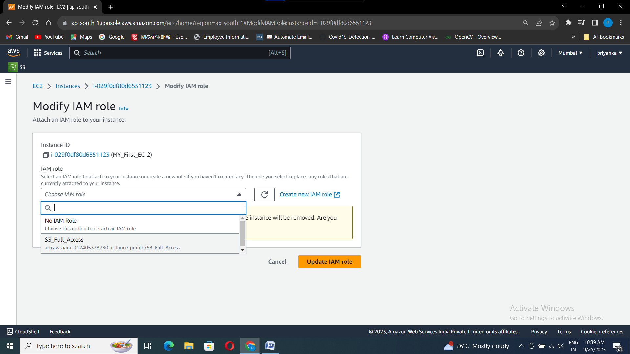
Choose the IAM role that we have created and click on “Update IAM role”.
Your EC2 instance is successfully connected to the S3 Services.
Now as we have given S3 full access to EC2 instance.
Through EC2 instance we can create, delete, upload , etc.

Slide 13
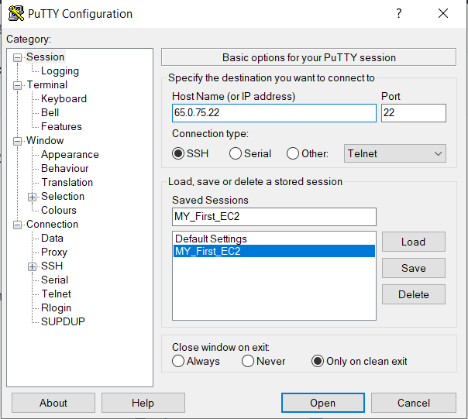
4. Verify Connected IAM Roles
Lets check whether we can access S3 Service in our connected EC2 instance.
Copy the IP Address of the instance, as we have saved the details of my instance in the putty, just select the saved name and click on load. Paste the copied IP Address in the host name.
Click on open.

Slide 14
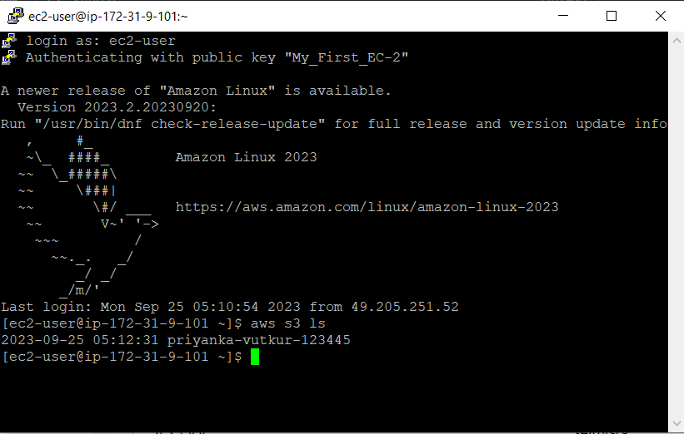
Give login as ec2-user as we have created EC2 instance with “AWS linux”.
Now lets list the buckets present in our S3 service.
Give “aws s3 ls” in the EC2 terminal.
Successfully you can see the list of S3 buckets present in the Root access.

