Slide 1
Amazon Route 53

Slide 2
Content:
Introduction.
Domain Name Providers.
Domain Registration.
Connect Domain Name server to your Route 53.

Slide 3
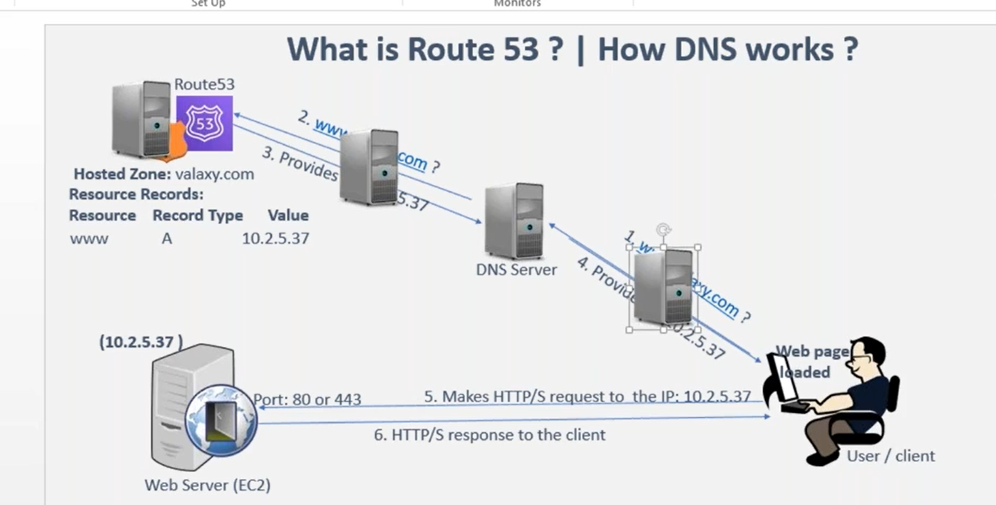
1.Introduction
Amazon Route 53 is a highly scalable and reliable Domain Name System (DNS) web service provided by Amazon Web Services (AWS). It is designed to route end users to internet applications by translating human-readable domain names (like www.example.com) into IP addresses that computers use to identify each other on the network.

Slide 4
Owner of the domain can update the records in the NameServer.
www : resource name, 10.2.5.37 : is it’s value
The name will be converted into the IP that concept is called as a domain naming system DNS concept
So whenever the client is hitting this domain name, the request will be sent to the d n s server base. There will be a DNS server, the DNS server is altogether a different server where it is holding the information about which name has to be converted into which IP address like how your phonebook he's storing the contacts of the name and the associated number. Same way. The DNS server simply in shortcut we can call this as a name server also, maybe DNS server is the full name.
So the browser has to send the request to the name server asking that question that hey, name server Tell me, what is the IP of this particular name? That's how the question has been raised to the name server. The name server responsibility is to take that question and give the response back to the user

Slide 5
2.Domain Name Providers.
GoDaddy: One of the largest and most well-known domain registrars. They offer a wide range of services beyond just domain registration.
Namecheap: Known for affordable domain registrations and a user-friendly interface.
Google Domains: Google's domain registration service, known for its simplicity and integration with other Google services.
Bluehost: A popular web hosting provider that also offers domain registration services.
HostGator: Another major web hosting provider that offers domain registration alongside their hosting services.
Network Solutions: One of the oldest domain registrars, known for providing a wide range of services related to domain management.

Slide 6
Hover: Known for its clean and straightforward approach to domain registration and management.
Name.com: Offers a range of domain-related services along with domain registration.
Register.com: Provides domain registration along with additional web services.
1&1 Ionos: Offers a variety of services including domain registration, web hosting, and website building tools.
Enom: Offers domain registration services along with tools for domain resellers.
Dynadot: Known for its competitive pricing and user-friendly interface.
NameSilo: Known for transparent pricing and straightforward domain management.
Porkbun: Gaining popularity for its quirky branding and competitive pricing.

Slide 7

Gandi.net: A French-based domain registrar known for its commitment to privacy and ethical practices.
AWS: AWS (Amazon Web Services) does provide domain registration services through a service called Amazon Route 53.
Note: from all of the above we are using Namecheap as it is cost effective compared to others.

Slide 8
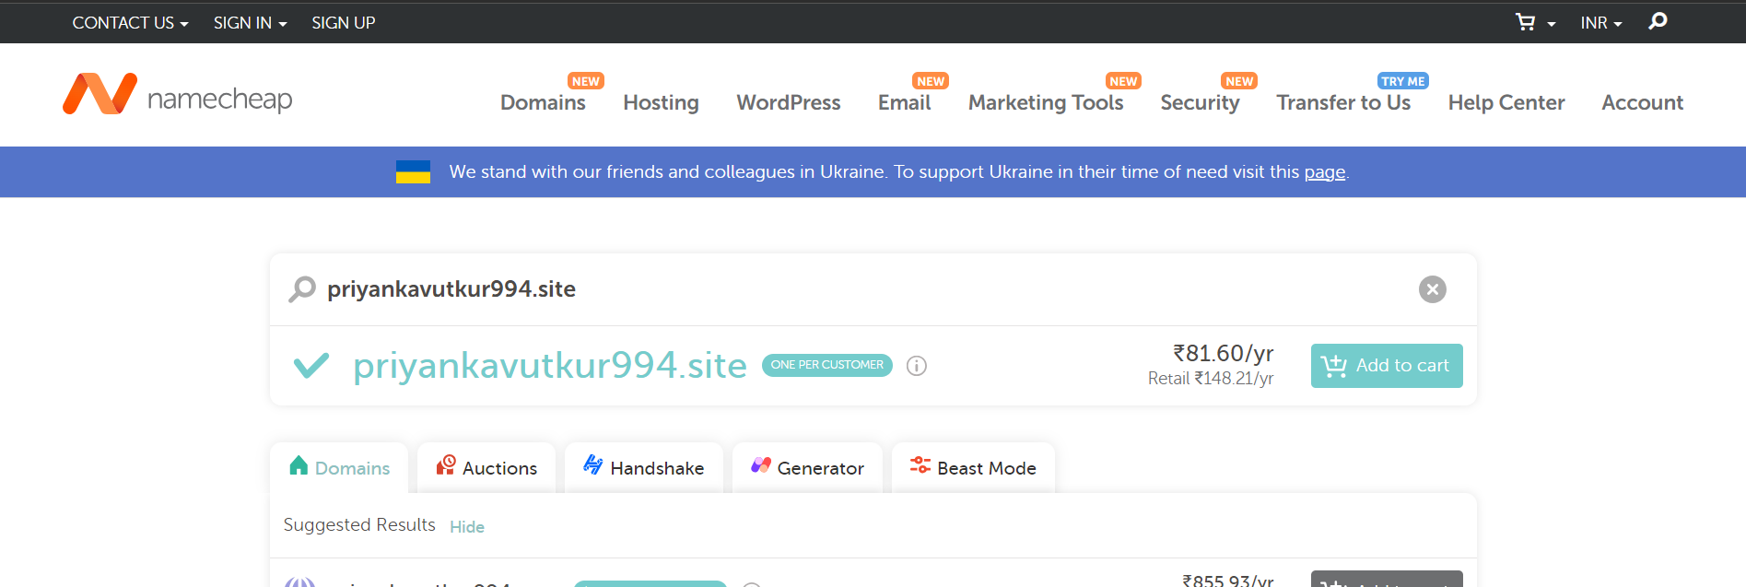
3. Domain Registration
Go to https://www.namecheap.com/domains/
Search for the domain you want, and check whether the domain exist or not.
If your domain exist add it to cart.
Suggested domain is “somename.site”, because “.site” domain is less cost in namecheap.

Slide 9
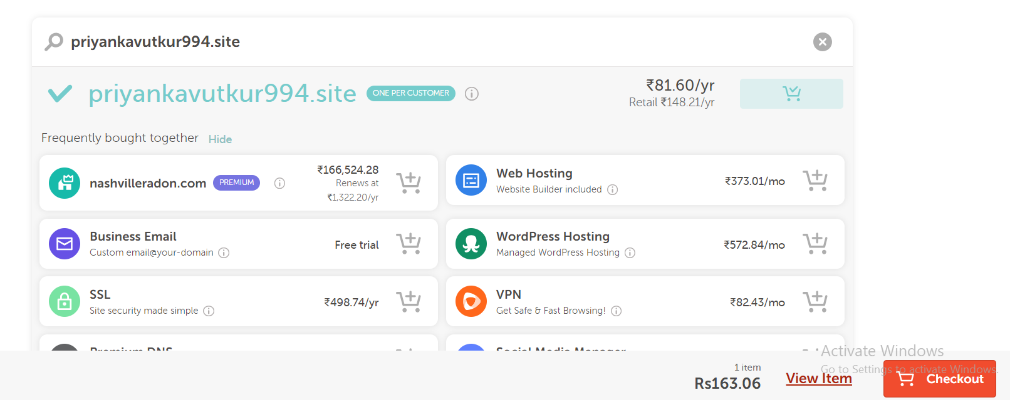
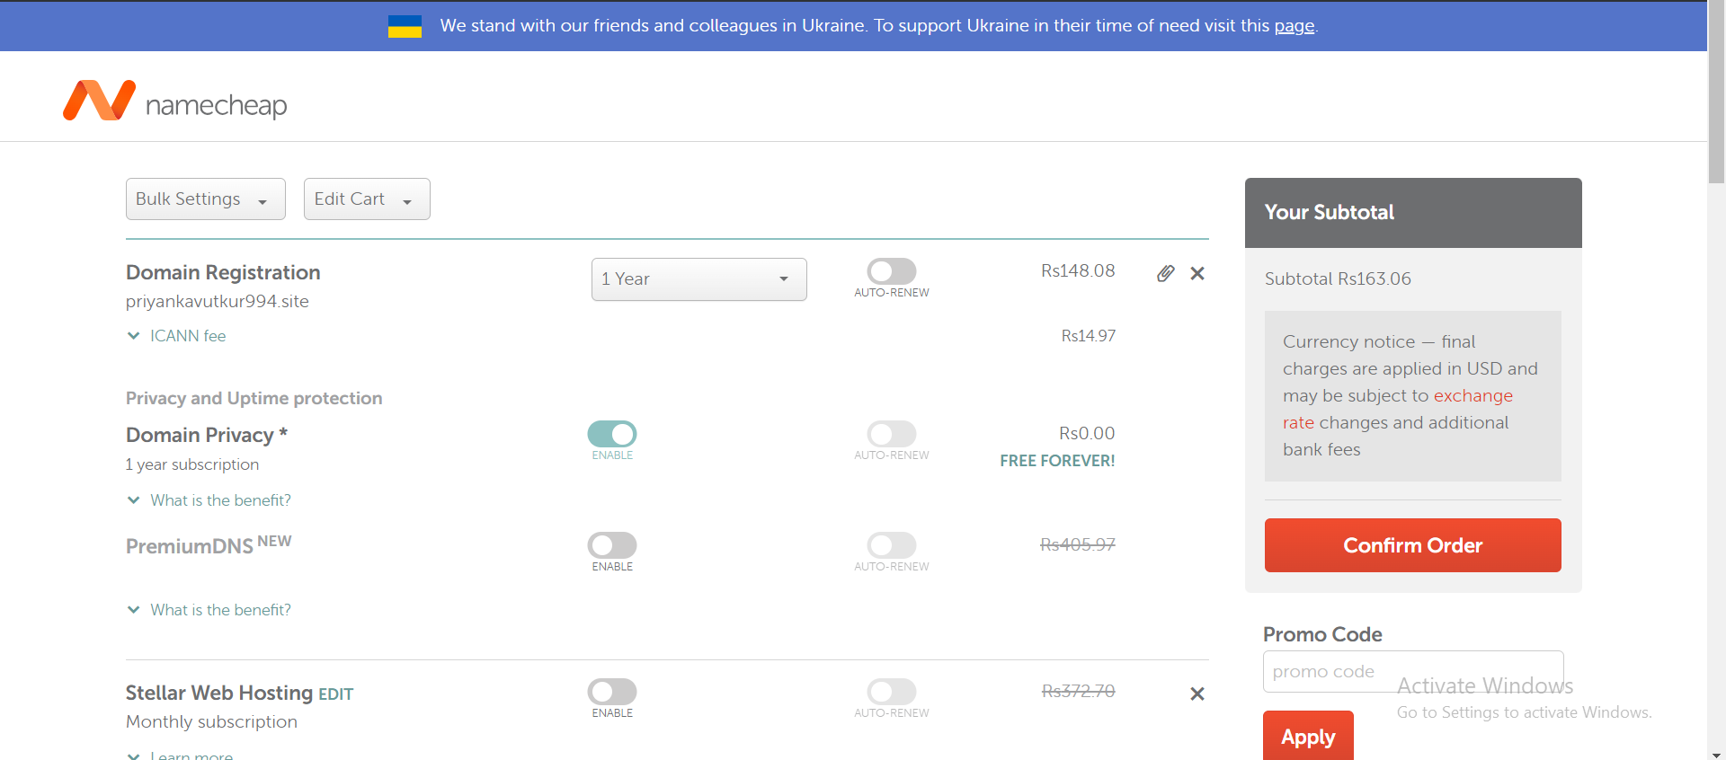
Click on checkout.
Click on conform order.

Slide 10
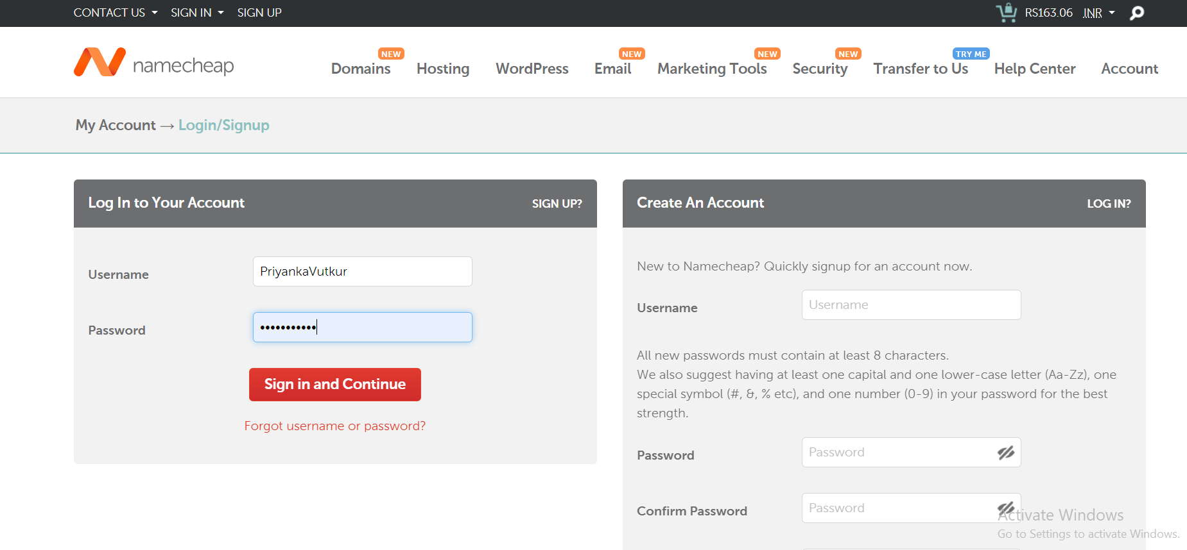
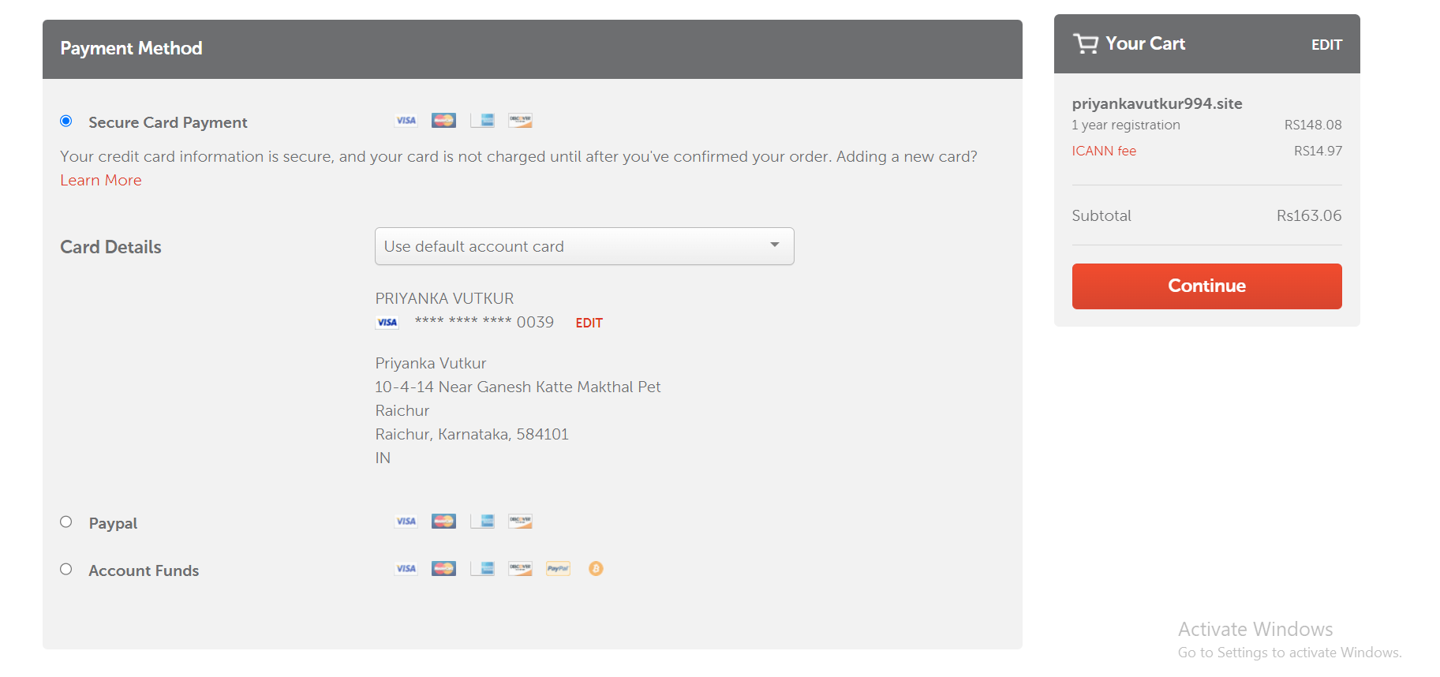
Create account, give your username and password.
If you already have an account of namecheap login to account.
Enter your card details, which has international net banking enabled.
Click on continue.

Slide 11
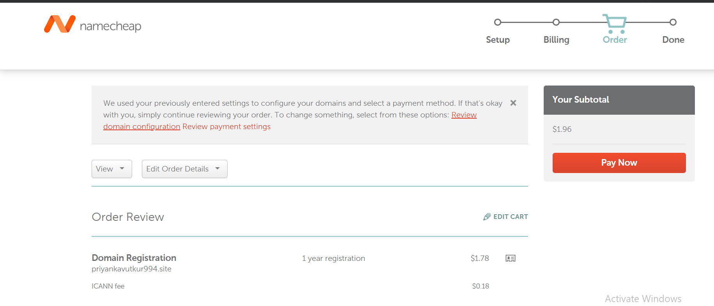
Next click on paynow, and enter otp.
Your successfully created your won domain in namecheap.
It takes 24 hours to activate your domain.

Slide 12
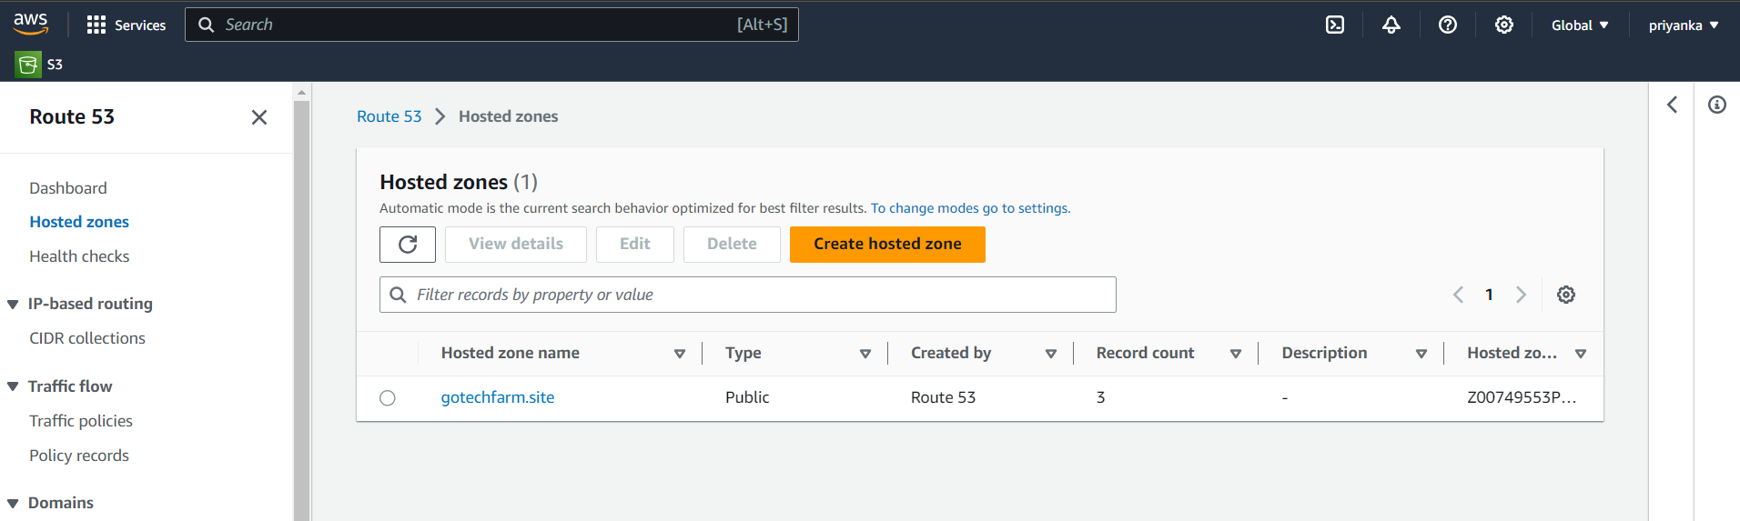
4. Connect Domain Name server to your Route 53.
Now to connect between Route53 to your namecheap.
Go to aws >route53>hosted zone.
Click on create hosted zone.

Slide 13
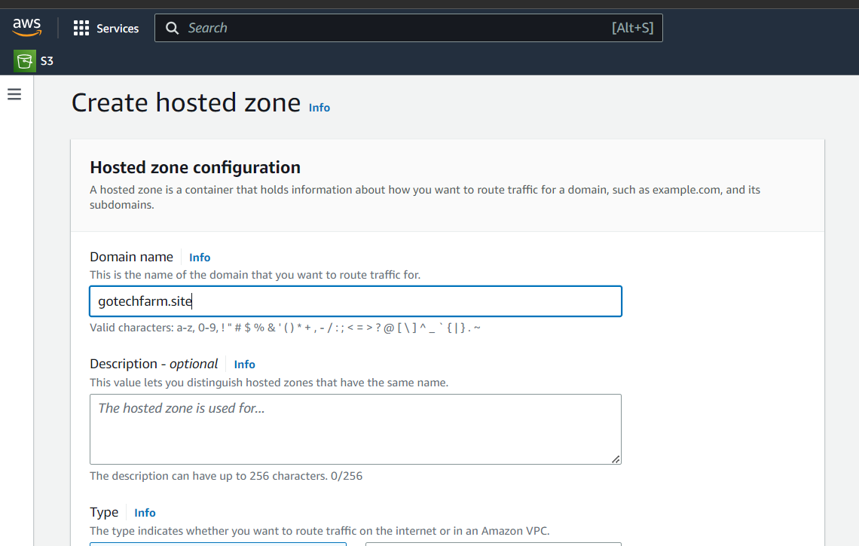
Enter your created domain name example here I have created “gotechfarm.site” as my domain name.
Keep public host.

Slide 14
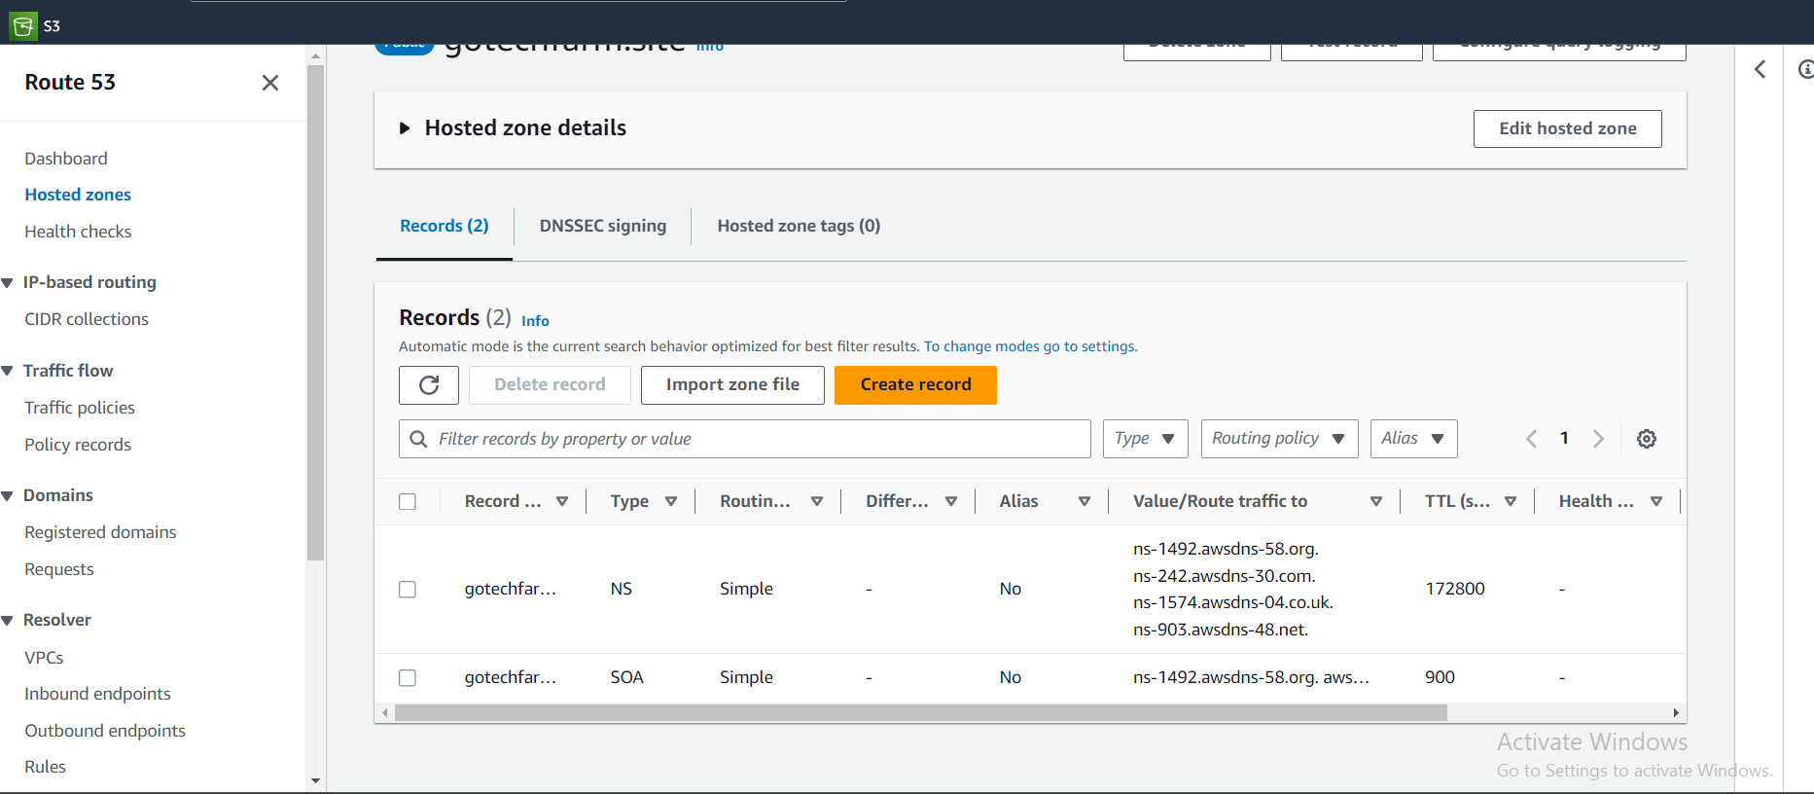
After your domain is activated in the namecheap, copy the name servers.

Slide 15
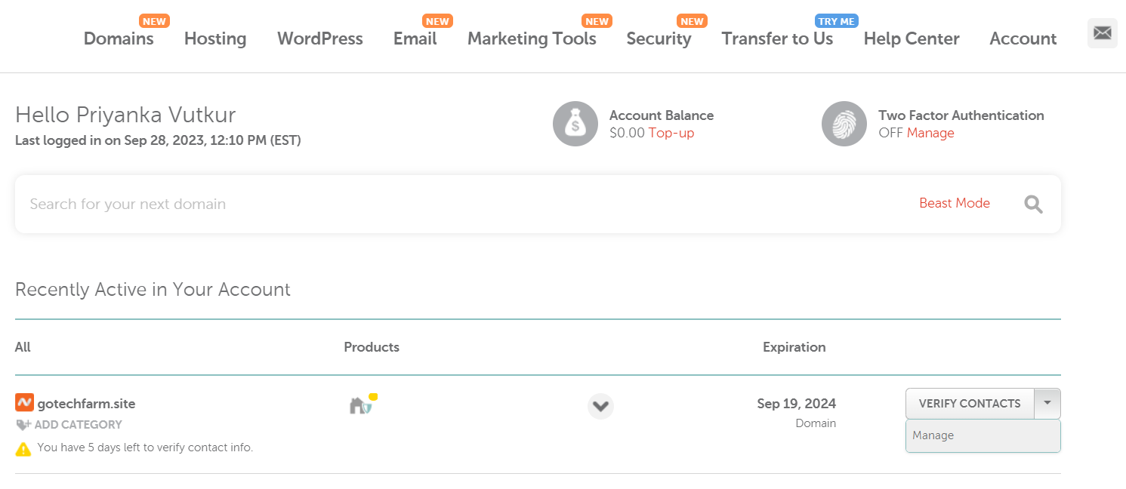
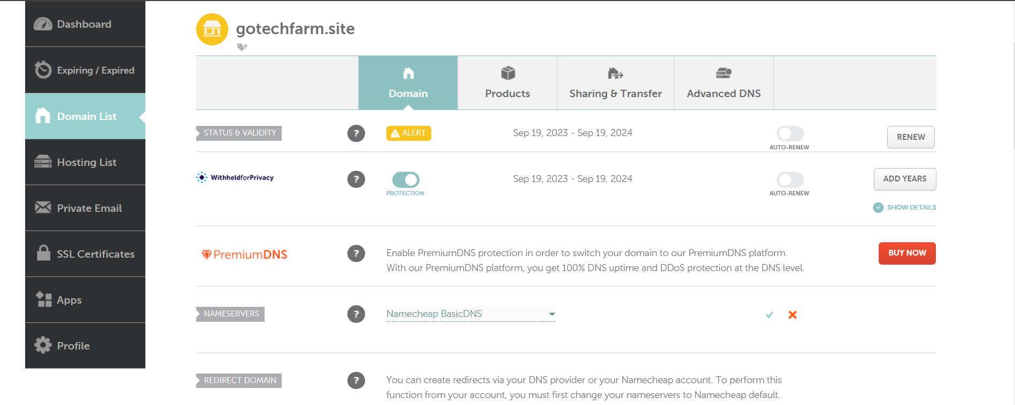
Go to namecheap website, login to your account.
Click on “verify Contacts” >manage.
In name servers click on arrow and select custom DNS and add the copied server names one by one.

Slide 16
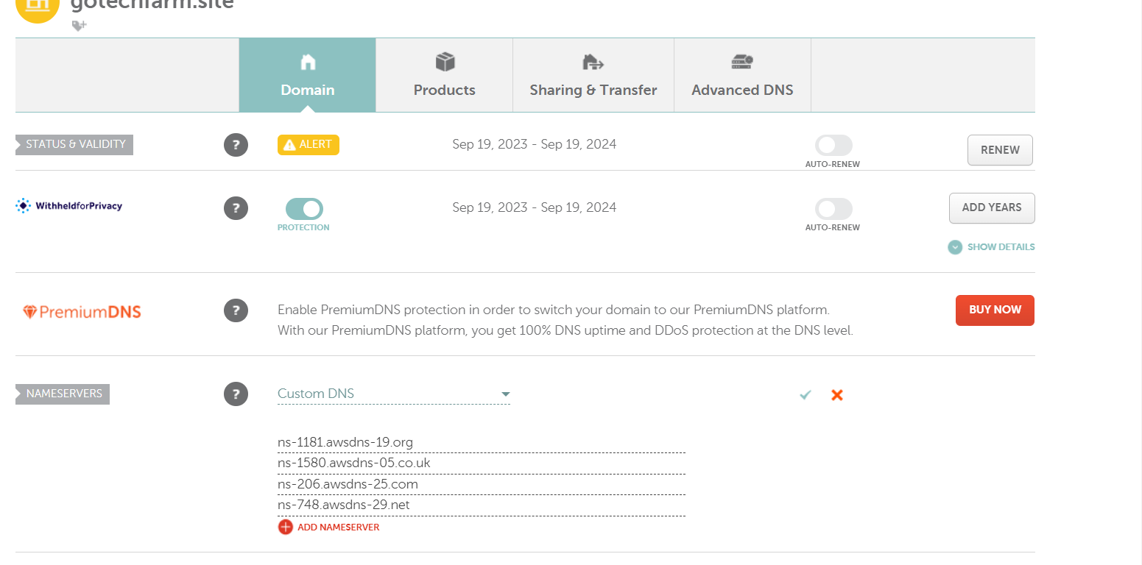
Note : remove “.” in the end of the name.
It takes 24 hours to activate these servers in your domain.

Slide 17
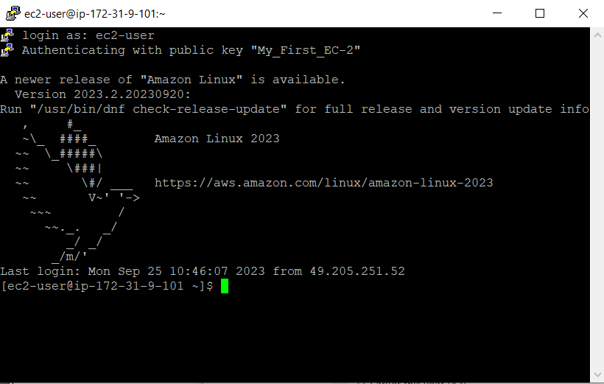
5. Host the site with your DNS
To host your website you need to create ec2 instance.
Follow the steps explained in the EC2 instance.
Now launch the ec2 instance.

Slide 18
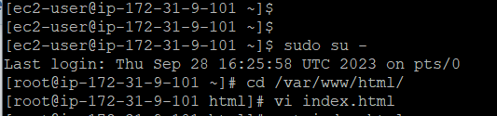
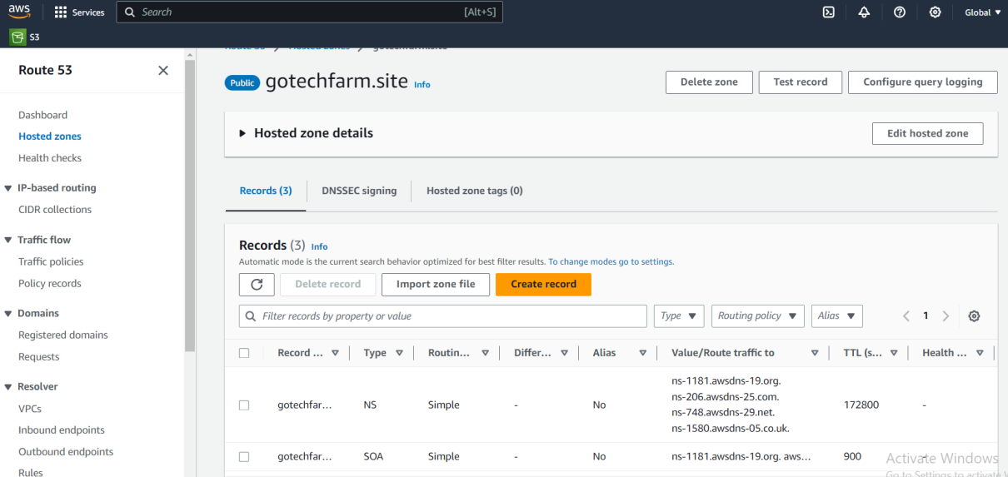
Now change to root user “sudo su –”
Change directory to the /var/www/html/
Create index.html in the html folder and add some content in it.
Copy the public id of the created instance.
Now go to route 53> hosted zones>select the hosted zone>create record.

Slide 19
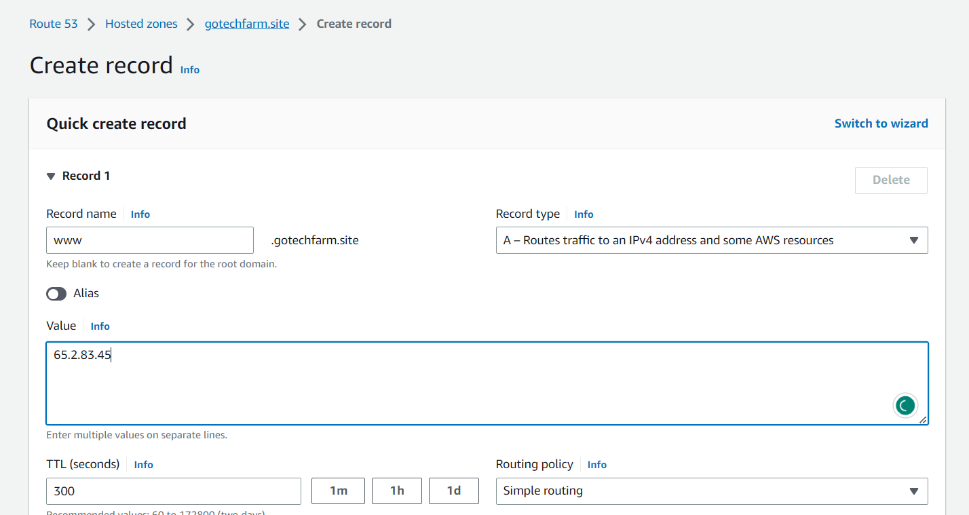
Enter subdomain as www, and enter instance public id in value.
Select record type “A”
Click on create record.
Your DNS is successfully connected to your IP.

Slide 20
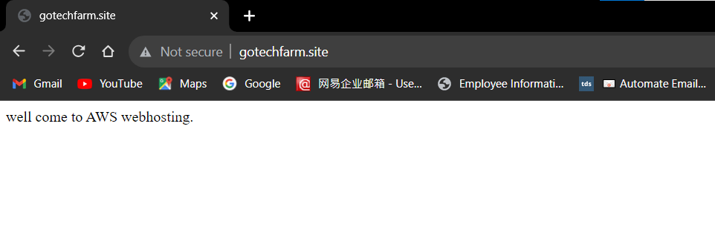
Now lets verify in the web browser, by entering the domain name that we have created.
You can see that our website is hosted in the internet.

