Slide 1
Amazon VPC
(Amazon Virtual Private Cloud)

Slide 2
Content:
Introduction.
The Architecture of Amazon VPC.
VPC Components.
Launching an EC2 Instance into a VPC

Slide 3
1. Introduction.
Amazon VPC or Amazon Virtual Private Cloud is a service that allows its users to launch their virtual machines in a protected as well as isolated virtual environment defined by them. You have complete control over your VPC, from creation to customization and even deletion. It’s applicable to organizations where the data is scattered and needs to be managed well. In other words, VPC enables us to select the virtual address of our private cloud and we can also define all the sub-constituents of the VPC like subnet, subnet mask, availability zone, etc on our own.
We can place the necessary resources and manage access to those resources in the VPC, a private area of Amazon that we control.
A default “VPC” will be generated when we register an AWS account, allowing us to manage the virtual networking environment, the IP address, the construction of subnets, route tables, and gateways.

Slide 4
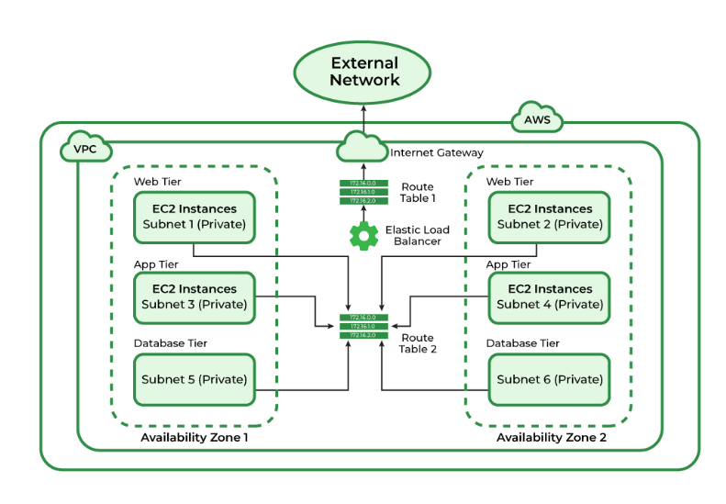
2. The Architecture of Amazon VPC
The basic architecture of a properly functioning VPC consists of many distinct services such as Gateway, Load Balancer, Subnets, etc. Altogether, these resources are clubbed under a VPC to create an isolated virtual environment. Along with these services, there are also security checks on multiple levels.
It is initially divided into subnets, connected with each other via route tables along with a load balancer.

Slide 5
VPC Fundamentals:
If the subnet has internet access then it is called PublicSubnet.
If the subnet doesn’t have internet access then it is called PrivateSubnet.
A subnet must reside entirely within one Availability Zone.
An entire subnet must be contained within a single Availability Zone.
Access between instances is managed by VPC Security Groups for both inbound and outgoing traffic (EC2 Security Groups can only define inbound rules).
We can specify Subnet IP Routing with the aid of the Route Table.
If a server/instance which is in a private subnet wants to reach the internet then it must have NAT in a public subnet.

Slide 6
3. VPC Components
VPC: You can launch AWS resources into a defined virtual network using Amazon Virtual Private Cloud (Amazon VPC). With the advantages of utilizing the scalable infrastructure of AWS, this virtual network closely mimics a conventional network that you would operate in your own data center. /16 user-defined address space maximum (65,536 addresses)
Subnetes: To reduce traffic, the subnet will divide the big network into smaller, connected networks. Up to /16, 200 user-defined subnets.
Route Tables: Route Tables are mainly used to Define the protocol for traffic routing between the subnets.
Network Access Control Lists: Network Access Control Lists (NACL) for VPC serve as a firewall by managing both inbound and outbound rules. There will be a default NACL for each VPC that cannot be deleted.
Internet Gateway(IGW): The Internet Gateway (IGW) will make it possible to link the resources in the VPC to the Internet.
Network Address Translation (NAT): Network Address Translation (NAT) will enable the connection between the private subnet and the internet.

Slide 7
4. Launching an EC2 Instance into a VPC
As we are already aware of the basic process of launching an EC2 instance on AWS, launching it into VPC is almost the same. Every EC2 instance launched on AWS is by default launched inside the default VPC of that particular user. To know more about the basic protocol for launching an EC2 follow the linked article.
We know the process of launching an EC2 instance via the management console.
Now, let us look at the process of launching an EC2 instance into another VPC rather than launching it in the default one.
Start by the same process of creating a new EC2 instance.

Slide 8
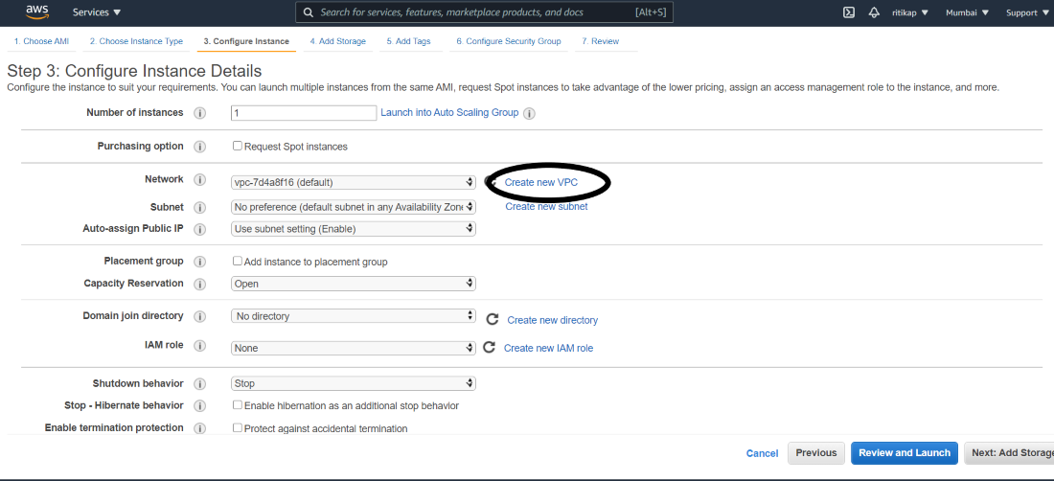
Follow the steps until STEP 3 “Configure Instance Details” occurs. Before proceeding to the next step either select “Create a new VPC” or from the list of existing VPCs, select the VPC for your new EC2 instance. Please refer to the image attached ahead for a better understanding of the concepts.
Once you are redirected to the next window. Simply change all other configurations as per your requirement and launch the EC2 instance.
And if you choose “Create a new VPC”, after getting redirected. Create a new VPC with all your desired configurations. And follow a similar process while launching the EC2 instance.
The process of creating a VPC is discussed ahead.

Slide 9
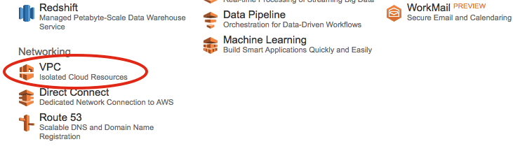
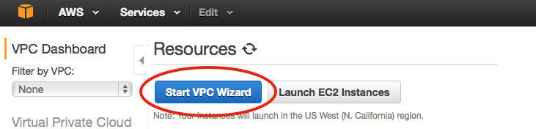
Step1: From the AWS management console, select VPC. Refer to the attached screenshot.
Step 2: After getting directed, click on “Start VPC”. Like this

Slide 10
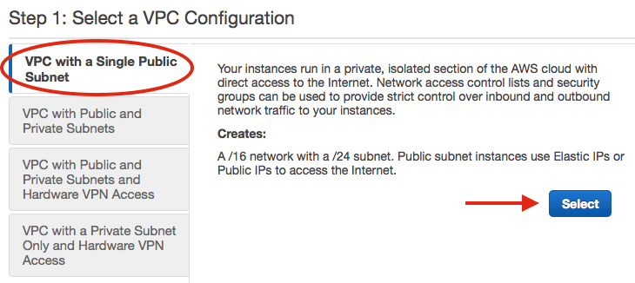
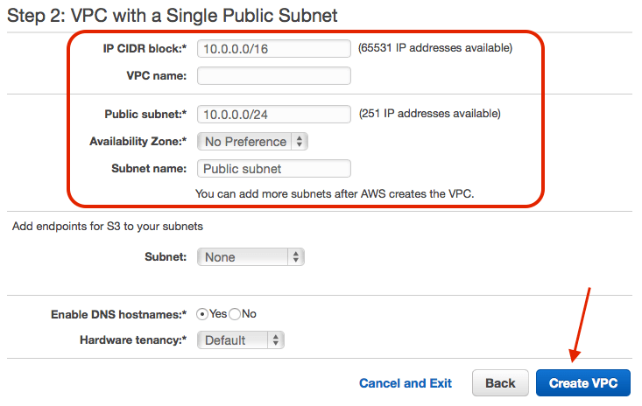
Step 3: Now, you will be given multiple options to choose from in the navigation pane. From them select the “VPC with a single subnet” option to go with. And finally, click select.
Step 4: After this, complete the final step. From the next window, cross-check all the details of the subnet and give a name to your VPC. And finally, click on create VPC.

Slide 11
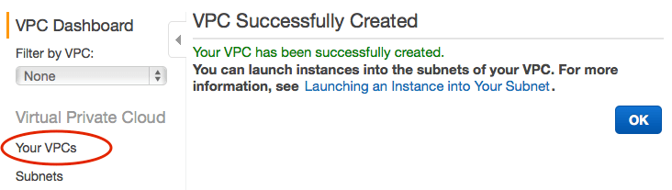
In a while, your new VPC will be successfully created. You can verify it by tapping on “Your VPC” in the VPC dashboard.
In this way, you can simply create a VPC and launch instances in it. If you are also a free tier account holder, make sure you delete all the instances before logging out of your AWS account. This will help you in reducing the bill amount.

