Slide 1
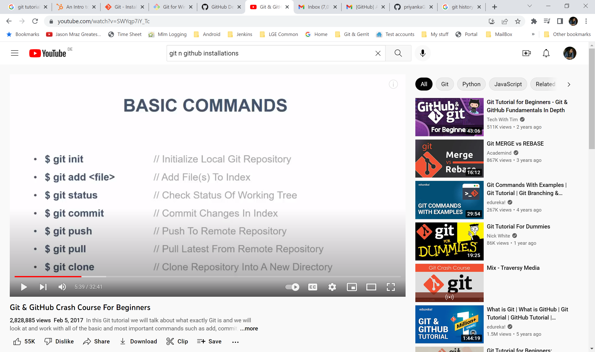
Git Commands

Slide 2
Git bash (command line )
Git pull
Git commit –m “comment”
Git push –u origin master
Git add .
Git checkout <new Branch>
Git merge <branch>
Touch <new file> ( to create files) in local

