Slide 1

AirBnb Listings - USA
Submitted By: Priyanka Taneja (801046756)

Slide 2
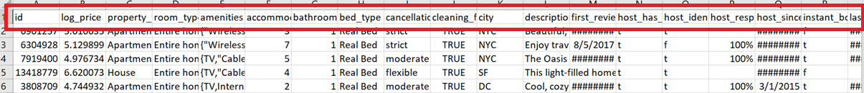
About the Dataset
The dataset is taken from Kaggle.com :
https://www.kaggle.com/rudymizrahi/airbnb-listings-in-major-us-cities-deloitte-ml
Analyze publicly available information so that we can see how Airbnb is being used to compete with the residential housing market.
This dataset has 28 attributes which includes: id, property_type, room_type, amenities, accommodates, bathrooms, bed_type, cancellation_policy..etc

Slide 3
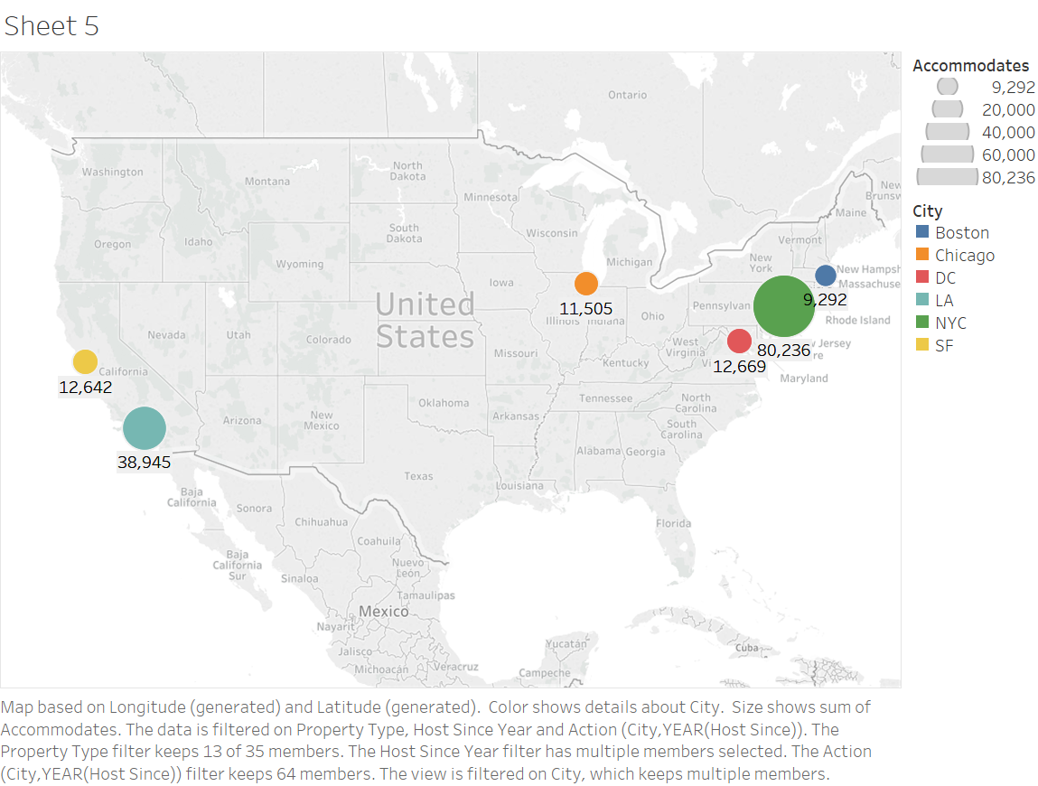
Tasks
How many accommodations for a particular property type is being provided in a city.
= New York City has the maximum number of accommodations.

Slide 4
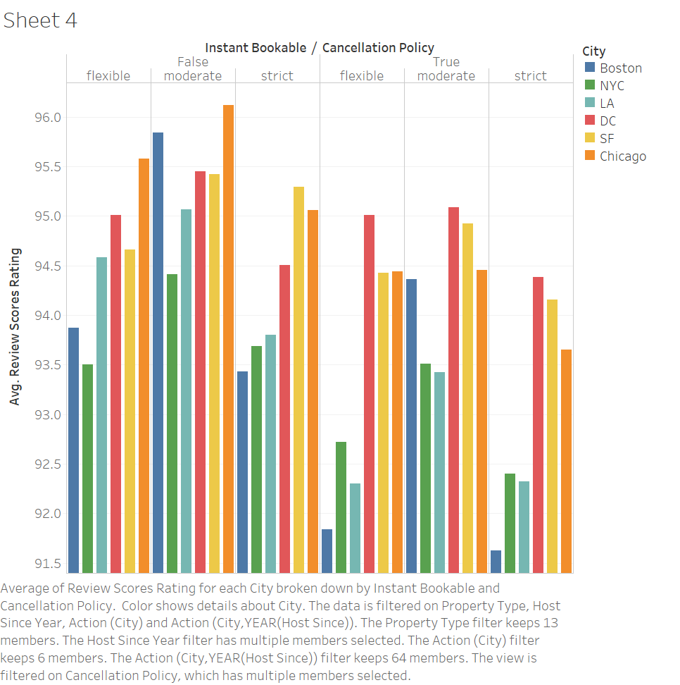
Tasks
Compare two locations based on customer reviews, cancellation policy, instant booking.

Slide 5
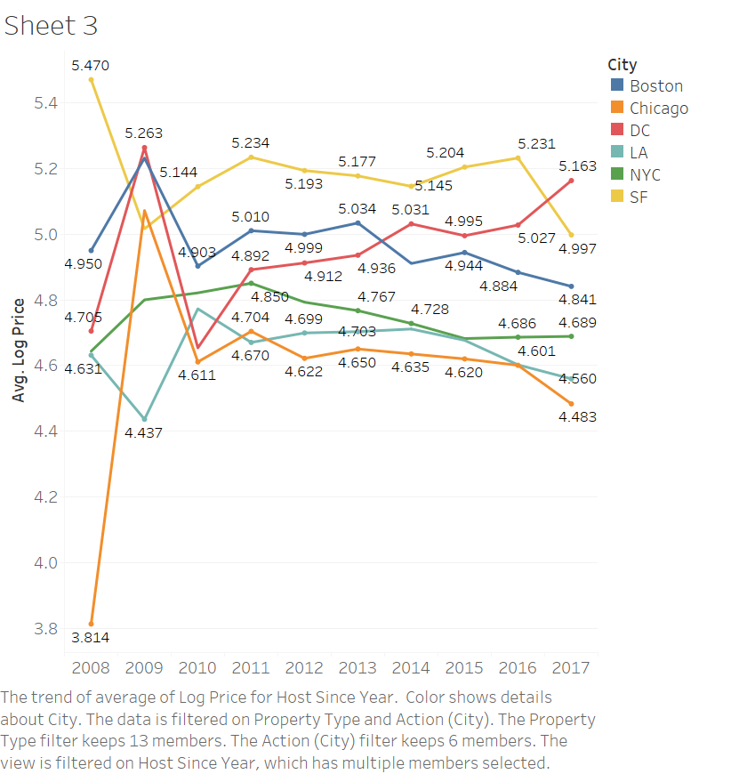
Tasks
Study the fluctuation in the price for various cities.

Slide 6
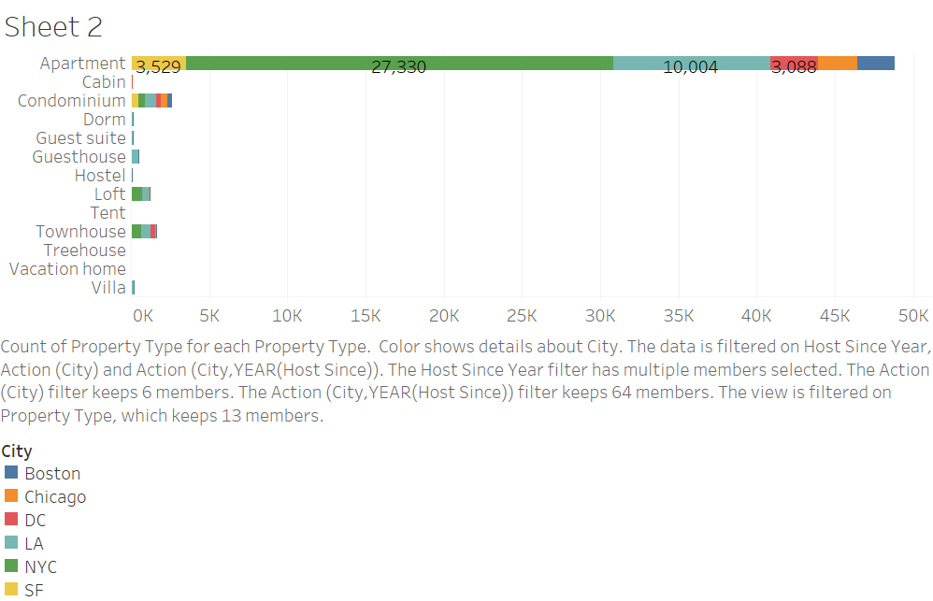
Tasks
What types of accommodations are provided in a particular city.

Slide 7
Let’s hit the DashBoard..
https://public.tableau.com/profile/priyanka.taneja#!/

Slide 8
Thank You

