Slide 1
ALGORITHM TO BOOST RESTAURANT’S YELP RATING BY PREDICTING USER BEHAVIOR AND PREFERENCES
Priyanka Aggarwal

Slide 2
DATASET:
The datasets being used for this project are taken from Yelp Dataset Challenge. www.yelp.com/dataset/challenge
Total Dataset Size: 4860.29 MB
It includes 174K businesses, 1.3M users, 5.2M reviews.
For purpose of this research, I am working on extracted data for restaurants in Toronto. The techniques can be applied to any other business or location.
Notes:
Toronto 7148 Las Vegas 5899 Phoenix 3647 Montréal 3332 Charlotte 2460 Pittsburgh 2207

Slide 3
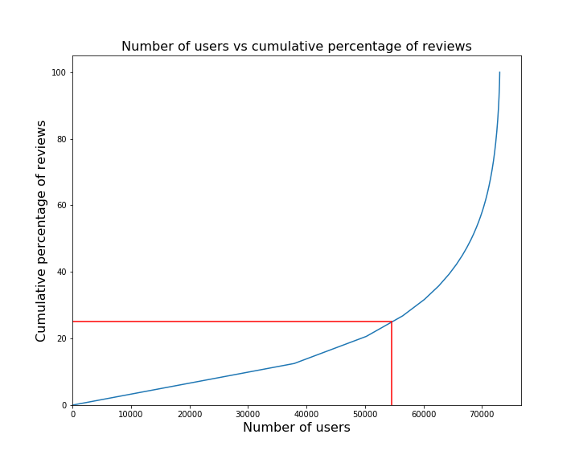
75% of the reviews are given by less than 25% of the reviewers

Slide 4
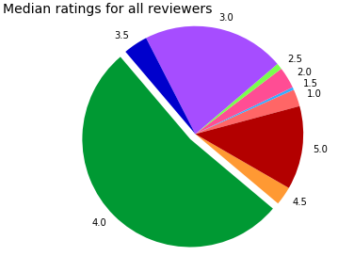
More than 50% reviewers give a median rating of 4.0
52.7%

Slide 5
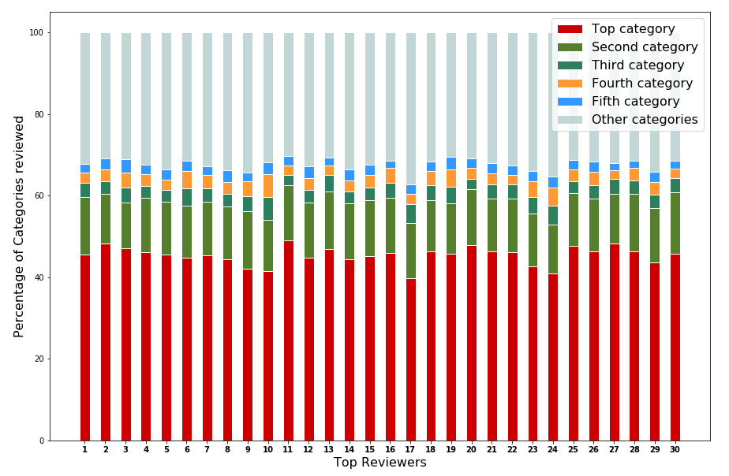
Each user is interested in a few categories of Restaurants

Slide 6
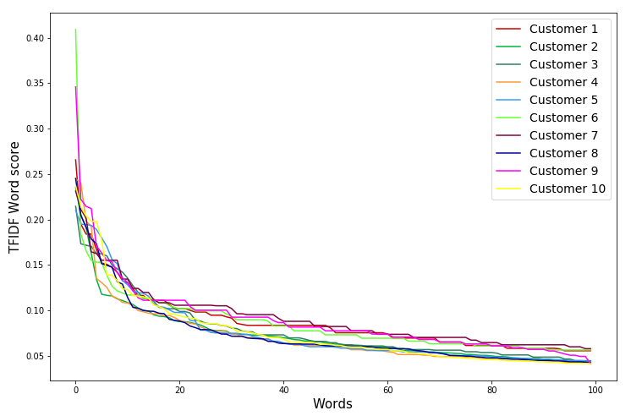
Analysis of review text shows that only a few keywords are enough to differentiate a customer

Slide 7
Restaurant signs up for the service
Customer submits a positive review
Algorithm predicts prospective positive reviewers
Restaurant invites these customers with special promotion
At customer’s visit, the algorithm extracts customer likes
Restaurant utilizes the extracted guidelines for a personalized service

