Slide 1

Multithreaded Sorting
Class: 180C – Operating Systems
Under: Prof. Jahan Ghofraniha
Presented By
Karthigai Amutha Ezhilarasu
Priyanka Agrawal
Mansi Ketan Thaker

Slide 2
Problem Statement
Write a multithreaded sorting program that works as follows: A list of integers is divided into two smaller lists of equal size. Two separate threads (which we will term sorting threads) sort each sub list using a sorting algorithm of your choice. The two sub lists are then merged by a third thread—a merging thread—which merges the two sub lists into a single sorted list.

Slide 3
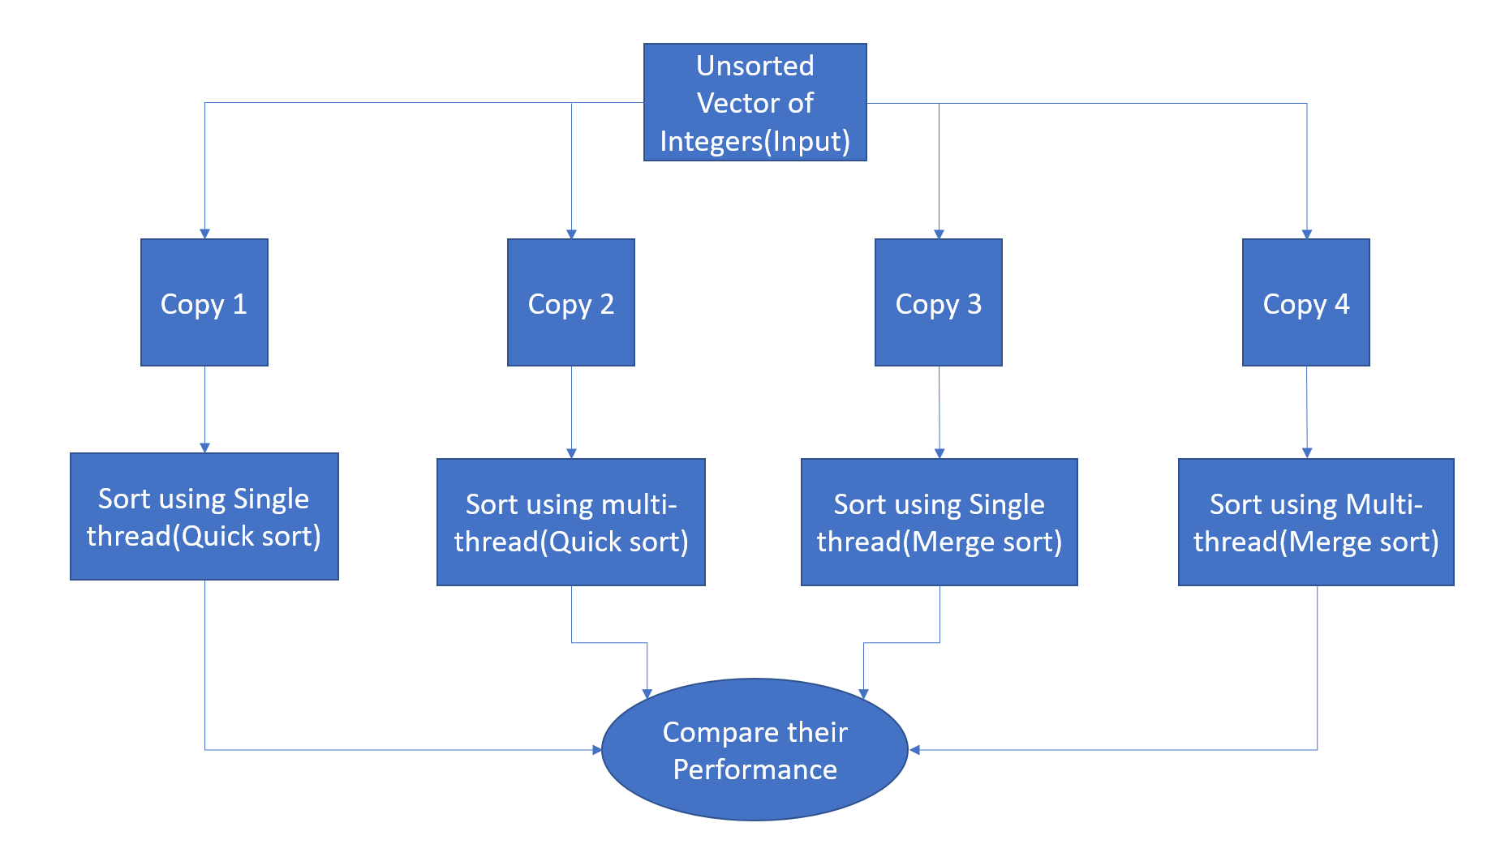
Overview of the project

Slide 4
Language and Libraries Used
std::chrono
The chrono library defines clocks, time periods and durations
To measure the execution time for different algorithms under single thread and multithread environment
std::thread
Built-in support for threads in C++
Language
C++

Slide 5
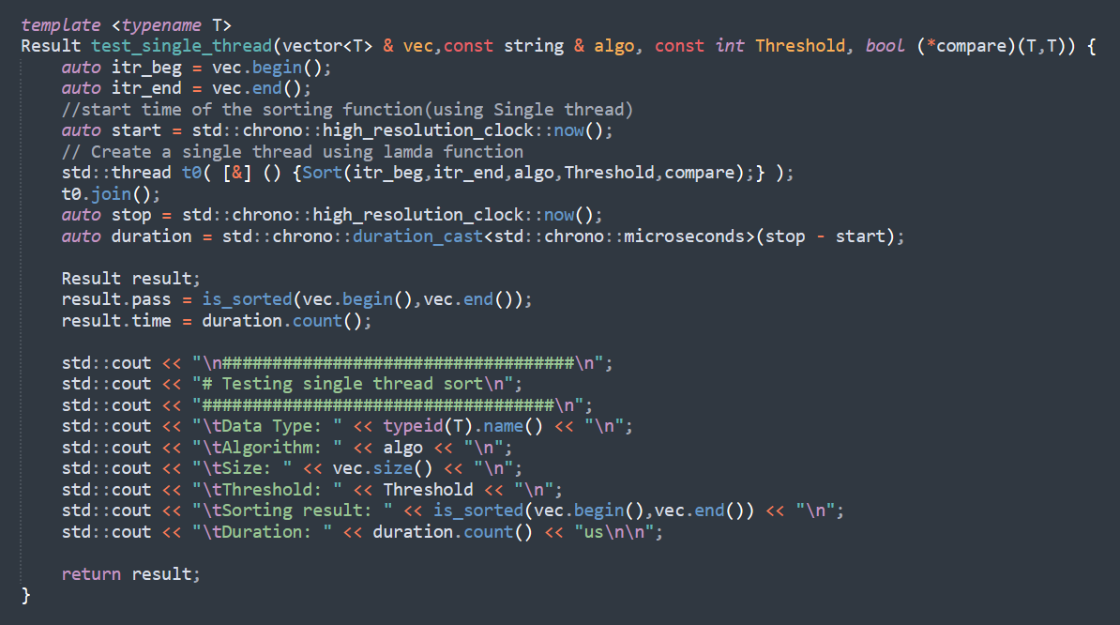
Sorting with a single thread
Vector to be sorted
Sorting Algorithm
Threshold (Insertion sort)
Compare Function
chrono functions
Thread Functions

Slide 6
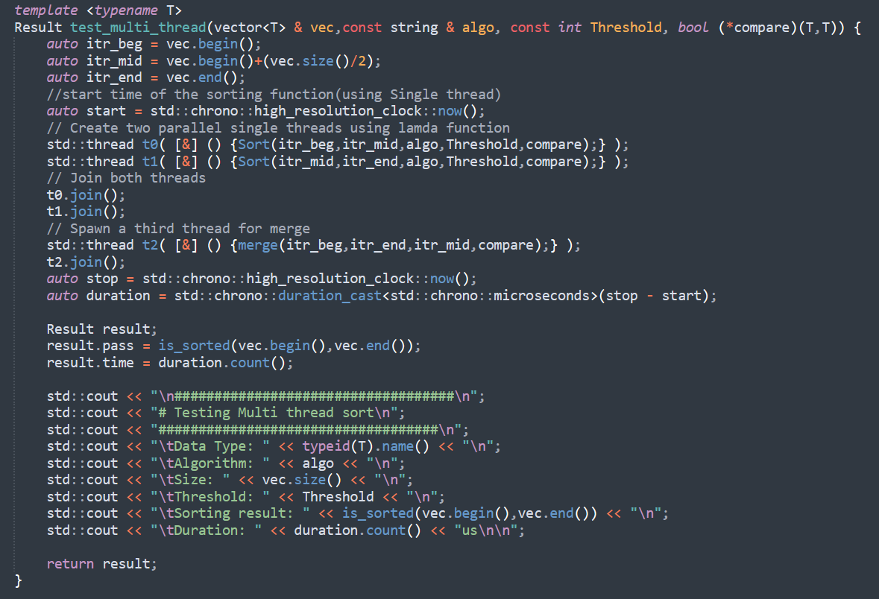
Sorting with Multi-threading

Slide 7
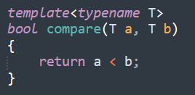
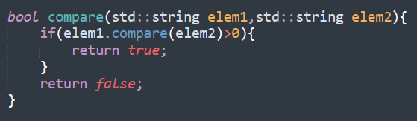

Compare Function
For basic datatypes(int, char, float, double etc.)
to be sorted in ascending order
For Strings to be sorted in alphabetical order
For sorting other user defined objects (for e.g., sorting of 2D figures based on their areas)

Slide 8
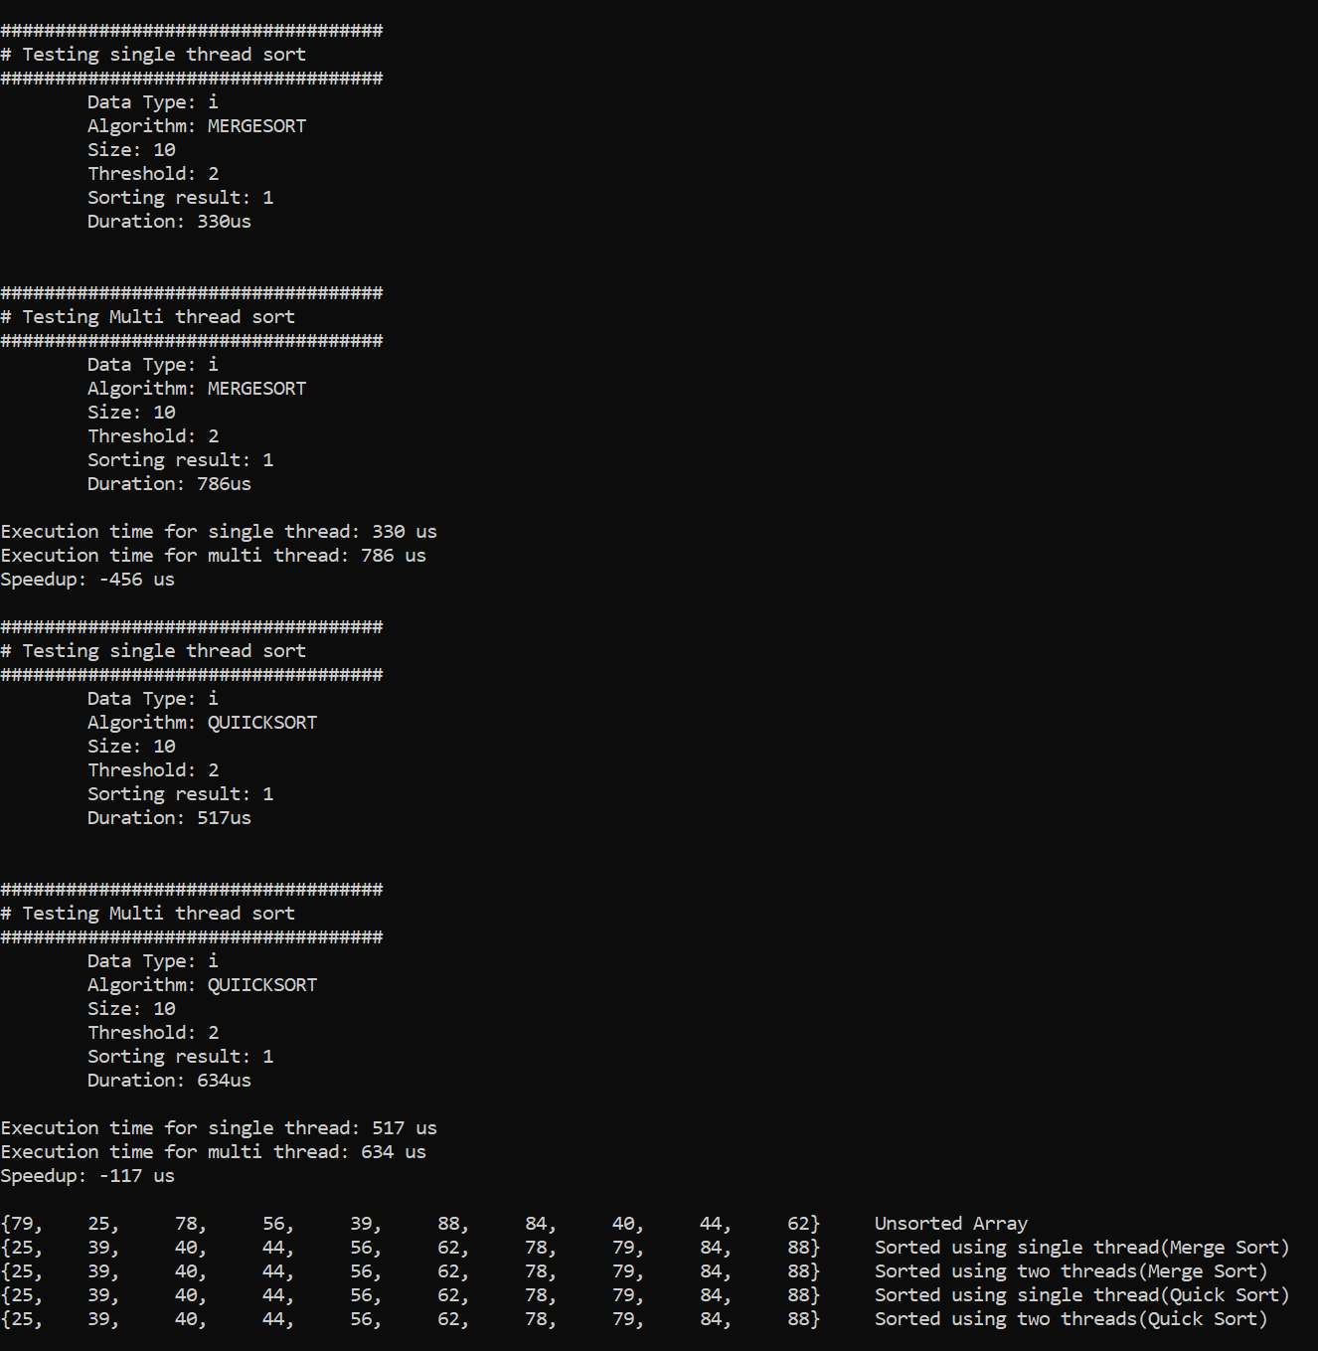
Sample output (Integers)

Slide 9
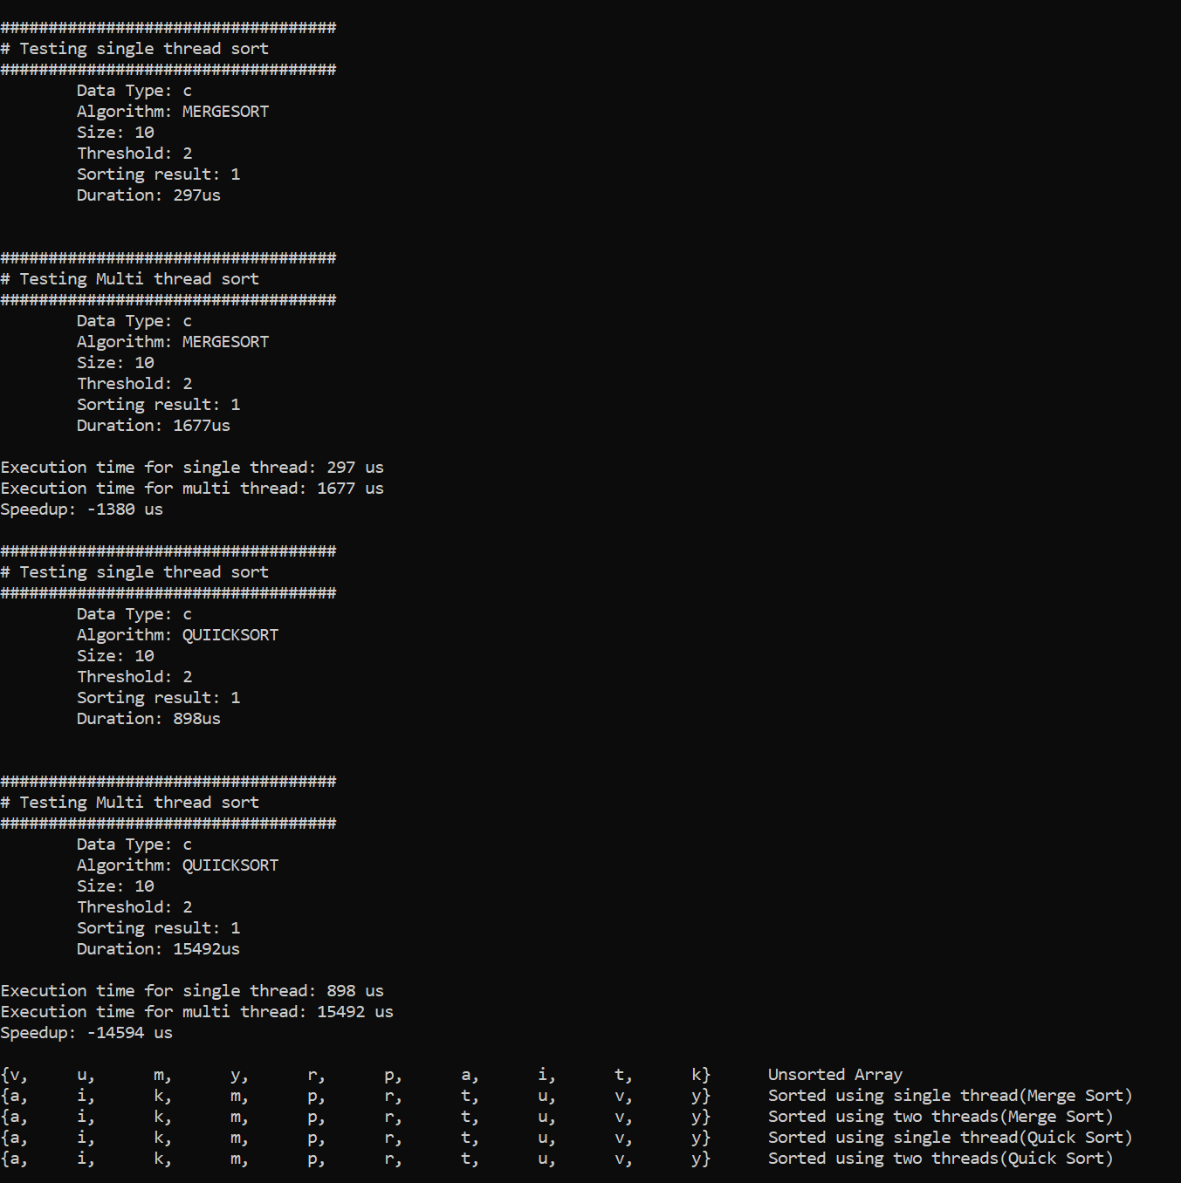
Sample output (characters)

Slide 10
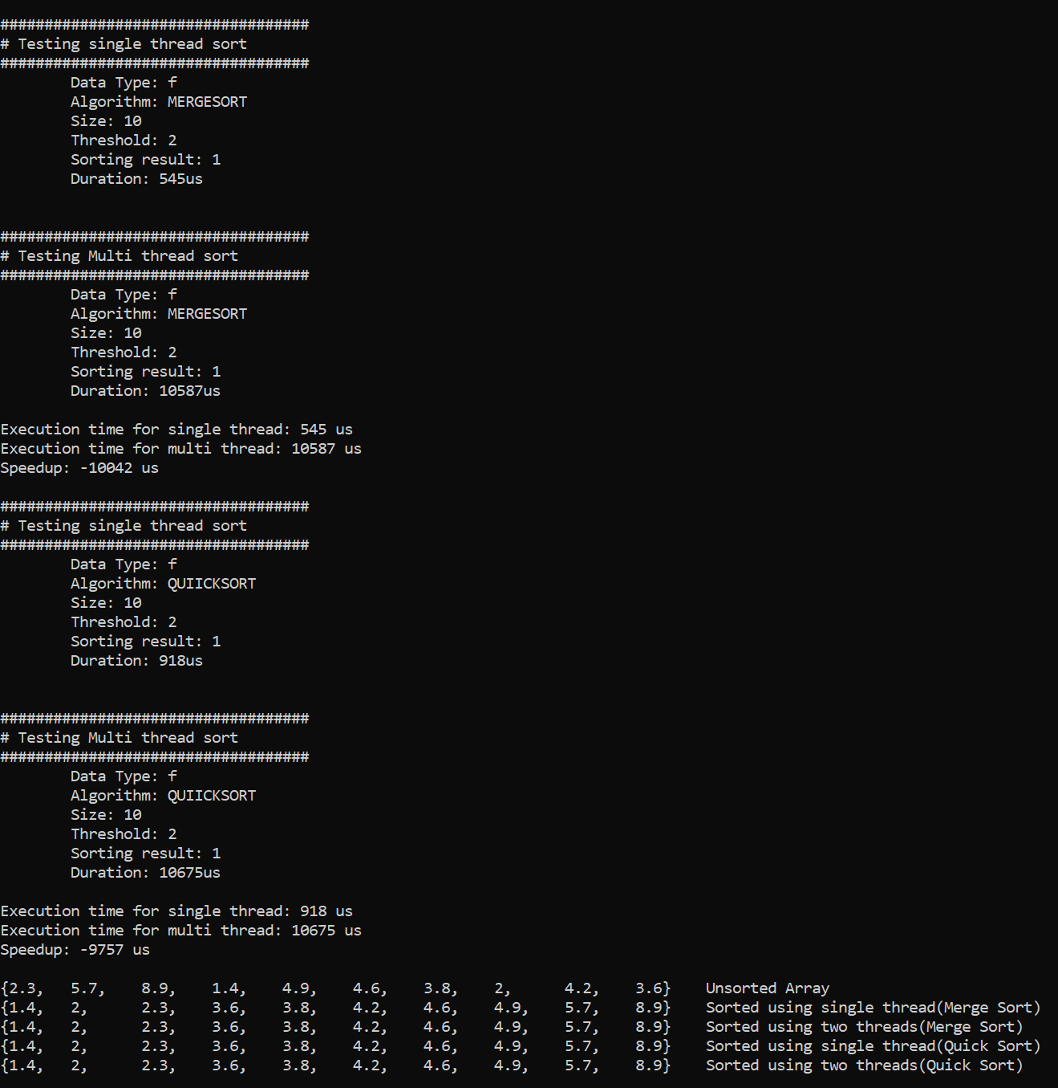
Sample output (Float)

Slide 11
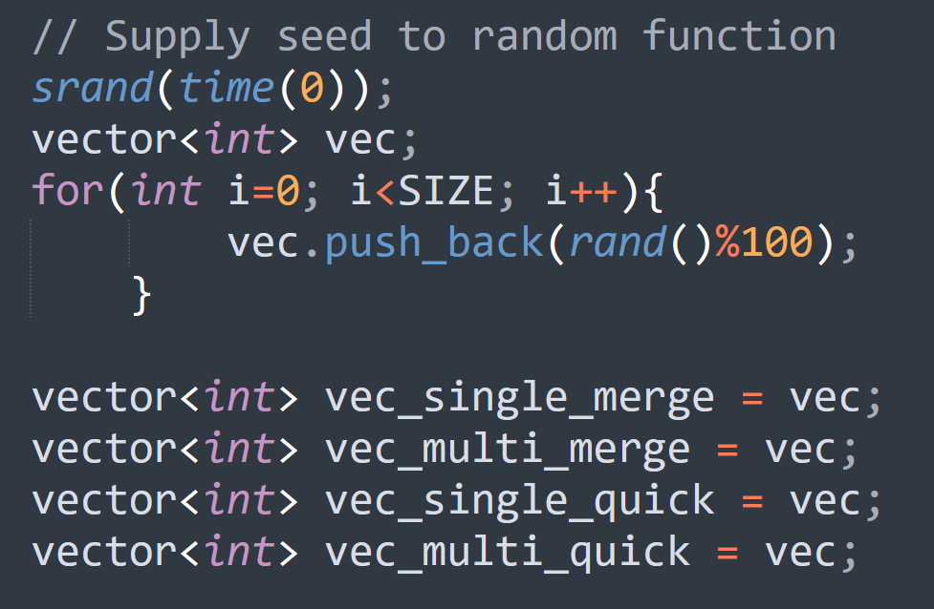
Creating Input elements using rand()

Slide 12
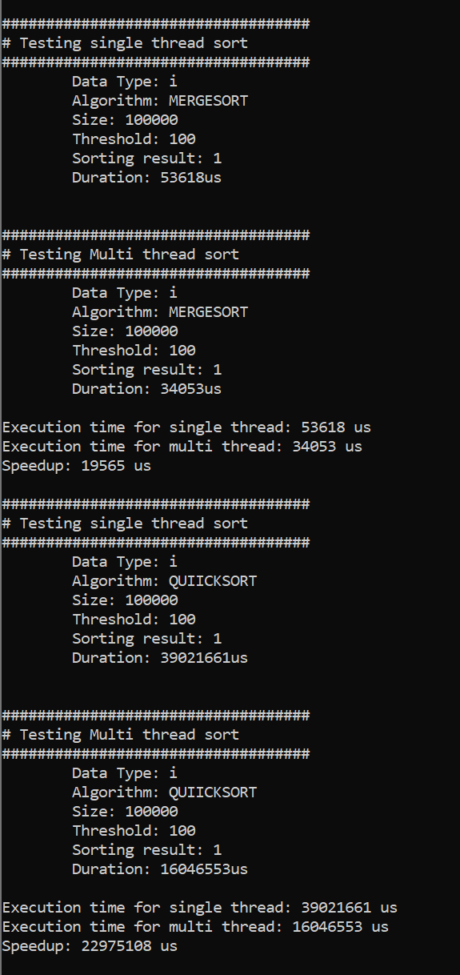
Sample Output (for a larger array)

Slide 13
Quicksort Algorithm
It is based on divide and conquer approach.
3 basic operations:
Pick
Select an element as a pivot.
Divide
Split the problem set
Move the smaller elements to the left of the pivot
Move the larger elements to the right of the pivot
Swapping done in place.
Repeat and combine
Recursively call the same procedure for left and right subarrays and combine them.

Slide 14
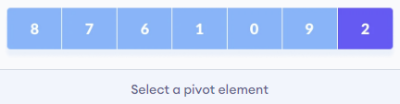
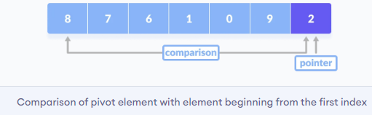
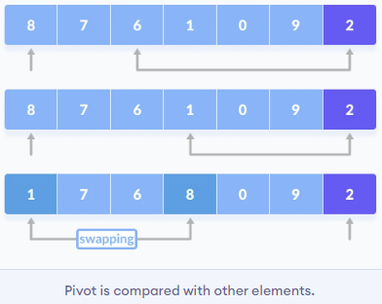
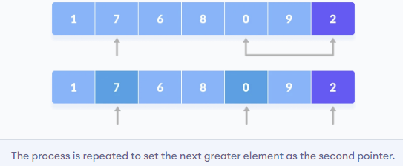
Quicksort Algorithm

Slide 15
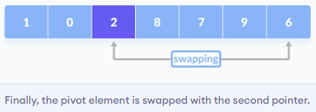
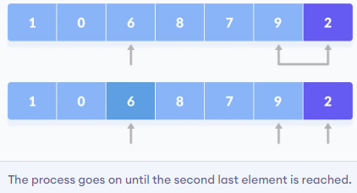
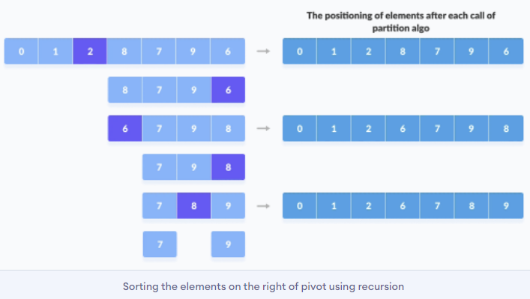
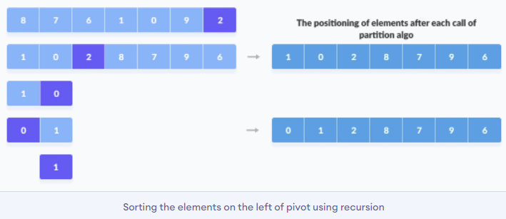
Quicksort Algorithm

Slide 16
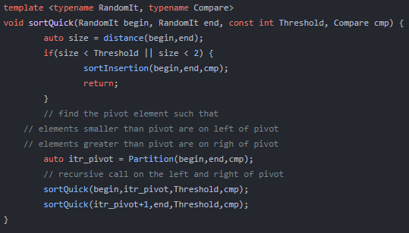
Quicksort function
Starting iterator
Ending iterator
Threshold value
Custom comparator
Call to sortInsertion when size < Threshold
Returns the sorted position of the pivot value
Recursive call to sortQuick function

Slide 17
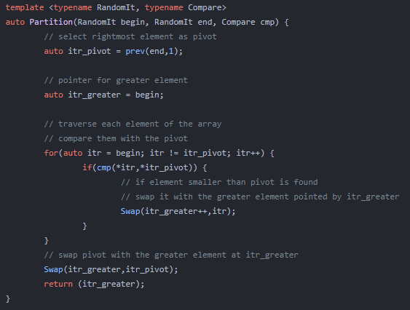
Partition function
Last element as pivot
Returns sorted position of the pivot value.

Slide 18
Merge Sort Algorithm
Based on divide and conquer approach.
3 basic operations:
Divide
Divide the list recursively into two halves until the threshold value.
Sort
Insertion sort for divided list with size < Threshold.
Merge
Merge the smaller lists into new list in sorted order.

Slide 19
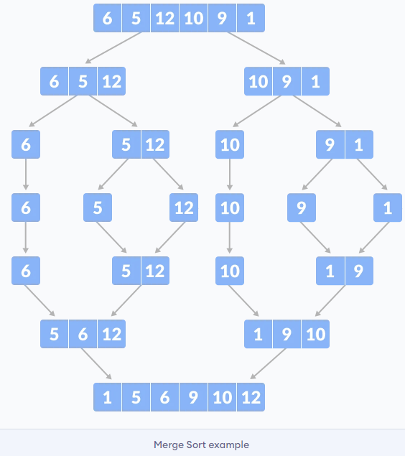
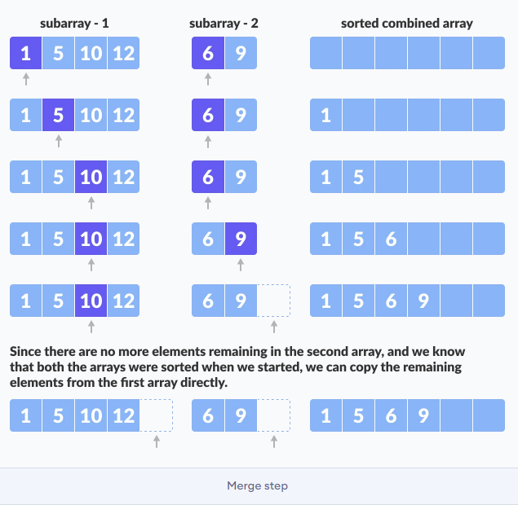
Merge Sort Algorithm

Slide 20
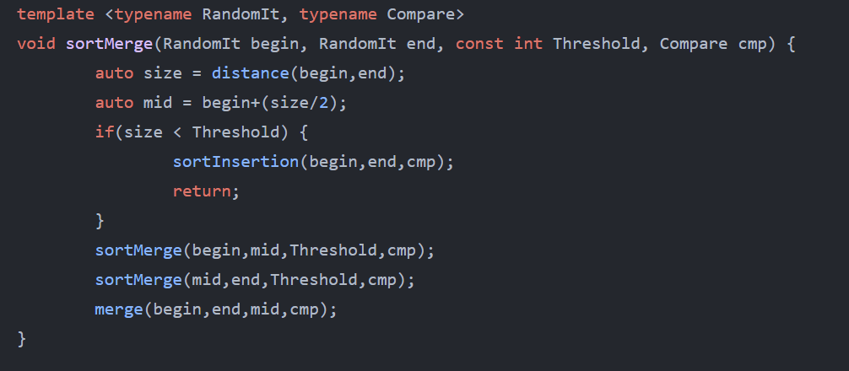
Merge Sort Function
Starting iterator
Ending iterator
Threshold value
Custom comparator
Call to sortInsertion when size < Threshold
Recursive call to sortMerge function
Call to merge function to merge the sorted array/vector.

Slide 21
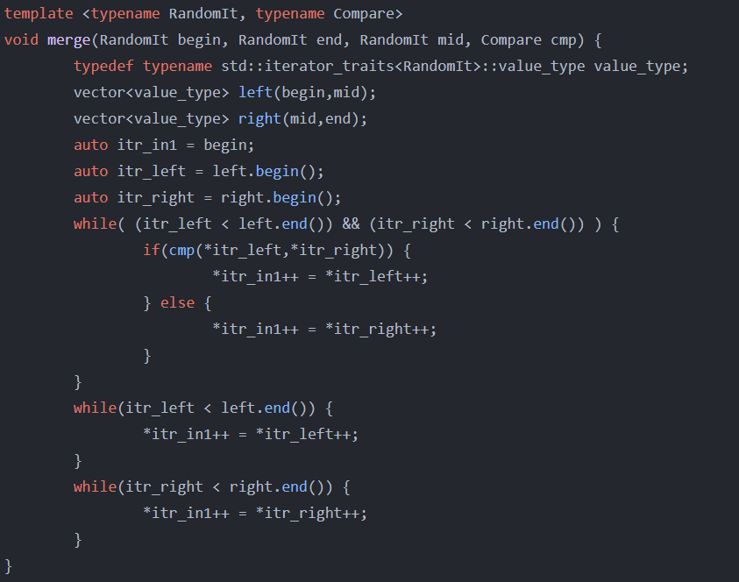
Merge function

Slide 22
Insertion Sort
Simple sorting algorithm.
3 basic operations:
Split
Array is virtually split into sorted and unsorted parts.
Compare and swap
Each element in the unsorted part is picked, compared with each element in the sorted part and placed at the correct position in the sorted sub-array.
Repeat
Repeat until array is sorted.

Slide 23
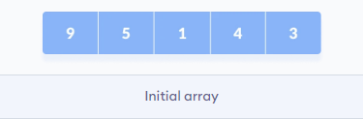
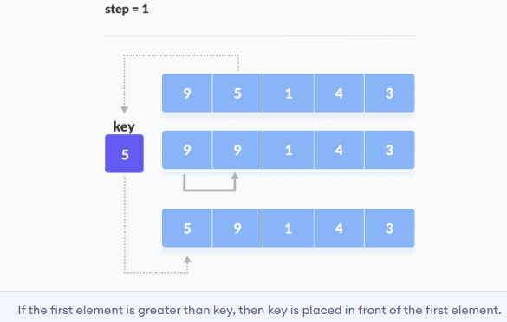
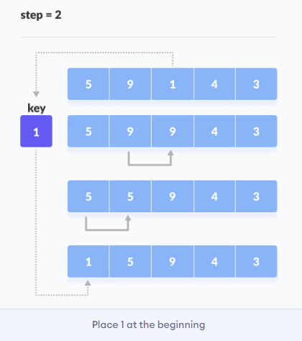
Insertion Sort

Slide 24
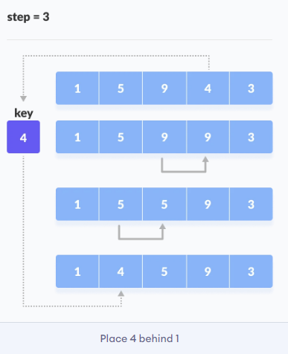
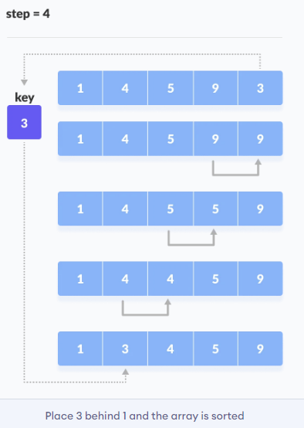
Insertion Sort

Slide 25
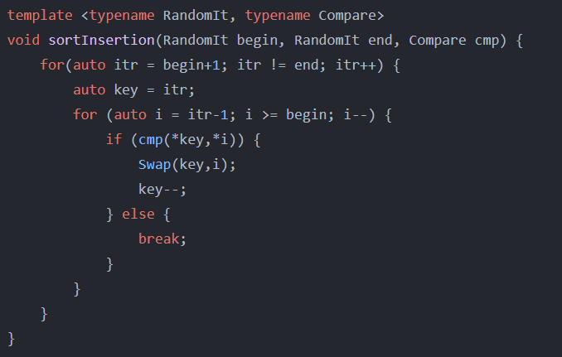
Insertion Sort Function
Starting iterator
Ending iterator
Custom comparator

Slide 26
Unit testing
Unit testing is a kind of software testing.
Unit testing is the first level of testing before performing Integration testing.
Unit testing will examine individual software units or components.
The main reason for software testing is to make code error-free.

Slide 27
How does Unit testing work?
In unit testing, every case has been checked and if the code doesn’t have any error, it will run successfully and print the pass message or else it will give error and so that we can see that there is some problem within the code .

Slide 28
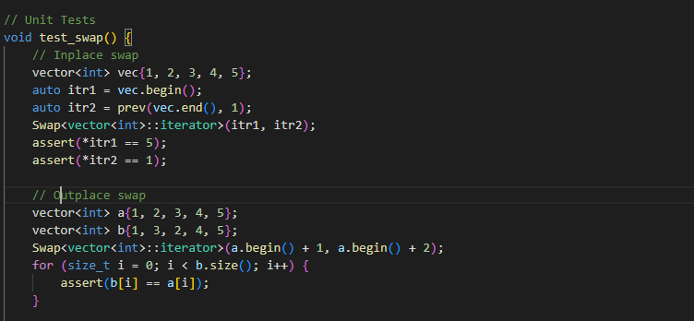
Example of Unit testing
Inplace Swap
Outplace Swap

Slide 29
Integration Testing
Integration testing is the second step of the testing.
And in which each module of the program is integrated together and tested as a group.
And while performing the integration testing if errors will be generated then report to the developer to fix that defects.

Slide 30
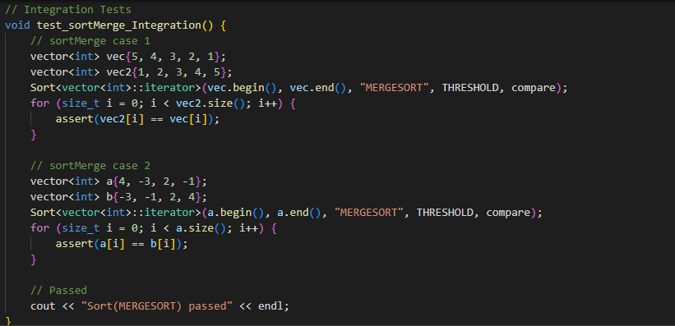
Integration Testing example
All positive integers
Positive and Negative integers

Slide 31
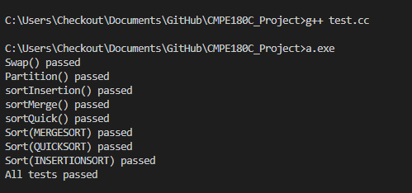
Testing Output

Slide 32
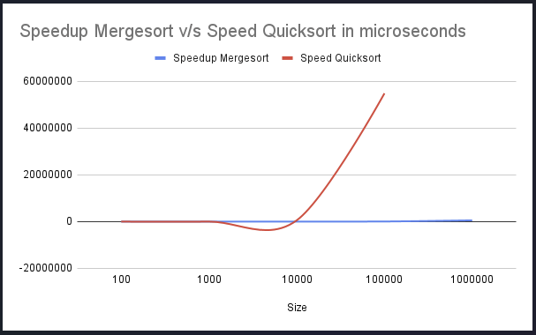
Conclusion
Single Vs Multi threading
Smaller Arrays (< 10000) => single thread performs better
Larger Arrays (>10000) => Multi threading starts giving better performance
As the array size increases, performance of multithreading improves a lot (for both the algorithms)

