Slide 1
Spring MVC Using Maven Archetype

Slide 3
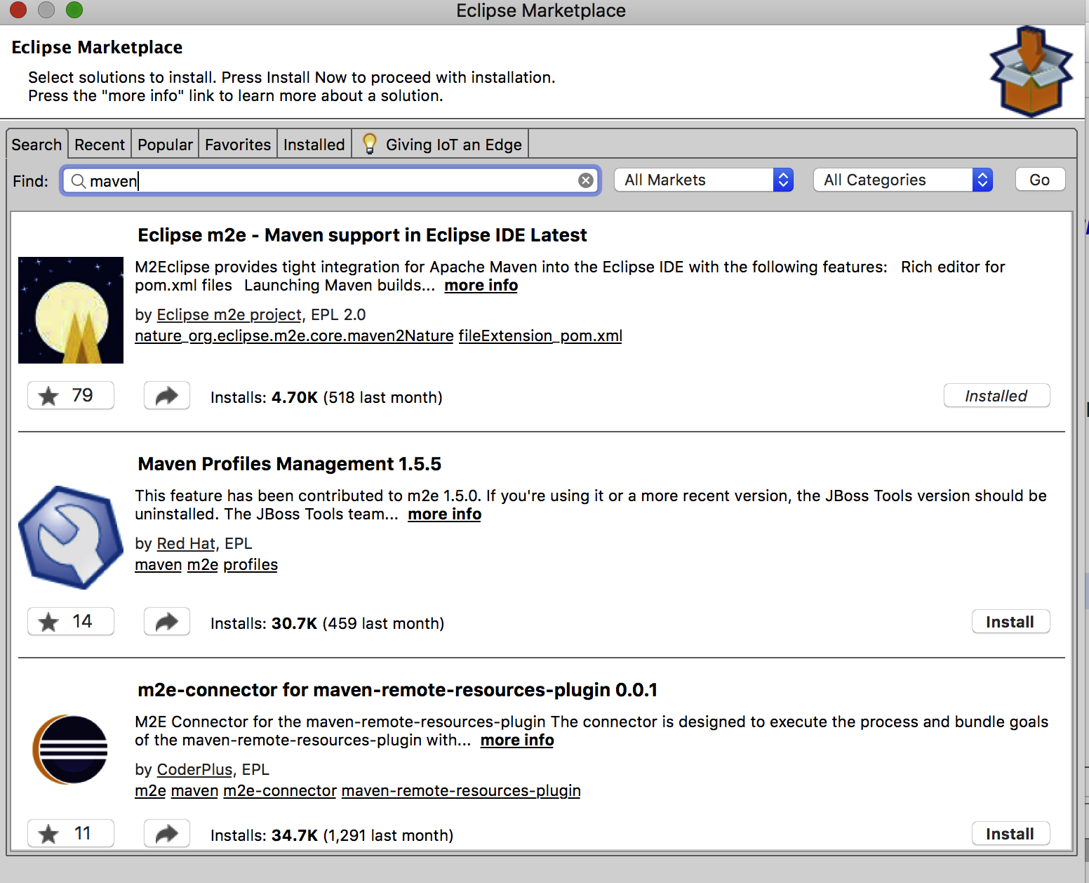
Install maven Plugin if it does not exist

Slide 4
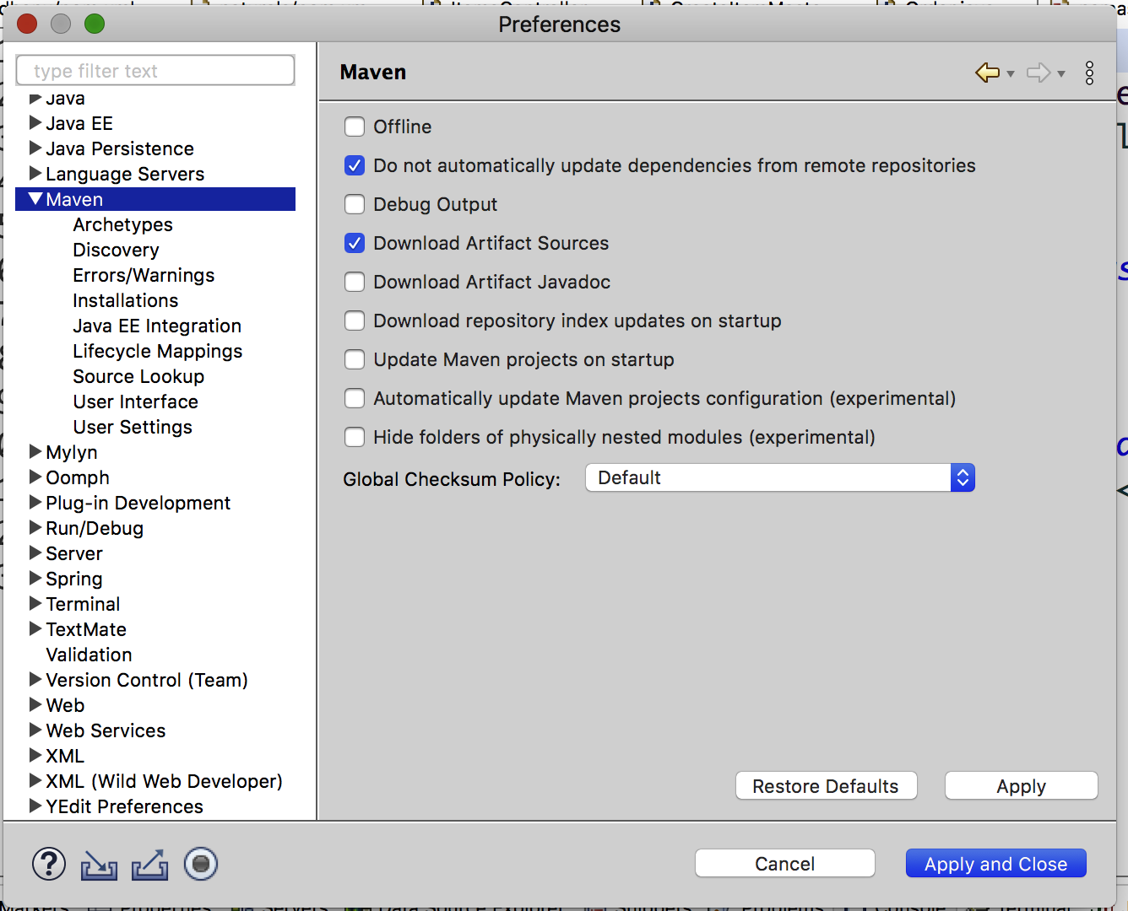
Using Maven to Create Spring MVC Project
Check in the eclipse→preferences if Maven appears as shown below.
If not found then you have to install m2 eclipse from market place on Eclipse

Slide 5
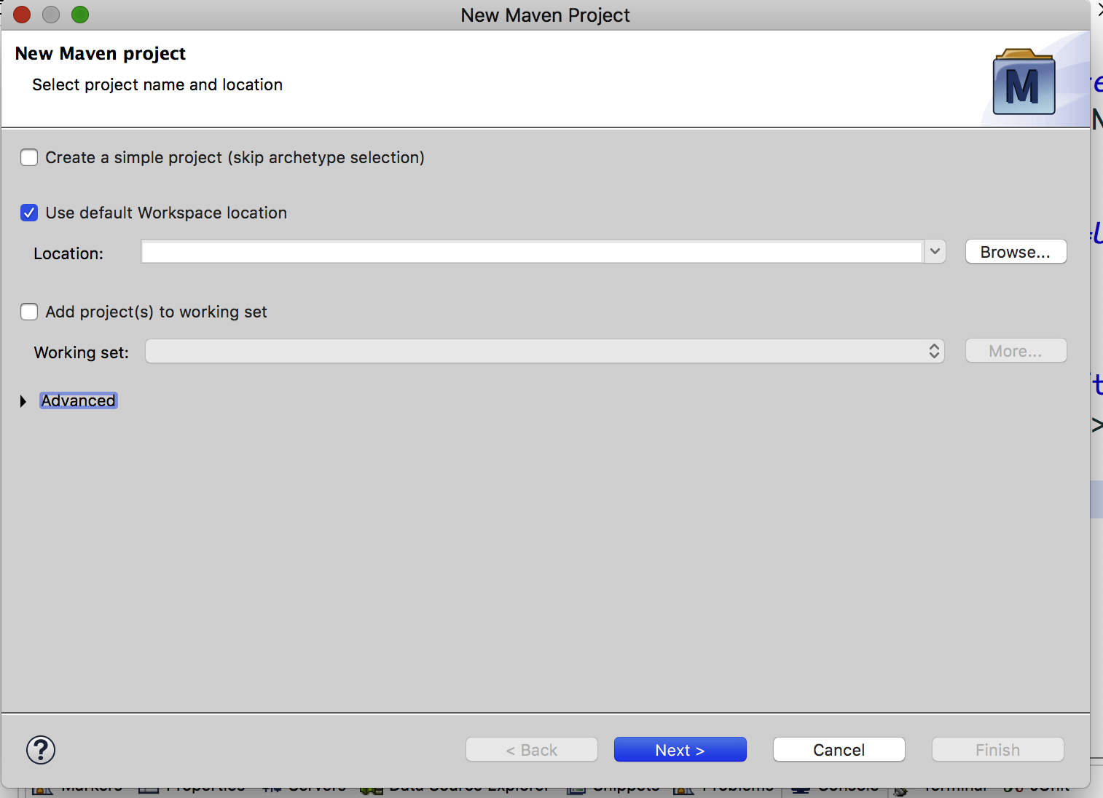
Using Maven to Create Spring MVC Project
3. goto new -> project-> Maven Project and click on next
You will see screen below click Next >

Slide 6
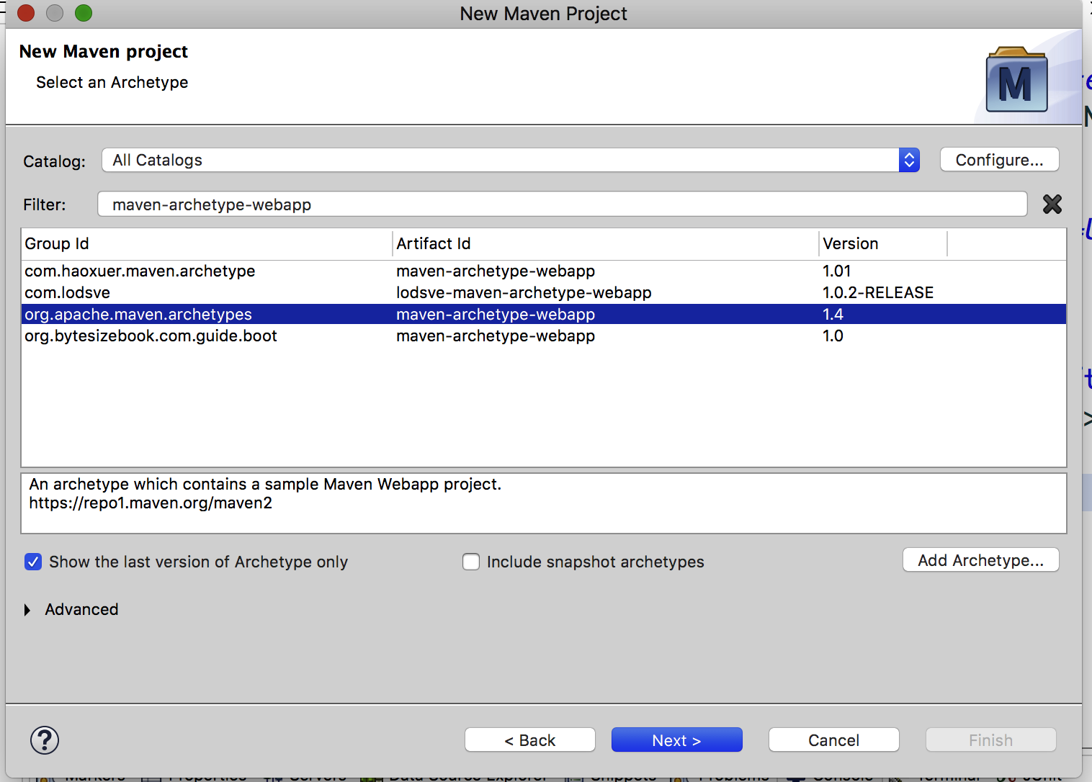
Using Maven to Create Spring MVC Project
4. We need to select type of archetype here.As we are creating web app here, please put following text in filter : maven-archetype-webapp as shown below select version 1.4 click Next >

Slide 7
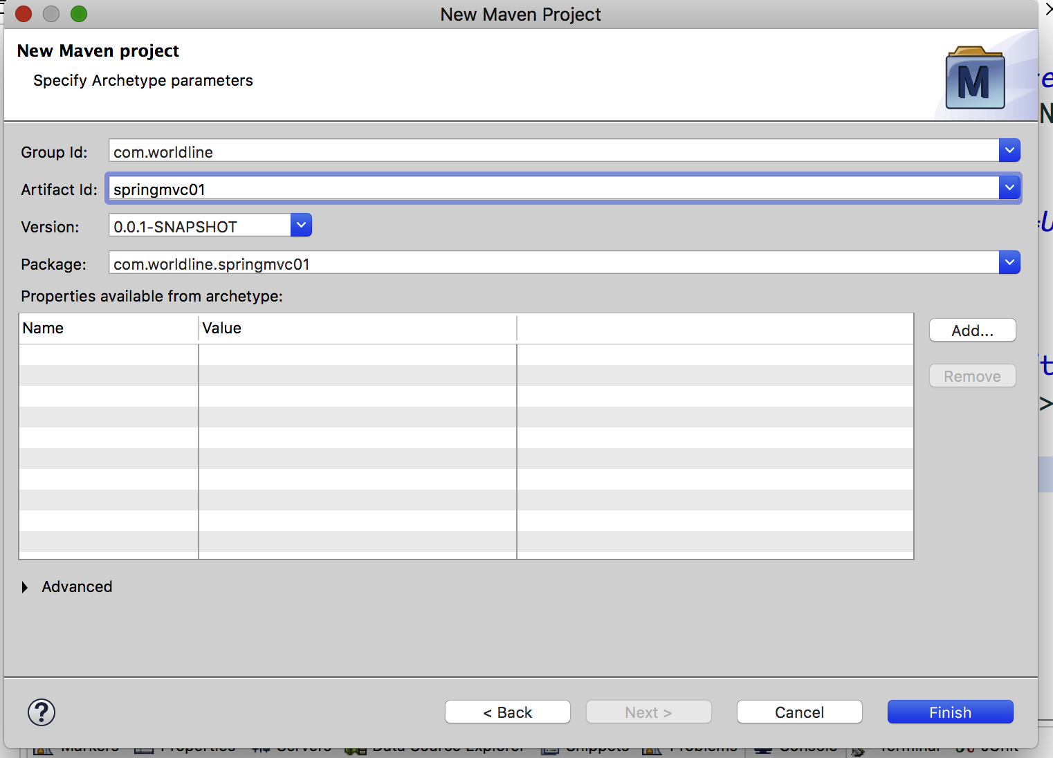
Using Maven to Create Spring MVC Project
5. We need to put group id and artifact id here. And then Click Finish
Group id : It uniquely identifies your project among all. So it may be something like com.companyname
Artifact id : It is name of jar or war without version. it may be something like project, so here we have put artifact id as springmvc01
Version : Version is used for version control for artifact id. If you distribute this project, you may incrementally create different version of it.

Slide 8
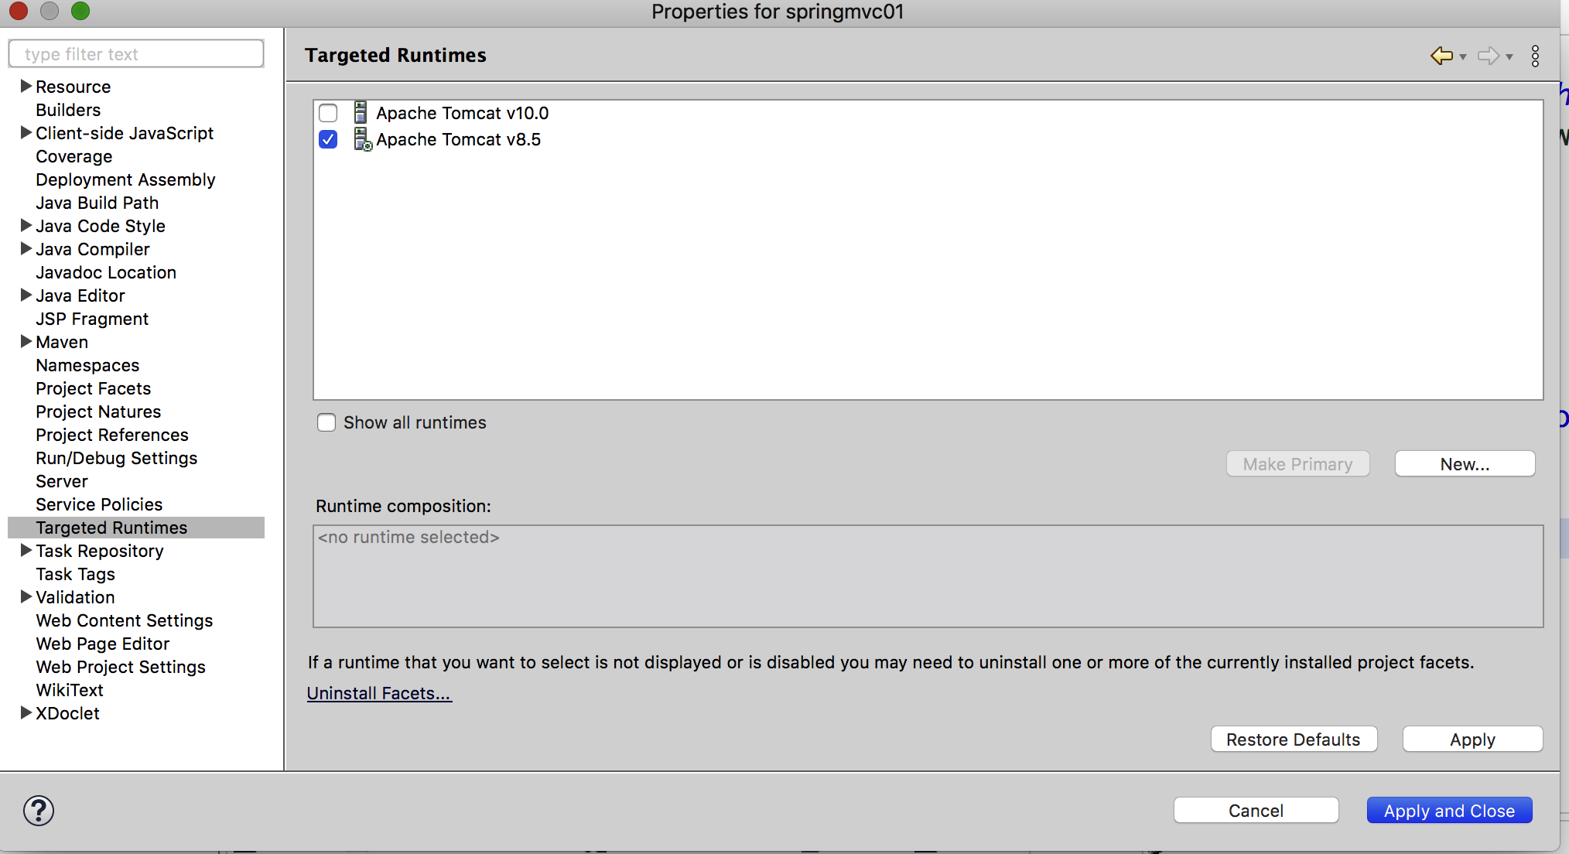
Using Maven to Create Spring MVC Project
6. Now right click on the project folder(In packageexlporeer you would see springmvc01 project)
7. Choose BuildPath→configureBuildPath->Library->JRE->edit. Set JDK1.8
8. Targeted RunTime -→choose Tomcat 8.5. click Apply and Close. button

Slide 9
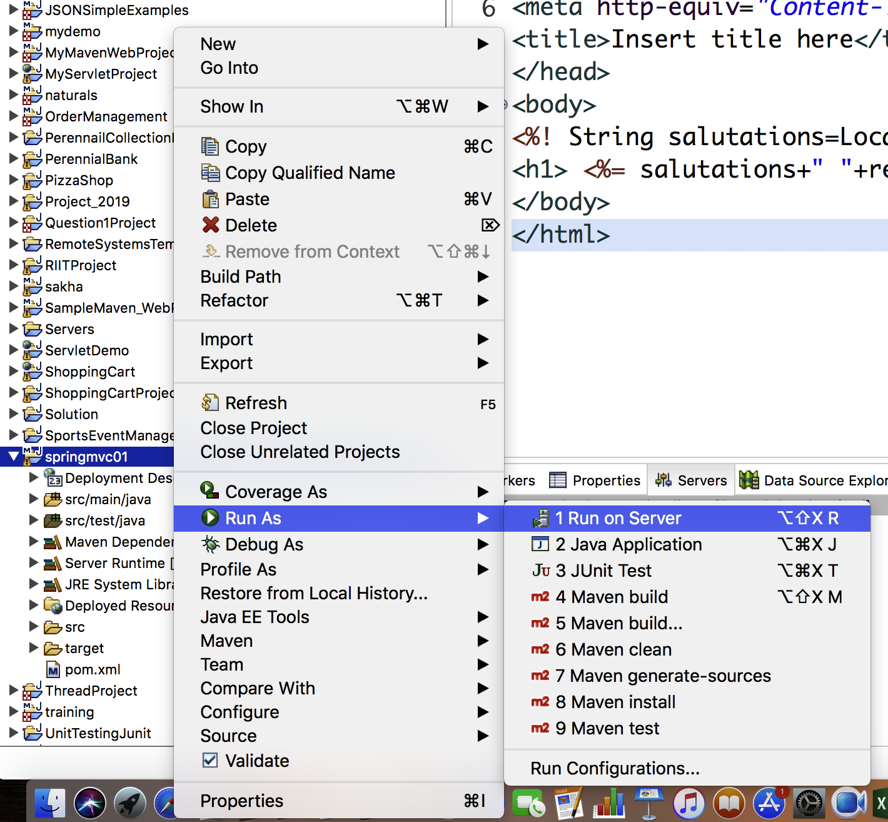
Using Maven to Create Spring MVC Project
9. Now right click on the project folder(In packageexlporeer you would see springmvc01 project)
10. Choose BuildPath→configureBuildPath->Library->JRE->edit. Set JDK1.8
11. Targeted RunTime -→choose Tomcat 8.5. click Apply and Close. Button
Now Run your application ss shown below

Slide 10
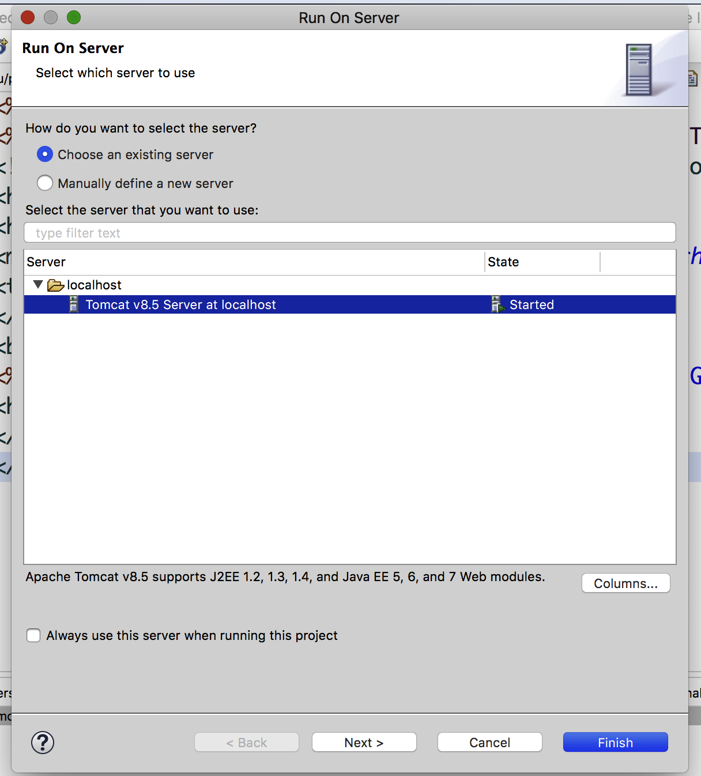
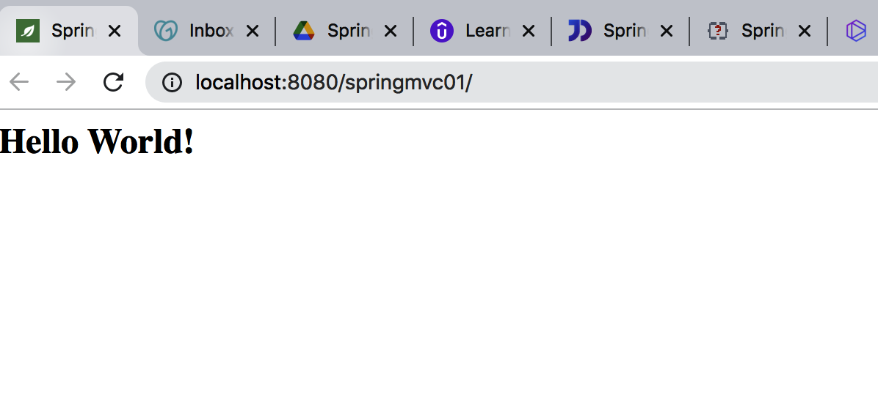
Using Maven to Create Spring MVC Project
12. Choose Tomcat 8.5 and click Finish You will see browser opening with Hello World as Response

Slide 11
Find out Where is “Hello World” coming from ?
It’s a default index.jsp page inside webapp folder
Now You have to do following on your own
Open your pom.xml and add following dependencies for spring mvc
Spring core version 4.3.9.RELEASE
Spring web version 4.3.9.RELEASE
Spring webmvc version 4.3.9.RELEASE
Servlet-api version 2.5 (<scope>provided</scope>)
Jsp-api. Version 2.1 (<scope>provided</scope>)
After this add <build> tag with following content(copy as it is) and save pom.xml
<build>
<plugins>
<plugin>
<artifactId>maven-compiler-plugin</artifactId>
<version>3.6.1</version>
<configuration>
<source>1.8</source>
<target>1.8</target>
</configuration>
</plugin>
<plugin>
<artifactId>maven-war-plugin</artifactId>
<version>3.3.1</version>
<configuration>
<warSourceDirectory>WebContent</warSourceDirectory>
</configuration>
</plugin>
</plugins>
<finalName>${project.artifactId}</finalName> <!-- added to remove Version from WAR file -->
</build>

Slide 12
<build>
<finalName>springmvc01</finalName>
<pluginManagement><!-- lock down plugins versions to avoid using Maven defaults (may be moved to parent pom) -->
<plugins>
<plugin>
<artifactId>maven-clean-plugin</artifactId>
<version>3.1.0</version>
</plugin>
<!-- see http://maven.apache.org/ref/current/maven-core/default-bindings.html#Plugin_bindings_for_war_packaging -->
<plugin>
<artifactId>maven-resources-plugin</artifactId>
<version>3.0.2</version>
</plugin>
<plugin>
<artifactId>maven-compiler-plugin</artifactId>
<version>3.8.0</version>
</plugin>
<plugin>
<artifactId>maven-surefire-plugin</artifactId>
<version>2.22.1</version>
</plugin>
<plugin>
<artifactId>maven-war-plugin</artifactId>
<version>3.2.2</version>
</plugin>
<plugin>
<artifactId>maven-install-plugin</artifactId>
<version>2.5.2</version>
</plugin>
<plugin>
<artifactId>maven-deploy-plugin</artifactId>
<version>2.8.2</version>
</plugin>
</plugins>
</pluginManagement>
</build>

