Slide 1
TWITTER DATA MINING { #PYTHON, #JAVA, #R}
-By Priyanka Balineni

Slide 2
CONTENTS
Introduction
Twitter Data Extraction
Comparison of user base for Python, R and Java
Geographical Analysis of tweets by country
Time Series Analysis of tweets on hourly basis
Generating Word Cloud of tweets
Conclusion

Slide 3
INTRODUCTION
Analysis of tweets to compare the usage of Python, R and Java
Java seems to be most used programming language in the beginning of 20th century but now Python is aggressively growing in it’s user base.
So, we would like know programmer’s choice based on their tweets on both the languages along with R.

Slide 4
Twitter Data Extraction
Tweets have been extracted for 5 days from Dec 8th to Dec 12th 2017.
All the tweets have been extracted using API keys.
Maximum number of tweets was limited to 100 per ping.
We extracted tweets for #python, #java and #R

Slide 5
CODE
Environment: Anaconda navigator- Jupyter notebook- Python 3.0
Packages: tweepy, json, datetime, time, os, sys, matplotlib, collections, wordcloud
Code can be explained in following steps:
Import all the required packages listed above
Process the tweets and extract frequently used words
Extract the location of tweets and generate frequency tables for top 5 countries.
Analyzed tweets over a span of five days on an hourly basis.
Generated word clouds for tweets of all the three hashtags.

Slide 6
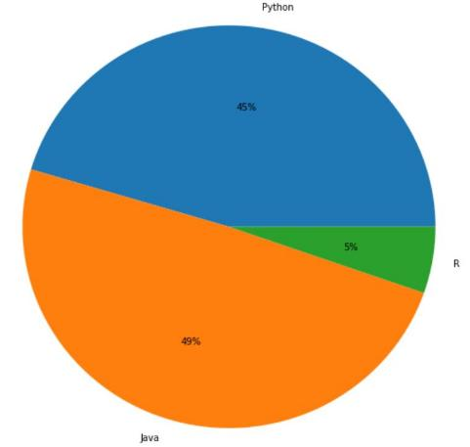
Comparison of user base for Python, Java & R

Slide 7
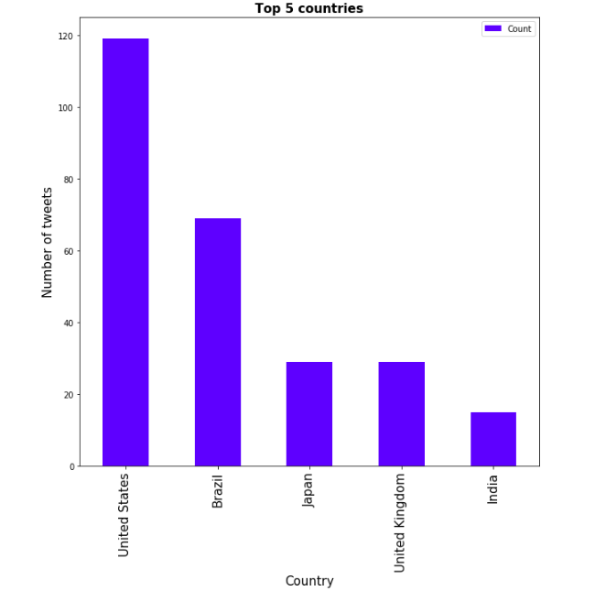
Geographical analysis of tweets by country

Slide 8
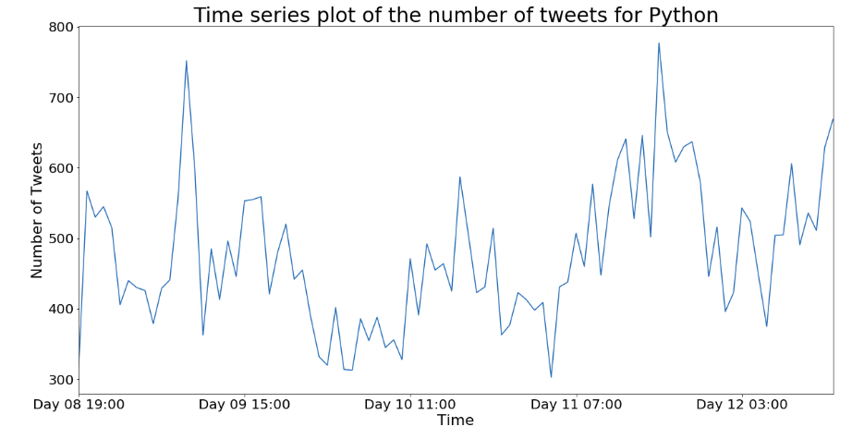
Time series analysis of tweets on hourly basis

Slide 9
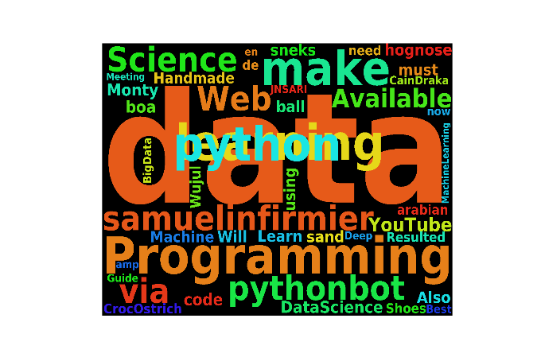
Word Cloud for Python

Slide 10
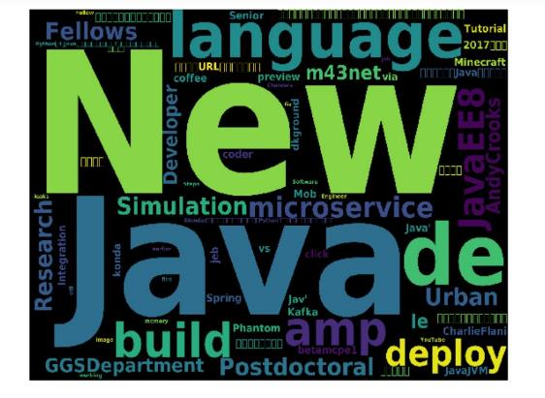
Word cloud for JAVA

Slide 11
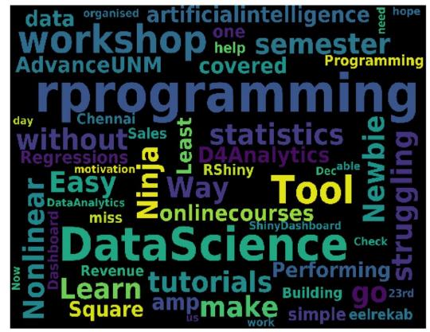
Word cloud for R

Slide 12
CONCLUSION
Python & R are the most used programming languages for Data Science.
Java is the most tweeted programming language.
USA has more number of tweets on python as compared to other countries.
Most of the tweets on all the languages are on Saturday.

Slide 13
THANK
YOU

