Slide 1
LIBERTY MUTUAL GROUP: PROPERTY INSPECTION PREDICTION
-BY PRIYANKA BALINENI

Slide 2
CONTENTS
INTRODUCTION
DATA DESCRIPTION
DATA PRE-PROCESSING
MODELS
PARAMETRIC METHODS
NON-PARAMETRIC METHODS
RESULTS
CONCLUSION

Slide 3
INTRODUCTION
Liberty mutual insurance provides wide range of insurance products and services to meet their customer needs.
New property receives home inspection
Investigators audit main key attributes of property such as:
Roof
Foundation
Window
Siding
These results help insurance group to decide whether the property is one they need to insure.
Based on property information we need to predict the hazard score before the time of inspection

Slide 4
Data description
I took dataset from Kaggle.
https://www.kaggle.com/c/liberty-mutual-group-property-inspection-prediction/data
The dataset contain 32 anonymized columns, ID and a Hazard score
32 anonymized variables and ID are explanatory variables
Hazard score is a target variables
Each row in the dataset corresponds to a property
The aim of the project is to forecast the hazard score based on explanatory variables.

Slide 5

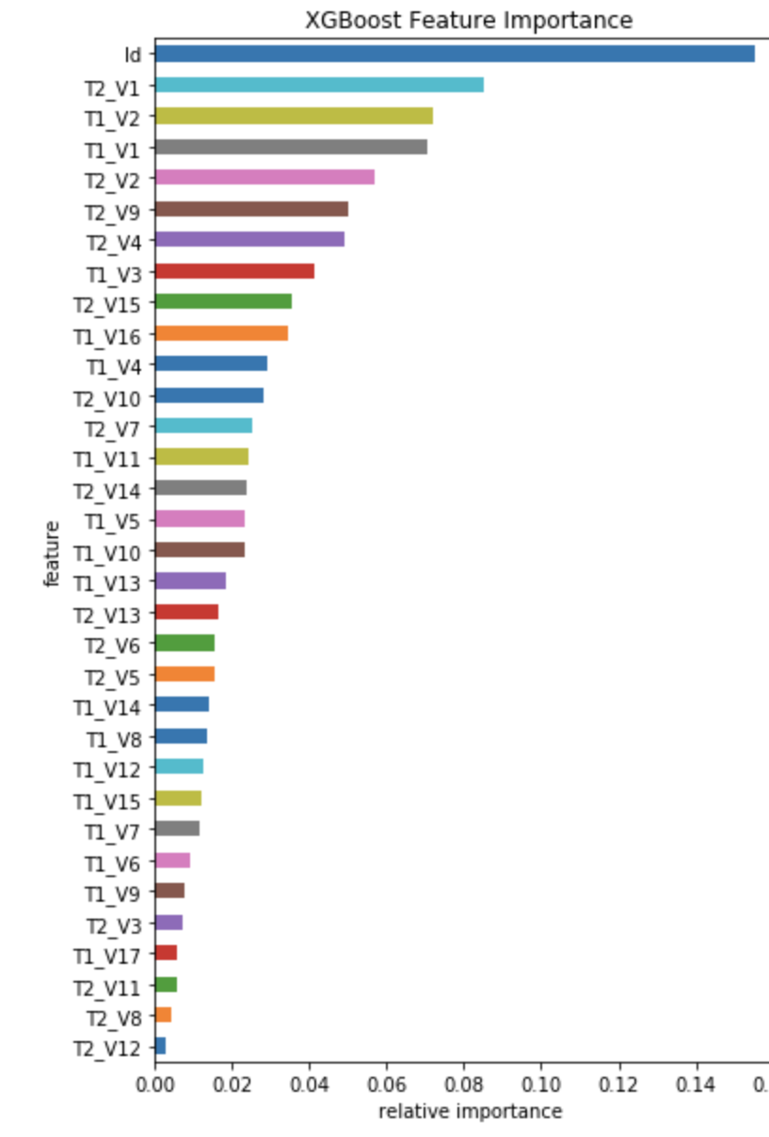

Data pre-processing
Check null values
Look at the type of data in the variables
Found categorical variables
Converting all categorical variables to numbers by grouping the mean values of Hazard score
Performed Xgboost feature importance to find out the relative importance of each feature in the construction of the model.
Split our data into training(70%) and test(30%) set
Notes:
Importance provides a score that indicates how useful or valuable each feature was in the construction of the model. The more an attribute is used to make key decisions the higher its relative importance.
This importance is calculated explicitly for each attribute in the dataset, allowing attributes to be ranked and compared to each other.

Slide 6
models
Two types of models
Parametric models:
Multivariate Linear Regression
Lasso Regression
Ridge Regression
Non- parametric models:
Random forest
Notes:
Parametric-Algorithms that simplify the function to a known form are called parametric machine learning algorithms.
Select a form for the function.
Learn the coefficients for the function from the training data.
Non-parametric: Algorithms that do not make strong assumptions about the form of the mapping function are called nonparametric machine learning algorithms. By not making assumptions, they are free to learn any functional form from the training data.

Slide 7
PARAMETRIC MODELS
Multivariate Linear Regression
Linear relation between explanatory variables and target variable
Resulted R² of 0.0885
Ridge Regression
L2-norm penality form
Resulted R² of 0.0886
Lasso Regression
L1-norm penality form
Resulted R² of 0.0887
Notes:
linear regression is a linear approach for modelling the relationship between a scalar dependent variable y and one or more explanatory variables
they work by penalizing the magnitude of coefficients of features along with minimizing the error between predicted and actual observations. These are called ‘regularization’ techniques. The key difference is in how they assign penalty to the coefficients:
Ridge: adds penalty equivalent to square of the magnitude of coefficients
Laaso regression: lasso (least absolute shrinkage and selection operator) is a regression analysis method that performs both variable selection and regularization in order to enhance the prediction accuracy and interpretability of the statistical model it produces.
adds penalty equivalent to absolute value of the magnitude of coefficients

Slide 8
NON-PARAMETRIC MODELS
RANDOM FOREST
A random forest fits the number of decision tree classifiers on various sub-samples of the dataset.
Uses averaging to improve accuracy
Control over-fitting
Number of trees, m= 500
Number of sub-samples= 11
Resulted R² of 0.101
Notes:
Random forest (or random forests) is an ensemble classifier that consists of many decision trees and outputs the class that is the mode of the class's output by individual trees.
operate by constructing a multitude of decision trees at training time and outputting the mean prediction of the individual trees
method contains bragging idea and random selection of features
trees that are grown very deep tend to learn highly irregular patterns: they overfit their training sets, i.e. have low bias, but very high variance. Random forests are a way of averaging multiple deep decision trees, trained on different parts of the same training set, with the goal of reducing the variance. This comes at the expense of a small increase in the bias and some loss of interpretability, but generally greatly boosts the performance in the final model.

Slide 9
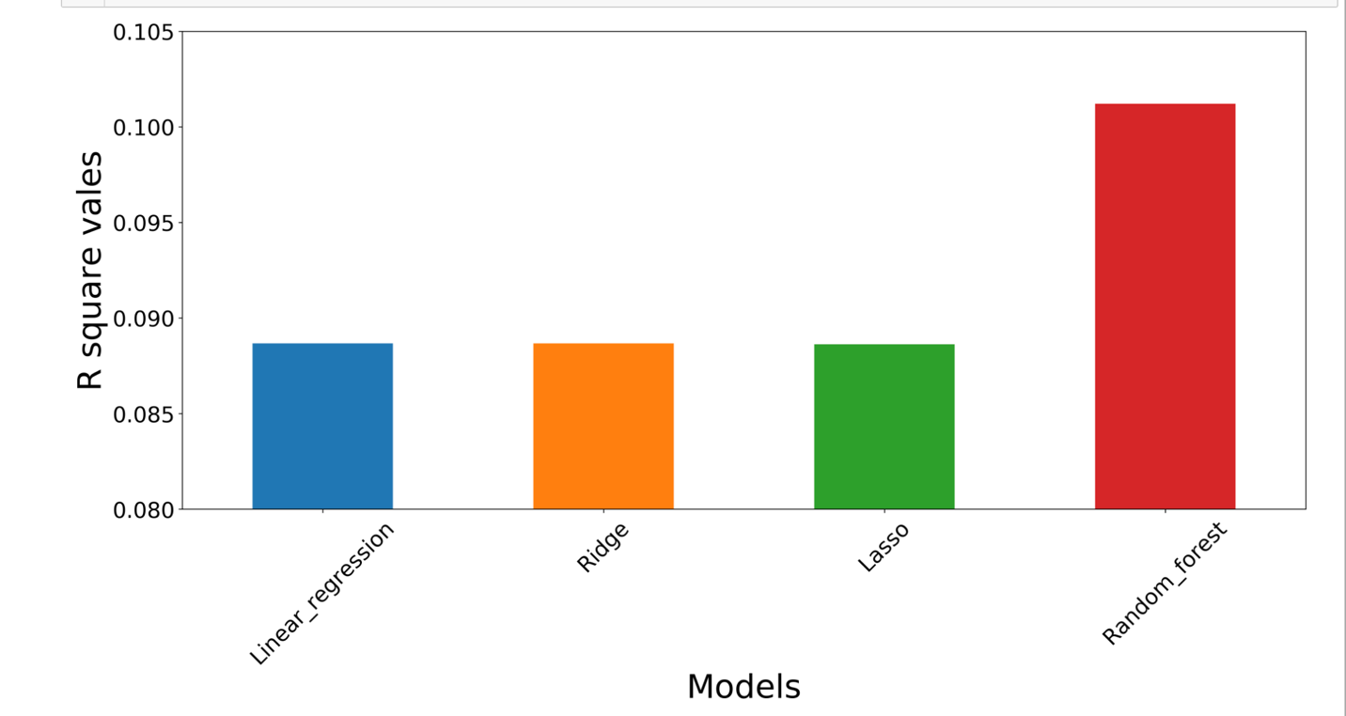
Analysis

Slide 10
conclusion
ID, T2_V1, T1_V2 has more feature importance
Random forest gives better results with an R² of 10.1%

Slide 11
THANK YOU

