Slide 1
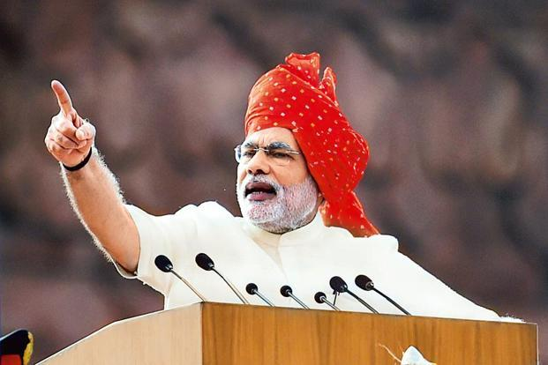

Tracking and Curbing Black Money Using Big Data

Slide 2

Engineering in Big Data Systems
Tracking and Curbing Black Money Using Big Data
Akshay Nakhawa
Pranay Sampat
Ruchi Goyal
Maansi Chandira
Priyanka Bandekar
- Guided by Professor Dino Konstantopoulos

Slide 3
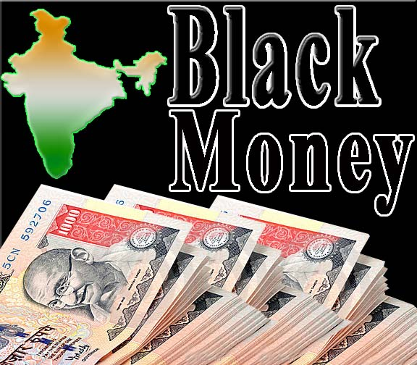
What is Black Money?
Black money refers to funds earned on the black market, on which income and other taxes have not been paid.
Black Money is unaccounted cash.
Holders of black money try to convert it into legitimate ('clean' or 'white') money through money laundering.

Slide 4
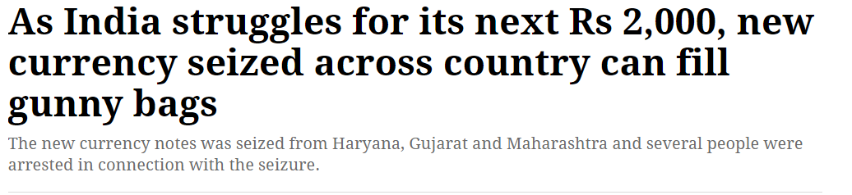
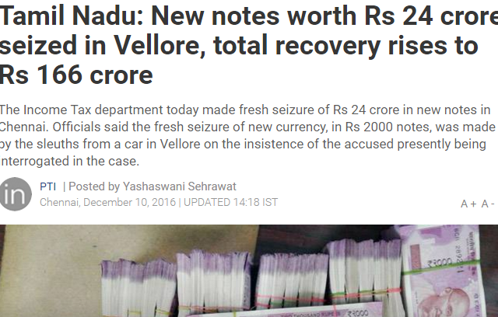
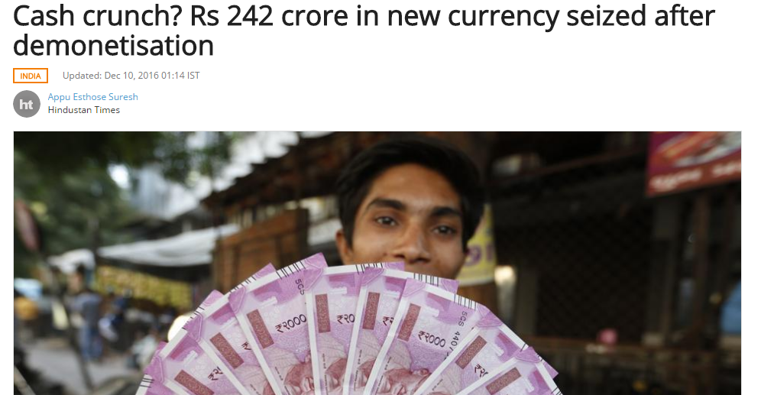
Reasons to select this topic

Slide 5
Project Objective
Proposed Idea
The purpose of our project is to build a prototype model to track and curb black money by uncovering hidden patterns and unknown correlations, leading to the discovery of meaningful trends using MapReduce.
To predict from where the black money is coming from and possible locations where cash hoarding may take place
Detect the prospective black money transaction and suspected Pan Card Nos.
Predict the value of required dependent variable for any unseen test dataset.
The results from our project will in turn will be helpful for Tax department and other government agencies to catch black money holders.

Slide 6
Assumptions and Dependencies
Only cash transactions are considered at banking and ATM systems as most of the black money or unaccounted money exists only in cash.
Every bank account is associated with Pan Number.
Banking systems are enabled with Scanning and Recording of the Currency serial number involved in any withdrawal/deposit transactions.
Every transaction will record the associated Pan number and currency serial No
Threshold is minimum of 5 lac for the transactions to be scrutinized.

Slide 7
Data Definitions
Blacklisted Notes: Serial No of the notes which did not appear in any transaction in our system from more than three months
PAN Number: Unique identifier [Like SSN] associated with single person across multiple accounts.
Location: Geo locations where transactions originated, may or may not be different than PAN – home location.
Threshold: A minimum amount of 5 lacs for the transaction to be scrutinized.

Slide 8
Use Case 1:Detecting Transactions with more than 70% BlackListed currency Serials
  Process all the transaction and the associated currency no’s and detecting if the deposited transaction has more than 70% of blacklisted notes are involved that transaction.
  Deriving a relationship between the Depositor and last known Withdrawers of those BlackListed Notes involved in such transaction along with their corresponding locations.
Constraints
Data Constraints
Financial Records are not available publically.
Currency Data with black listed currency holders was not available

Slide 9
Map Reduce
Data Constraints
Financial Records are not available publically.
Currency Data with black listed currency holders was not available

Slide 10
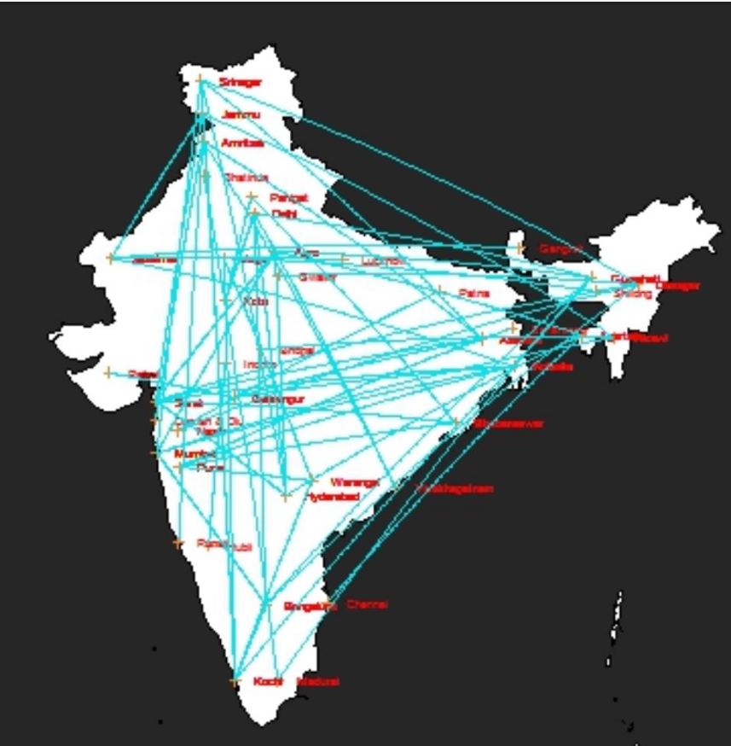
Visualisations: Displaying the connections between transactions and locations

Slide 11
Business Logic
Use Case1: Detect Black Listed Currency involved in Deposit Transactions
Black Listed Currency with Last Known Withdrawer
Transaction History
CdM
Map Reduce
List of PANs Involved in Black Listed Money Transactions

Slide 12
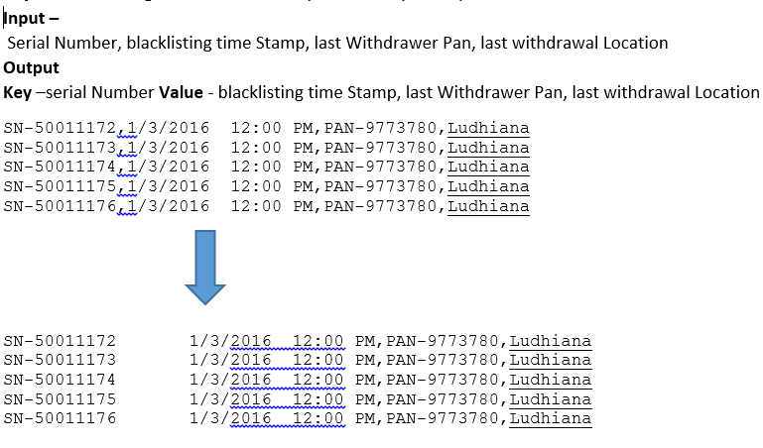
Business Logic
Use Case1: Detect Black Listed Currency involved in Deposit Transactions
Approach : Map Reduce
MapReduce Job1 Mapper1:

Slide 13
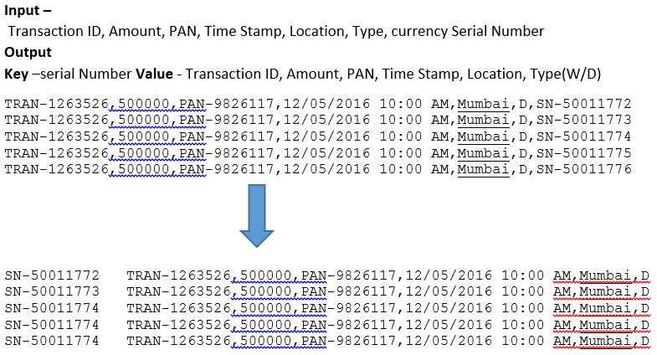
Business Logic
Use Case1: Detect Black Listed Currency involved in Deposit Transactions
Approach : Map Reduce
MapReduce Job1 Mapper2:

Slide 14
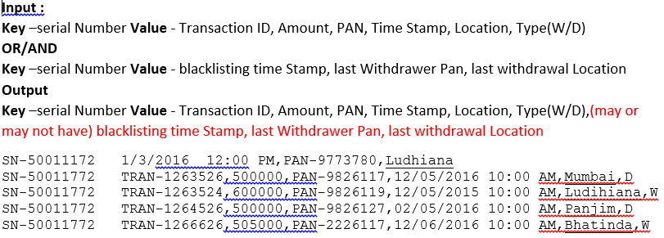
Business Logic
Use Case1: Detect Black Listed Currency involved in Deposit Transactions
Approach : Map Reduce
MapReduce Job1 Reducer1:

Slide 15
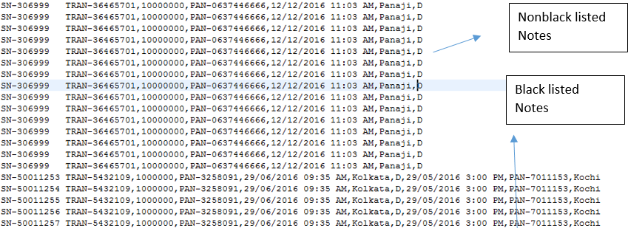
Business Logic
Use Case1: Detect Black Listed Currency involved in Deposit Transactions
Approach : Map Reduce
MapReduce Job1 Reducer1:

Slide 16
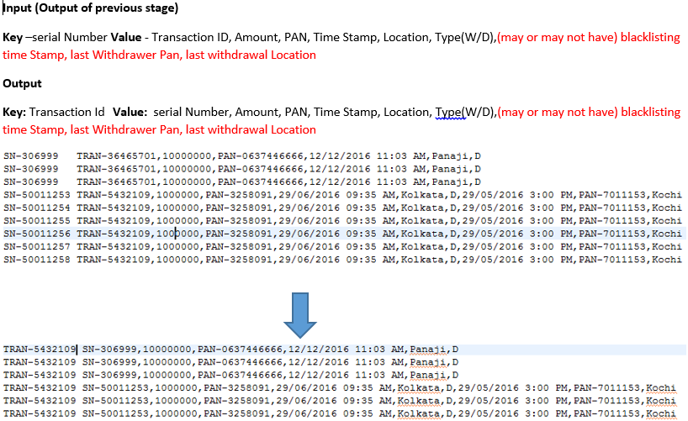
Business Logic
Use Case1: Detect Black Listed Currency involved in Deposit Transactions
Approach : Map Reduce
MapReduce Job2 Mapper1:

Slide 17
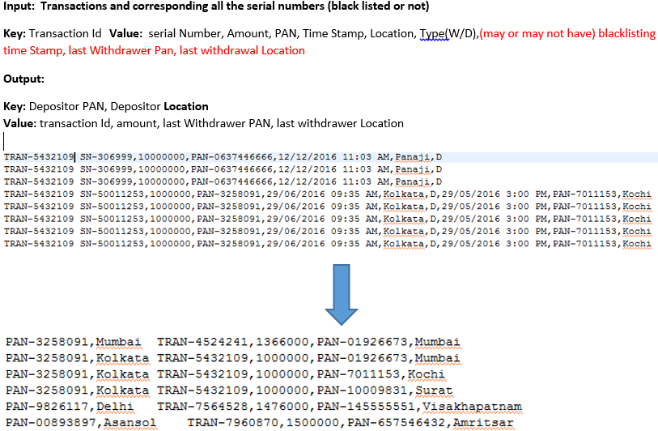
Business Logic
Use Case1: Detect Black Listed Currency involved in Deposit Transactions
Approach : Map Reduce
MapReduce Job2 Reducer1:

Slide 18
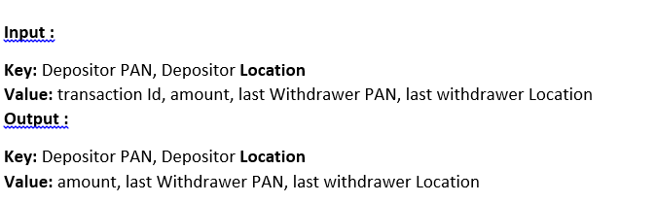
Business Logic
Use Case1: Detect Black Listed Currency involved in Deposit Transactions
Approach : Map Reduce
MapReduce Job3 Mapper1:

Slide 19
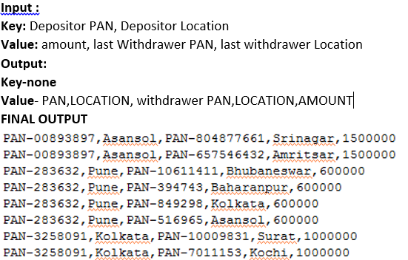
Business Logic
Use Case1: Detect Black Listed Currency involved in Deposit Transactions
Approach : Map Reduce
MapReduce Job3 Reducer1:

Slide 20
Business Logic
Use Case2: Detecting Probable Black Money Transactions (Anamolies)
Transaction History
PAN Pair of a Transaction with Amount having more than 70% of note similarity

Slide 21
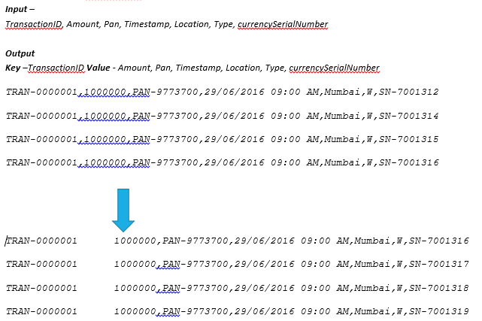
Business Logic
Use Case2: Detecting Probable Black Money Transactions (Anamolies)
Approach : Map Reduce
MapReduce Job1 Mapper1:

Slide 22
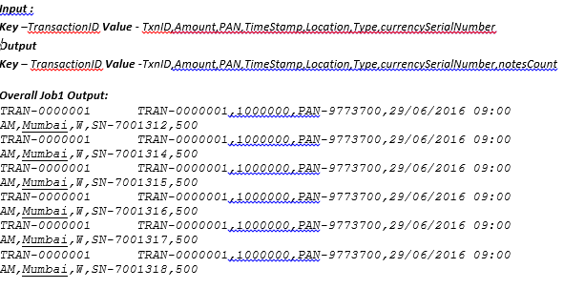
Business Logic
Use Case2: Detecting Probable Black Money Transactions (Anamolies)
Approach : Map Reduce
MapReduce Job1 Reducer1:

Slide 23
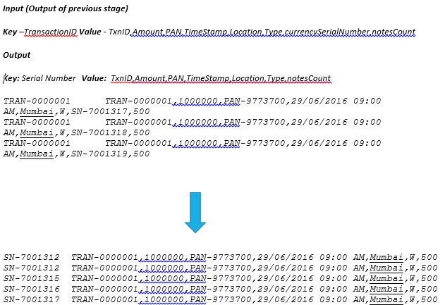
Business Logic
Use Case2: Detecting Probable Black Money Transactions (Anamolies)
Approach : Map Reduce
MapReduce Job2 Mapper1:

Slide 24
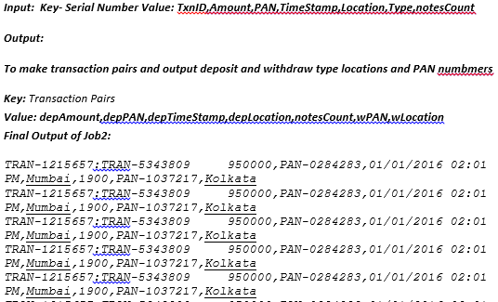
Business Logic
Use Case2: Detecting Probable Black Money Transactions (Anamolies)
Approach : Map Reduce
MapReduce Job2 Reducer1:

Slide 25
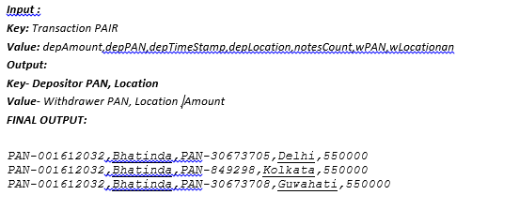
Business Logic
Use Case2: Detecting Probable Black Money Transactions (Anamolies)
Approach : Map Reduce
MapReduce Job3 Mapper1 and Reducer1:

Slide 26
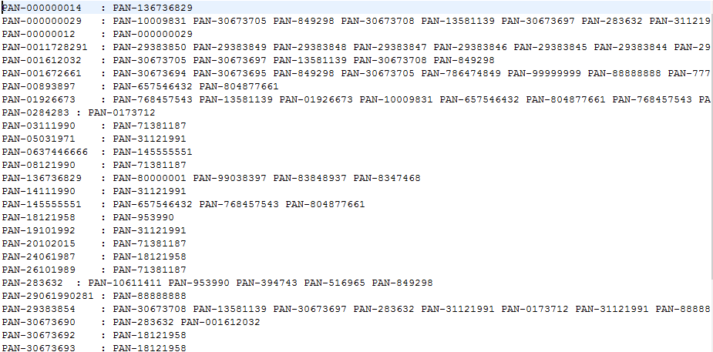
Business Logic
Use Case3: Applying PageRank to detect Probable Suspects
Approach : Map Reduce
MapReduce Input to Iterator:

Slide 27
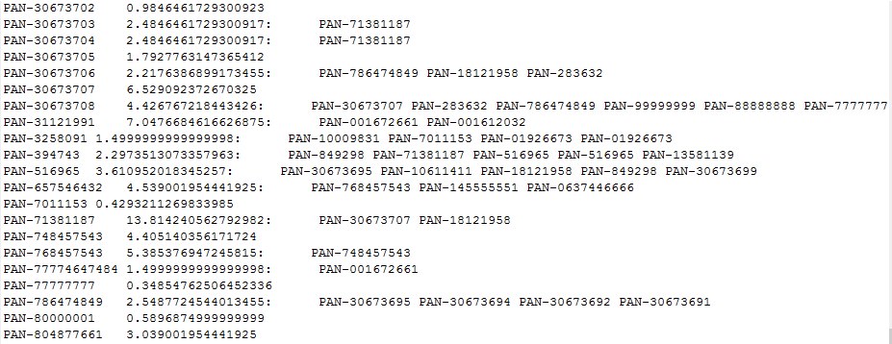
Business Logic
Use Case3: Applying PageRank to detect Probable Suspects
Approach : Map Reduce
MapReduce Output of Iterator:

Slide 28
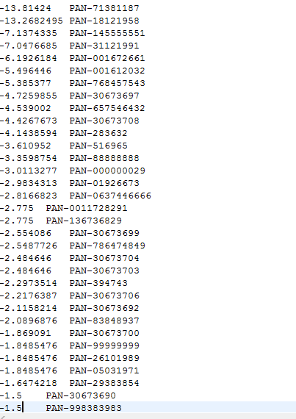
Business Logic
Use Case3: Applying PageRank to detect Probable Suspects
Approach : Map Reduce
MapReduce Output of Viewer:

Slide 29
Map Reduce
Use Case1:
To detect transactions with PAN holder details having more than 70% of the serial notes being matched with blacklisted notes
Use Case2:
To form transaction pairs and detect the count of serial notes being more than 70% and report such cases as anomalies and forward it to the IT department for further investigation.
Use Case3:
To find the PAN holder having highest count of black listed notes via PageRank algorithm

Slide 30


Slide 31


