Slide 1
Dashboard
GIC Café Employement Project

Slide 2
Dashboard Overview
Description:
An interactive tool for visualizing the cafés and the employees details
Datasources:
Internal databases -
Restful APIs

Slide 3
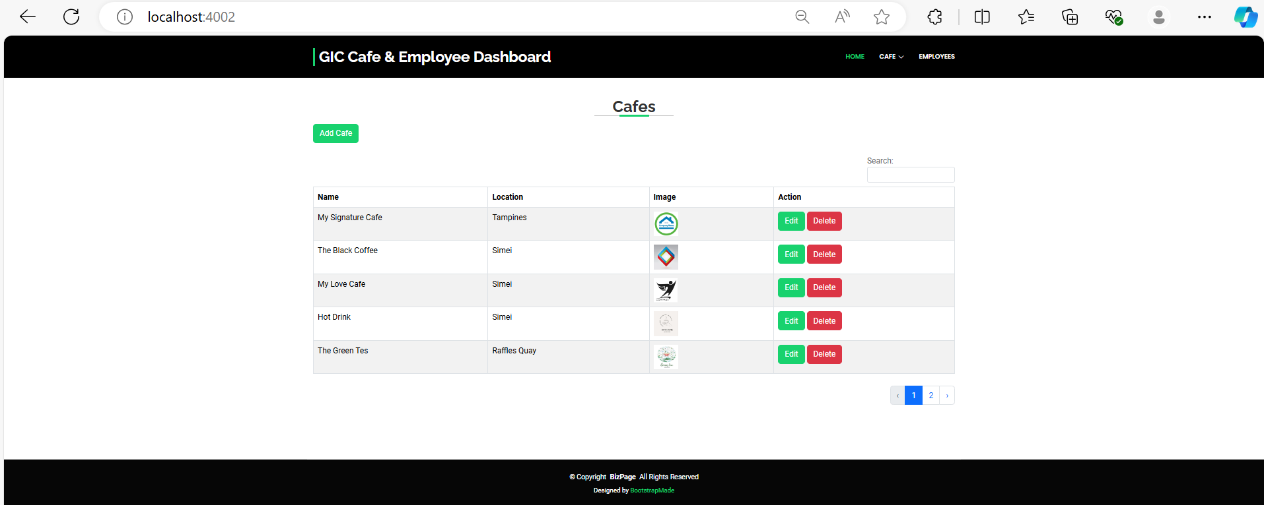
Features and Functionality
Interactive Elements:
- Filters to view café & Employees list by name, location.
- Features to add new cafes & Employees
- List the no of Employees as the cafes & location
- List the no of working days of the employees in cafes

Slide 4
Technical Details
Technology Stack: -
Node.js, Express -
Database: MySQL
EJS files
Bootstrap 5
HTML5
CCS3
Jquery

Slide 5
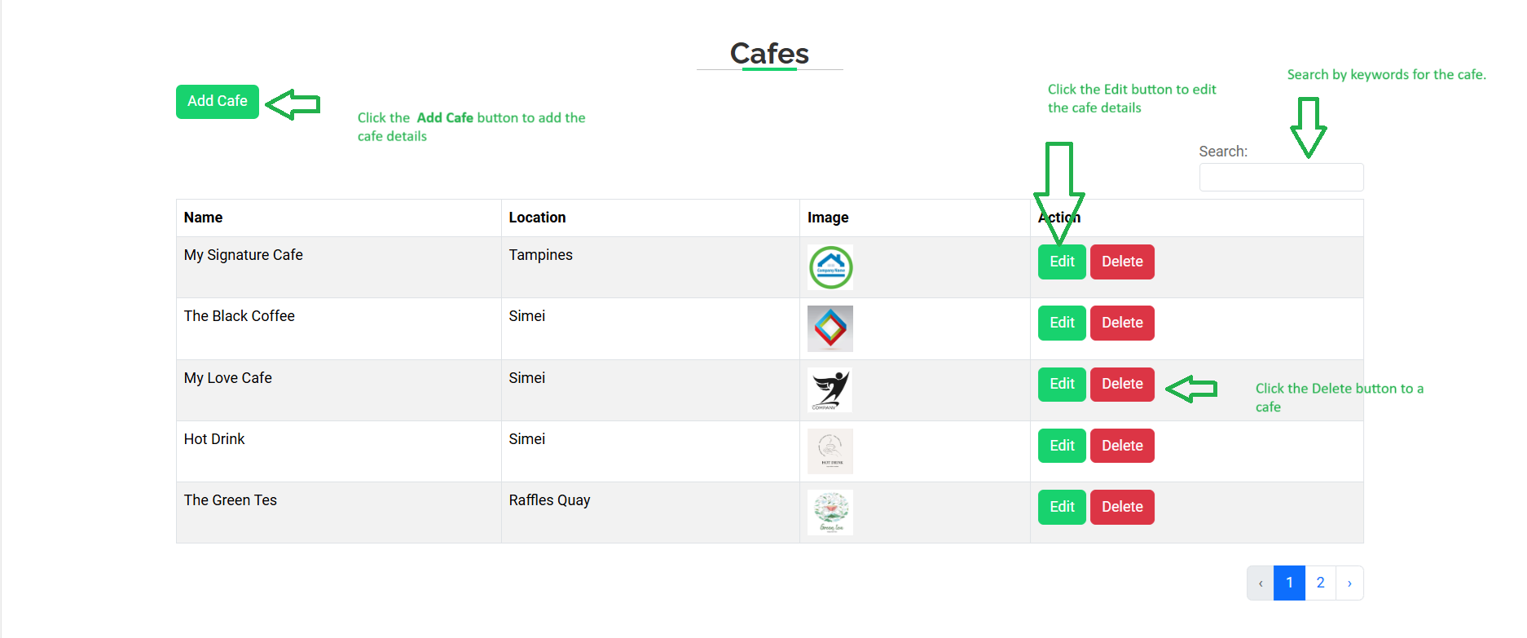
Café Dashboard

Slide 6
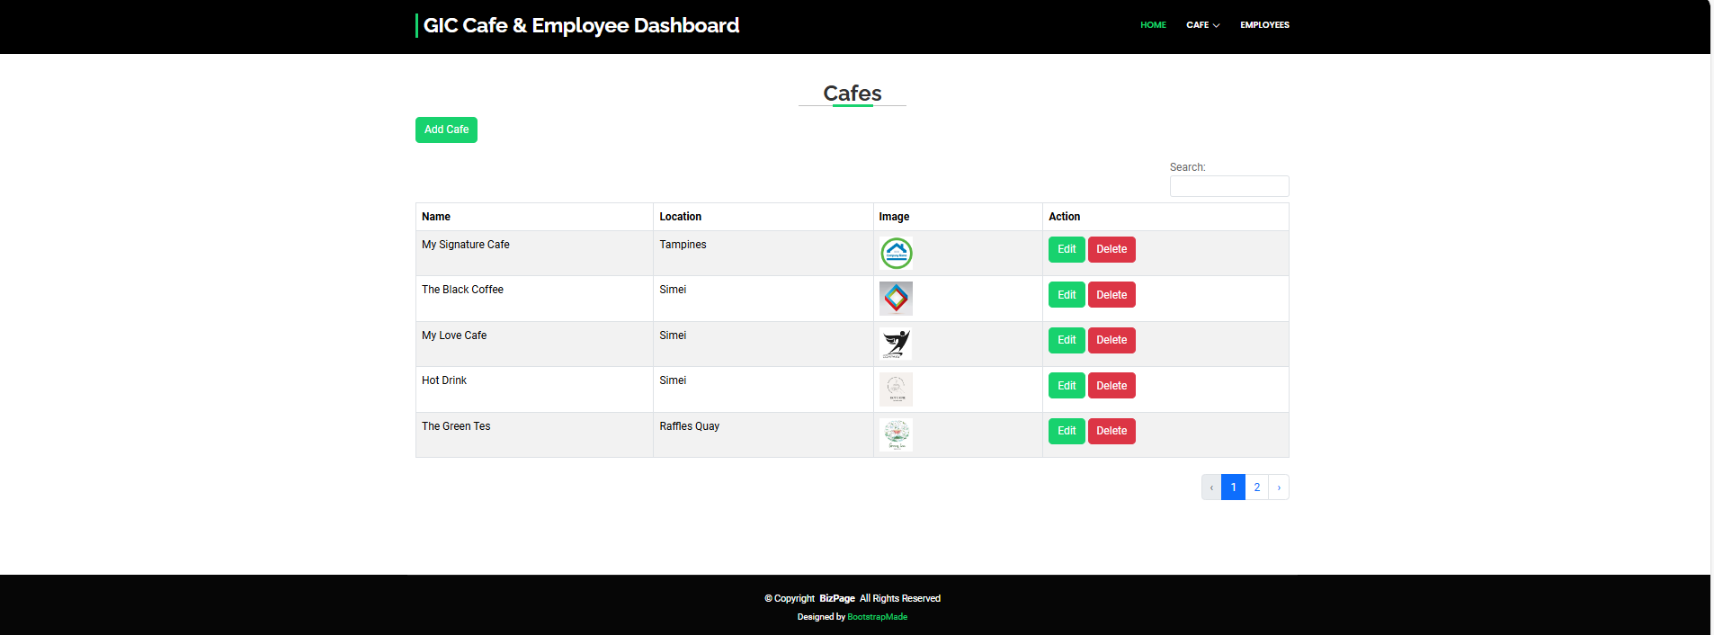
Usage Instructions
Accessing the Dashboard:
URL : http://localhost:4002/

Slide 7
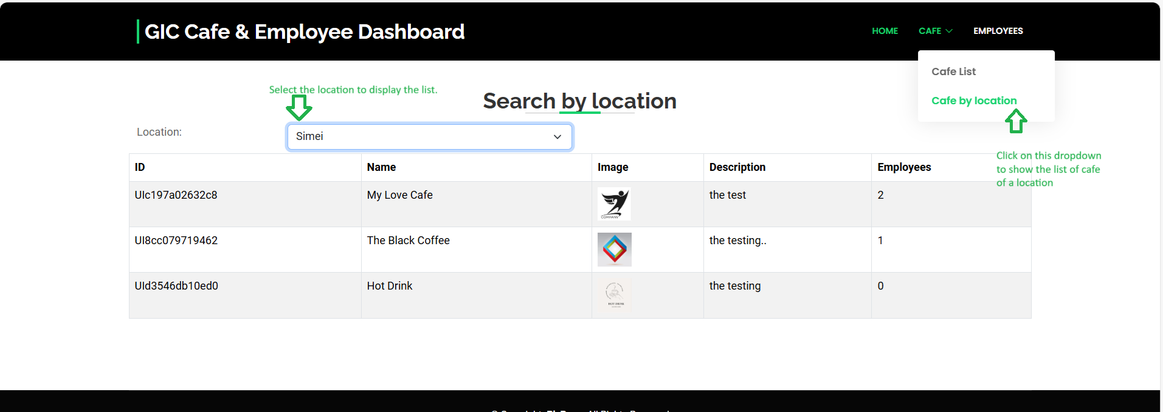
No Of Employees by café location

Slide 8
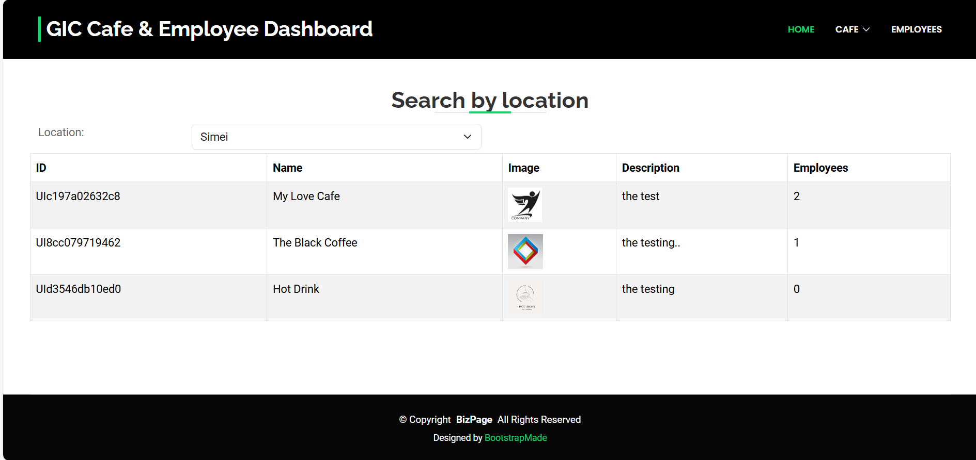
Usage Instruction
Accessing the No of Employees by café:
URL: http://localhost:4002/cafelocation

Slide 9
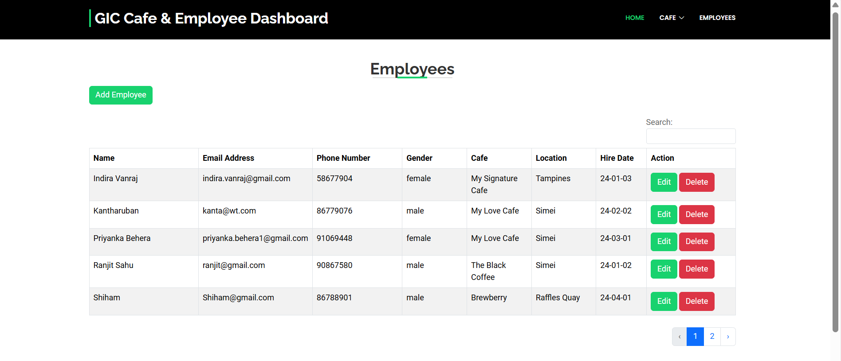
Employee dashboard

Slide 10
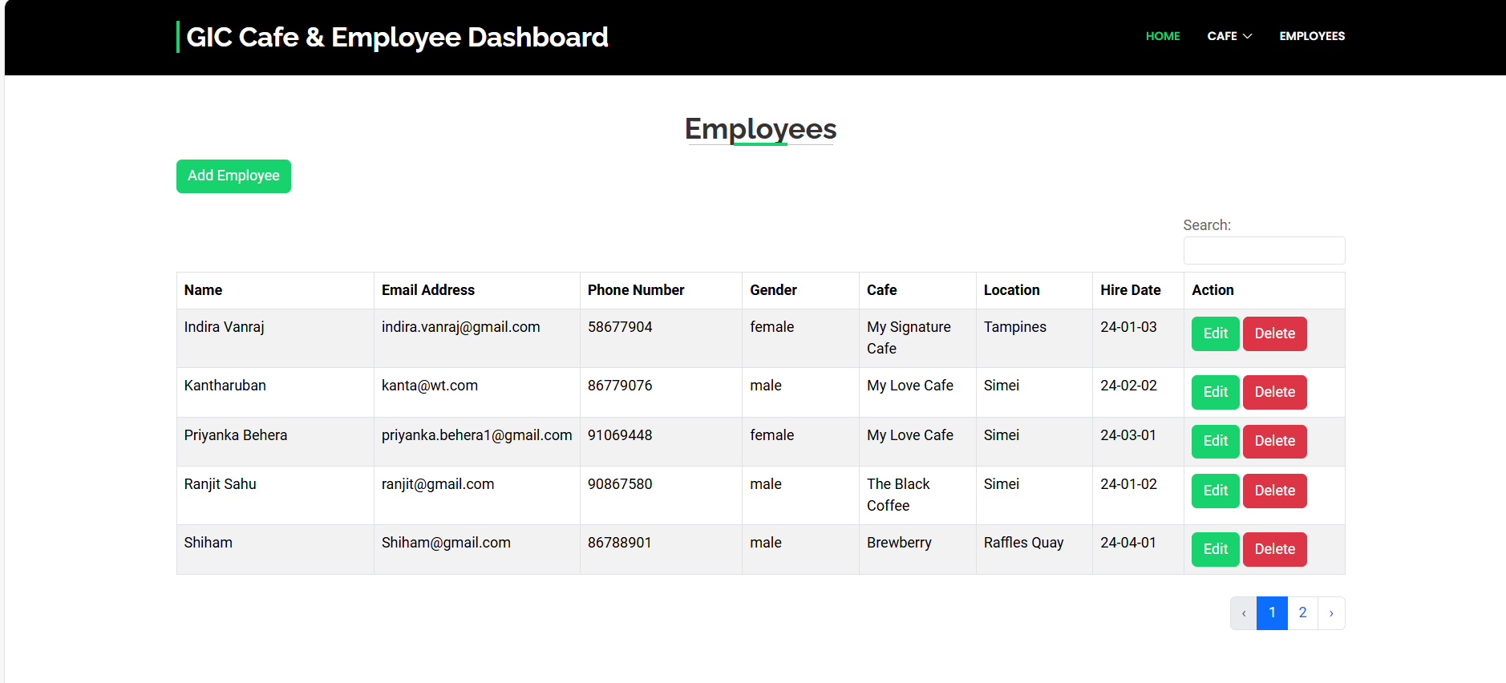
Usage Instruction
List the employees
URL : http://localhost:4002/emplist

Slide 11
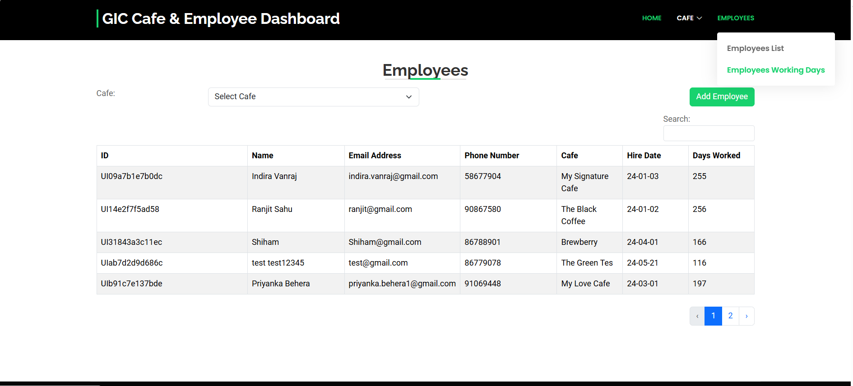
Employee Number of Working days

Slide 12
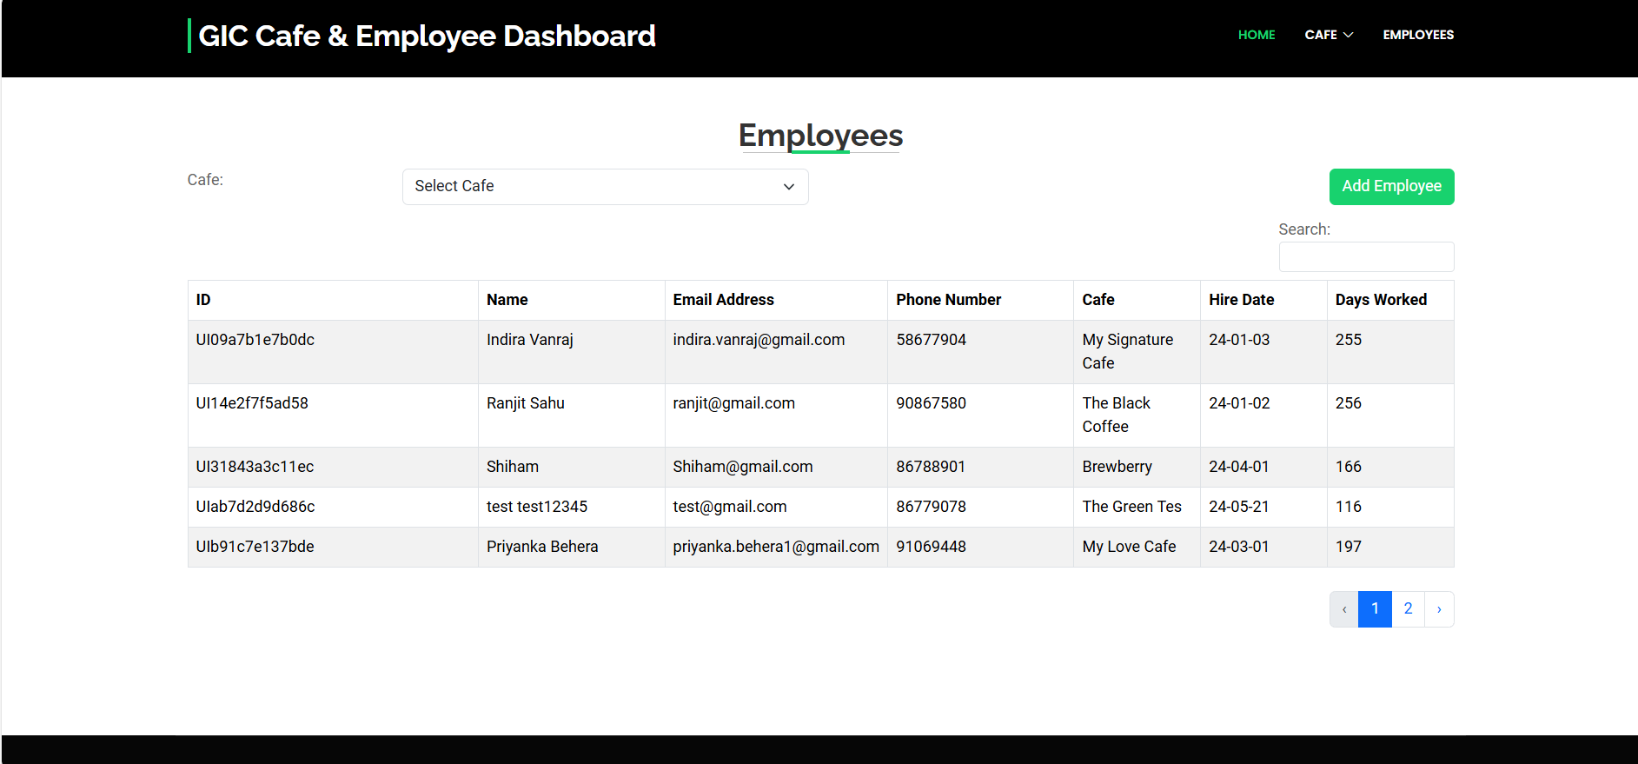
Usage Instruction
Employees by working days
URL:http://localhost:4002/empbycafe

