Slide 1




Enhancing Literature filtering using NLP
Master Thesis Topic Presentation
Priyanka Bhargava
priyanka.bhargava@st.ovgu.de
October 12, 2022

Slide 2
Overview
1. Introduction –About SLR
2. Benefits of Systematic Literature Review
3. Motivation
4. Research Problem
4.1 Phases of SLR
4.2 Research questions
4.3 State of The Art
5. Proposed Approach
6. References

Slide 3



TYPES OF LITERATURE
Introduction
Primary Literature
Original research
Secondary Literature
Summary and synthesis of primary literature
Tertiary Literature
Usually with references to primary of secondary sources
Systematic Review
Identify, Evaluate and Interpret available literature to answer a research question.
Includes review of Primary studies.
Systematic Mapping/Scoping Studies
The goal is to pave the path for future primary studies by performing a wide overview of research area.Helps in discovering suitable areas for systematic reviews as well.
Tertiary Reviews
Systematic review of systematic reviews.The idea is to answer a wider research question.Less resource intenseful.
+
+
+
+
+

Slide 4





Benefits of Systematic Literature Review
Specificity
Summarise existing evidence concerning treatment and technology.
Answers important questions.
Comprehensive
Identify Gaps in current research and hence opening areas for future research.
Decision making
To help in providing a framework for new activities.
Methodical
Makes the literature less biased if well-defined methodology is followed.
Notes:
– SR are very popular in evidence based science.
– They drive the decision making process as they require thorough investigation in order to justify certain treatment/method/approach etc and it’s an exhaustive process.
– They are a credible source as they are comprehensive, reproducible and precise in stating outcomes
Each stage is pre-planned which means the whole process is well thought through and all the steps are pre- defined which makes the SR’s transparent, reproducible and bias free.
Ability to fuel a decision making process for ex:- efficacy of a vitamin c in treating common cold.

Slide 5


Motivation
Performing a manual SLR takes anywhere from 2 to 4 years
By the time the SLR study is completed the data is already outdated.
Several steps include in the SLR process and automating them would save time and manual efforts.
Manual search is error prone and insensitive to precision.
Notes:
-So traditionally speaking if we were to perform every step manually then it’s just too much to handle.
- with the boom in research and technology there are tons of papers being published it’s just not possible to perform an extensive SR manually.
-On an average an SLR takes 2 to 4 years to complete
-since it’s a method driven process it take various steps and each consumes time.
- therefore the motivation is to fully or semi automate the process.

Slide 6
Research Problem
Step 1
Step 3
Step 5
Step 7
Step 9
Identify need for SLR
Identify sources and exclusion/exclusion criteria
Find primary studies
Data Extraction
Data Presentation and Interpretation
Step 2
Step 4
Step 6
Step 8
Research Question Formulation
Definition of search strategy
Screen articles based on criteria
Data Synthesis
Fig. 2: Phases of Systematic Literature Review
Notes:
-Few of the steps can further be divided into sub steps but overall the main idea around each stage remains same.
-starting with the need of the SLR we next define the RQ and formulate it precisely, generally an S:R has 1 or 2 main questions to answer.

Slide 7
Research Questions
What are the similarities and differences in terms of approaches and goals of the existing literature on automated literature review?
How does automating the screening phase of Systematic Literature Review affect the following metrics ?
Manual Screening time vs Automated Screening time.
Quality of articles/primary studies(Recall/Precision)

Slide 8
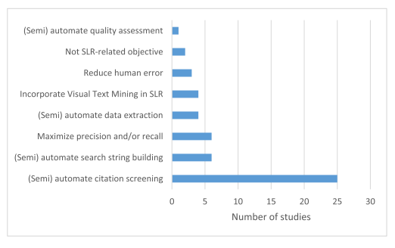
State of The Art
Fig. 3: Objective of automation(Raymon van Dinter, Bedir Tekinerdogan, Cagatay Catal)

Slide 9
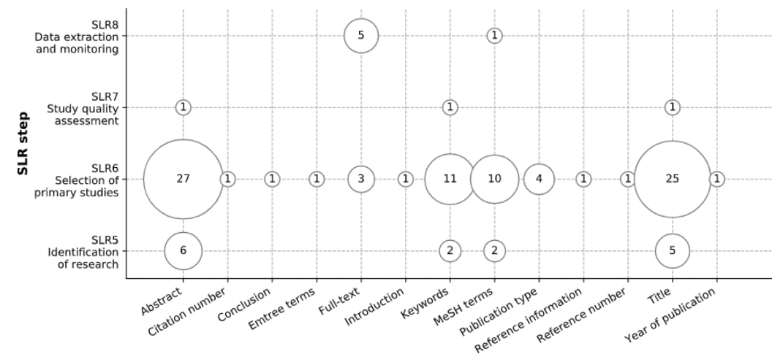
State of Art
Fig. 4: Document features used in automation(Raymon van Dinter, Bedir Tekinerdogan, Cagatay Catal)

Slide 10
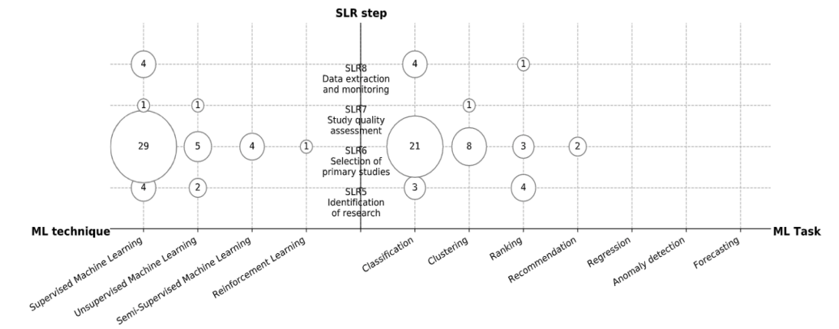
State of Art
Fig. 5: Machine Learning automation techniques and tasks per SLR step(Raymon van Dinter, Bedir Tekinerdogan, Cagatay Catal)

Slide 11



4
Add pre-trained embeddings
Proposed Approach
N
L
P
M
O
D
E
L
Vectorization
2
CrossRef
3
Mongo Database
Stemming
Get Metadata
5
Remove Stopwords
Document
Similarity calculation and Ranking
Tokenization
Query
1
3
Query
Query Enhancer
Remove punctuations, numbers
Natural Language Processing
Software engineering
Lowercase
Machine Learning
Filter
Literature Review
Deduplication

Slide 12
References
[1] Raymon van Dinter, Bedir Tekinerdogan, Cagatay Catal,
Automation of systematic literature reviews: A systematic literature review,Information and Software Technology,Volume 136,2021,106589,ISSN 0950-5849,https://doi.org/10.1016/j.infsof.2021.106589
[2] Kitchenham, Barbara & Charters, Stuart. (2007). Guidelines for performing Systematic Literature Reviews in Software Engineering.

Slide 13
THANKYOU!
Questions ?

