Slide 1
PROJECT TITLE
CAPSTONE PROJECT
Presented by Boda.Priyanka
College Name : Acharya Nagarjuna University
Department: BCA final year

Slide 2
OUTLINE
Problem Statement
System Development Approach
Algorithm & Deployment
Result
Conclusion
Future Scope
References

Slide 3
Problem Statement
Problem Statement: To securely transmit secret messages without drawing attention, this project uses steganography
to embed encrypted text into image pixels, avoiding traditional and detectable encryption formats.
System Development & Working: Developed using Python, OpenCV, NumPy, and OS module.
The system encrypts a message using XOR with a password and embeds it into the image’s RGB pixels.
The same password is required to decrypt and retrieve the message.
It supports PNG/JPG formats and does not require external storage.
Outcome & Scope: The project successfully hides sensitive data inside images with password protection.
It’s efficient, discreet, and visually lossless. Future enhancements could include GUI support or media file expansion.

Slide 4
System Approach
Python – Core programming language used for building the entire application
OpenCV (cv2) – For loading, editing, and saving image files
NumPy – For pixel-level array manipulations and efficient image data handling
OS module – To open files automatically after processing
IDEs used: VS Code / PyCharm / Jupyter Notebook (any Python-supported IDE)

Slide 5
Algorithm & Deployment
The project begins by importing required libraries like OpenCV and NumPy. An input image is selected, and the secret message is encrypted using XOR logic with a user-defined password. The encrypted data is then embedded into the image’s pixel values. The modified image is saved without any visible change. During decryption, the image is read, pixel data is extracted, and the original message is retrieved using the same password. The project is tested for accuracy, and results are documented.

Slide 6
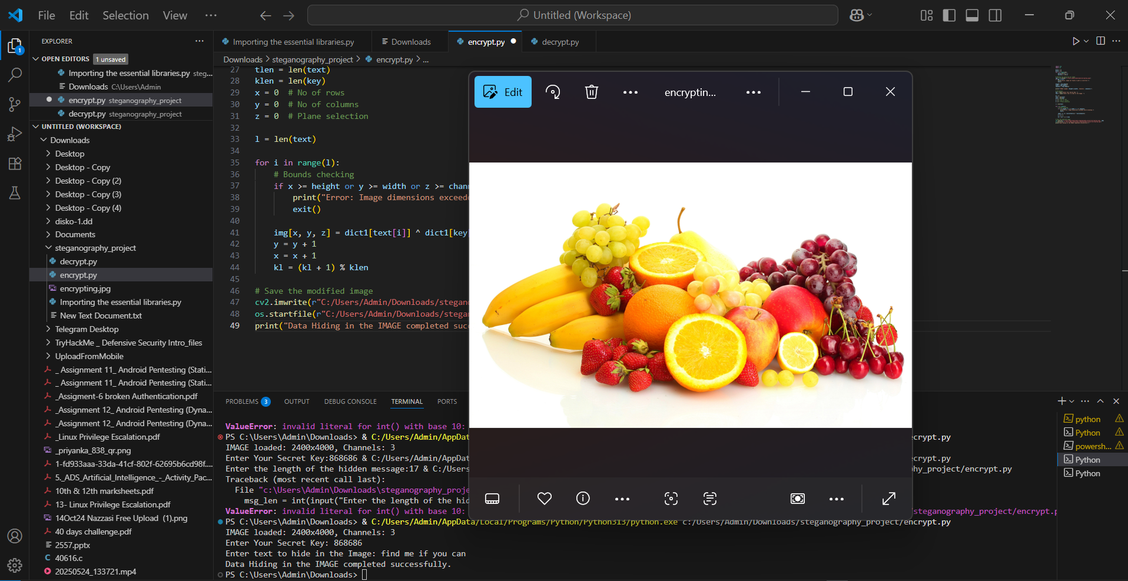
Result

Slide 7
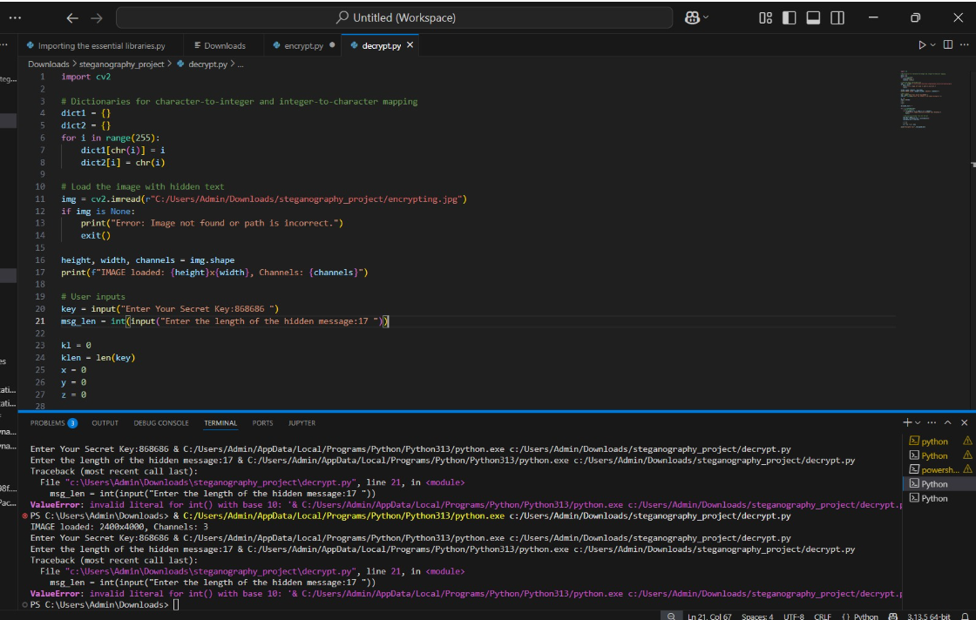
Result

Slide 8
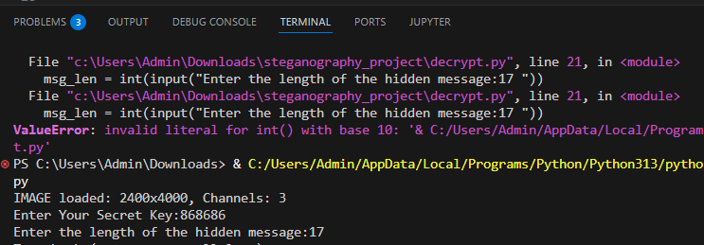
Result

Slide 9
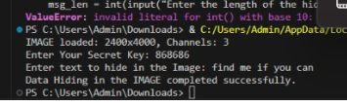
Result

Slide 10
GITHUB LINK
priyankaboda09/Steganography_AICTE-Project

Slide 11
Conclusion
This project successfully demonstrates how steganography
can be used to securely hide messages within images using
XOR-based encryption and password protection.
It ensures confidentiality without altering the image's appearance,
making it a practical solution for covert communication.
The implementation is simple, efficient, and requires no external storage or complex tools.

Slide 12
Future scope(Optional)
Add a graphical user interface (GUI) for easier use
Support hiding larger data types like files, audio, or video
Implement advanced steganography methods
(e.g., DCT or frequency domain techniques)
Integrate message compression and stronger encryption before embedding
Deploy as a secure web or mobile application for real-time use

Slide 13
References
GeeksforGeeks: Helped understand how to hide messages in images using Python. 🔗 Image-Based Steganography
OpenCV Docs: Used for editing and processing images in the project. 🔗 OpenCV Documentation
NumPy Docs: Helped in working with image pixel data as arrays. 🔗 NumPy Documentation
Python Docs: Referred for using built-in Python functions and OS module. 🔗 Python Official Docs
Gary Kessler’s Article: Gave a clear overview of what steganography is. 🔗 Overview of Steganography

Slide 14
THANK YOU

