Slide 1

ITC 6000 Database Management Systems Final Project Presentation Customer Personality Analysis Database
Project -5
Priyanka Chandak

Slide 2
Project Overview
Customer Personality Analysis dataset consists data of a company's ideal customers.
Primary Use Case:
Modeling an enterprise database
Store the structured data related to the Customer and services
Track customer information to manage the sales of products.
Perform analysis to predict future trends of customer preference for tactical and strategic decision making.
Key Business Challenges:
Collection of inaccurate data.
Lack of insight.
Missing data points

Slide 3
Application Solution
use of real-time validation tools.
specific process in place to identify and resolve conflicting and out of date information.
Cost Model
The company for web purchases is freemium revenue model as the focus is on building the large customer base while ensuring they service free users cost-effectively.

Slide 4
Personas'
Casual end-users: The managers of the company who occasionally access the database, but they look for different information each time.
Naïve or Parametric end-users: The administrators or the store managers, cashiers of the stores who will enter the customer information.
Sophisticated end-users: These are the business analyst, data scientists and engineers who need to have a thorough knowledge of the facilities provided by the DBMS.

Slide 5
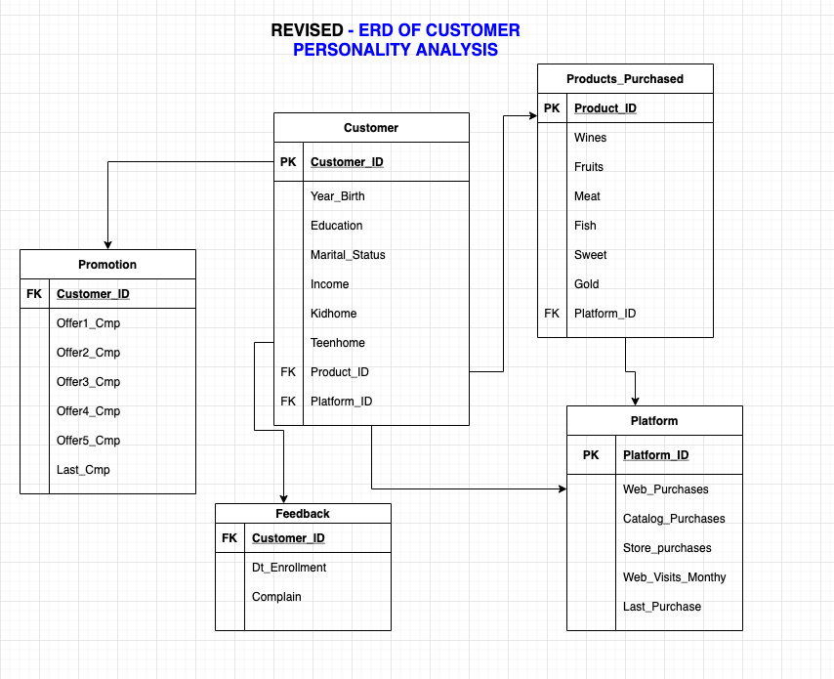
ER Diagram

Slide 6
Business Rules
BUSINESS RULES
A Customer will purchase Products.
A Customer can use different Platforms to purchase.
Different Promotional offer campaigns can be chosen by the Customer.
A Customer Complain will be registered only if it is less than 2 years old.
Feedback can be provided by the Customer.

Slide 7
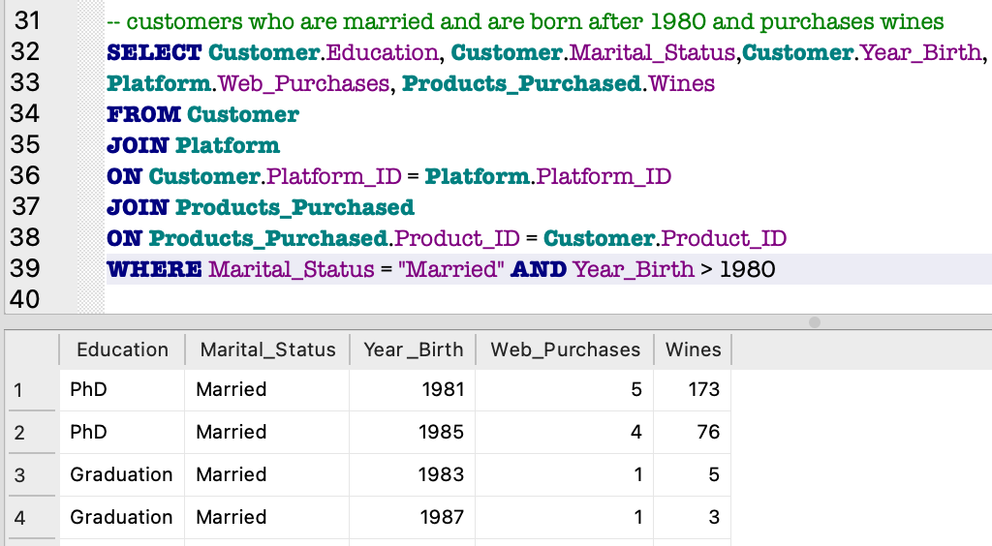
SQL Examples
Example 1 : Customers who are married and are born after 1980 and purchases wines.
To retrieve the data for the above example, JOIN clause have been used to join tables (Customer-Platform-Products_Purchased)

Slide 8
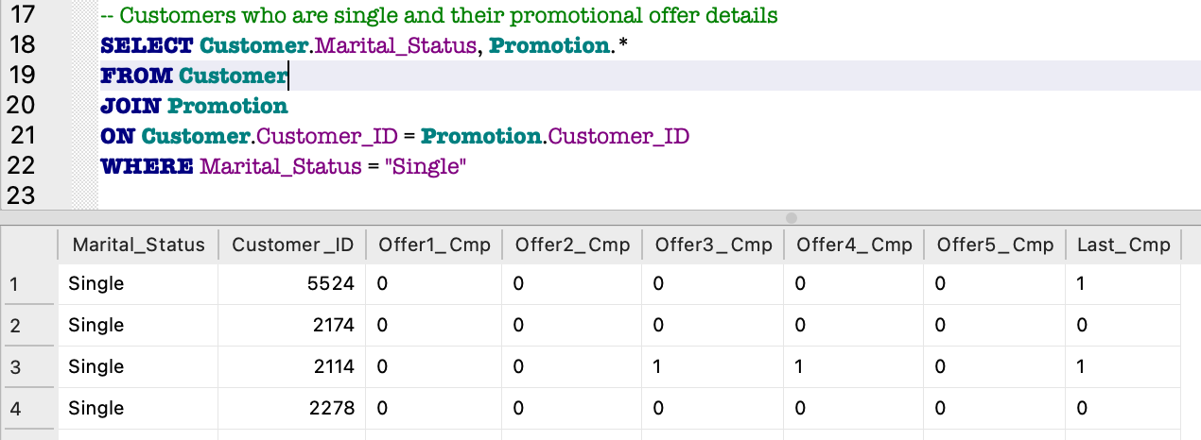
Example 2 : Customers who are single and their promotional offer details.
To retrieve the data from the Customer and Promotion table, JOIN clause have been used and it has been joined on Customer_ID of both the tables.

Slide 9
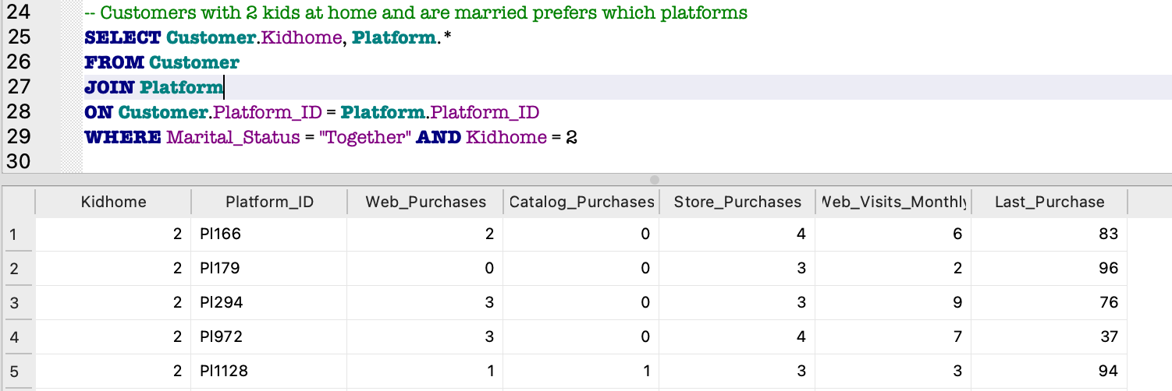
Example 3 : Customer with 2 kids and are married prefers which platform
To retrieve the data from the Customer and Platform table, JOIN clause have been used and it has been joined on Platform_ID of both the tables.

Slide 10
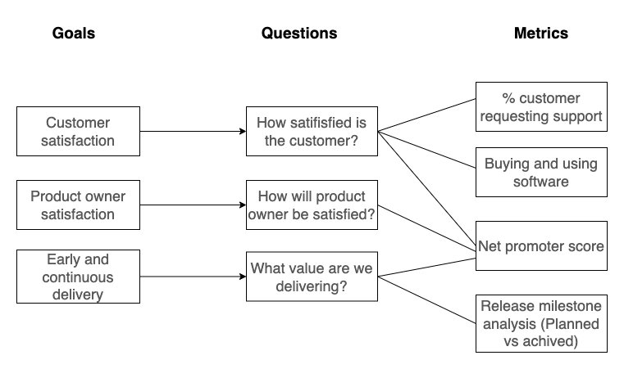
Metrics and Analytics
Database performance metrics help with database performance monitoring and optimize it for the business. Below listed our primary goals and traced the goal with data and metrics:

Slide 11
Security and Architecture
As we are storing sensitive information of customers (birth year and income), there could be privacy/security concerns for our database.
The data is likely to be targeted by the hackers
Architecture :
We are planning to host our solution on cloud
Ease of access
Scalability
Reduced cost
Data Security
Data Analysis
Storage Requirements:
Initially 5gb storage is enough for our data. Later on, it can be expanded as per the needs

Slide 12
Next steps / Lessons Learned
Learnt about database architecture and use-cases using ER diagrams
Understood referential integrity and data normalization along with basic SQL syntax
Got hands on experience of different SQL commands like SELECT and JOIN which helps in manipulating and retrieving data
Learnt trade offs between different architecture types, SDLC and data security
Learnt how to generate valuable insights, metrics and reports from raw data
Future Ideas – Gaining more knowledge on advanced SQL concepts such as data warehousing, cloud and use of analytics to solve complex business problems. Also working on multiple real-world use-cases or scenarios.

