Slide 1
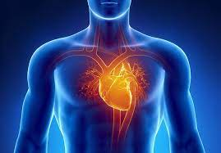

Prediction of Heart Stroke : Multiple Linear Regression & Logistic Regression Model
By: Priyanka Chandak

Slide 2
INTRODUCTION
In this Project, I have worked on Heart stroke dataset which consists of 5118 observations with 12 variables which are Id, Gender, Age, Hypertension, Heart disease, ever married, work type, Residence type, average glucose level,
Goal 1: To predict the age in which people get health issues -
Multiple Linear Regression Model
Goal 2: To predict whether a person has had a stroke or not -
Logistic Regression Model

Slide 3
EXPLORATORY DATA ANALYSIS – KEY FINDINGS
- Number of Female patients are more than male patients.
- Average BMI is 28.89 which shows overweight issues, which may lead to hypertension (Normal BMI 22- 25)
- Majority of patients does not have hypertension ( Yes : 498 , No : 4612)
- Low heart disease (276 out of 4834) and stroke cases (Yes : 249, No : 4861)
- Majority of patients work for private firms.
- Majority patients are non-smokers.
- Majority patients are in their 40s age group.
- Older patients of age range 75-79 tends to get more stroke and heart diseases.
- Patients in the age group 50-79 tend to get diagnosed with hypertension.
- There is a correlation between target variable and numerical variables (hypertension, heart, glucose, bmi, stroke)

Slide 4
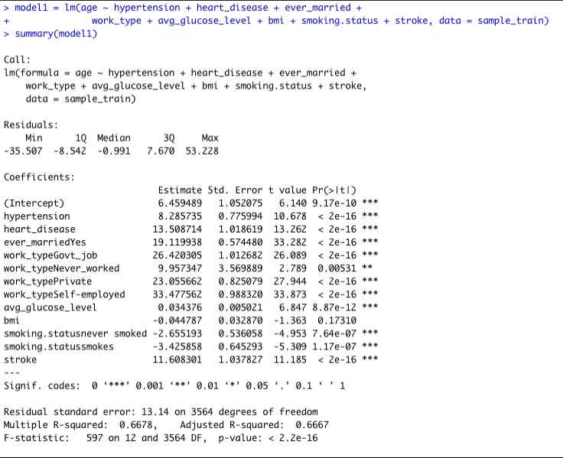
MULTIPLE LINEAR REGRESSION MODEL
It can be observed that except BMI, all the variables are statistically significant with the target variable (age)
R Squared : 0.66
Model is significant as p value is less than 0.05
Higher the F statistic, better the chances of getting a significant model

Slide 5
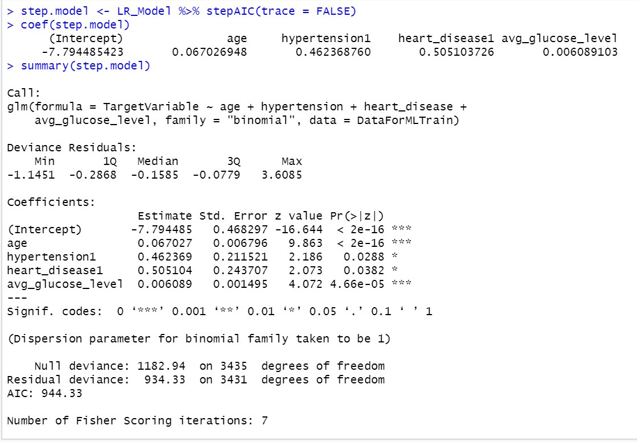
LOGISTIC REGRESSION MODEL
INTERPRETATIONS OF THE STEPWISE REGRESSION MODEL:
It can be observed that age is most significantly associated with the target variable, hypertension1 and avg_glucose_level is also associated with the target variable but is slightly less significant than age. Apart from that heart_disease1 is also considered important as per stepwise feature selection criteria.
The co-efficient estimate of all the predictor variables is positive. This means with an increase in predictor variables will be associated with an increased probability of getting a Heart stroke.
The goodness of fit is measured by the difference between the Null deviance and the Residual deviance. Compared to the full model the difference is moderate in between the Null and the Residual deviance, hence it is a better model.
The Akaike Information Criterion (AIC) is a method to evaluate how well does the model fit the data it has been generated from. The lower the AIC compared to other models the better it is because it means with lower number of predictor variables It will have similar accuracy. Here, in the model as per stepwise feature selection criteria the AIC is 944.33 compared to the Full model which had an AIC of 965.45.

Slide 6
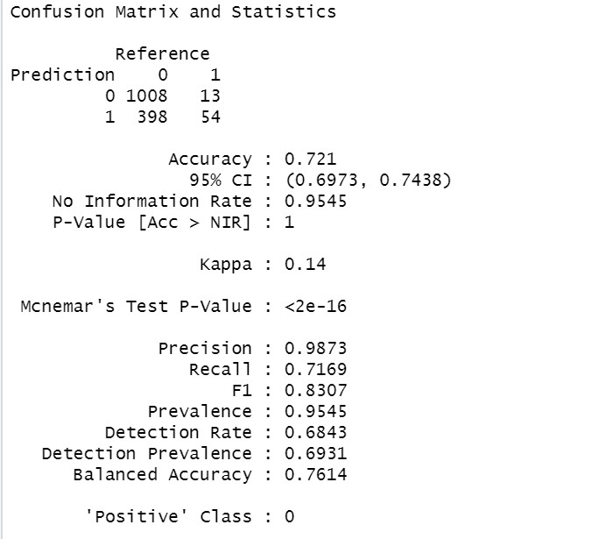
ACCURACY OF THE MODEL: Confusion Matrix
INTERPRETATIONS:
The confusion matrix provides us with the details of the model accuracy and the errors in the prediction.
True Negative: When the model predicted 0 and it is originally 0, here it is 1008.
True Positive: When the model predicted 1 and it is originally 1, here it is 54.
False Negative: When the model predicted 0 but it is originally 1, here it is 13.
False Positive: When the model predicted 1 but it is originally 0, here it is 398.
Accuracy: Accuracy is 72.1% means model predicts 72.1% correctly whether a person have had a heart stroke or not.
Precision: Precision checks how correctly does the model predicts true positives. The precision value of 98.73% means that the model predicts correctly 98.73 of times if the person has had a heart stroke or not.
Recall/True Positive Rate/Sensitivity: Recall checks how often does the model predict yes when it is originally yes. The Recall value of 71.69% shows that the model predicts the Heart stroke correctly 71.69% of times when originally a heart stroke has occurred.
F1-Score: The F1-score of the model for the testing dataset is 83.07%.
The Specificity is 80.05%. It is also referred to as True Negative Rate, shows the proportion of negative class correctly.

Slide 7
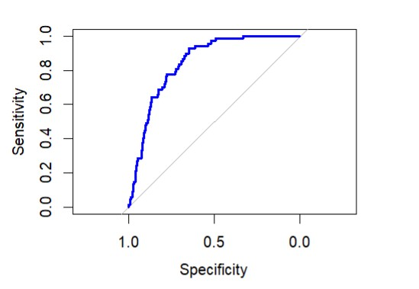

THE ROC (RECEIVER OPERATING CHARACTERSTIC CURVE) AND THE AUC(AREA UNDER THE CURVE)
The ROC curve shows the performance of the classification model at all the classification thresholds. It is produced by plotting the True Positive Rate (TPR) against the False Positive Rate (FPR).
The ROC curve for this model fits moderately. Improvements can be made if more data were to be collected. They also might be made if additional factors were collected, specifically ones which are risk factors by those with domain knowledge.
The Area under the curve tells us how better the model will perform. The higher the AUC curve the better will the classifier of the model perform on a given task.
The AUC value of 0.8437, which is near to 1 indicates that the model is good at predicting whether the Person have had a Heart Stroke or not.

Slide 8
CONCLUSION & FUTURE IDEAS
In this project we worked on two major goals : Goal 1: To find out at which age does a person gets health issues like hypertension, heart disease, diabetes etc. with an accuracy of 66%
In future we could find specifically at which age could a person get heart disease given we have had a greater number of observation for number of people getting strokes is 243 versus the number of people getting stroke. The information of these variables would help us to predict more accurately for any heart disease or stroke occurrence or chances of getting a stroke with given health parameters.
In Goal 2: We predicted whether person has had a heart stroke or not with an accuracy of 72%.
Other ideas are given we get more data points on a person getting heart stroke, we can build a better model with better accuracy. If we can have access to more information of parameters or features like cholesterol levels, Triglyceride levels, CRP levels etc. would help us to predict more accurately for any heart disease or stroke occurrence or chances of getting a stroke with given health parameters. Also, the features should be significant predictor variable.

Slide 9
REFRENCES
https://www.analyticsvidhya.com/blog/2021/05/how-to-create-a-stroke-prediction-model/
https://www.stat.cmu.edu/capstoneresearch/spring2021/315files/team16.html
https://www.kaggle.com/adrynh/exploratory-data-analysis-on-stroke-dataset
https://www.analyticsvidhya.com/blog/2021/06/25-questions-to-test-your-skills-on-linear-regression-algorithm/
https://degreesofbelief.roryquinn.com/common-evaluation-measures-for-classification-models#:~:text=Detection%20Rate%20%2Dshows%20the%20number,a%20proportion%20of%20all%20predictions.
https://stackoverflow.com/questions/38829646/confusion-matrix-of-bsttree-predictions-error-the-data-must-contain-some-leve
https://stats.stackexchange.com/questions/175767/why-the-probability-in-my-logistic-regression-is-far-from-0-5-in-r

