Slide 1

Super Store Sales Visualizations - with Tableau & R-Shiny
By: PRIYANKA CHANDAK

Slide 2
INTRODUCTION
The dataset chosen for this project from Kaggle is “Super Store Sales data”. This dataset consists of 20 Variables with 11000 observations.
The dataset consists of information of Customer name, region, country, orders, product category and sub-category, sales, profits, discounts, order dates, etc.
The reason behind choosing this dataset was to analyze and understand the business questions for big retail chains, ecommerce companies and build useful insights for their executives to facilitate in business decision-making.
For this project, Tableau and R-Shiny has been used to build dashboards and visualizations using ethical strategies to address key business insights to the stakeholders.

Slide 3
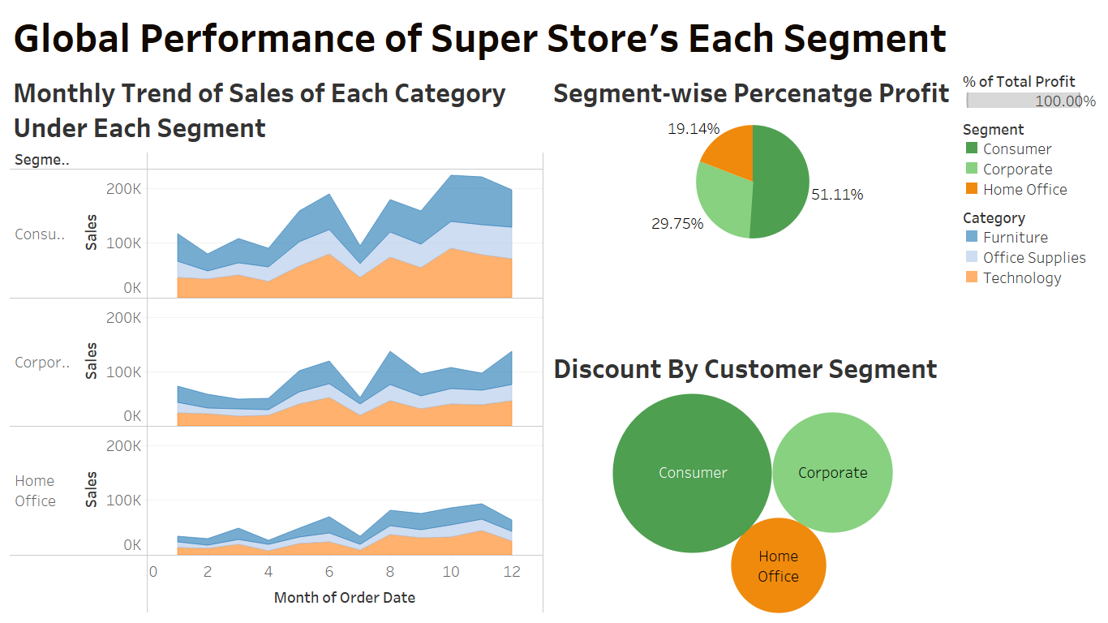
DASHBOARD - 1

Slide 4
OBJECTIVE OF DASHBOARD -1
How is each segment performing globally as they have multiple stores across the world and in different countries, to have a bigger picture of the super store sales each segment will give an understanding of how to optimize profits, best convert for a new or first-time sale and trends of past behaviors.
Graph -1 :
Chart-type: A line chart to represent the Monthly sales of each category under each segment.
Observation: It can be observed that in each segment the sales reach their first peak in June and have a steep fall in July and thereafter it starts rising. The highest sale for the consumer segment is in October, For the corporate segment it is during August and for home office it is during November.
Graph -2 :
Chart-type: Pie-chart displaying the Percentage of profit of the 3 segments.
Observation: It can be observed that the lowest contribution is from Home Office Segment which is 19.14% followed by 29.75% by Corporate segment and, the highest contribution is from Consumer Segment which is 51.11%.
Graph -3 :
Chart-type: Bubble chart displaying the Discount Provided in each of the 3 segments.
Observation: It can be observed that the lowest discount is provided in Home Office Segment by Corporate segment and, the highest discount is provided to the Consumer Segment.

Slide 5
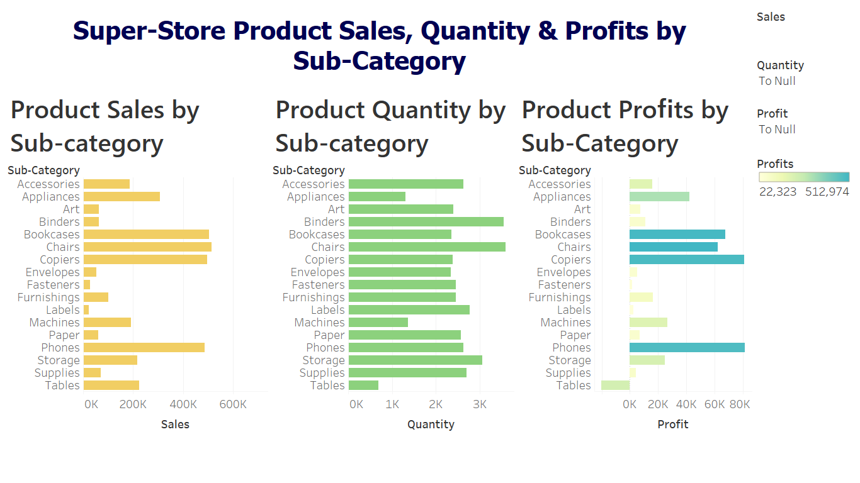
DASHBOARD - 2

Slide 6
OBJECTIVE OF DASHBOARD - 2
What is the sales, inventory and Profit of each Product sub-category? Which are the highest selling and lowest selling product sub-category? Is it feasible to maintain inventory levels for all the sub-category?
Graph -1 :
Chart-type: A Horizontal bar chart to representing the sales of each Product Sub-category.
Observation: It can be observed that the highest sales are of Bookcases, chairs, copiers and phones. bringing revenue in the range of $500k Alternatively, the lowest sales are of labels and Fasteners bringing revenue of $20k.
Graph -2 :
Chart-type: A Horizontal bar chart to representing the sales of each Product Sub-category.
Observation: It can be observed that the highest Quantity or inventory are of Binders, chairs, Accessories, Labels and storage. Alternatively, the lowest Quantities are of Labels, Tables, and Machines.
Graph -3 :
Chart-type: A Horizontal bar chart to representing the sales of each Product Sub-category.
Observation: It can be observed that the highest profits are from phones, bookcases, chairs, and copiers in the range of $500k. Alternatively, Tables are having a losses of around $20k. Apart from that, Art, Envelopes, Fasteners and Papers are least profit-making products.

Slide 7
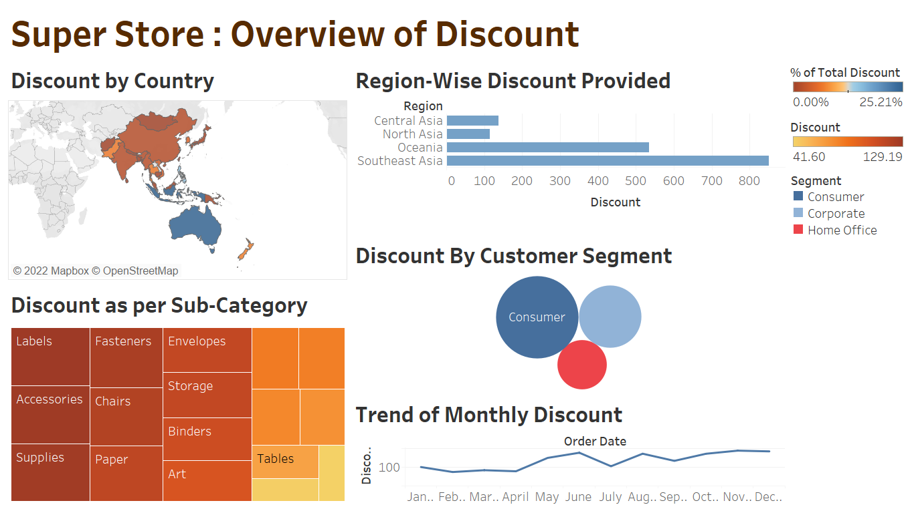
DASHBOARD - 3

Slide 8
OBJECTIVE OF DASHBOARD - 3
How much Discount is provided in different Regions and across different countries? Which Product and Customer segment gets the most discount? What is the trend of monthly discount?
Graph -1 :
Chart-type: World Map indicating percentage of discounts across different countries.
Observation: It can be observed that the highest discount is provided in Countries such as Indonesia, Australia, New Zealand, Thailand and the lowest discount is provided in Countries like India, China, Afghanistan and Mongolia.
Graph -2 :
Chart-type: A Horizontal bar chart to representing Region-wise Discount provided.
Observation: It can be observed that the highest Discount is provided in Southeast Asia and lowest Discount is provided in North Asia.
Graph -3 :
Chart-type: Bubble chart displaying the Discount Provided in each Customer Segment.
Observation It can be observed that the lowest discount is provided in Home Office Segment by Corporate segment and, the highest discount is provided to the Consumer Segment.

Slide 9
Graph - 4 :
Chart-type: Square Graph displaying the Discount Provided in each Product sub-category.
Observation It can be observed that the highest discounted sub- categories are labels, Accessories, Supplies, Paper, Chairs and Fasteners. The lowest Discounted products are tables, copiers, furnishings and phones.
Graph - 5 :
Chart-type: Trend Line displaying the Monthly Discount provided.
Observation It can be observed that peak month of discount is June for super store sales and the lowest discount is in February.

Slide 10
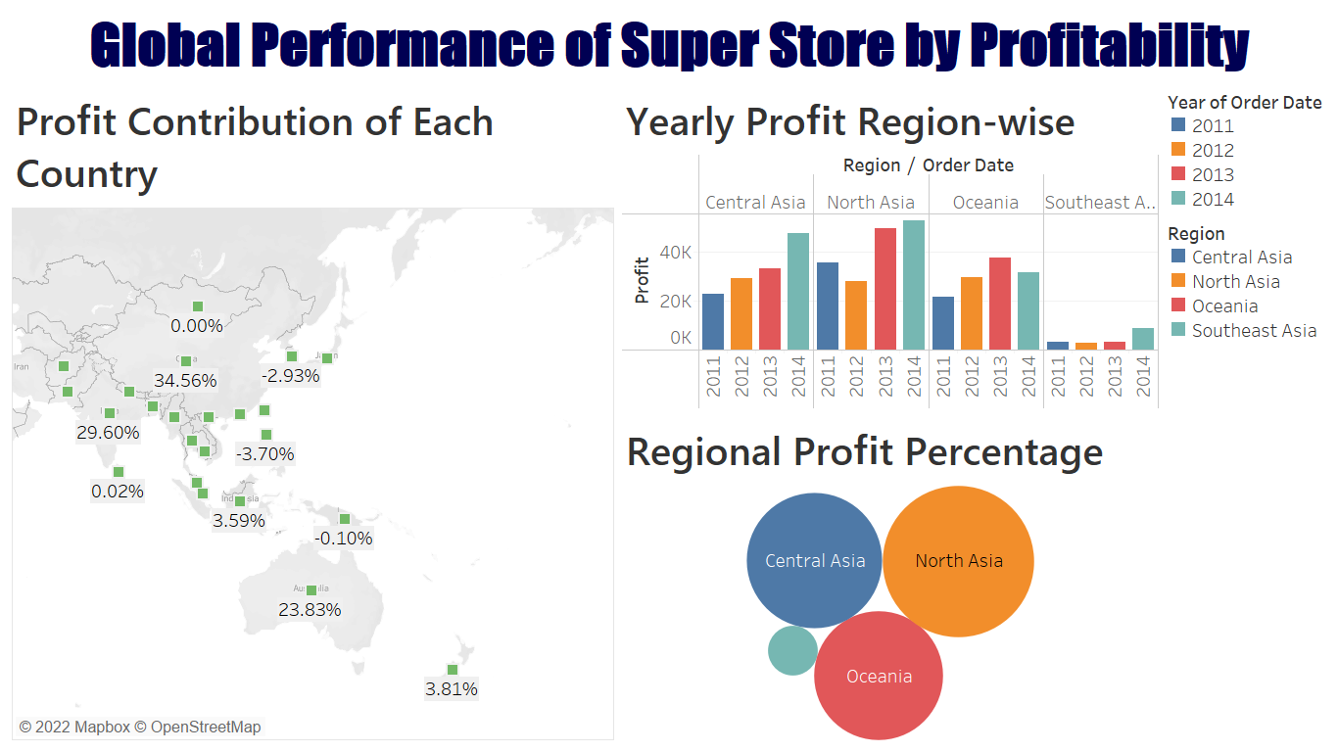
DASHBOARD - 4

Slide 11
OBJECTIVE OF DASHBOARD - 4
What is the Global Performance of Super store as per Profits ? Which are the most profitable Regions and Countries? What is the yearly trend of Profits across different Regions?
Graph -1 :
Chart-type: World Map representing the Percentage of Profits across countries for super store.
Observation: It can be observed that the highest Profitable region for super store sales are China, India, Australia and the Countries incurring losses are Philippines, South Korea and Papua New Guinea.
Graph -2 :
Chart-type: Multiple bar chart to represent the Yearly Profit across the 4 Regions.
Observation: It can be observed that there is an increasing trend in the yearly profits earned across the 4 regions. 2014 is the highest profit generating for all the 4 regions compared to the profits of 2011 for all the 4 regions.
Graph -3 :
Chart-type: Bubble Chart displaying the Total Profit Contribution by each Region
Observation: It can be observed that the highest Profit Contributing Region is North Asia followed by Central Asia and Oceania.

Slide 12
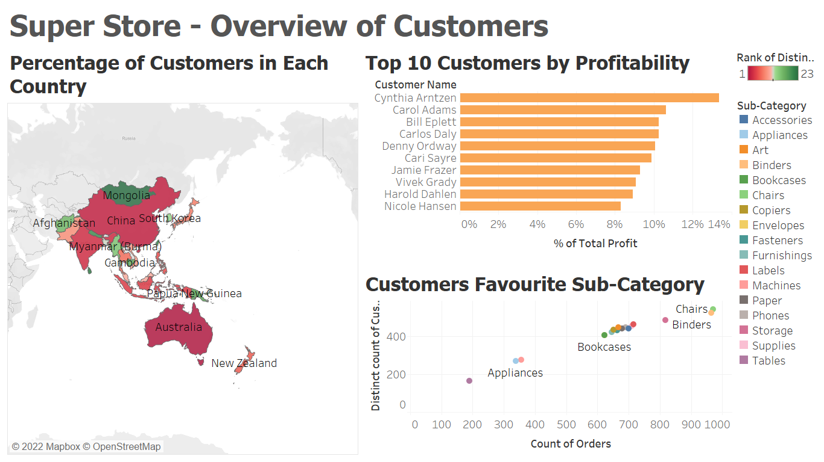
DASHBOARD - 5

Slide 13
OBJECTIVE OF DASHBOARD - 5
What are the percentage of customers in each country? Which Product sub-category are favorites of the Super store among customers ? Who are the Top 10 Customers of Super Store Sales across all the Regions?
Graph -1 :
Chart-type: World Map representing the Percentage of Customers across countries for super store.
Observation: It can be observed that the maximum percentage of customers are from Australia, India, China and the minimum percentage of Customers are from Mongolia, Sri Lanka and Nepal.
Graph -2 :
Chart-type: Horizontal bar chart to represent the Top 10 Customers as per Profit Contribution
Observation: It can be observed that the top customers are Cynthia Arntzen, Carol Adams, Bill Eplett who are from Australia and New-Zealand.
Graph -3 :
Chart-type: Scatter Chart displaying Favorite Sub-category of Products among Customers.
Observation: It can be observed that the favorite products of customers as per orders are Chairs, Binders and Storage.

Slide 14
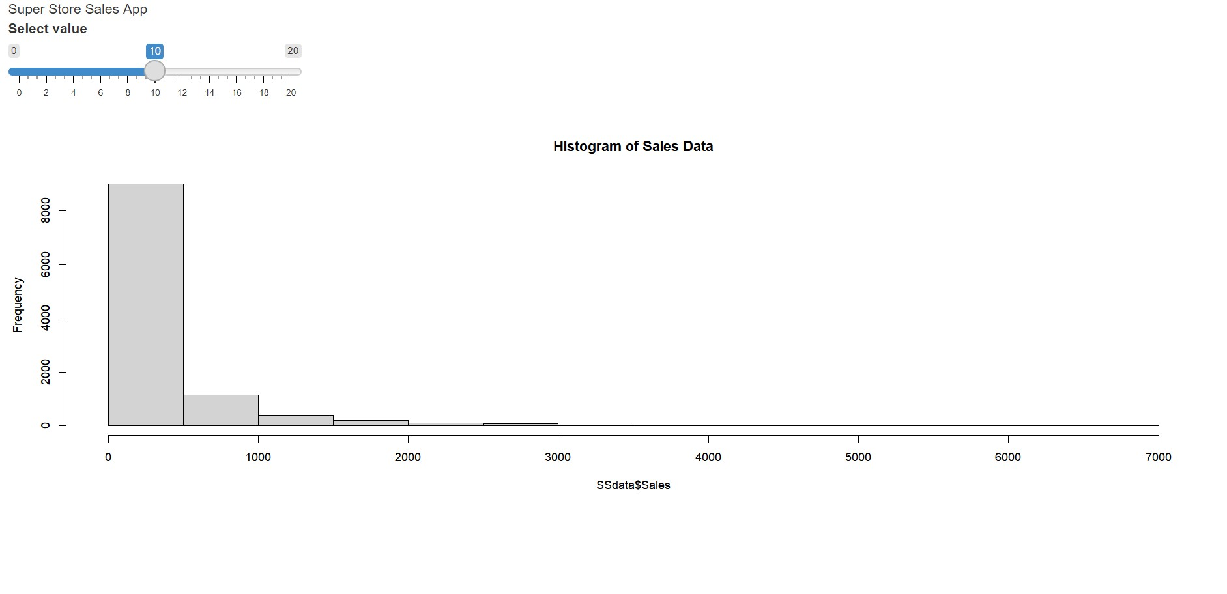
DASHBOARD - 6
The Histogram of Sales data App on R-shiny shows that most of the sales are in the range of $500 and $1000 for most of the super store sales product.

Slide 15
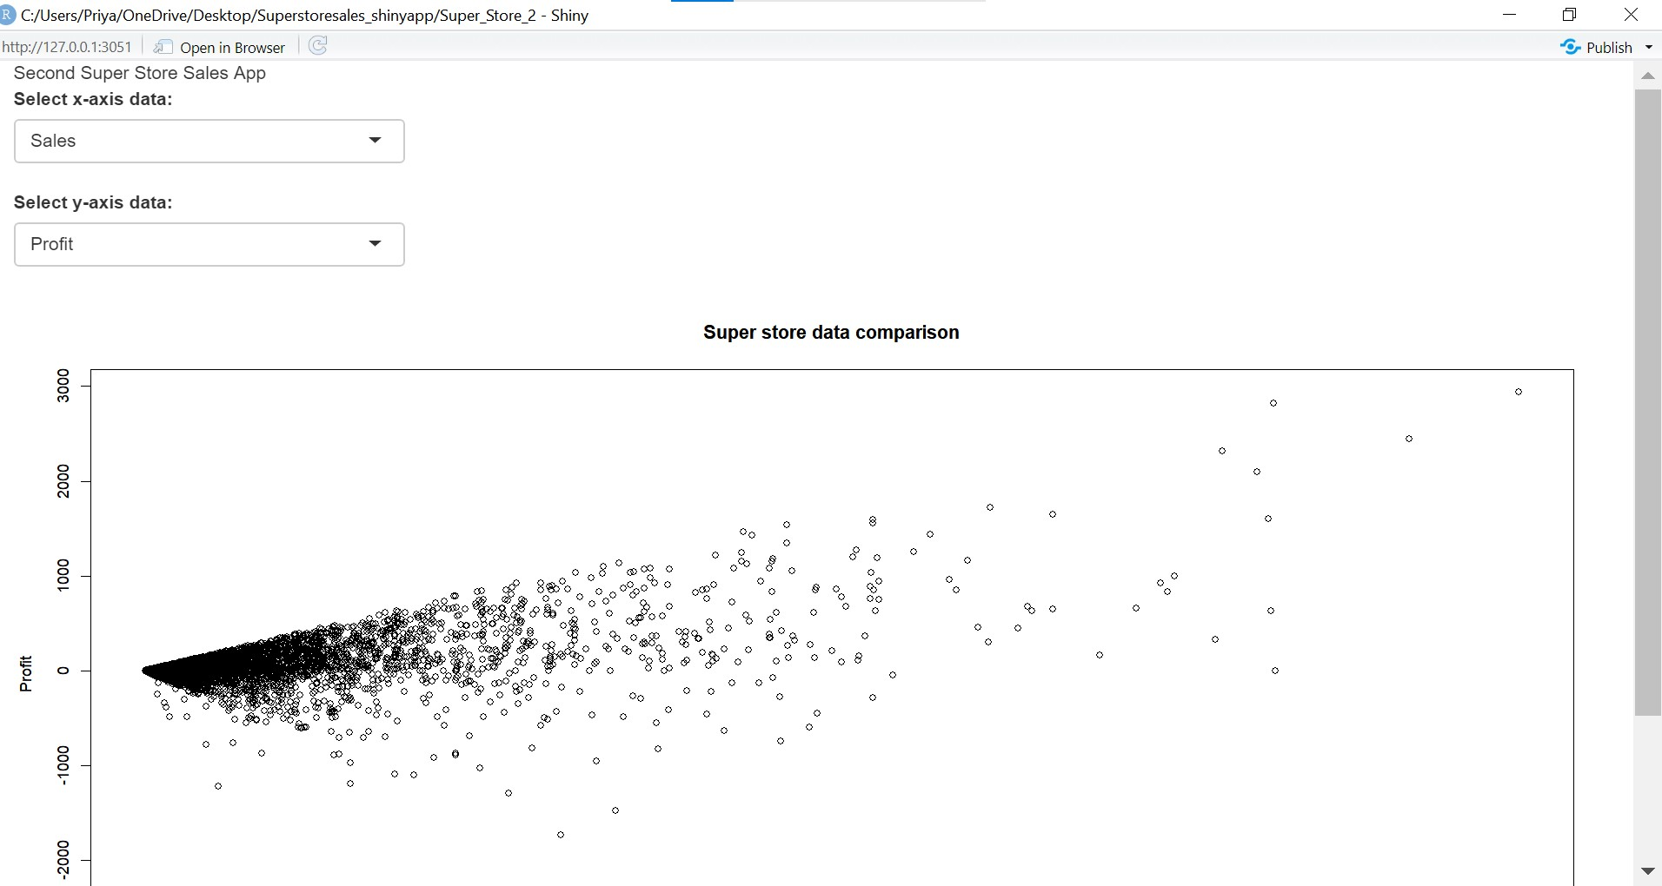
DASHBOARD - 7
The Scatter plot data App on R-shiny shows the sales vs Profit relationship, which shows that profit is positively correlated to the sales data.

Slide 16
References
https://www.kaggle.com/datasets/waqasalinaqvi/superstore-sales-data
Knaflic, Cole N. (2015). Storytelling with Data: A Data Visualization Guide for Business Professionals. Hoboken, NJ. John Wiley & Sons. ISBN: 978-1-119-00225-3
Nusbaumer Knaflic, C. (2019). Storytelling with Data: Let's Practice! United States: Wiley. ISBN: 978-1-119-62150-8

