Slide 1


Project Report on Practical Online Test System
for College Automation System
Swami Keshavanand Institute of Technology, Management & Gramothan, Jaipur
Project Mentor-
Ms. Nikhar Bhatnagar
Team Members-
Priyanka Chandra(12ESKCS738) Shaibya Gupta(12ESKCS747) Sneha Bansal(12ESKCS752)

Slide 2
Introduction
This web application provides the facility to conduct the online examinations.
It saves time as it allows multiple students to give their examinations at the same time and they do not need to wait for the results as the result is generated at that time only after the exam gets over.
It also has the timer facility that means that the timer for the test is set.
The student will have to complete the test in the given time interval only.
Administrator has the facility to update create or delete the test questions or the test papers provided to the students during their tests.
Users or students can login give their tests with his specific id and check their results also.

Slide 3
Tools Used-
Advance Java(servlet)
Dream Weaver
HTML
Java Script
MYSQL
Rational software architect(RSA)
References-
http://www.wikipedia.com
http://www.google.com

Slide 4
Scope
This system allows the student to give their exams at any time and access the tests from any place where they are comfortable with a definite username and password. No student can login with their wrong username and password. This is for the security purposes. Student will not have to wait for their results. The results will be displayed after the completion of the exam. Results are accessed fast.

Slide 5
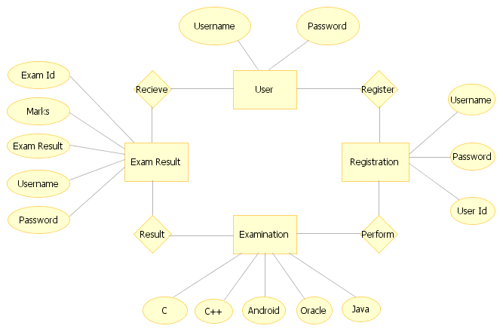
DATA FLOW DIAGRAMS
Data flow diagram
ER-DIAGRAM

Slide 6
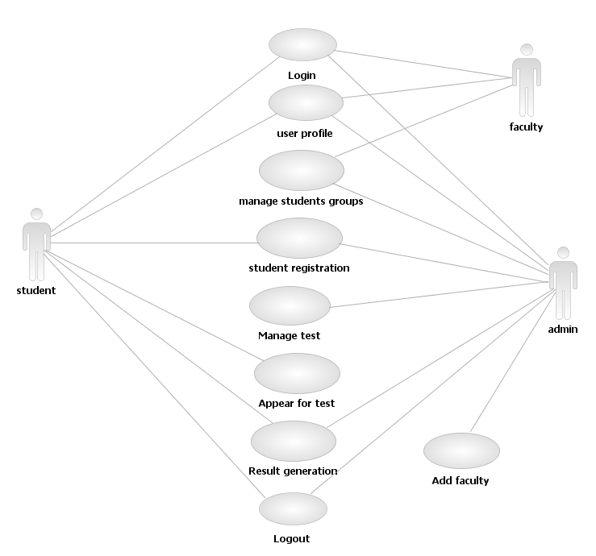
Usecase digram

Slide 7
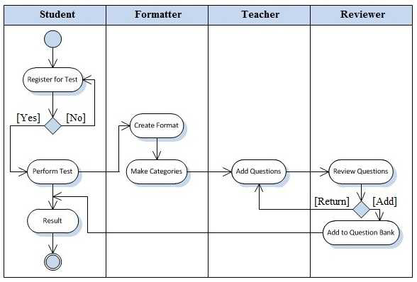
Activity diagram

Slide 8
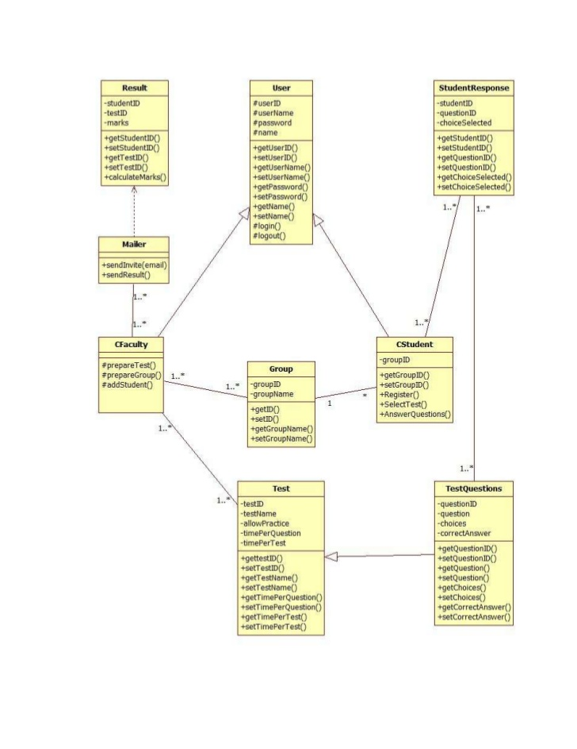
Class diagram

Slide 9
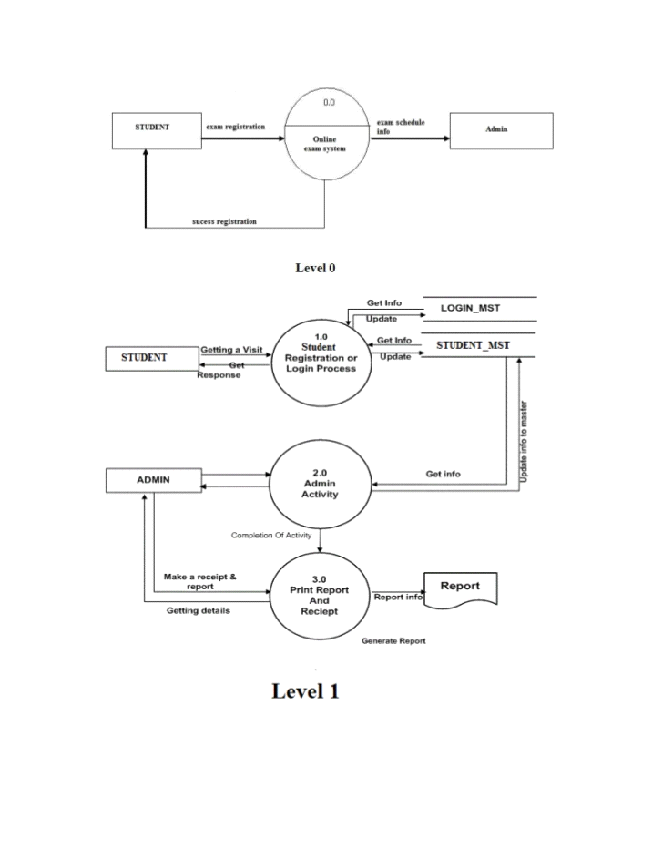
DFD

Slide 10
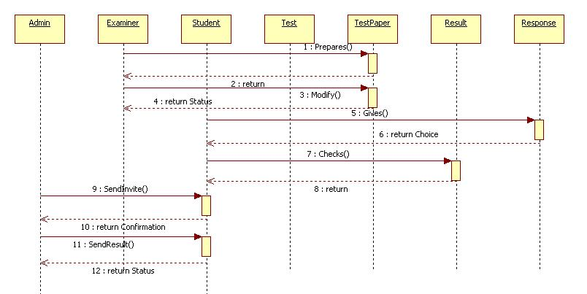
SEQUENCE DIAGRAM

Slide 11
FUNCTIONAL REQUIREMENTS
Legal / Regulatory requirement
Authentication
Administration
Timer
OTP(One Time Password)
User details
User id and password

Slide 12
NON FUNCTIONAL REQUIREMENTS
External Interfaces(Mouse , keyboard)
Enabled navigations across the screen
Mozilla Firefox
testability
Good Response Time and throughput

Slide 13
ADVANTAGES
Can be easily accessed 24/7 over the open test period
Can be allow Y minutes to answer X number of question
Immediate test feedback when a test is submitted
Can contains a combination of true/false, multiple choice, and in some cases assay question
Good Response Time and throughput

Slide 14
DISADVANTAGES
Highly dependent on honor system; hard to catch cheating. A group of students can take turns taking test first to share answer with others in the group raising their overall grade.
Hard or difficult to ask question or contest answers
Can be slow responding due to connection speed(i.e dial- up would limit the use of graphics or media files)

Slide 15
THANK YOU

