Slide 1
RETAIL SALES
DATA ANALYTICS PROJECT
From raw transactions to business insights
Prepared by: Priyanka Chauhan
Week 6 • Git, GitHub & Final Data Analytics Project

Slide 2
01 | Dataset & Tools
A transaction-level view of retail sales
RECORDS
ORIGINAL COLUMNS
TOTAL SALES
AVG. TRANSACTION
1,000
9
₹456,000
₹456
Dataset fields
Tools used
• Transaction ID, Date, Customer ID
• Gender, Age, Product Category
• Quantity, Price per Unit, Total Amount
• Python and pandas for inspection and analysis
• Matplotlib for visualizations
• Power BI for the interactive dashboard
• Git and GitHub for version control and submission
02

Slide 3
02 | Data Preparation & EDA
Validate the dataset before interpreting the results
01
Validation results
Imported retail_sale.csv using pandas
Load
MISSING VALUES
DUPLICATES
02
0
0
Checked shape, columns, data types and summary statistics
Inspect
03
• Dates were converted for time-based analysis.
• Numeric fields were checked for valid values.
• Calculated transaction amounts matched Total Amount in all rows.
• No rows needed to be removed for missing or duplicate values.
Checked missing values, duplicate rows, dates and numeric fields
Validate
04
Grouped sales by category, gender and month
Analyze
03

Slide 4
03 | Visualizations & Findings
The analysis compares revenue, units sold, customer gender and time
Five charts included in the project
Headline results
• Sales by product category
• Sales by gender
• Monthly sales trend
• Quantity sold by category
• Sales by age group
TOP REVENUE CATEGORY
HIGHEST MONTH
Electronics
May 2023
FEMALE SALES
MALE SALES
₹232,840
₹223,160
Note: January 2024 contains only ₹1,530 in recorded sales and may represent a partial month; compare it cautiously with full months.
04

Slide 5
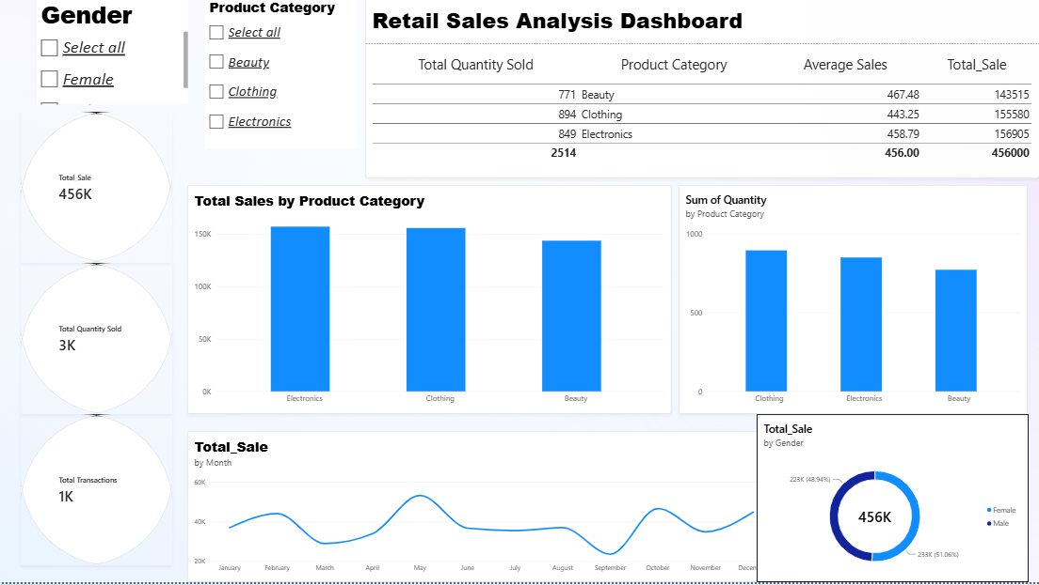
04 | Power BI Dashboard
Interactive summary for exploring retail performance
Suggested dashboard elements
• KPI cards: Total Sales, Transactions, Quantity Sold
• Sales by Product Category
• Sales by Gender
• Monthly Sales Trend
• Quantity by Category (4th visual)
• Slicers: Gender, Product Category and Date
Replace the placeholder with a screenshot from your actual Power BI report before submission.
05

Slide 6
05 | Business Insights & Recommendations
Use findings to guide practical next steps
Insights
Recommendations
• Total recorded revenue is ₹456,000 across 1,000 transactions.
• Electronics has the highest category revenue at ₹156,905.
• Clothing has the highest quantity sold at 894 units.
• Female-customer sales (₹232,840) exceed male-customer sales (₹223,160).
• May 2023 is the highest-sales month (₹53,150); September 2023 is the lowest full month (₹23,620).
• Review Electronics pricing, margins and stock availability to sustain revenue performance.
• Use category-level quantity and revenue together when planning inventory.
• Investigate the causes of monthly sales variation before making staffing or promotion decisions.
• Use customer and date slicers in Power BI to explore segments; validate patterns with more data.
Conclusion: This project demonstrates a reproducible workflow from data validation and EDA to visualization, dashboarding and version-controlled documentation.
06

