Slide 1
Reliability Analysis
Team members:
Nagamani kummari
Divyateja annapareddy
Vijay kumar dharmaji
Priyanka reddy cherabudla

Slide 2

OUTLINE
Reliability and Problem Description
Basic Principles of Reliability Analysis
What techniques did we use?
Excel Spreadsheets
User Interface
Procedures
Conclusion
References

Slide 3
What is Reliability and Problem Description?
What is Reliability?
Systems in parallel and series
Key reliability terms
F(t)- cumulative failure distribution
f(t)- failure distribution
R(t)= 1-F(t) – survival rate
r(t) failure rate r(t)= f(t)/1-F(t)
= f(t)/R(t)

Slide 4
Basic Principles of Reliability Analysis:
Define the Problem
Construct the optimization and simulation models
Test and Validate the models
Design the experiments
Conduct experiments
Evaluate the results
Implement the results

Slide 5
What did we use ?
Weibull distribution – Fitting Weibull is common for reliability.
Optimization - Selects best alternative
Simulation – imitation of the operation of an real world process
Examples for reliability- Space, Telecom, Automotive etc.

Slide 6
Excel Spreadsheets and how to resolve?
Welcome Sheet
Calculation Sheet for Weibull parameters.
Hidden calculation sheet for preparing simulation data
Simulation sheet
Calculation Sheet for recording the results of simulation runs
Output Sheet
Resolve Options

Slide 7
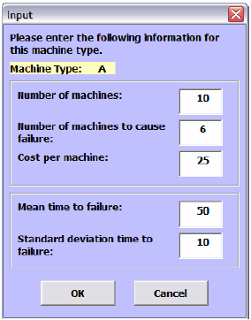
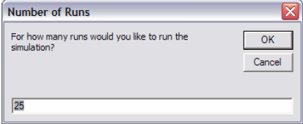
User Interface
Input form
Simulation sheet
Input box
-By M.Hanna

Slide 8
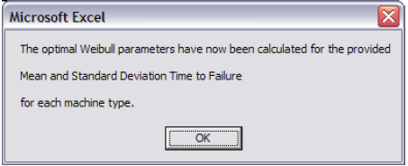
User Interface
Message Box
Navigational Buttons
Functional Buttons
-By M.Hanna

Slide 9
Types of Maintenance
Run to failure
Scheduled Inspections
Failure Finding Inspections
On condition Inspections
Scheduled Preventive Maintenance
Service
Repair
Replace

Slide 10
Procedures:
Main Procedure
ClearPrev
ClacWeibull

Slide 11
Contd.
StartSim
PrepSim
CreateData
PrepAnalysis

Slide 12
Redundant Systems:
Many complex systems (mainframe computers, network hardware etc) are molded with reliability models.
Each component has a failure probability and a repair time. The model determines predicted availability for system.
What happens if the component fails? Often system have multiple redundant nodes. How do we detect failure to repair it?

Slide 13
Conclusion and Future Direction
DSS can become a powerful tool in aiding decision making
Reliability is used to reduce time.
Reliability analysis problem is applied on larger scale real world problems like space, airways etc.

Slide 14
References:
“Principles of Designing and developing spreadsheet based decision support systems” By Michelle M.Hanna
“Reliability Analysis” By Professor Ernst G.Frankel
“Decisions in Reliability Analysis” By F.R Farmer
www.wikipedia.com “Reliability Engineering”
“Reliability and safety engineering” by “ Ajit Kumar Verma

Slide 15
THANKYOU

