Slide 1
DATAMITES INTERNSHIP
MOVIE DATABASE – SQL PROJECT
IMDB SQL Analysis Project
Project By: Priyanka C Meti
Database: SQL Server
Language: SQL

Slide 2
Project Overview
This project performs SQL analysis on Movies and Directors database
to extract insights on:
• Popularity
• Revenue
• Ratings
• Directors Performance
• Gender Representation

Slide 3
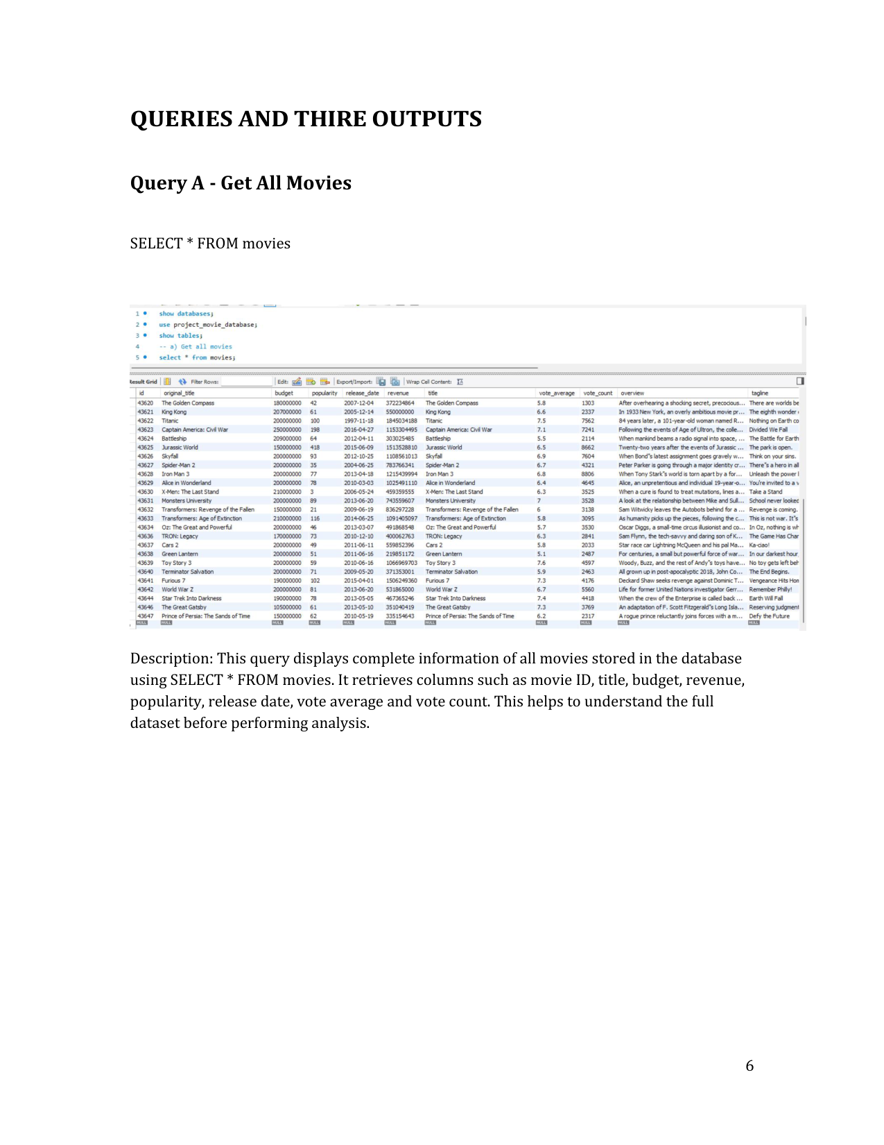
Query Output

Slide 4
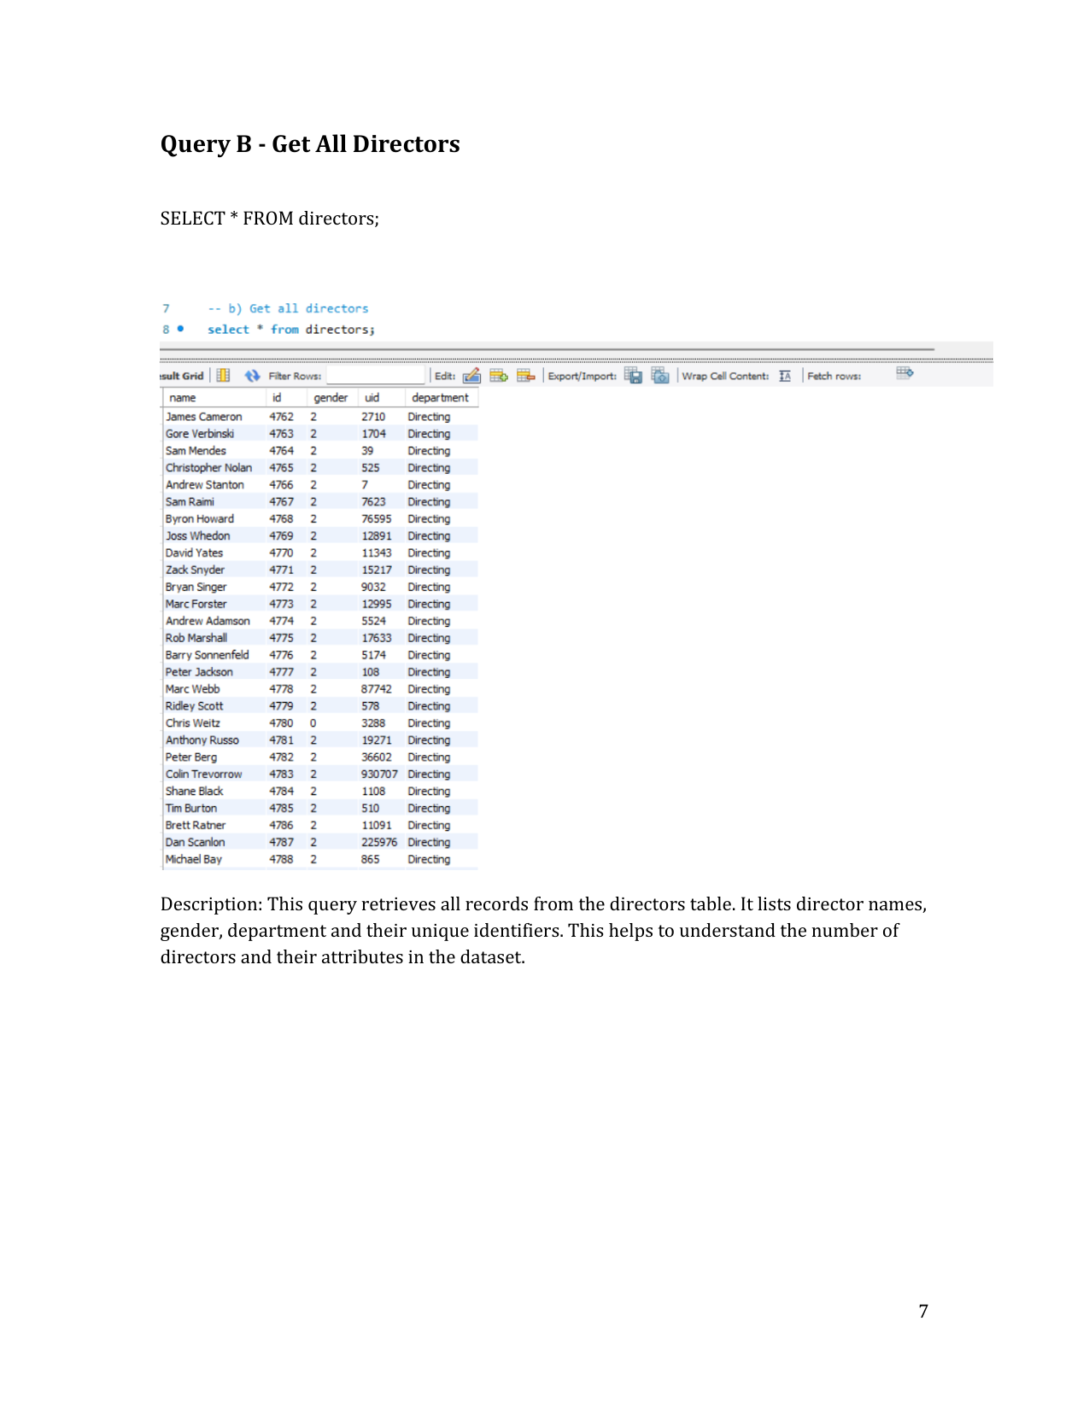
Query Output

Slide 5
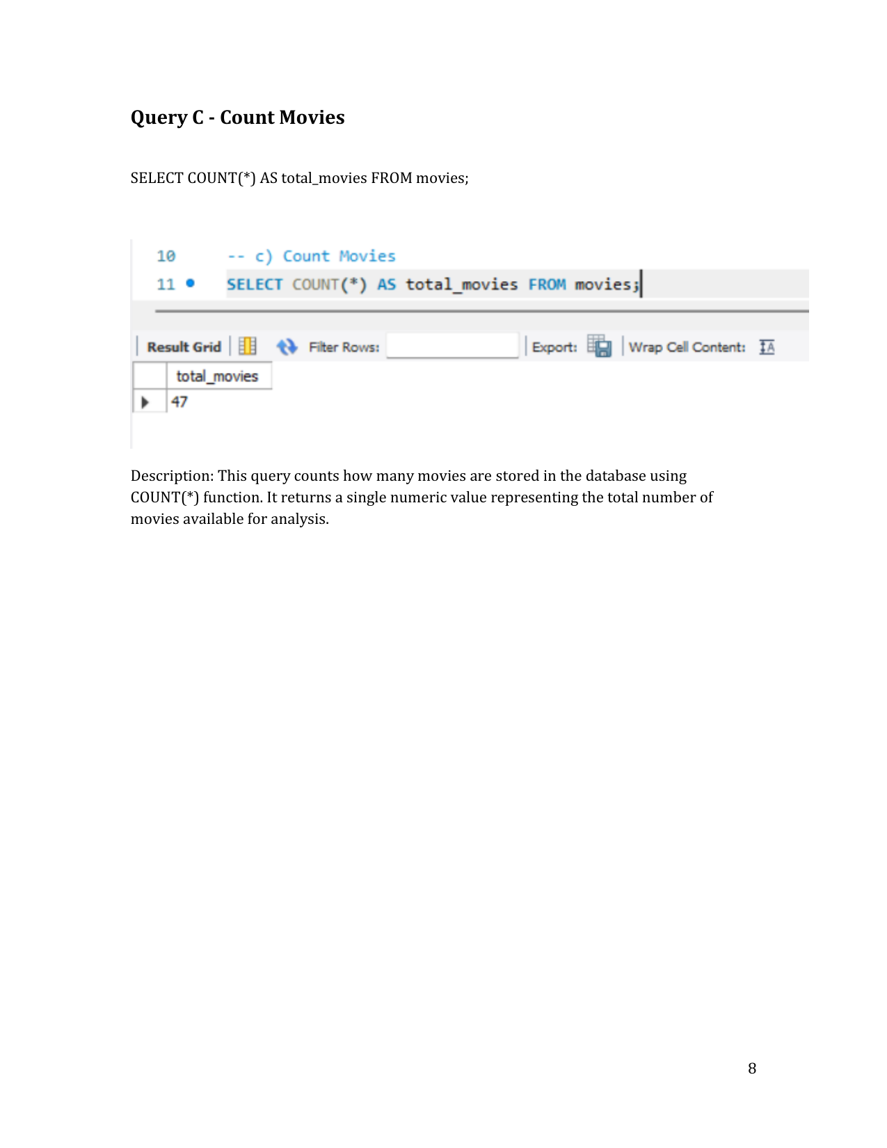
Query Output

Slide 6
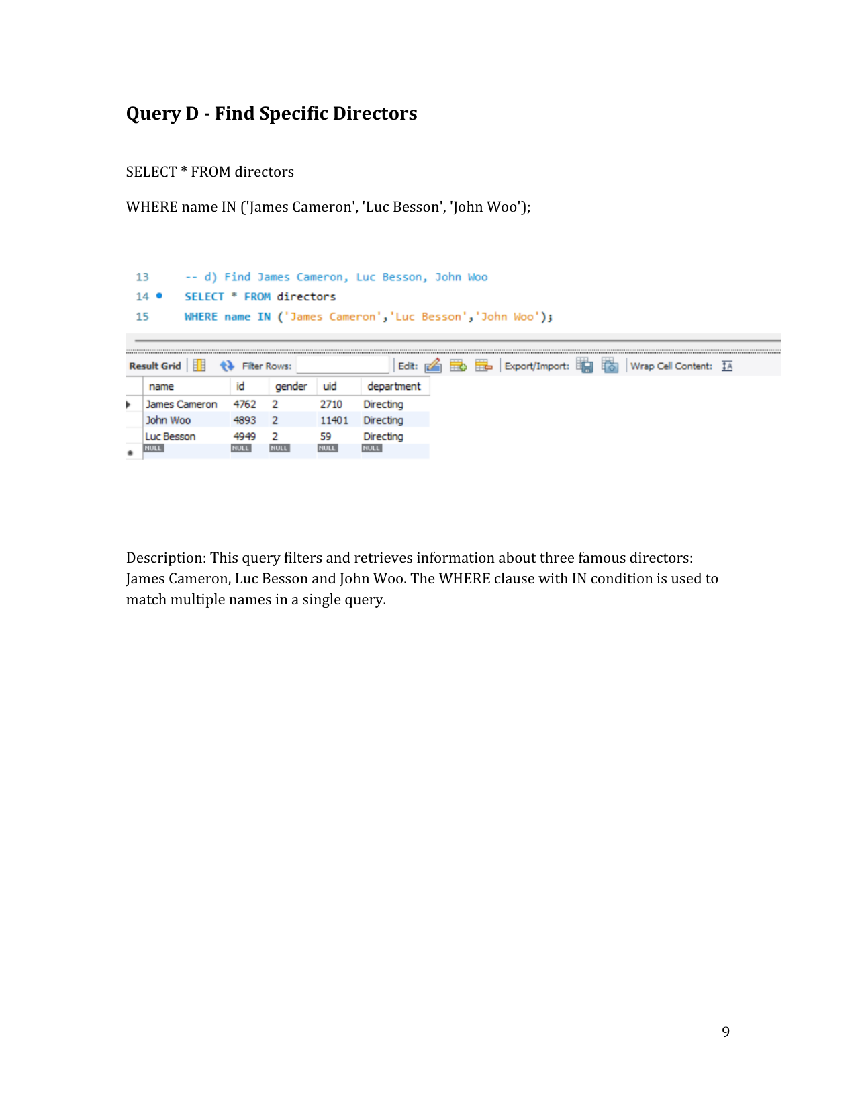
Query Output

Slide 7
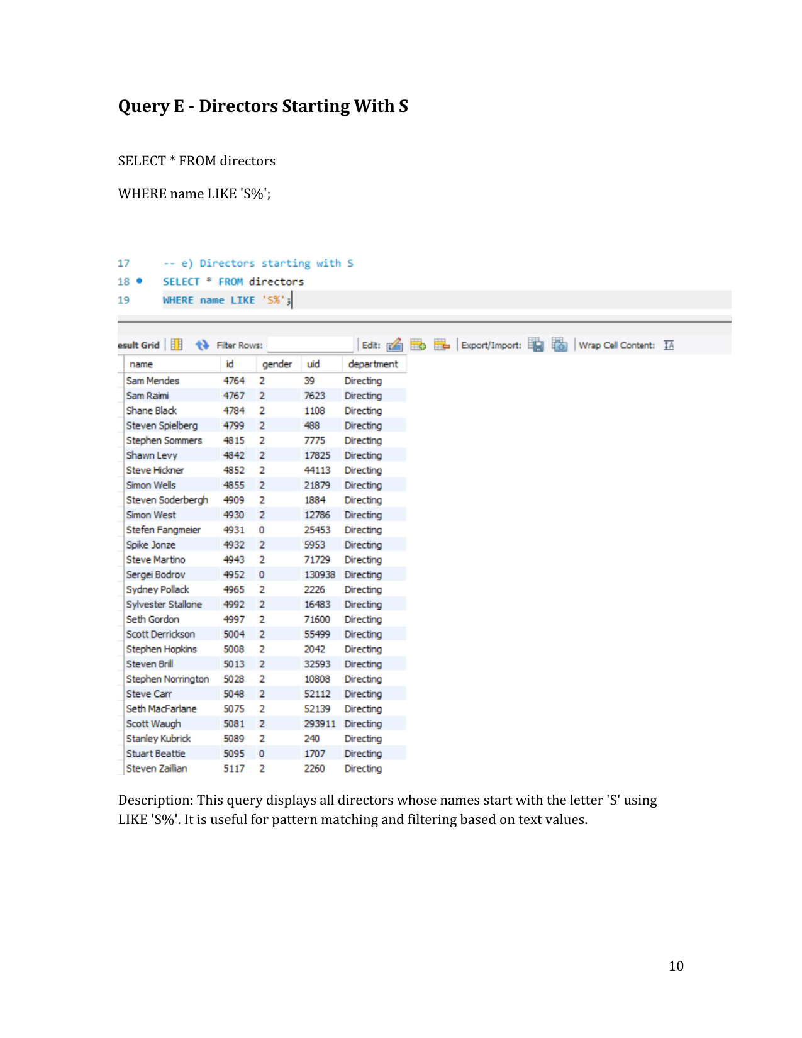
Query Output

Slide 8
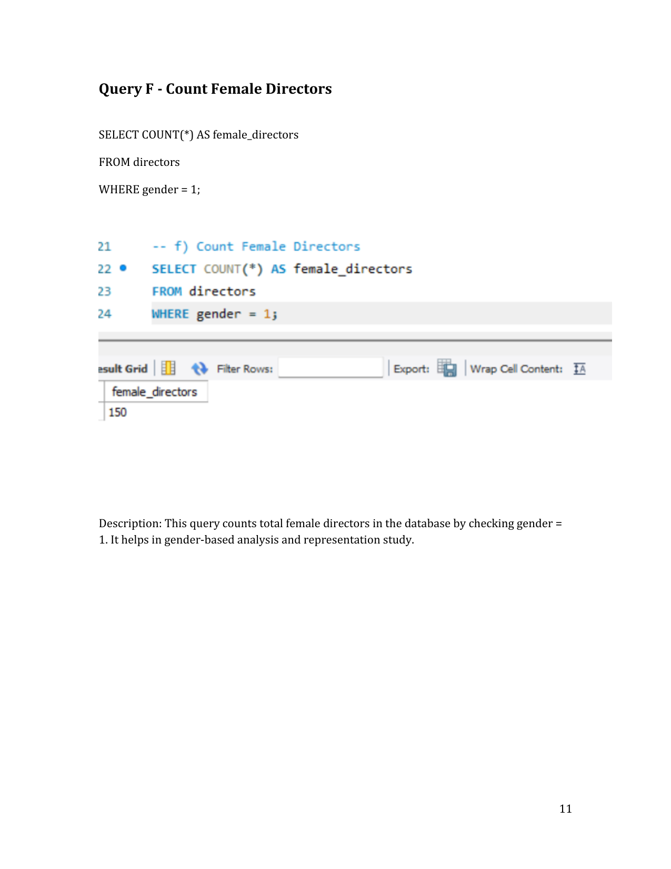
Query Output

Slide 9
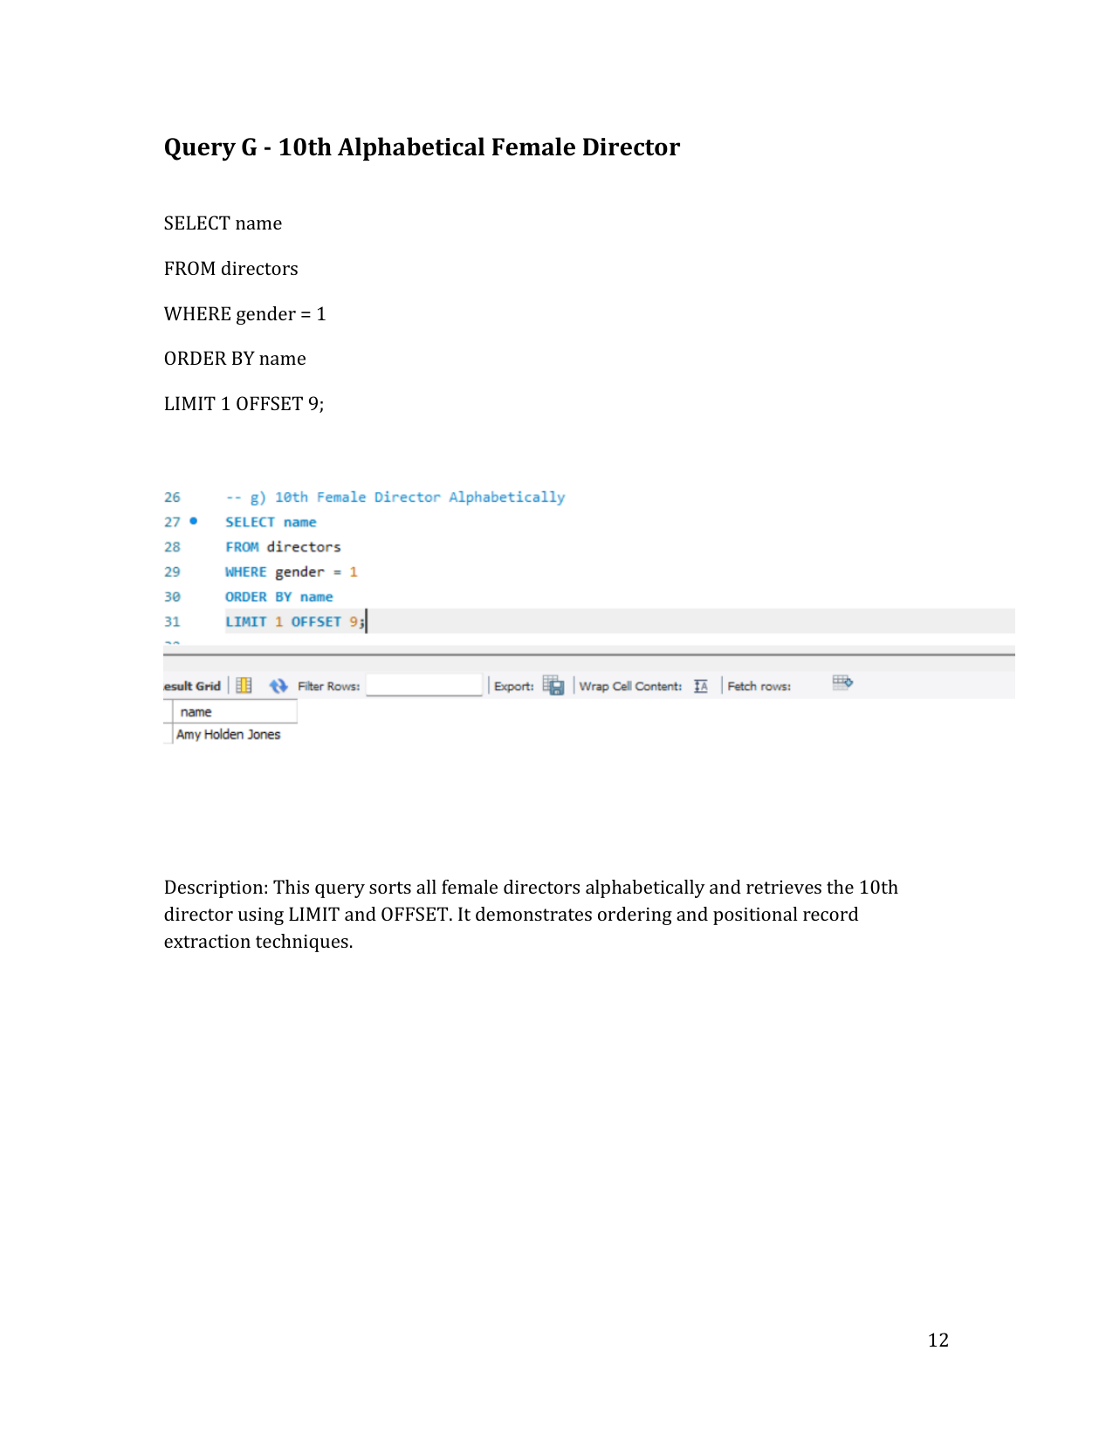
Query Output

Slide 10
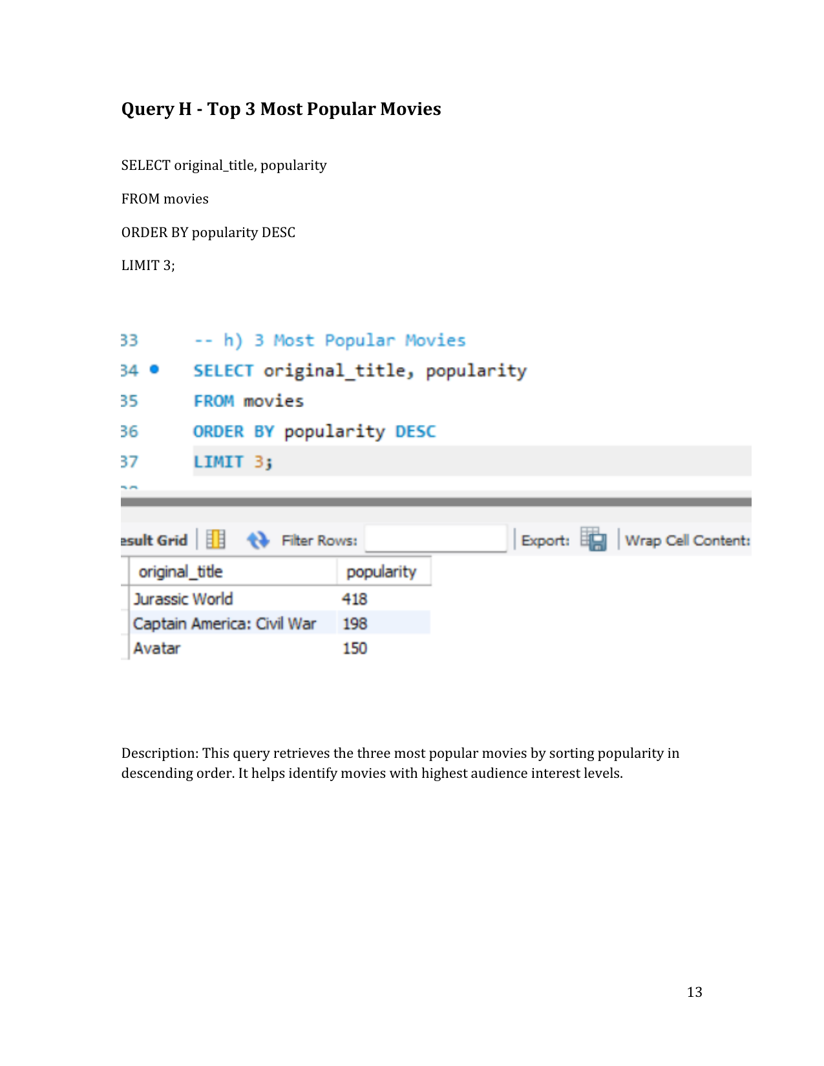
Query Output

Slide 11
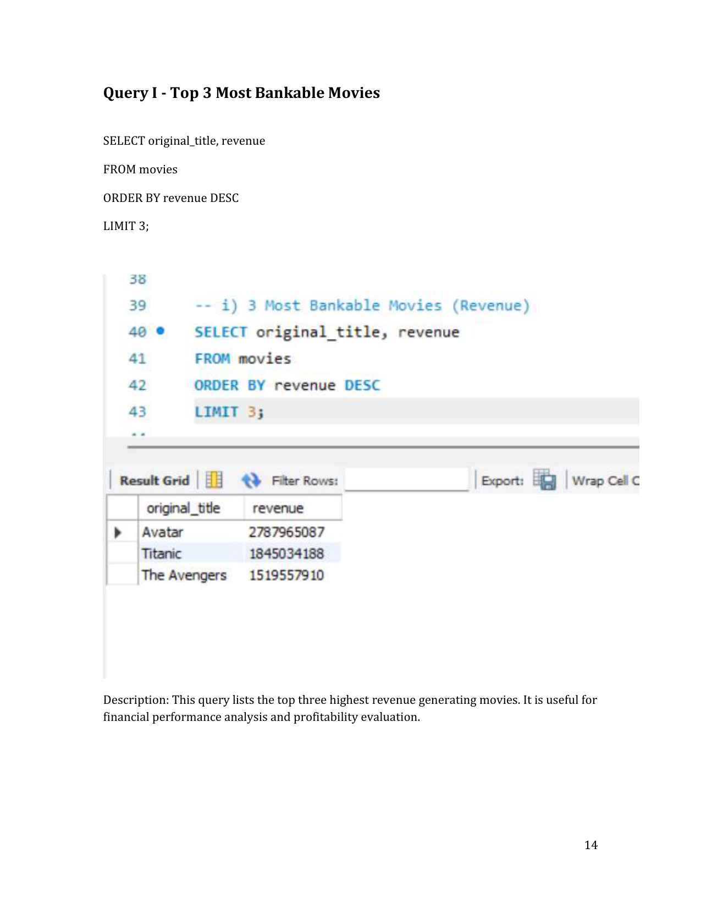
Query Output

Slide 12
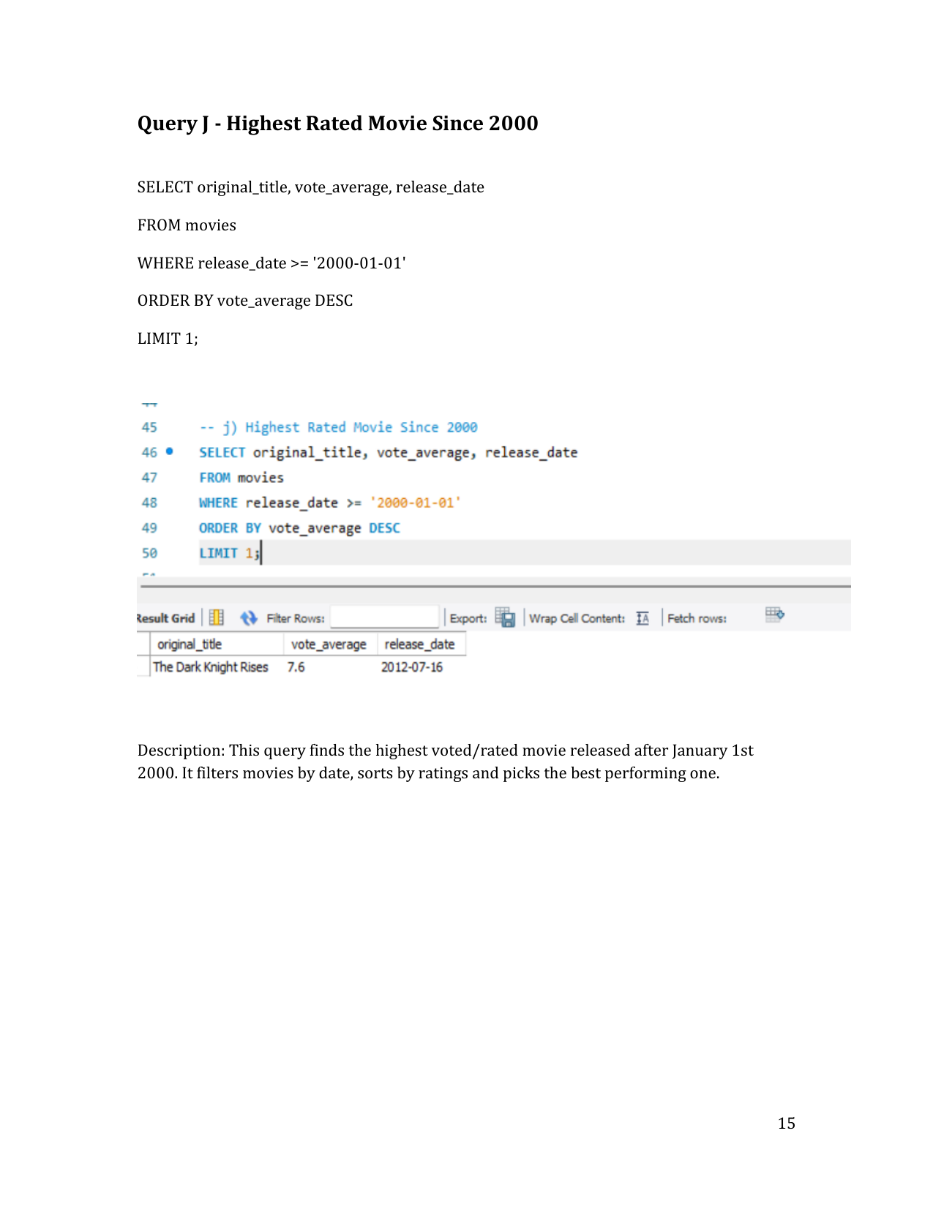
Query Output

Slide 13
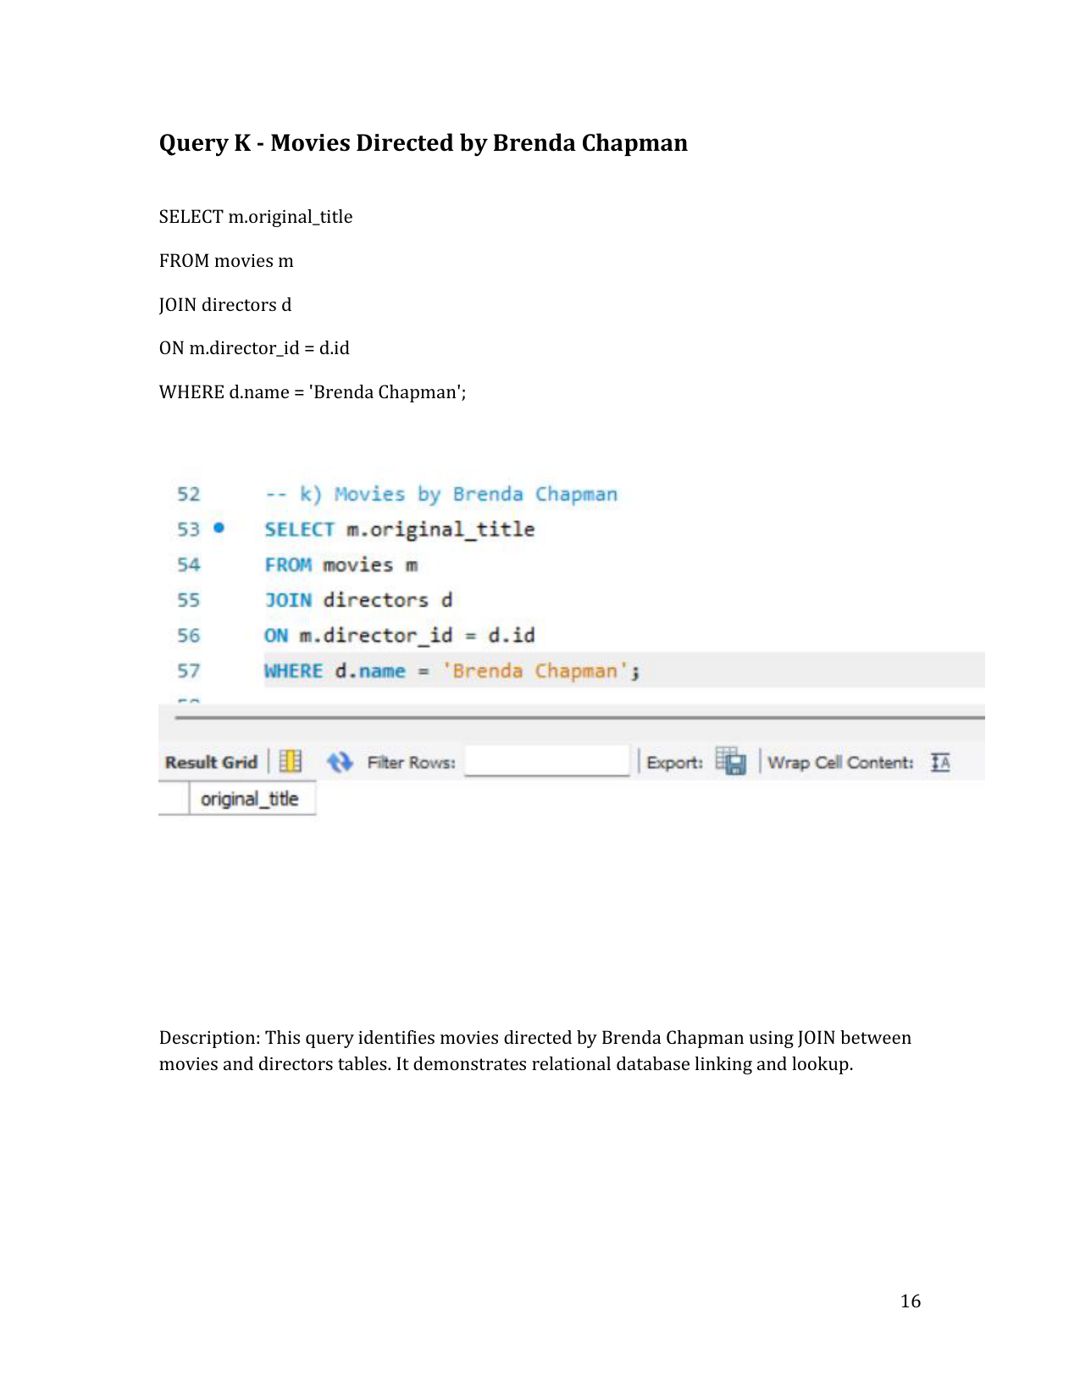
Query Output

Slide 14
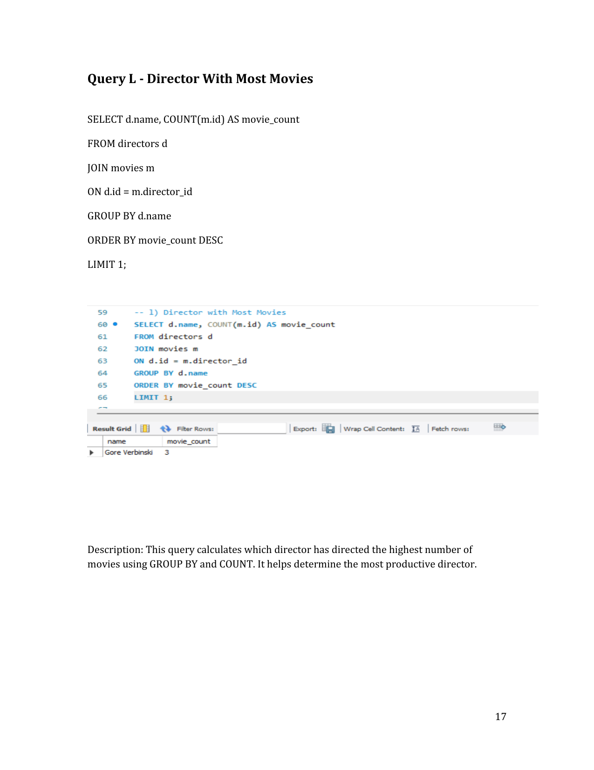
Query Output

Slide 15
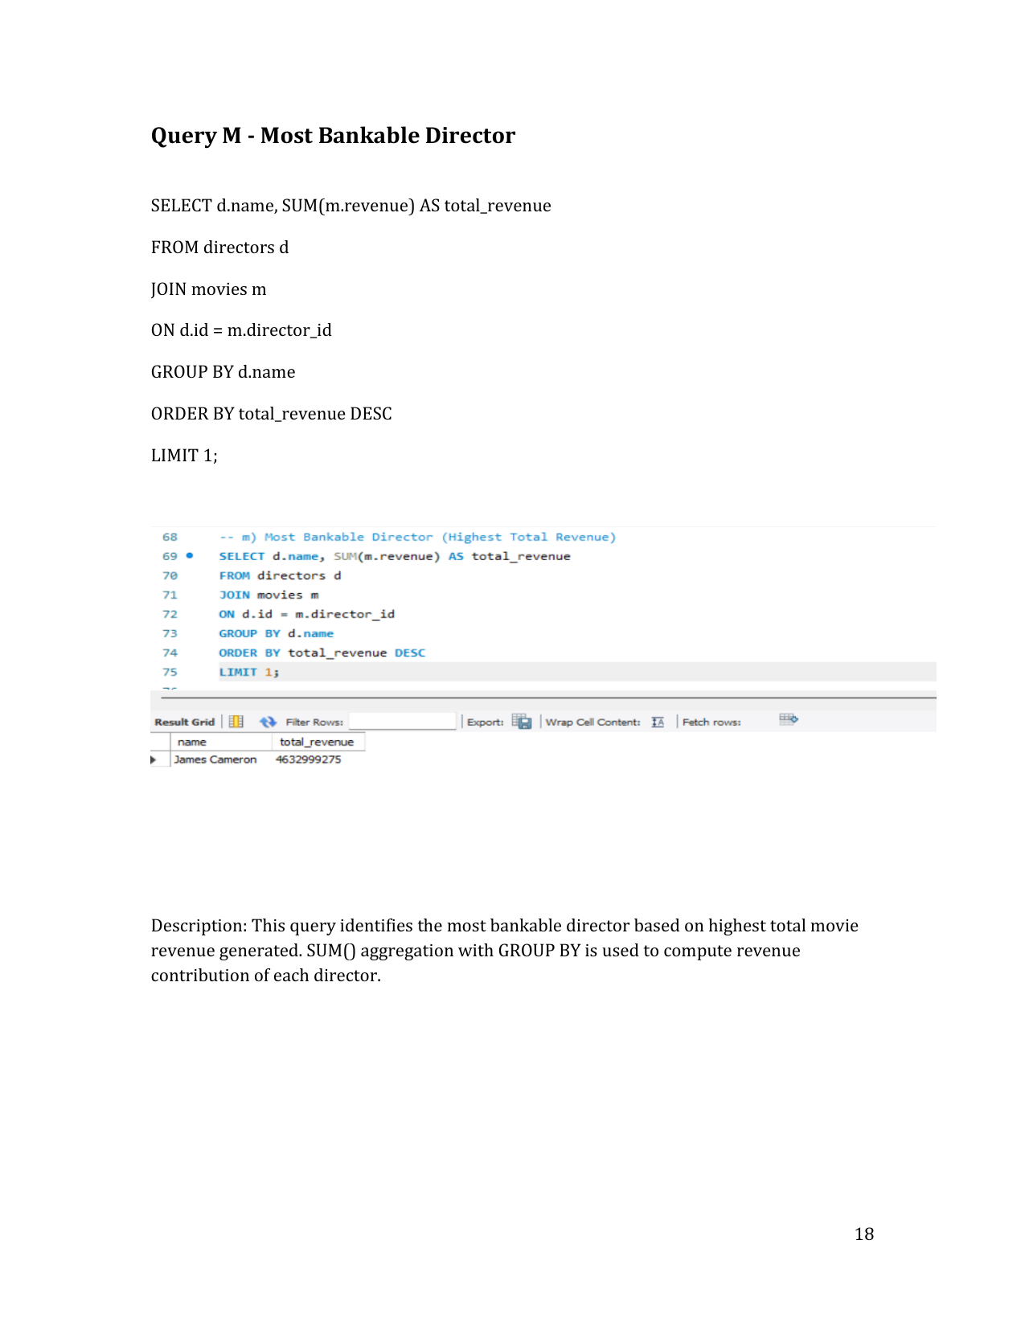
Query Output

Slide 16
Conclusion
✔ Successfully analyzed Movie Database using SQL
✔ Extracted meaningful analytical insights
✔ Demonstrated SQL expertise & analytical capability
This project showcases strong readiness for Data Analyst roles.

